Slide 1

PRODUCT RECOMMENDATION SYSTEM
Team:
Vishnu Shashank- 20MCB1009
Akshay Kumar Yadav – 20MCB1015
Vallu Prajith – 20MCB1018
Ezhil Oviya – 20MCB1003
PROFESSOR : Dr. Bhuvaneswari Anbalagan

Slide 2
INTRODUCTION
Recommender systems aim to predict users’ interests and recommend product items that quite likely are interesting for them
A product recommendation is basically a filtering system that seeks to predict and show the items that a user would like to purchase.
It may not be entirely accurate, but it shows you what you like then it is doing its job right.
Data required for recommender systems stems from explicit user ratings after watching a movie or listening to a song or by using a product .
Recommendations typically speed up searches and make it easier for users to access content they’re interested in.
By using this system, it allows companies to position ahead of their competitors and eventually increase their earnings.

Slide 3

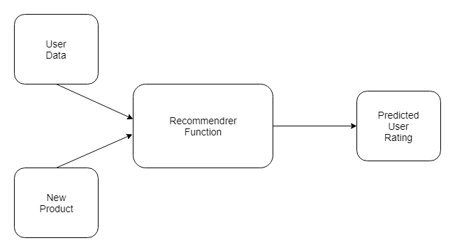
ARCHITECTURE

Slide 4
Modules
constructing a recommendation system with Python and machine learning module
Transforming and normalizing data
Training models
Evaluating model performance
Selecting the optimal model
PANDAS and NUMPY for the Data Manipulation
SKLEARN for splitting the data into train and test set
SEABORN for the EDA Process.

Slide 5
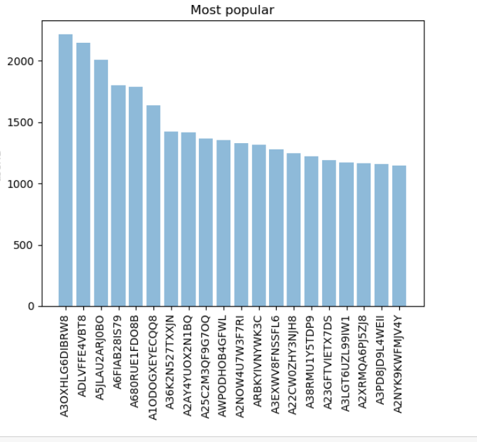
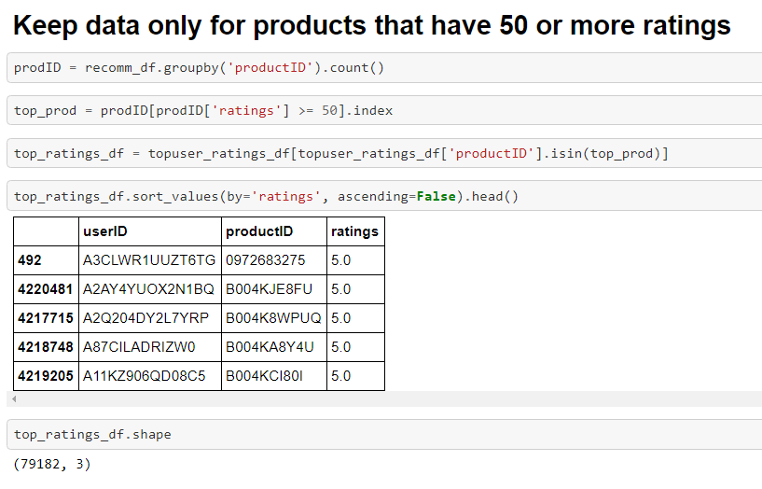
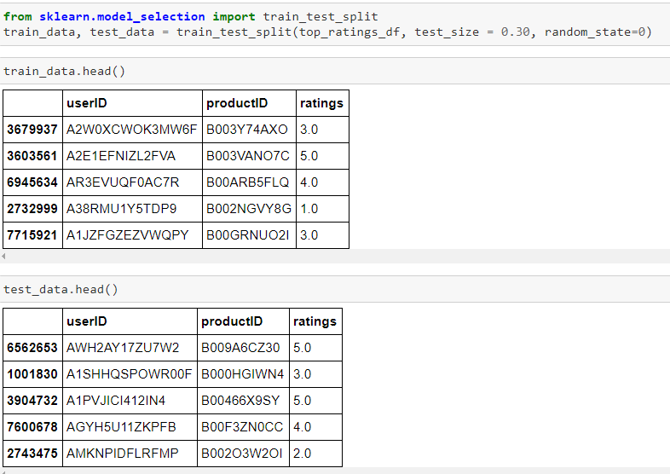
SAMPLE WORKOUT

Slide 6
RECOMMENDATION MODELS
Popularity-Based Recommendation System:
It works on the principle of popularity and or anything which is in trend.
These systems check about the product or movie which are in trend or are most popular among the users and directly recommend those.
For example, if a product is often purchased by most people then the system will get to know that that product is most popular so for every new user who just signed it, the system will recommend that product to that user also and chances becomes high that the new user will also purchase that.

Slide 7
Collaborative Filtering:
It is considered to be one of the very smart recommender systems that work on the similarity between different users and also items that are widely used as an e-commerce website and also online movie websites.
It checks about the taste of similar users and does recommendations.
The similarity is not restricted to the taste of the user moreover there can be consideration of similarity between different items also.
The system will give more efficient recommendations if we have a large volume of information about users and items.

Slide 8
KNN with Means:
THE KNN doesn’t make any assumptions on the underlying data distribution, but it relies on item feature similarity.
When a KNN makes a prediction about a product, it will calculate the “distance” between the target product and every other products in its database.
It then ranks its distances and returns the top k nearest neighbor movies as the most similar product recommendations.
Singular Value Decomposition:
SVD is a matrix factorisation technique, which reduces the number of features of a dataset by reducing the space dimension from N-dimension to K-dimension
In the context of the recommender system, the SVD is used as a collaborative filtering technique.
It uses a matrix structure where each row represents a user, and each column represents an item.
The elements of this matrix are the ratings that are given to items by users
It finds factors of matrices from the factorisation of a high-level (user-item-rating) matrix.

Slide 9
Dataset Details
The Dataset Considered here was Electronics Dataset from the Amazon.
The Dataset Contains around 1000091 entries and 4 attributes
The Size is around 350 MB
It contains:
USER_ID
PRODUCT_ID
RATINGS
TIMESTAMP

Slide 10
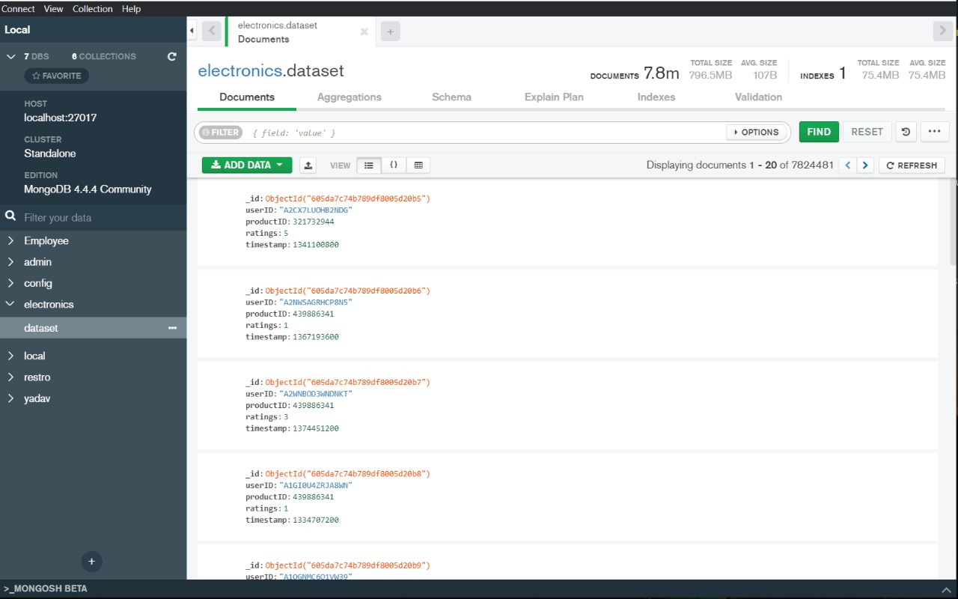
DATABASE : MongoDB

Slide 11
And Also Parameter Tuning is also applied ,The parameter tuning is applied with the help of surprise selection model on SVD For PARAMETER TUNING, The Result Obtained was :0.858
COMPARATIVE RESULTS
MODELS | RMSE VALUE
KNN | 0.9941
SVD | 0.9606
POPULARITY FILTERING | 1.0914

Slide 12
Challenges
Processing Huge Datasets for pre-processing.
Sometimes The System might not be aware of the new Users.
A key problem of collaborative filtering is how to combine and weight the preferences of user neighbors.
Sometimes, users can immediately rate the recommended items
As a result, the system gains an increasingly accurate representation of user preferences over time.
Collaborative methods are effective but sometimes they can’t deliver sufficient diversity.

Slide 13
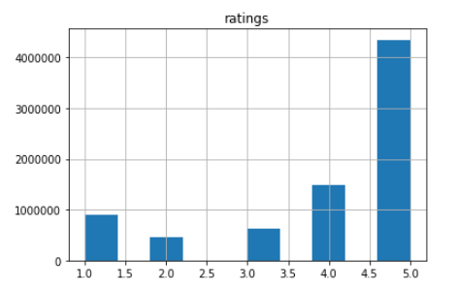
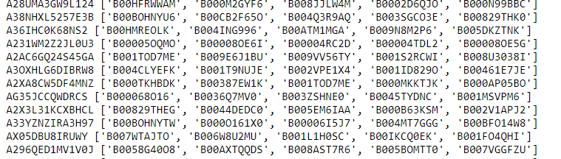
OUTCOME
Since our goal is to recommend new products to each user based on his/her habits, we will recommend 5 new products.
So,For Every User ,The System Recommend 5 Products

Slide 14
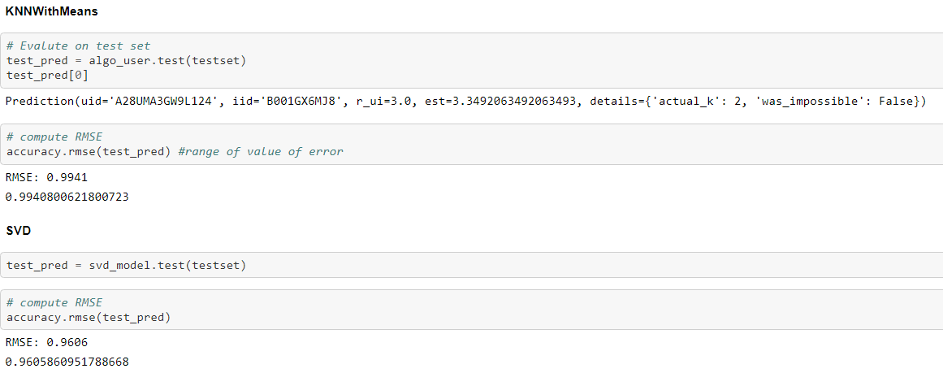
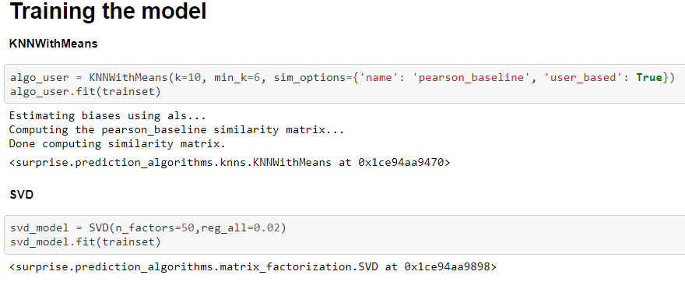
OUTCOME

Slide 15
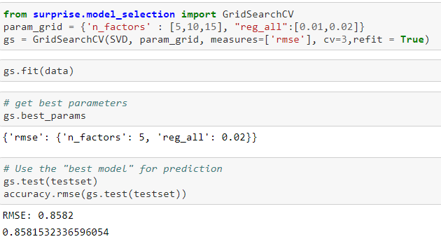
OUTCOME OF PARAMETER TUNING

Slide 16
CONCLUSION
Collaborative filtering uses user's behaviour (in this case explicit ratings to give) similar items / similar users and recomend products accordingly
Read and explored the dataset. Considered only first three columns userId, productId, and ratings, Here Time_Stamp is removed.
Analyzed the data and plotted the histogram based on ratings and usedID.
Splitted the data randomly into train and test dataset.
Build Popularity Recommender model and found the RMSE value for Popularity Recommender model as 1.091
Collaborative Filtering model.The RMSE value for Collaborative Filtering model, by KNNWithMeans is 0.9941 and SVD is 0.9606. After parameter tuning of SVD it is 0.858
Recommended new products to each user based on his/her habits and have recommended 5 new products.
Between RMSE of Popularity and Collaborative filtering , Collaborative fitering fares better with 0.86 scores.
Popularity based algorithm have their used cases when user would just like to browse most popular items

Slide 17

THANK YOU

