Slide 1

Data Mining and Machine Learning
Project Presentation
COVID-19: Behind The Numbers
Rambod Rahmani

Slide 2
COVID-19: Behind The Numbers
Decemebr 31, 2019: A cluster of cases of pneumonia reported in Wuhan.
January 5, 2020: WHO published the first Disease Outbreak News.
January 12, 2020: China publicly shared the genetic sequence of COVID-19.
January 12, 2020: China publicly shared the genetic sequence of COVID-19.
At the beginning of 2020, a new virus started spreading around in the capital of Central China’s Hubei province: the city we all came to know as Wuhan. As it turned out, this was the start of a world-changing event with overwhelming extent: Coronavirus Disease 2019 (COVID-19). After the first wave of the virus has passed over the entire world, the aim of this work is to address the following questions:
Which countries have been affected the most by COVID-19?
Is it possible to build personalized predictive models for symptomatic COVID-19 pa-tients based on basic health preconditions?

Slide 3
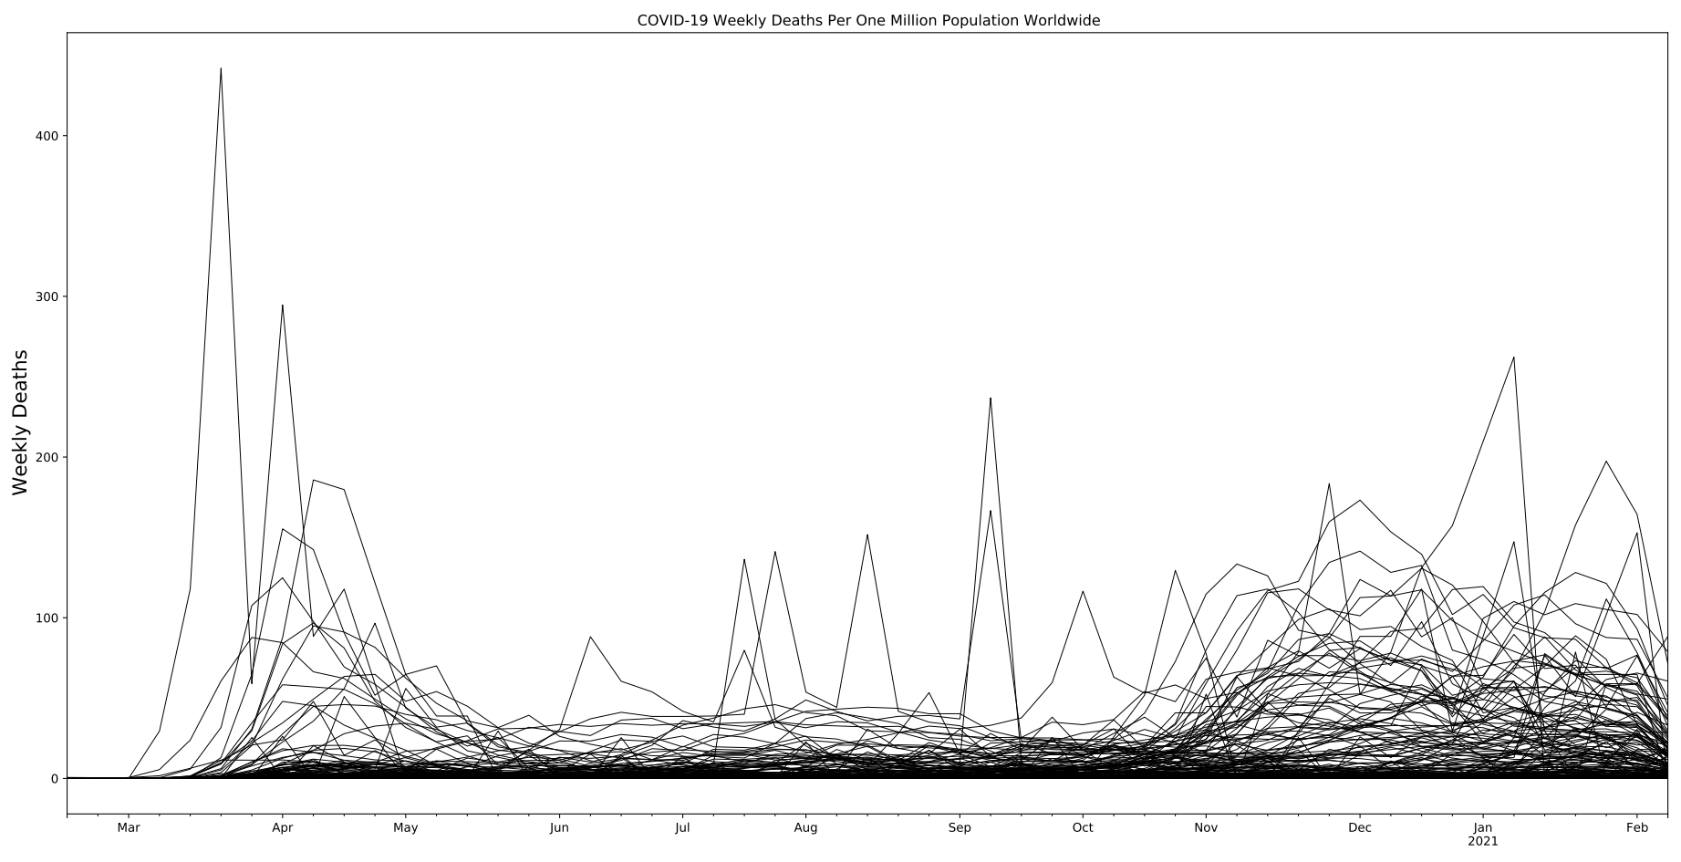
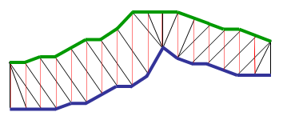
Which countries have been affected the most by COVID-19?
We need to understand what is hidden behind the official numbers:
  What is the most unbiased ranking criteria?
  Total number of confirmed cases?
  Total number of confirmed cases per one million population?
Countries have different testing policies:
  No testing at all means no cases.
  We need a quantity unrelated to the testing rates and policies.
In this mess, how many different
characteristic curves can we find?
Time Series Clustering:
  Euclidean Distance.
  Dynamic Time Warping algorithm.

Slide 4
Is it possible to build personalized predictive models for symptomatic COVID-19 patients based on basic health preconditions?
Global spread of the virus SARS-CoV-2:
  A spike in demand for hospital care.
Hospital systems across the world have been over-extended:
  Northern Italy, Ecuador, New York City...
Decisions on how to best allocate very limited medical resources:
  who to test;
  who to admit into hospitals;
  who to treat in an Intensive Care Unit (ICU);
  who to support with a ventilator;
  Mortality.
  Use Advanced Frequent Pattern Mining to extract personalized predictive models based on prior medical conditions.

Slide 5
Dataset Description
Source:
  The Johns Hopkins University Center for Systems Science and Engineering.
  The Federal government of Mexico.
Description:
  The data on confirmed cases and confirmed deaths is updated daily and is published by Johns Hopkins University, the best available global dataset on the pandemic.
  The dataset required for the Frequent Pattern analysis was quite hard to find: usually COVID-19 datasets only contain daily values (numbers) of confirmed cases and deaths. They rarely come equipped with the medical preconditions of the patients. Luckily, the Federal government of Mexico provided such a dataset
Volume: ~ 1.0 GiB
Variety: Multi-sources and multi-format.
Velocity/Variability: new data available daily.

Slide 6
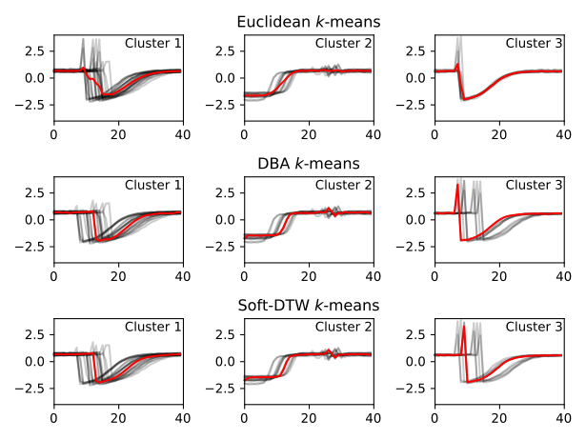





Software Architecture
Python 3
  cmd
  csv
  pandas
  numpy
  matplotlib.pyplot
  sklearn
  tslearn
  mlxtend
Jupyter Notebook

