Slide 1

Data Mining and Machine Learning
Project Presentation
COVID-19: Behind The Numbers
Rambod Rahmani

Slide 2
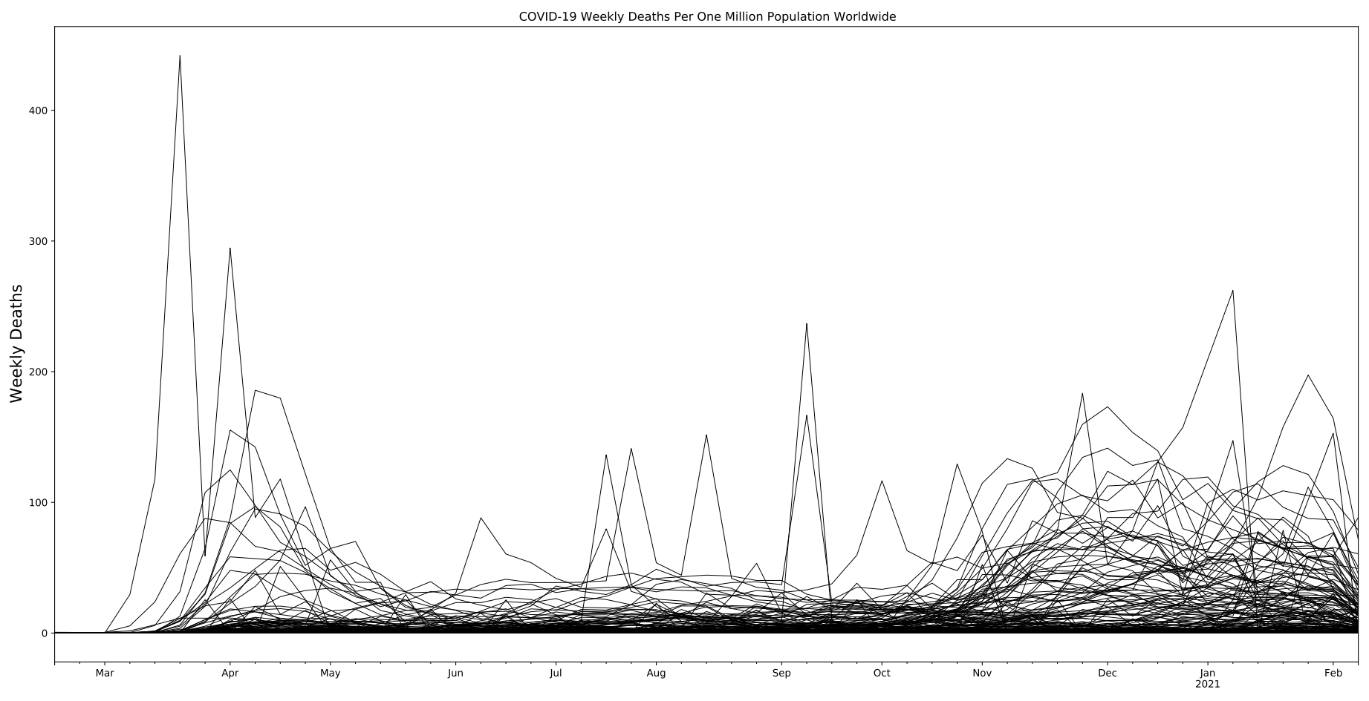
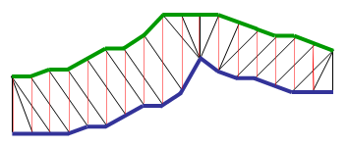
Which countries have been affected the most by COVID-19?
We need to understand what is hidden behind the official numbers:
  What is the most unbiased ranking criteria?
  Total number of confirmed cases?
  Total number of confirmed cases per one million population?
Countries have different testing policies:
  No testing at all means no cases.
  We need a quantity unrelated to the testing rates and policies.
In this mess, how many different
characteristic curves can we find?
Time Series Clustering:
  Euclidean Distance.
  Dynamic Time Warping algorithm.

Slide 3
Is it possible to build personalized predictive models for symptomatic COVID-19 patients based on health preconditions?
Global spread of the virus SARS-CoV-2:
  A spike in demand for hospital care.
Hospital systems across the world have been over-extended:
  Northern Italy, Ecuador, New York City...
Decisions on how to best allocate very limited medical resources:
  who to test;
  who to admit into hospitals;
  who to treat in an Intensive Care Unit (ICU);
  who to support with a ventilator;
  mortality.
  Use Advanced Frequent Pattern Mining to extract personalized predictive models based on prior medical conditions.

