Slide 1
Large-Scale and Multi-Structured Databases Project Design StockSim: stock portfolio simulator
Yuri Mazzuoli, Rambod Rahmani, Marco Pinna

Slide 2
Application Highlights
StockSim is a Java Application which allows users to simulate stock portfolios using statistical models built using U.S. stock market historical data.
Users can sign up and sign in.
Users can view stock charts (Line chart, Bar charts, Candle and stick charts).
Users can create stock portfolios.
Users can simulate their stock portfolios: at the end of each simulation, statistics are provided and visualized.
The administrator can add or remove a stock from the database.

Slide 3
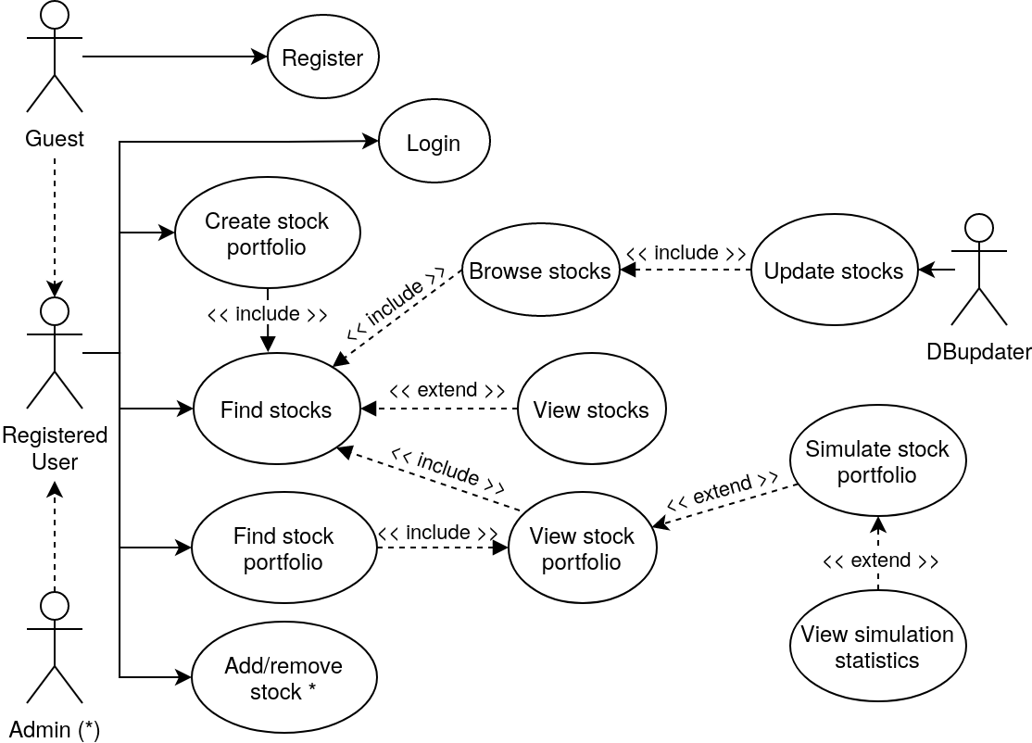
Actors and main supported functionalities

Slide 4
Dataset Description
Source:
Yahoo! Finance
NasdaqTrader
Description:
Yahoo! Finance is a media property that is part of Yahoo!'s network. It provides financial news, data and commentary including stock quotes, press releases, financial reports, and original content.
NasdaqTrader is a website that covers the Nasdaq market providing proprietary access to trading liquidity.
Volume: ~ 2.7 GB
Variety: granted by the heterogeneous composition of the U.S. stock market stocks.
Velocity/Variability: indices and shares of each of the 8000+ U.S. stock market stocks are updated automatically every day.

Slide 5
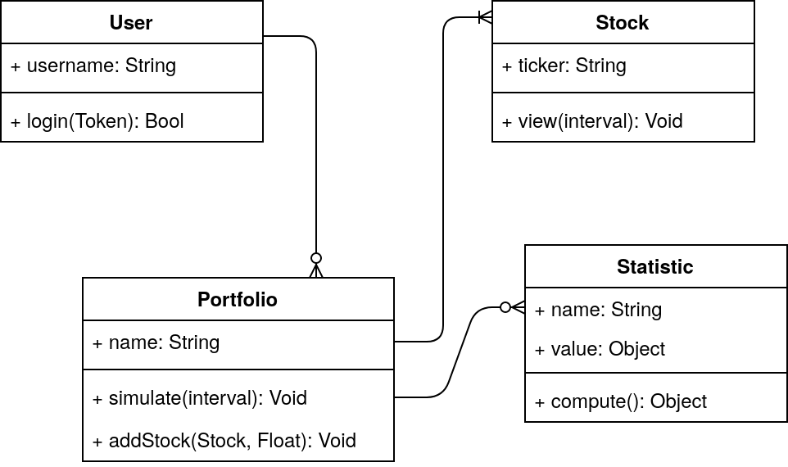
Preliminary UML Class Diagram

Slide 6
Requirements and Entities handled by Document DB
Users’ authentication, personal information and preferences.
Stocks’ information (company details, trade, capitalization, etc…).
Indexes’ information (composition, details, etc…).
Stock Portfolio’s information (name, composition, scope, etc…).
Stock portfolio simulation results.

Slide 7
Requirements and Entities handled by Column DB
U.S. stock market stocks and ETFs historical data day by day, starting from 1971:
open, high, low, close and adjusted close prices.
Market indexes computation.
Fast and reliable data retrieval and statistics computation.

Slide 8











Software Architecture Preliminary Idea
Java 8
Python (yfinance module)
IntelliJ IDEA
Maven
MongoDB (MongoDB Driver Sync)
Apache Cassandra (Datastax Java Driver)
JfreeChart 1.5.1
Log4j
JUnit
Git
JFreeChart

