Slide 1
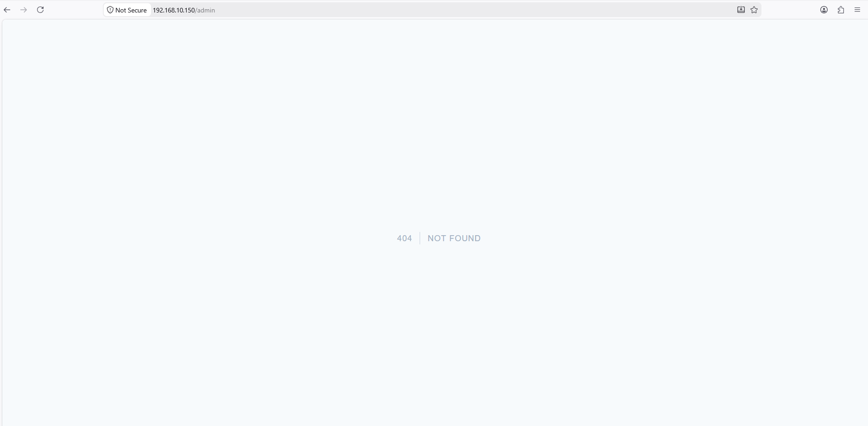
3.1 Business logic flow
Business logic flow
To be replace with IAM Code
Business logic flow
To be replace with IAM Code

Slide 2
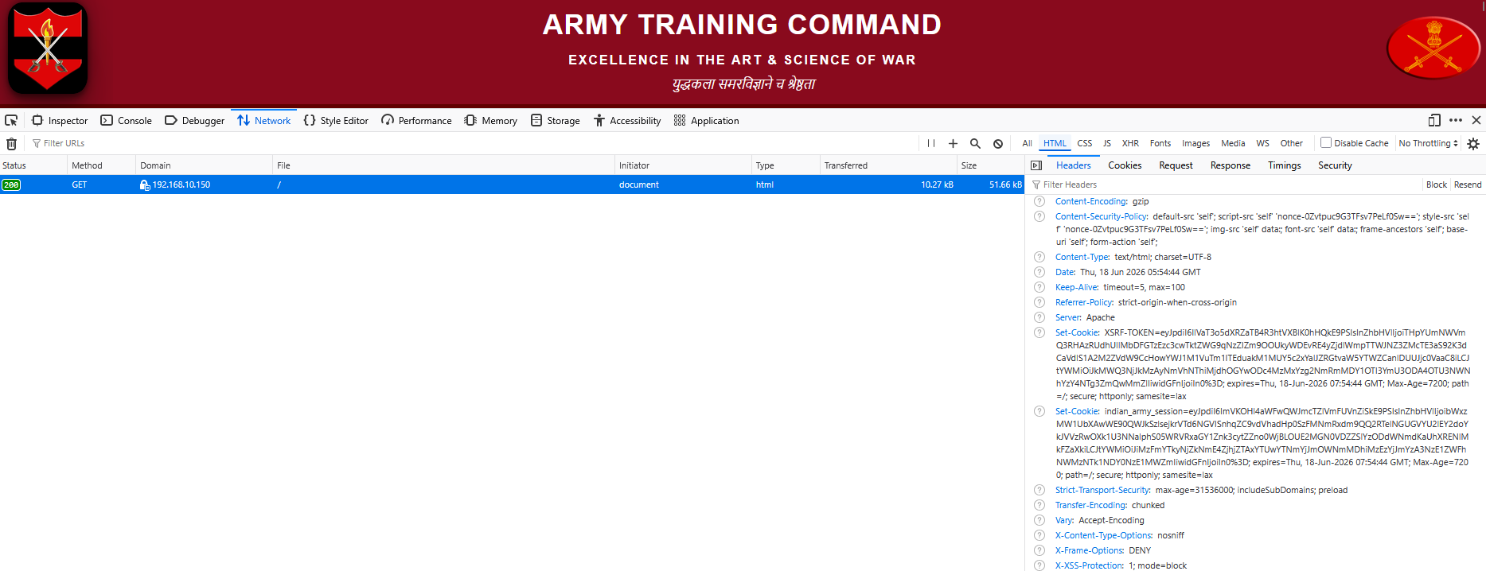
3.2 HTTP Header Vulnerability

Slide 3

3.3 Hidden Directory

Slide 4

3.4 Absolute Path Disclosure

Slide 5

3.5 Internal Server Error

