Slide 1
NLP – Level-3 Training

Slide 2
AGENDA
Topic Modelling
Introduction to Topic Modelling
How does it work ?
Uses
Demo
Document Classification

Slide 3
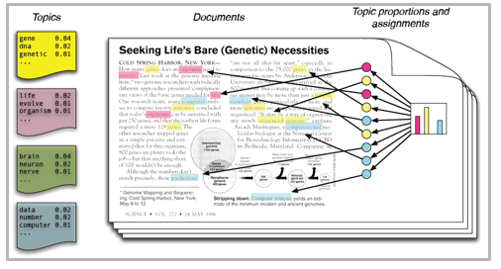
Introduction
Analytics Industry is all about obtaining the “Information” from the data. With the growing amount of data in recent years, that too mostly unstructured, it’s difficult to obtain the relevant and desired information.
Humans, with years of practice subconsciously, pick up nuances and stack up to the sophistication with the help of localized cultural cues and we meticulously derive deep meanings with the help of very few words. But, over the period technology has developed some powerful methods which can be used to mine through the data and fetch the information that we are looking for.
One such technique is Topic Modelling. As the name suggests, it is a process to automatically identify topics present in a text object and to derive hidden patterns exhibited by a text corpus. Thus, assisting better decision making.
Notes:
https://analyticsindiamag.com/beginners-guide-to-latent-dirichlet-allocation/
https://www.analyticsvidhya.com/blog/2016/08/beginners-guide-to-topic-modeling-in-python/

Slide 4
What’s Topic Modelling ?
Topic Modelling (also called Topic Analysis or Topic Extraction) is a unsupervised machine learning technique that organizes and understands large collections of text data, by assigning “tags” or categories according to each individual text’s topic or theme.
Uses NLP to break down human language so that you can find patterns and unlock semantic structures within texts to extract insights and help make data-driven decisions.
Provides methods for automatically
discovering the hidden themes in the collection
classifying the documents into the discovered themes
using the classification to organize/summarize/search the documents
Notes:
https://monkeylearn.com/topic-analysis/

Slide 5
Scope of Topic Modelling
Topic analysis can be applied at different levels of scope:
Document-level
Sentence-level
Sub-Sentence level
Notes:
https://monkeylearn.com/topic-analysis/

Slide 6
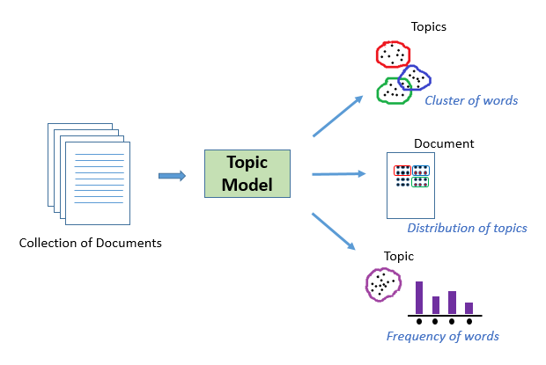
Topic Modelling - Usage
Text Classification
Document clustering
Organizing large blocks of textual data
Information retrieval from unstructured text
Notes:
https://www.analyticsvidhya.com/blog/2018/10/mining-online-reviews-topic-modeling-lda/#:~:text=As%20the%20name%20suggests%2C%20Topic,large%20blocks%20of%20textual%20data
https://nlpforhackers.io/topic-modeling/

Slide 7
Topic Modelling Algorithms
There are several algorithms for doing topic modelling.
The most popular ones include:
Latent Dirichlet Allocation (LDA)
Latent Semantic Analysis (LSA) or Latent Semantic Indexing (LSI)
Non-Negative Matrix Factorization (NMF)
But, in this session we will be dealing with only LDA.
Notes:
https://nlpforhackers.io/topic-modeling/

Slide 8
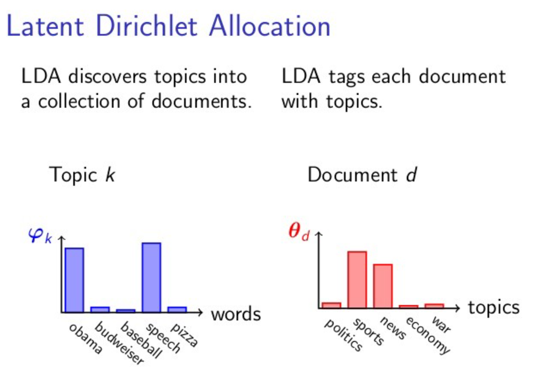
Latent Dirichlet Allocation (LDA)
Latent Dirichlet Allocation is the most popular topic modeling technique
LDA assumes documents are produced from a mixture of topics.
Those topics then generate words based on their probability distribution.
Given a dataset of documents, LDA backtracks and tries to figure out what topics would create those documents in the first place

Slide 9
LDA (conti…)
Let’s take a small example and let sample documents are as below (each line represents a document):
I like to eat broccoli and bananas.
I ate a banana and spinach smoothie for breakfast.
Chinchillas and kittens are cute.
My sister adopted a kitten yesterday.
Look at this cute hamster munching on a piece of broccoli.
Suppose we choose k=2 (number of topics are 2) for our model:
Topic A: 30% broccoli, 15% bananas, 10% breakfast, 10% munching, …… (we could interpret topic A to be about food)
Topic B: 20% chinchillas, 20% kittens, 20% cute, 15% hamster, ……… (we could interpret topic B to be about cute animals)
Now some new document can be tagged with the above-given topics using the observations made by the LDA model.
Banana and spinach smoothie is a good combination for a healthy breakfast.
Kittens look cute as they munch on a bowl of milk, bananas, and chocolates.
Here, we can say that sentence 1 is 100% Topic A and sentence 2 is 40% Topic B with 60% Topic A.

Slide 10
LDA (conti…)
Suppose we have a collection of documents and we want to learn `K` topics out of them.
We will go through each document (d).
Then for each word (w) in the document we will calculate the following:-
X = p(topic | document) = the proportion of words in document d that are currently assigned to topic t.
Y = p(word w | topic t) = the proportion of assignments to topic t over all documents that come from this word w. (The same word can be in multiple documents, hence its coverage over the documents)
3. X * Y is essentially the probability that topic `t` generated word `w`, so it makes sense that we re-sample the current word’s topic with this probability.

Slide 11
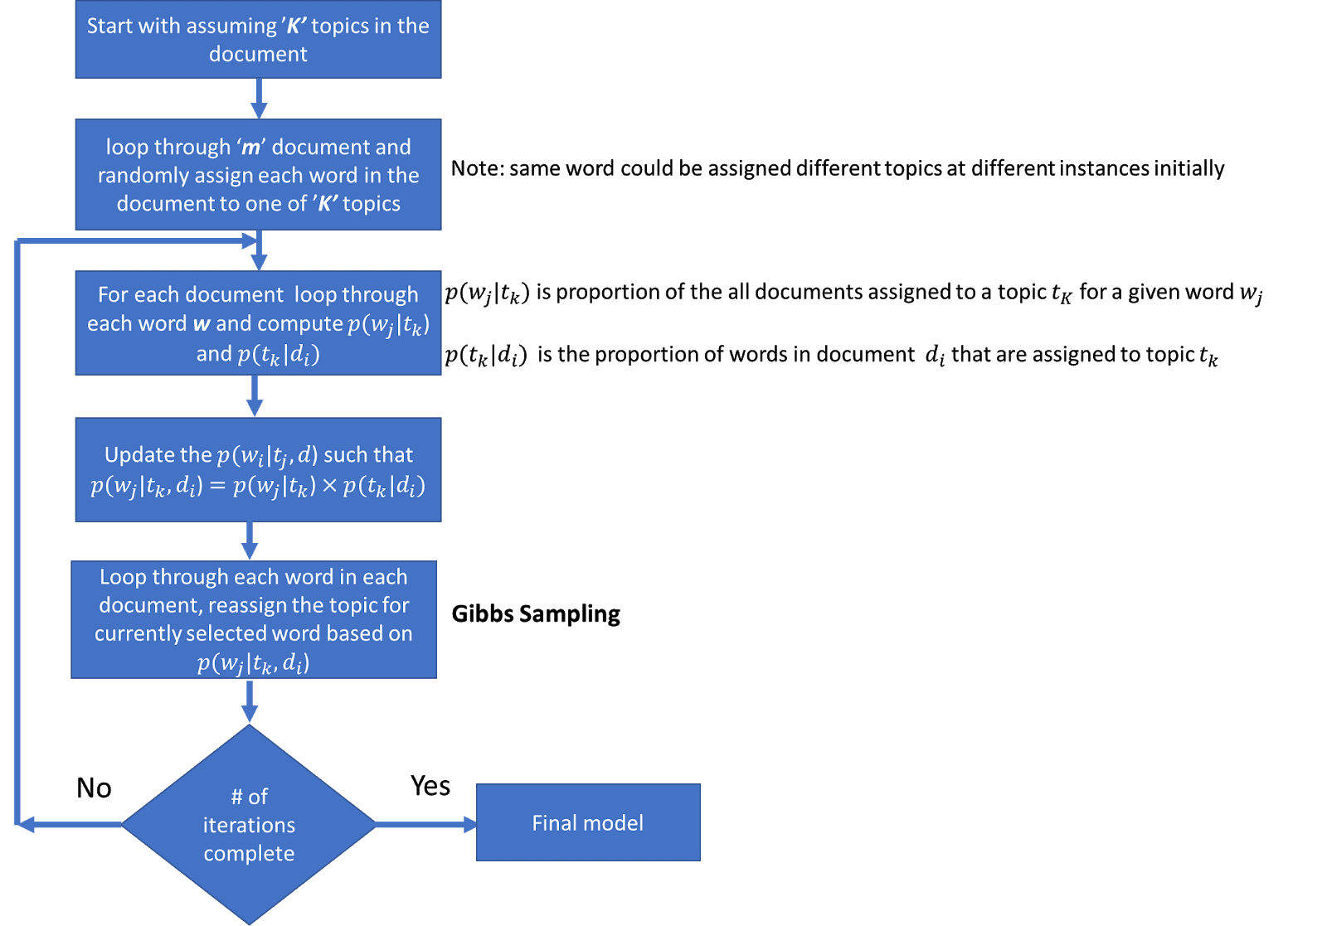
LDA (conti…)
Notes:
https://www.mygreatlearning.com/blog/understanding-latent-dirichlet-allocation/

Slide 12
INTRODUCTION
Notes:
# importing required libraries
import nltk
nltk.download('stopwords')
nltk.download('wordnet')
from nltk.corpus import stopwords
from nltk.stem.wordnet import WordNetLemmatizer
import string
#----------------------------------
# preparation of dataset
doc1 = "Sugar is bad to consume. My sister likes to have sugar, but not my father."
doc2 = "My father spends a lot of time driving my sister around to dance practice."
doc3 = "Doctors suggest that driving may cause increased stress and blood pressure."
doc4 = "Sometimes I feel pressure to perform well at school, but my father never seems to drive my sister to do better."
doc5 = "Health experts say that Sugar is not good for your lifestyle."
# compile documents
doc_complete = [doc1, doc2, doc3, doc4, doc5]
print('\n\nData\n\n')
print(doc_complete)
#-------------------------------
# set of stopwords
stop = set(stopwords.words('english'))
exclude = set(string.punctuation)
lemma = WordNetLemmatizer()
def clean(doc):
stop_free = " ".join([i for i in doc.lower().split() if i not in stop])
punc_free = ''.join(ch for ch in stop_free if ch not in exclude)
normalized = " ".join(lemma.lemmatize(word) for word in punc_free.split())
return normalized
doc_clean = [clean(doc).split() for doc in doc_complete]
print('\n\nCleaned Data\n\n')
print(doc_clean)
#-------------------------------------------------
# Preparing Document-Term Matrix
from gensim import corpora
# Creating term dictionary of corpus, where each unique term is assigned an index.
dictionary = corpora.Dictionary(doc_clean)
dictionary
#-----------------------------------------------------
# Converting list of documents (corpus) into Document Term Matrix using dictionary prepared above.
doc_term_matrix = [dictionary.doc2bow(doc) for doc in doc_clean]
#----------------------------------------------------------------------------------------------------------------------------
from gensim.models.ldamodel import LdaModel as Lda
# Creating the object for LDA model using gensim library & Training LDA model on the document term matrix.
ldamodel = Lda(doc_term_matrix, num_topics=50, id2word = dictionary, passes=50, iterations=500)
# Print all the 50 topics
for i,topic in enumerate(ldamodel.print_topics(num_topics=3, num_words=5)):
words = topic[1].split("+")
#print (words,"\n")
ldamodel.print_topics(num_topics=3, num_words=5)
#----------------------------------------------------------------------------------------------------------------------------
from gensim.parsing.preprocessing import preprocess_string, strip_punctuation,strip_numeric
lda_topics = ldamodel.show_topics(num_words=5)
topics = []
filters = [lambda x: x.lower(), strip_punctuation, strip_numeric]
for topic in lda_topics:
#print(topic)
topics.append(preprocess_string(topic[1], filters))
print(topics)

Slide 13
INTRODUCTION
Notes:
{"cells":[{"metadata":{"_uuid":"0718f7143904159b620a449a4d19fe3ea6c7b11d"},"cell_type":"markdown","source":"# Overview\nIn this workbook, we'll leverage Sklearn's TFIDF vectorizer and MiniBatchKmeans to perform some simple document clustering. After which , we'll plot the clusters using PCA and TSNE, then show the top keywords in each cluster."},{"metadata":{"_uuid":"8f2839f25d086af736a60e9eeb907d3b93b6e0e5","_cell_guid":"b1076dfc-b9ad-4769-8c92-a6c4dae69d19","trusted":true},"cell_type":"code","source":"import numpy as np\nimport pandas as pd\nimport matplotlib.pyplot as plt\nimport matplotlib.cm as cm\n\nfrom sklearn.cluster import MiniBatchKMeans\nfrom sklearn.feature_extraction.text import TfidfVectorizer\nfrom sklearn.decomposition import PCA\nfrom sklearn.manifold import TSNE","execution_count":null,"outputs":[]},{"metadata":{"_uuid":"e68b26a96c179b6bd5b8e7f6e509cf2bae6c3bf2"},"cell_type":"markdown","source":"## Importing the data\nImporting the data is simple with Pandas. The source file is a newline delimited JSON file"},{"metadata":{"_cell_guid":"79c7e3d0-c299-4dcb-8224-4455121ee9b0","_uuid":"d629ff2d2480ee46fbb7e2d37f6b5fab8052498a","trusted":true},"cell_type":"code","source":"data = pd.read_json('../input/combined.json', lines=True)\ndata.head()","execution_count":null,"outputs":[]},{"metadata":{"_uuid":"792e7c26f00e20f59e0908f96845305252921ff6"},"cell_type":"markdown","source":"## Extracting keywords\nHere I use the TfidfVectorizer since I'm hoping the IDF score will pull out unique words that I can use in clustering. There are lots of options to explore here to get different results, including CountVectorizer"},{"metadata":{"trusted":true,"_uuid":"a1e3d5c09accb60b684f8b22aa6a4f2544469886"},"cell_type":"code","source":"tfidf = TfidfVectorizer(\n min_df = 5,\n max_df = 0.95,\n max_features = 8000,\n stop_words = 'english'\n)\ntfidf.fit(data.contents)\ntext = tfidf.transform(data.contents)","execution_count":null,"outputs":[]},{"metadata":{"_uuid":"10928181e141e10137ad9c7990f28bc2c8ed0cfa"},"cell_type":"markdown","source":"## Finding Optimal Clusters\nClustering is an unsupervised operation, and KMeans requires that we specify the number of clusters. One simple approach is to plot the SSE for a range of cluster sizes. We look for the \"elbow\" where the SSE begins to level off. MiniBatchKMeans introduces some noise so I raised the batch and init sizes higher. Unfortunately the regular Kmeans implementation is too slow. You'll notice different random states will generate different charts. Here I chose 14 clusters."},{"metadata":{"trusted":true,"_uuid":"67d51d6735d9386c256b9b03fc431555507a6c2a"},"cell_type":"code","source":"def find_optimal_clusters(data, max_k):\n iters = range(2, max_k+1, 2)\n \n sse = []\n for k in iters:\n sse.append(MiniBatchKMeans(n_clusters=k, init_size=1024, batch_size=2048, random_state=20).fit(data).inertia_)\n print('Fit {} clusters'.format(k))\n \n f, ax = plt.subplots(1, 1)\n ax.plot(iters, sse, marker='o')\n ax.set_xlabel('Cluster Centers')\n ax.set_xticks(iters)\n ax.set_xticklabels(iters)\n ax.set_ylabel('SSE')\n ax.set_title('SSE by Cluster Center Plot')\n \nfind_optimal_clusters(text, 20)","execution_count":null,"outputs":[]},{"metadata":{"trusted":true,"_uuid":"f03b074bcc9505a6700bcfe90724544f840ff8ee"},"cell_type":"code","source":"clusters = MiniBatchKMeans(n_clusters=14, init_size=1024, batch_size=2048, random_state=20).fit_predict(text)","execution_count":null,"outputs":[]},{"metadata":{"_uuid":"d2326f23c16d679d71d214f3d2a966c568a046aa"},"cell_type":"markdown","source":"## Plotting Clusters\nHere we plot the clusters generated by our KMeans operation. One plot uses PCA which is better at capturing global structure of the data. The other uses TSNE which is better at capturing relations between neighbors. In order to speed up the process with TSNE, I sample from 3,000 documents and perform a PCA 50 dimension reduction on the data first. Next I show a scatterplot further sampling the sample down to 300 points."},{"metadata":{"trusted":true,"_uuid":"f4f81096ef9a89c5fb8b60908edbbaec415a6be2"},"cell_type":"code","source":"def plot_tsne_pca(data, labels):\n max_label = max(labels)\n max_items = np.random.choice(range(data.shape[0]), size=3000, replace=False)\n \n pca = PCA(n_components=2).fit_transform(data[max_items,:].todense())\n tsne = TSNE().fit_transform(PCA(n_components=50).fit_transform(data[max_items,:].todense()))\n \n \n idx = np.random.choice(range(pca.shape[0]), size=300, replace=False)\n label_subset = labels[max_items]\n label_subset = [cm.hsv(i/max_label) for i in label_subset[idx]]\n \n f, ax = plt.subplots(1, 2, figsize=(14, 6))\n \n ax[0].scatter(pca[idx, 0], pca[idx, 1], c=label_subset)\n ax[0].set_title('PCA Cluster Plot')\n \n ax[1].scatter(tsne[idx, 0], tsne[idx, 1], c=label_subset)\n ax[1].set_title('TSNE Cluster Plot')\n \nplot_tsne_pca(text, clusters)\n ","execution_count":null,"outputs":[]},{"metadata":{"_uuid":"5977476abc9118892d86f3b3aeb69de54c1623c7"},"cell_type":"markdown","source":"## Top Keywords\nLastly, we'll cycle through the clusters and print out the top keywords based on their TFIDF score to see if we can spot any trends. I'll do this by computing an average value across all dimensions in Pandas, grouped by the cluster label. Using numpy, finding the top words is simply sorting the average values for each row, and taking the top N.\n\nYou can see that we have a pretty good result. Topics including exploitation of children, tax fraud, civil rights, and environmental issues can be inferred from the top keywords. Other interesting approaches to this might include LDA topic modeling or possibly working with pre-trained word embeddings."},{"metadata":{"trusted":true,"_uuid":"3c9db70cff067ca3c7d7f79063086c566f21eb18"},"cell_type":"code","source":"def get_top_keywords(data, clusters, labels, n_terms):\n df = pd.DataFrame(data.todense()).groupby(clusters).mean()\n \n for i,r in df.iterrows():\n print('\\nCluster {}'.format(i))\n print(','.join([labels[t] for t in np.argsort(r)[-n_terms:]]))\n \nget_top_keywords(text, clusters, tfidf.get_feature_names(), 10)","execution_count":null,"outputs":[]},{"metadata":{"trusted":true,"_uuid":"6a2e21a659835bfbe41de33970a2d681769017d4"},"cell_type":"code","source":"","execution_count":null,"outputs":[]}],"metadata":{"kernelspec":{"display_name":"Python 3","language":"python","name":"python3"},"language_info":{"name":"python","version":"3.6.6","mimetype":"text/x-python","codemirror_mode":{"name":"ipython","version":3},"pygments_lexer":"ipython3","nbconvert_exporter":"python","file_extension":".py"}},"nbformat":4,"nbformat_minor":1}

Slide 14
https://analyticsindiamag.com/beginners-guide-to-latent-dirichlet-allocation/
http://blog.echen.me/2011/08/22/introduction-to-latent-dirichlet-allocation/
https://towardsdatascience.com/latent-dirichlet-allocation-lda-9d1cd064ffa2
https://www.cl.cam.ac.uk/teaching/1213/L101/clark_lectures/lect7.pdf
https://nlpforhackers.io/topic-modeling/
https://www.analyticsvidhya.com/blog/2018/10/mining-online-reviews-topic-modeling-lda/#:~:text=As%20the%20name%20suggests%2C%20Topic,large%20blocks%20of%20textual%20data
https://towardsdatascience.com/nlp-extracting-the-main-topics-from-your-dataset-using-lda-in-minutes-21486f5aa925
https://www.kaggle.com/arthurtok/spooky-nlp-and-topic-modelling-tutorial
https://www.youtube.com/watch?v=Cpt97BpI-t4&list=RDCMUC8ofcOdHNINiPrBA9D59Vaw&start_radio=1&ab_channel=BhaveshBhatt
https://www.youtube.com/watch?v=DpGl7KL6WKY&ab_channel=SHASHIKUMAR
https://monkeylearn.com/topic-analysis/
https://monkeylearn.com/blog/introduction-to-topic-modeling/
https://towardsdatascience.com/topic-modeling-with-latent-dirichlet-allocation-by-example-3b22cd10c835
https://medium.com/@vivekvscool/natural-language-processing-topic-modelling-including-latent-dirichlet-allocation-lda-860e5a3d377f

