Slide 1
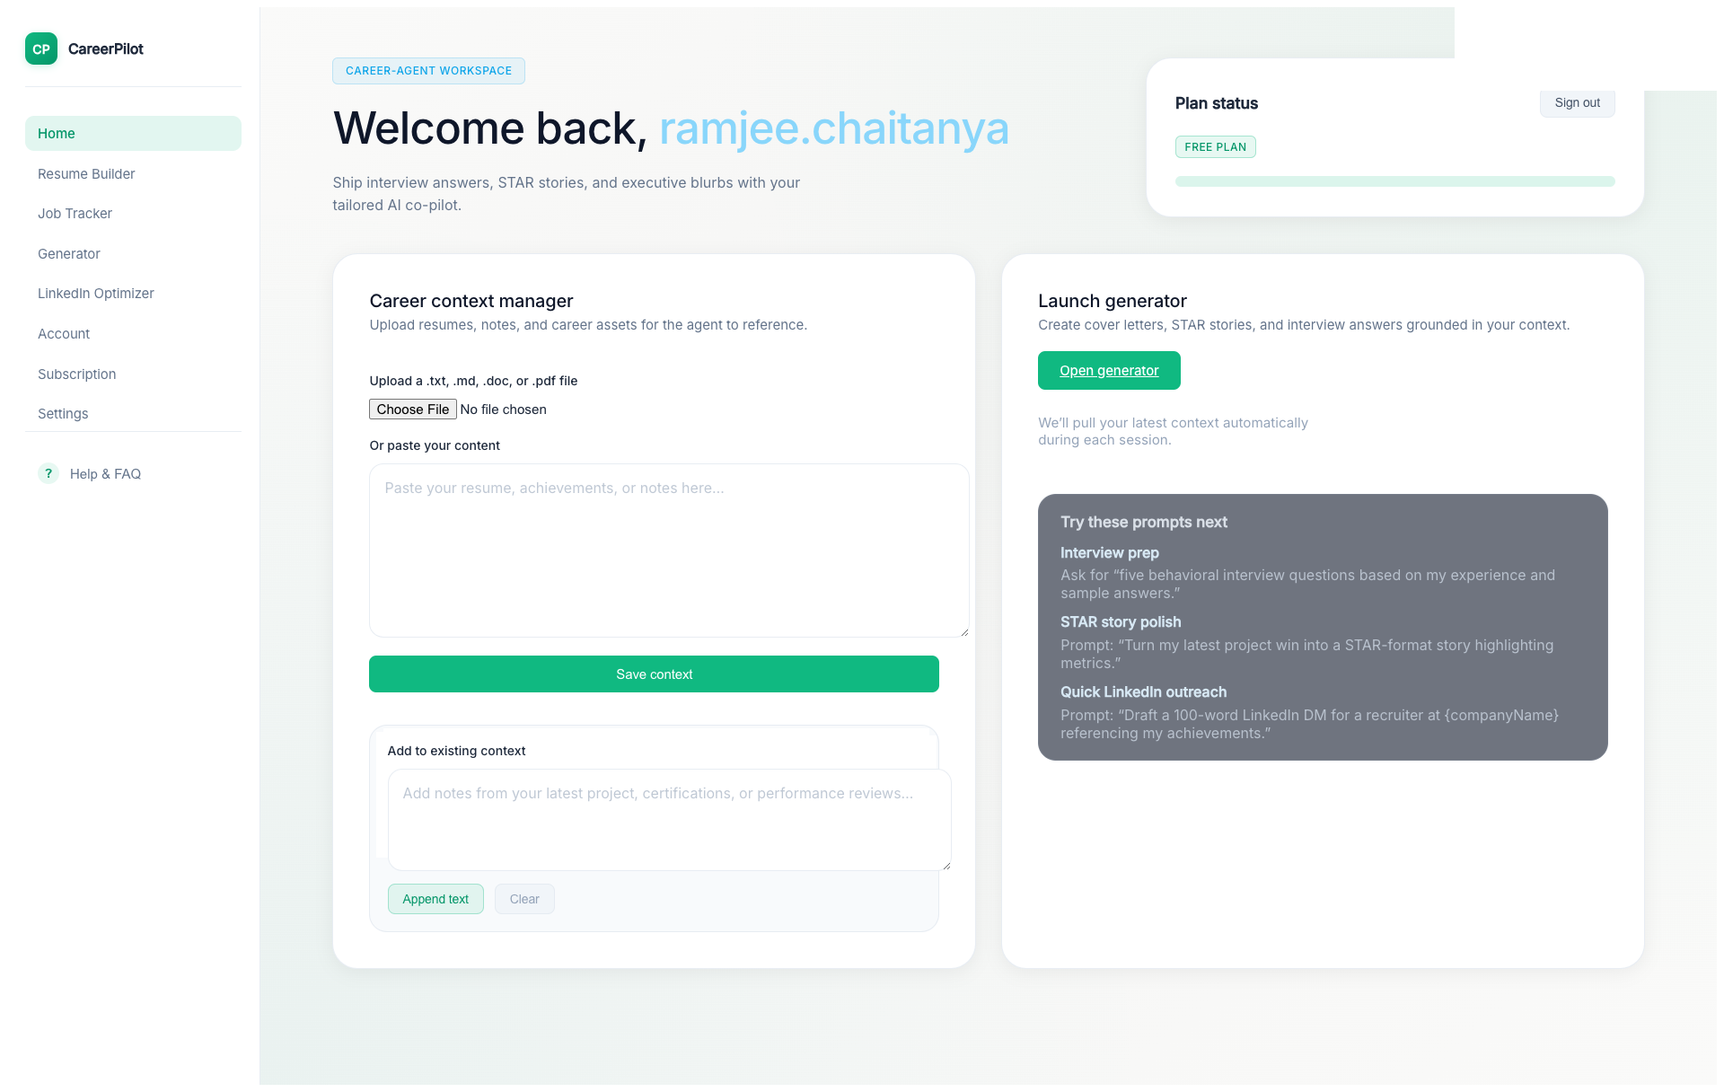
Introduction
Notes:
"Welcome to CareerPilot Consulting, your AI co-pilot for winning career moments. Whether you're applying for your dream job or preparing for interviews, CareerPilot helps you create personalized, professional career materials in minutes."

Slide 2

Home - Upload Career Context
Notes:
"Let's start by uploading your career context. This is crucial - upload everything from day one of your career. Include your resume, previous cover letters, project descriptions, achievements, and any career-related documents. The more comprehensive your context, the more effective the AI will be at creating personalized materials that truly represent your experience."

Slide 3
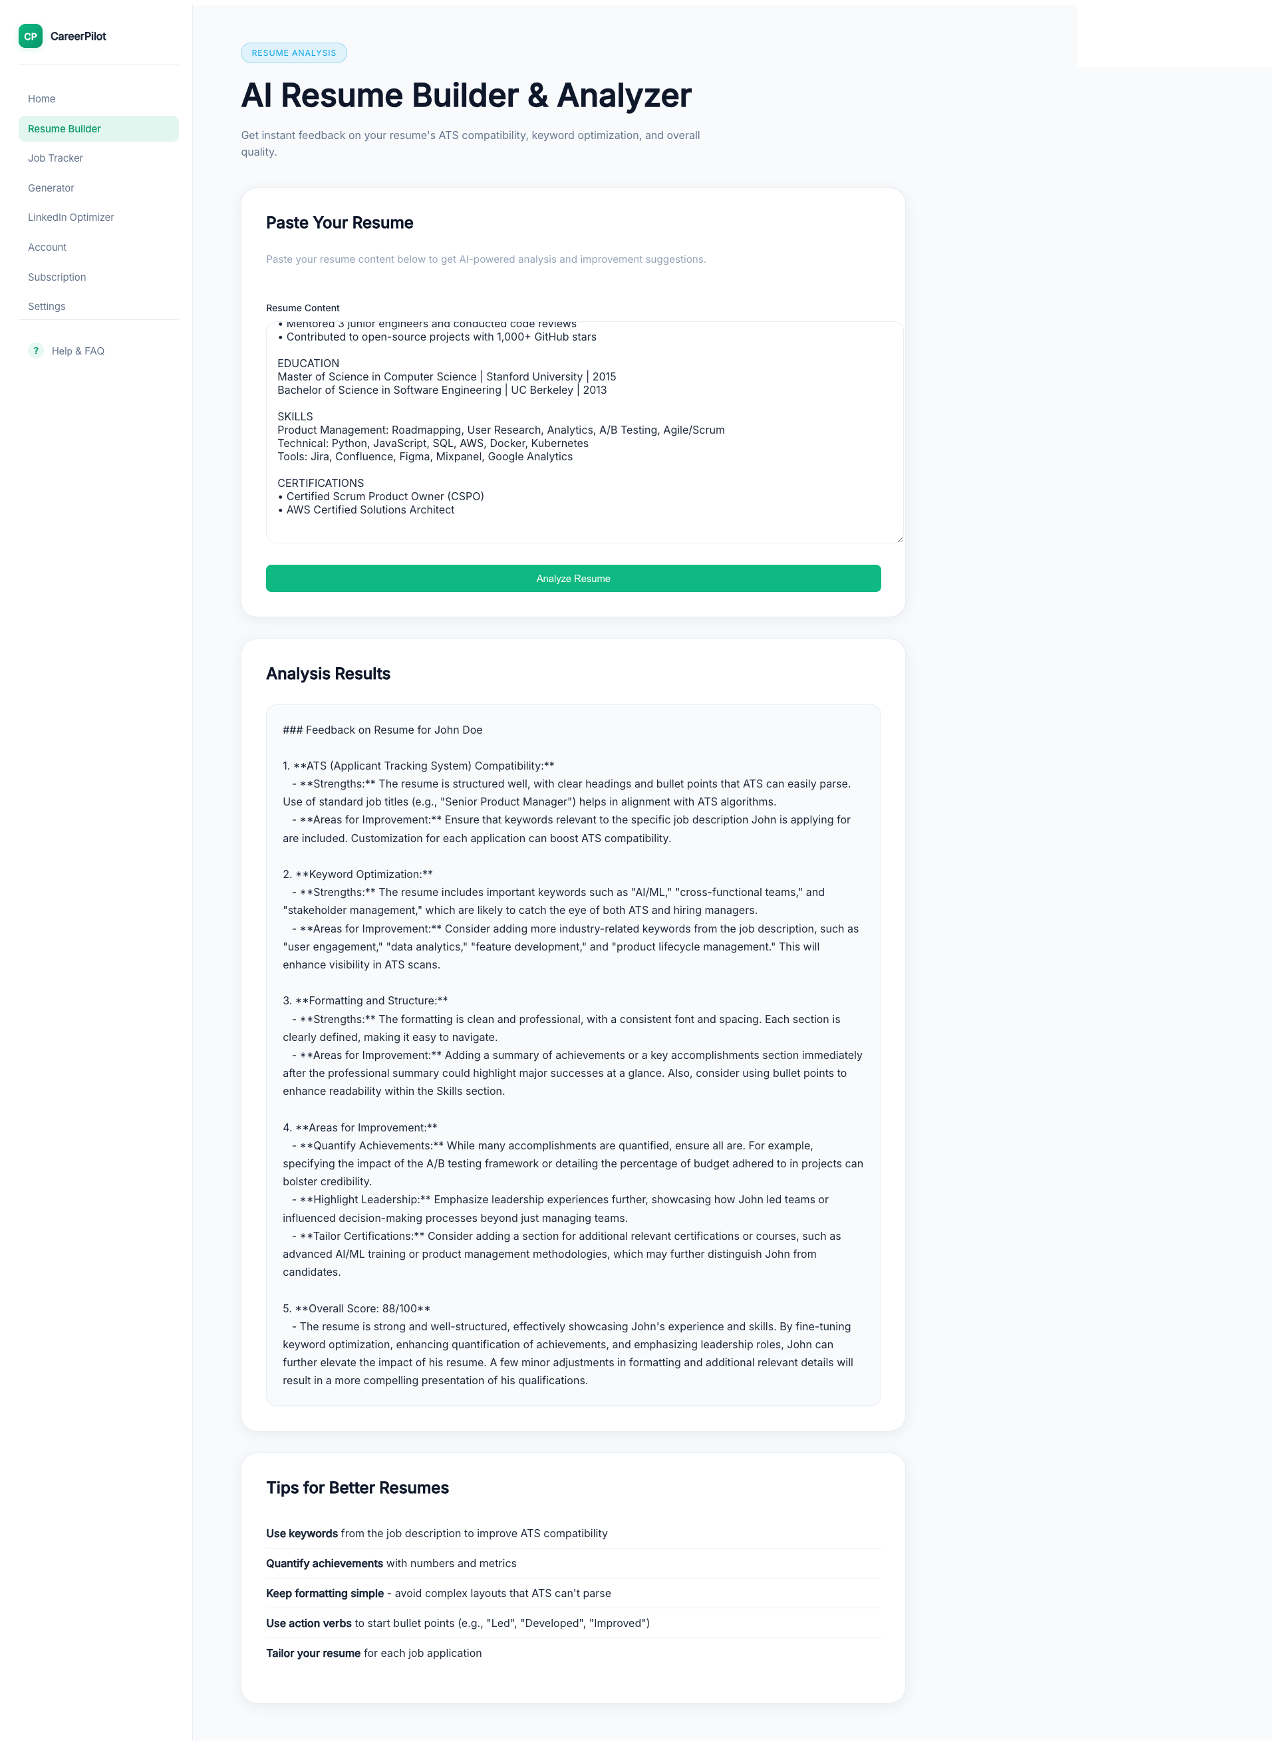
Resume Builder - Analyze Resume
Notes:
"Next, let's use the Resume Builder. Simply paste your resume, and CareerPilot will analyze it to provide valuable insights. It will identify strengths, suggest improvements, and help you optimize your resume for better results."

Slide 4
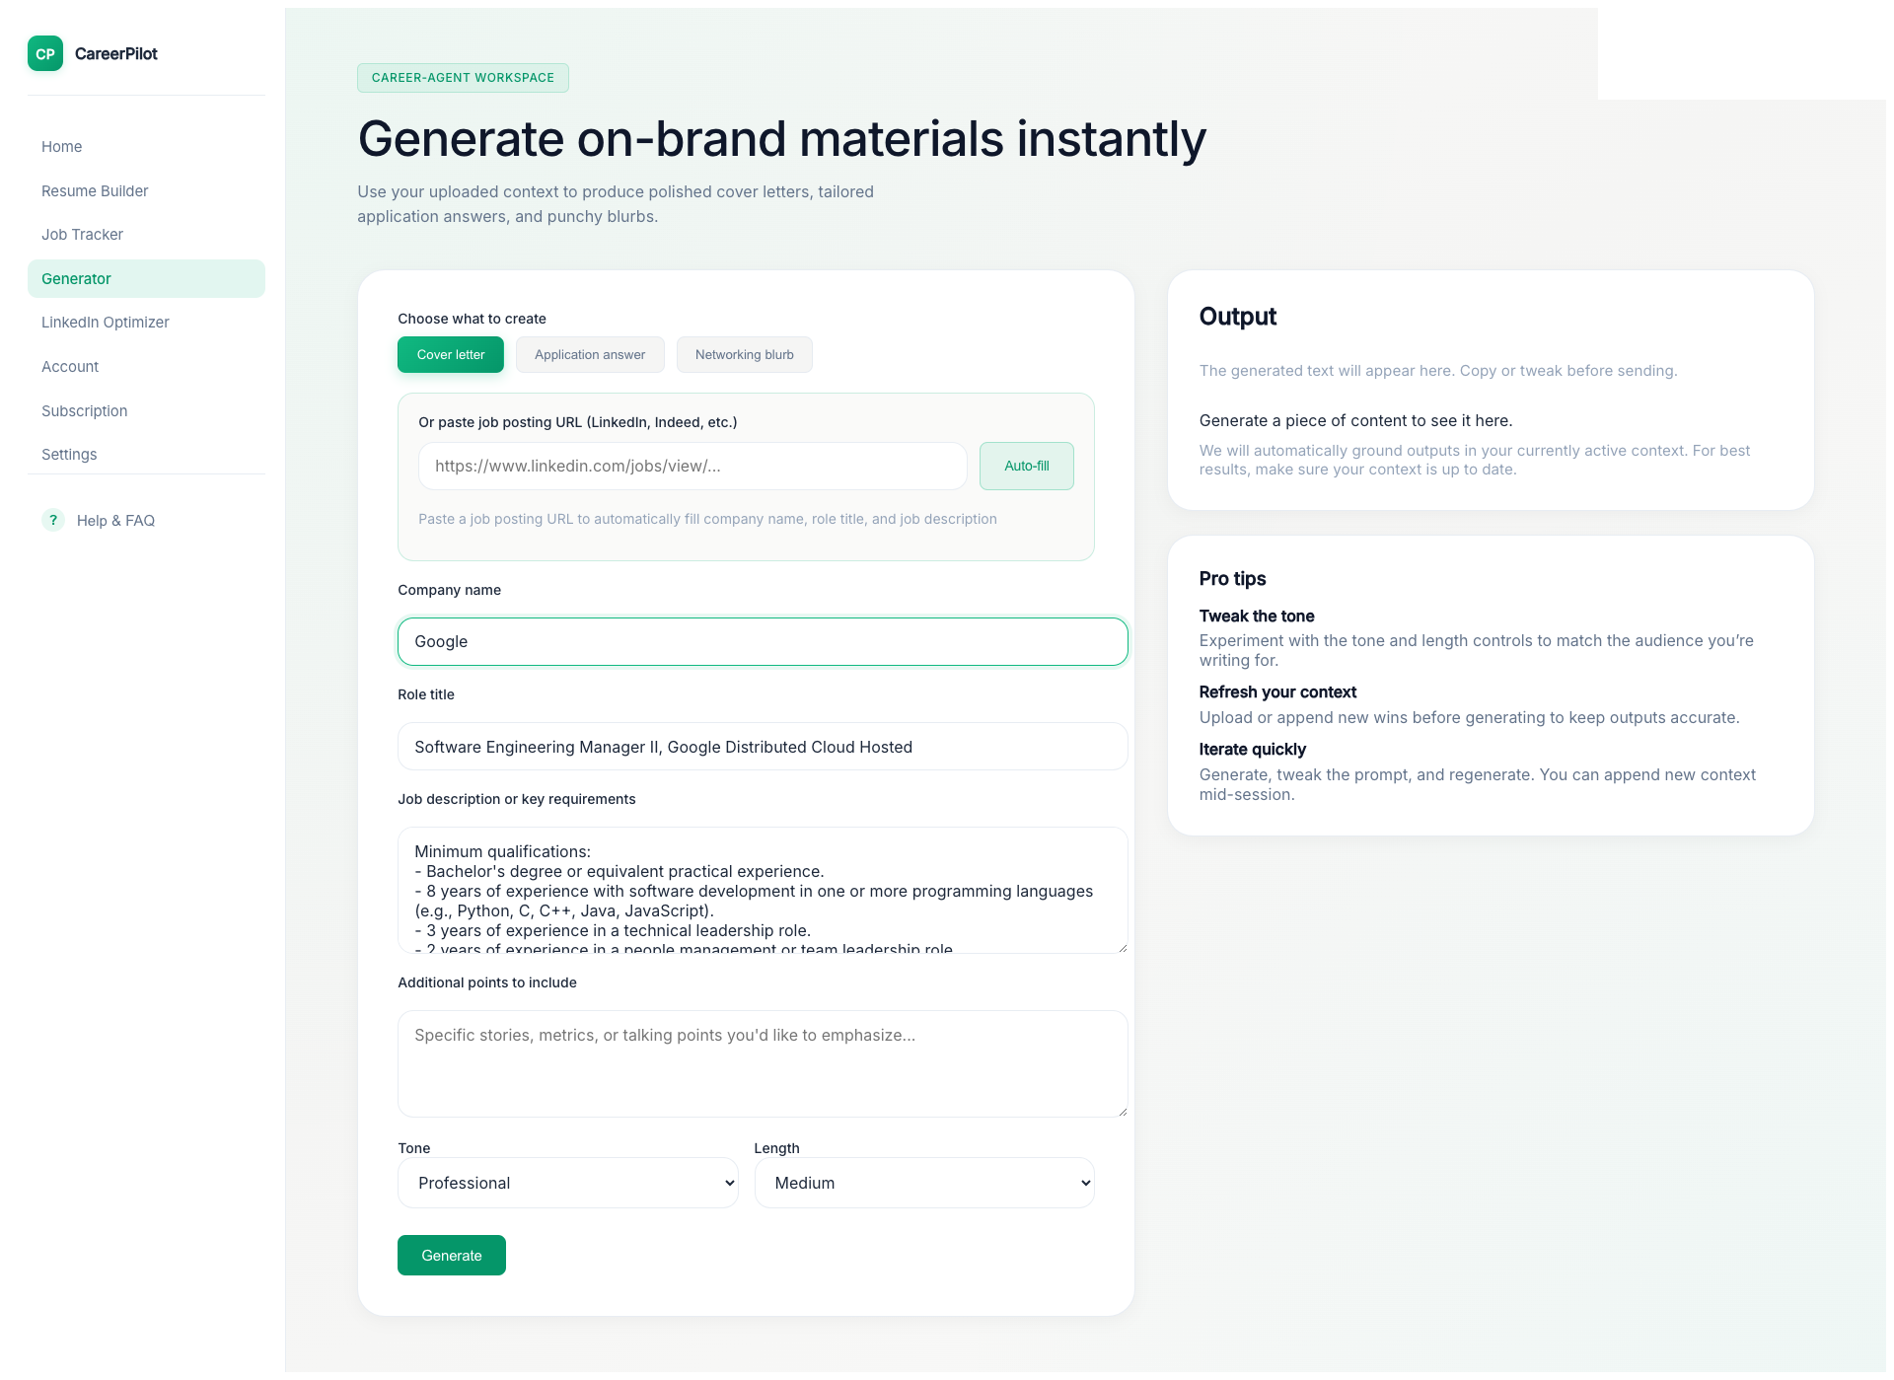
Generator - Cover Letter with Auto-Fill
Notes:
"Now let's generate a personalized cover letter. Navigate to the Generator and select 'Cover Letter' mode. Here's the smart part - paste a job posting URL, and CareerPilot's AI will automatically parse the page, extract the company name, role title, and job description. Watch as it fills in all the details for you."

Slide 5
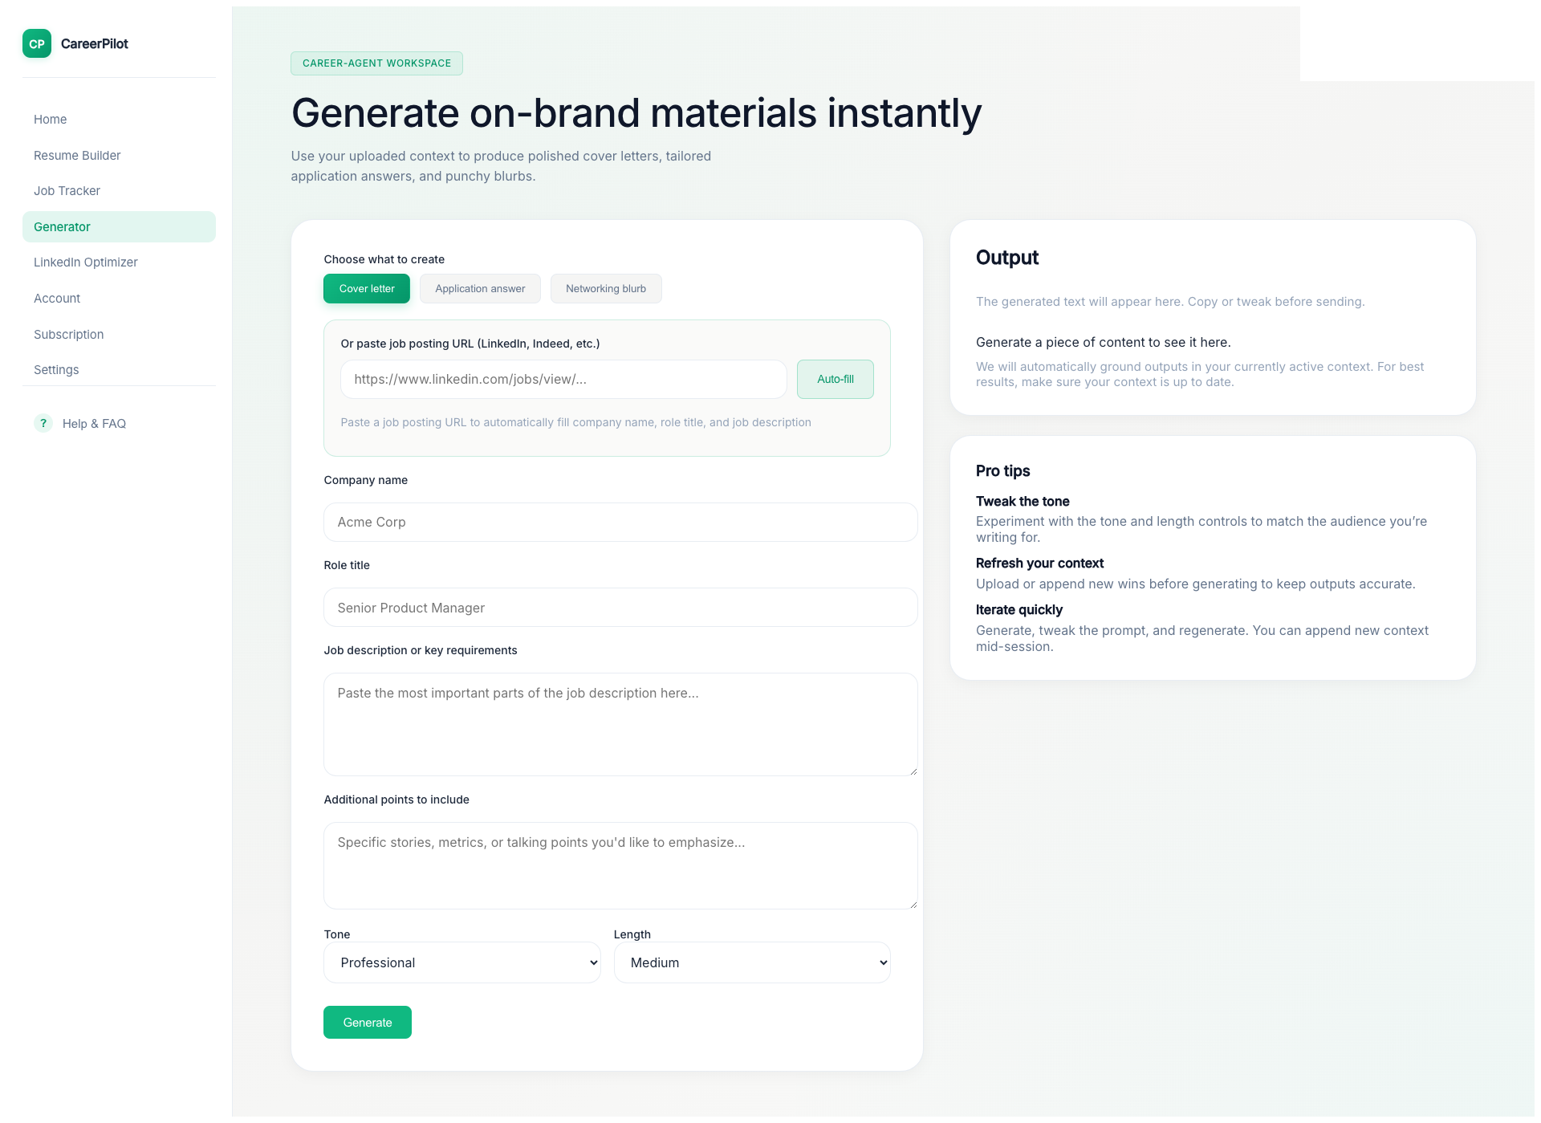
Generator - Application Answer & Networking Blurb
Notes:
"The Generator also helps with interview preparation. Switch to 'Application Answer' mode to get tailored responses to interview questions. And don't forget the 'Networking Blurb' feature - it creates professional, engaging messages for LinkedIn networking that help you stand out."

Slide 6
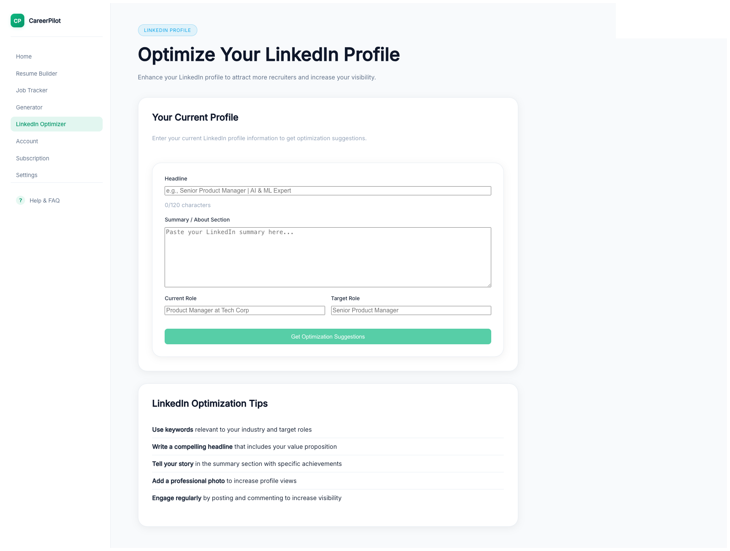
LinkedIn Optimizer
Notes:
"The LinkedIn Optimizer helps you maximize your professional presence. It analyzes your profile and provides recommendations to improve visibility, keyword optimization, and overall profile strength. This ensures recruiters and hiring managers can easily find you."

Slide 7
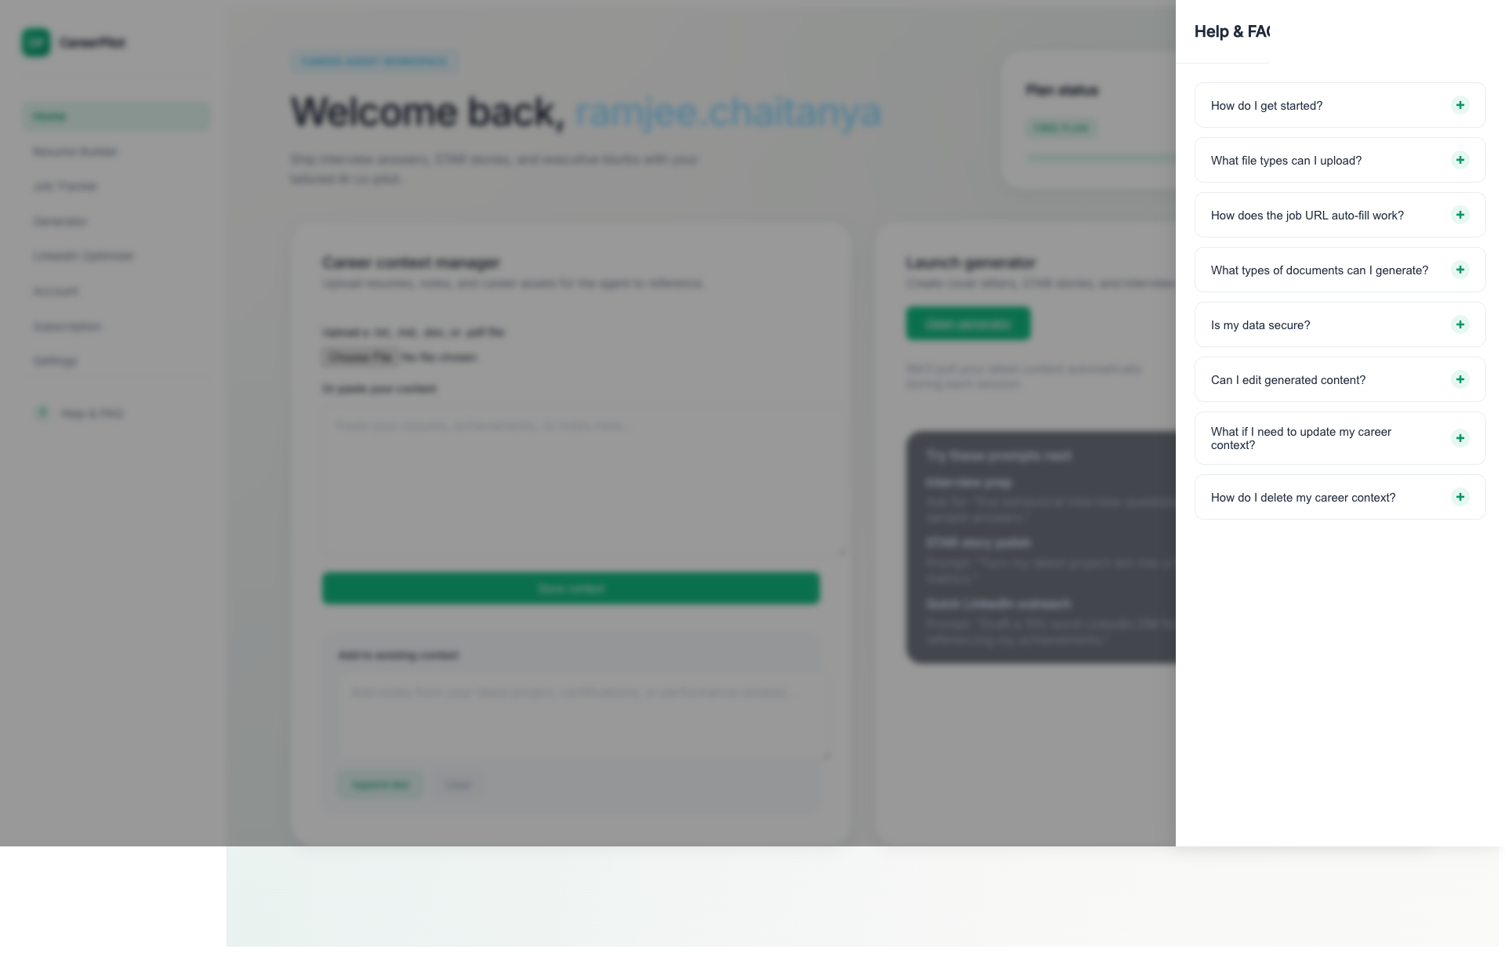
Help & FAQ
Notes:
"If you have questions, click the Help button in the sidebar to access frequently asked questions and get support whenever you need it."

Slide 8

Notes:
"CareerPilot Consulting makes it easy to create professional, personalized career materials. From uploading your career context to generating cover letters and optimizing your LinkedIn profile, we've got you covered. Sign up today and take your career to the next level."

