Slide 1
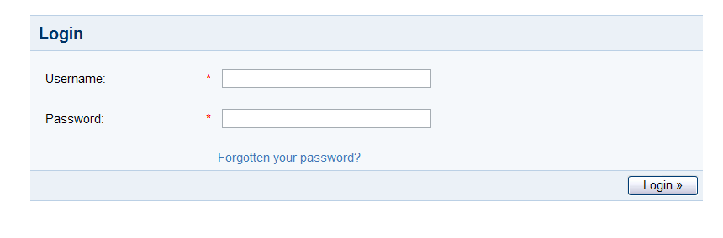
IDC IGF UPLOAD TOOL
User has to use their Active Directory ID & PWD to login

Slide 2
IDC IGF UPLOAD TOOL
Welcome User
LogOut
Create Profile
My Info
Search
Zero Touch Provisioning
Create/Modify RFI
Create/Modify Request
Notifications
Welcome to IDC IGF TOOL UPLOAD
This User-Interface helps PEI team to create the role profiles for Linux kickstart automation, helps in uploading the IGF data into CMDB, provides updation option for IGF data until the Intake process is began.
The data is locked once the validation is successful and Intake process is began.
This will be the first page the user will be able to see after proper authentication. Please click on Create Profile to see the next screen.

Slide 3
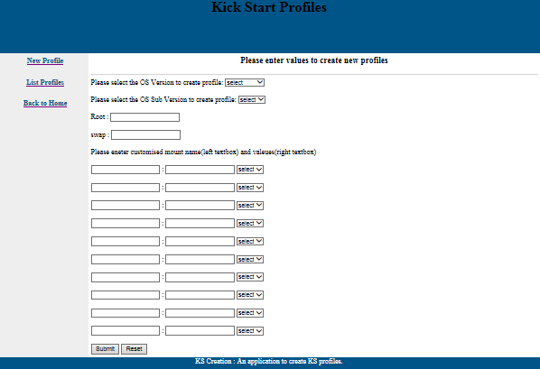
IDC IGF UPLOAD TOOL
Welcome User
LogOut
Create Profile
Zero Touch Provisioning
Search
Begin Intake Of Prov. Data
Create/Modify RFI
Create/Modify Request
Notifications
1
Role Profile
2
HardWare Profile
Subnet ID
1
Role Profile
2
HardWare Profile
Subnet ID
Download
Upload Profile
Click on Role Profile to Create a role profile for OS customization. Next Click on “List Profile”

Slide 4
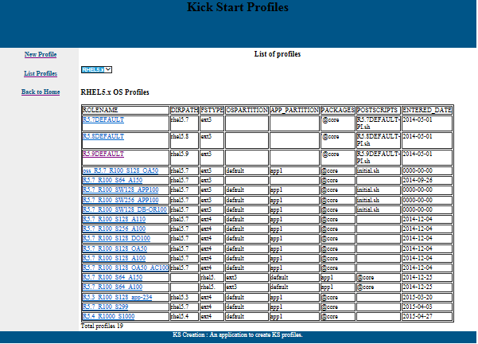
IDC IGF UPLOAD TOOL
Welcome User
LogOut
Create Profile
Zero Touch Provisioning
Search
Begin Intake Of Prov. Data
Create/Modify RFI
Create/Modify Request
Notifications
1
Role Profile
2
HardWare Profile
Subnet ID
Download
Upload Profile
Upon Selection of required OS Version, it will provide the available role profiles. Next Click on “Hardware Profile”

Slide 5
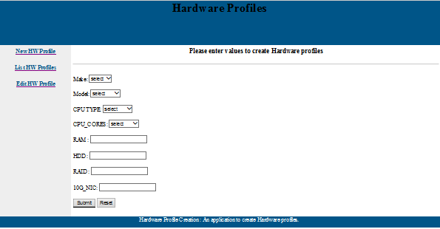
IDC IGF UPLOAD TOOL
Welcome User
LogOut
Create Profile
Zero Touch Provisioning
Search
Begin Intake Of Prov. Data
Create/Modify RFI
Create/Modify Request
Notifications
1
Role Profile
2
HardWare Profile
Subnet ID
Download
Upload Profile
User can create a new “Hardware Profile” in the current screen and click submit to save. Next click on ‘List Hw Profiles’ to search existing profiles.

Slide 6
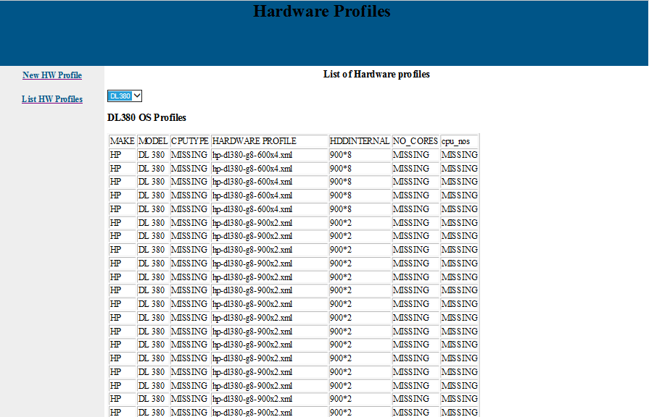
IDC IGF UPLOAD TOOL
Welcome User
LogOut
Create Profile
Zero Touch Provisioning
Search
Begin Intake Of Prov. Data
Create/Modify RFI
Create/Modify Request
Notifications
1
Role Profile
2
HardWare Profile
Subnet ID
Download
Upload Profile
User can search for the required h/w profile in this screen & edit the same.. Click on “Subnet ID” in the left pane to move further.

Slide 7
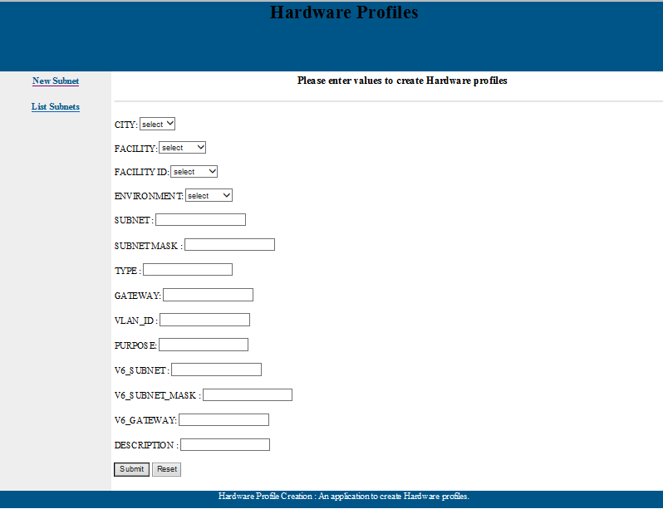
IDC IGF UPLOAD TOOL
Welcome User
LogOut
Create Profile
Zero Touch Provisioning
Search
Begin Intake Of Prov. Data
Create/Modify RFI
Create/Modify Request
Notifications
1
Role Profile
2
HardWare Profile
Subnet ID
Download
Server Hall
Upload Profile
Click on “Subnet ID” on the Left pane to create new subnets as planed. Next click on “List Subnets”

Slide 8
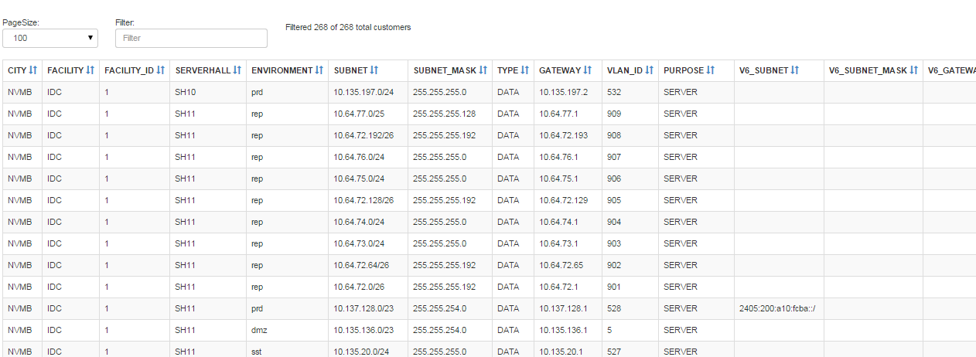
IDC IGF UPLOAD TOOL
Welcome User
LogOut
Create Profile
Zero Touch Provisioning
Search
Begin Intake Of Prov. Data
Create/Modify RFI
Create/Modify Request
Download
Notifications
Upload Profile
1
Role Profile
2
HardWare Profile
Subnet ID
This screen provides the row wise record and provided option to edit. Next, click on “Create/Modify Request” to

Slide 9
IDC IGF UPLOAD TOOL
Welcome User
LogOut
Create Profile
Zero Touch Provisioning
Search
Begin Intake Of Prov. Data
Create/Modify RFI
Create/Modify Request
Create a Request
Select VM or Physical | Physical
PROJECT_ID | OSS-BSS-PRJ1
REQUESTOR SUB-GROUP | OSS/BSS
ENVIRONMENT | Dev
LOCATION | IDC-1
SERVER NUMBER | server1
Hardware Profile | HPDL380G9_2C_126RAM_6x900HDD
Role Profile | OSS-BSS.NICE.DEV1
Cluster Type | NA
External Mounts | NA
Please enter the Quantity for the above configuration | 2
Notifications
1
Single/Multiple Machine Req
2
IGF_Bulk Upload
Search & Edit
Create a Request
Select VM or Physical | Virtual Machine
PROJECT_ID | OSS-BSS-PRJ1
BaseHost Name | NVMBD1AAA01D00
ENVIRONMENT | Dev
Hardware Profile | VM_R20_C10_HDD250GB
Role Profile | OSS-BSS.NICE.APP2
Cluster Type | MS-Cluster-Type1
Please enter the Quantity for the above configuration | 2
Upon selection of “Single/Multiple Machine Req” the above screen will be appearing. Next click on ‘IGF_Bulk Upload” to see bulk upload option

Slide 10
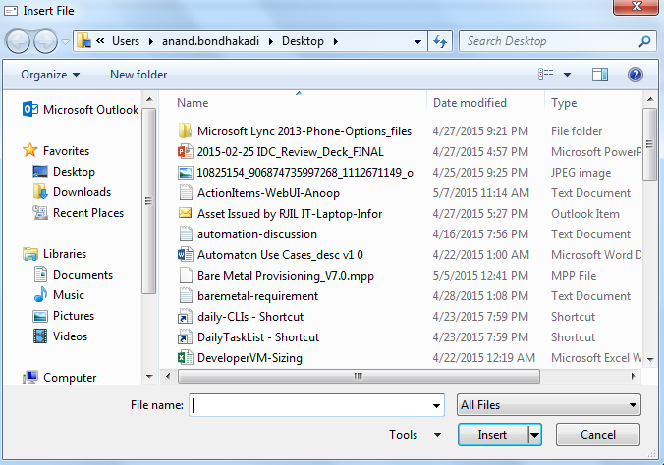
IDC IGF UPLOAD TOOL
Welcome User
LogOut
Create Profile
Zero Touch Provisioning
Search
Begin Intake Of Prov. Data
Create/Modify RFI
Create/Modify Request
Notifications
1
Single/Multiple Machine Req
2
IGF_Bulk Upload
Search & Edit
IGF_BULK UPLOAD
 | Browse
SUBMIT
When user clicks on “Browse” button a File-Insert Dialogue box is opened for selecting file and upload into the system. The backend script will do sanity check and insert records into CMDB.

Slide 11
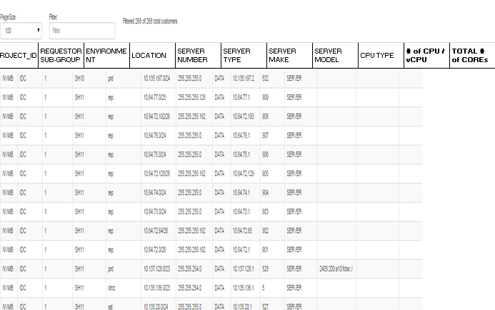
IDC IGF UPLOAD TOOL
Welcome User
LogOut
Create Profile
Zero Touch Provisioning
Search
Begin Intake Of Prov. Data
Create/Modify RFI
Create/Modify Request
Download
Notifications
Upload Profile
1
Single/Multiple Machine Req
2
IGF_Bulk Upload
Search & Edit
User can filter on the required field for search and edit the row. Next click on “Create/Modify RFI” to update delta information and make records Ready For Implementation.

Slide 12
IDC IGF UPLOAD TOOL
Welcome User
LogOut
Create Profile
Zero Touch Provisioning
Search
Begin Intake Of Prov. Data
Create/Modify RFI
Create/Modify Request
Notifications
1
Single/Multiple Machine Update
2
IGF_Bulk Update
Reports
User can filter on the required field for search and edit the row.

Slide 13
IDC IGF UPLOAD TOOL
Welcome User
LogOut
Create Profile
Zero Touch Provisioning
Search
Begin Intake Of Prov. Data
Create/Modify RFI
Create/Modify Request
Download
Notifications
Upload
IGF_BULK UPDATE
 | Browse
1
Single/Multiple Machine Update
2
IGF_Bulk Update
Report
SUBMIT
When user clicks on “Browse” button a File-Insert Dialogue box is opened for selecting file and upload into the system. The backend script will do sanity check and update the records into CMDB.

Slide 14
IDC IGF UPLOAD TOOL
Welcome User
LogOut
Create Profile
Zero Touch Provisioning
Search
Begin Intake Of Prov. Data
Create/Modify RFI
Create/Modify Request
Download
Notifications
Upload
Provides Option to view report/status based on Project_id
Provides Option to view report/status based on Owner
Provides Option to view report/status based on Serial Number
1
Single/Multiple Machine Update
2
IGF_Bulk Update
Report
When user clicks on “Browse” button a File-Insert Dialogue box is opened for selecting file and upload into the system. The backend script will do sanity check and insert records into CMDB.

Slide 15
IDC IGF UPLOAD TOOL
Welcome User
LogOut
Create Profile
Zero Touch Provisioning
Create/Modify RFI
Create/Modify Request
Notifications
Create/Modify Request
Once this button is clicked it will prompt for project_id for which ZTP to start.
The backend tool will pull the data from CMDB and validates and reports to the customer about any failure.
If validation is successful then the data will be fed into a transaction table.
It will then make an API call to linux-scripts to begin the Zero Touch Provisioning
1
Begin Auto Provisioning
2
Report
When user clicks on “Browse” button a File-Insert Dialogue box is opened for selecting file and upload into the system. The backend script will do sanity check and insert records into CMDB.

Slide 16
IDC IGF UPLOAD TOOL
Welcome User
LogOut
Create Profile
Zero Touch Provisioning
Create/Modify RFI
Create/Modify Request
Notifications
Create/Modify Request
Provides Option to view report/status based on Project_id
Provides Option to view report/status based on Owner
Provides Option to view report/status based on Serial Number
1
Begin Auto Provisioning
2
Report
When user clicks on “Browse” button a File-Insert Dialogue box is opened for selecting file and upload into the system. The backend script will do sanity check and insert records into CMDB.

Slide 17
Data Structures
TABLE NAME: | T_OSPROFILES
Column Name |  | Example Values
ROLENAME | PK | OSS.NICE.PRD
OWNER |  | OSS
APPNAME |  | NICE
DIRPATH |  | rhel6.5
FSTYPE |  | ext4
OSPARTITION |  | /=100GB
PACKAGES |  | libvirtd, gnome, python
OS_VERSION |  | rhel6.5_x86_64bit
POSTSCRIPTS |  | postscript.sh
ENTERED_DATE |  | 8/5/2015
FS1 |  | /tmp=40gb, ext4
FS2 |  | /app1=200gb, ext4
FS3 |  | /app2=200gb, ext4
FS4 |  | /app3=200gb, ext4
FS5 |  | /app4=200gb, ext4
FS6
FS7
FS8
FS9
FS10
FS11
FS12
FS13
FS14
TABLE NAME: | t_packages
Column Name |  | Example Values
OS_VERSION | PK | rhel6.5
Packages |  | ntp,libvirt
TABLE NAME: | t_hardware_profile
Column Name |  | Example Values
HW_PROFILENAME | PK
MAKE |  | HP
MODEL |  | DL380G9
CPU_TYPE |  | Intel Xeon E5-2690 v3
CPU_CORES |  | 2X24
RAM |  | 196
HDD |  | 2X600 GB, 6X900 GB
RAID_CONFIGURATION |  | 2D-R1_6D_R5
10G_NIC |  | 2

Slide 18
Data Structures
Field | Type | Example Values
SERIALNUMBER | varchar(64) | SGH424ABCD
CITY | varchar(4) | NVMB
FACILITY | varchar(1) | IDC
FACILITYID | int(1) | 1
STORE_LOCATION | varchar(20) | IDC1
PONUMBER | varchar(50) | PO12345
REFNUMBER | varchar(50) | 987654
AMC_START_DATE | datetime | 1/4/2015
AMC_END_DATE | datetime | 31/3/2017
PROJECT_NAME | varchar(50) | OSS-BSS-PRJ1
PROJECT_OWNER | varchar(50) | OSS/BSS
OWNER_CONTACTNO | varchar(22) | 9632001234
OWNER_EMAIL | varchar(50) | rajiv.ba.kumar@ril.com
DEVICETYPE | varchar(20) | SERVER
PLATFORM | varchar(50) | INTEL
MAKE | varchar(50) | HP
MODEL | varchar(50) | DL380G9
STATUS | varchar(12) | IN STORE
INSERT_DATE | datetime | 1/5/2015
UPDATE_DATE | timestamp
COMMENT | varchar(100)
Field | Type | Example Values
SERIALNUMBER | varchar(50)
CITY | varchar(4)
FACILITY | varchar(1)
FACILITYID | int(1)
SERVERHALL | varchar(20)
RACK_NUMBER | varchar(20)
RACK_NAME | varchar(3)
U_LOCATION | int(2)
S_LOCATION | varchar(1)
DEVICETYPE | varchar(50)
PLATFORM | varchar(50)
PROJECT_NAME | varchar(50)
OWNER_EMAIL | varchar(50)
MAKE | varchar(50)
MODEL | varchar(50)
ILO_PASSWD | varchar(20)
NETWORK_INTERFACE | varchar(20)
HDDINTERNAL | varchar(50)
SAN_INTERFACE | varchar(20)
COMMENT | varchar(100)
LAST_UPDATED_BY | varchar(20)
POWER_MGMT | varchar(1)
SPACE_MGMT | varchar(1)
HW_MGMT | varchar(1)
STATUS | varchar(12)
INSERT_DATE | datetime
UPDATE_DATE | timestamp

Slide 19
Data Structures
Table Name: t_server_provisioning
SERIALNUMBER |  | PHASE2
CITY |  | 10G_IP
FACILITY |  | 10g_NO
FACILITYID |  | LIVE_IP_1
PROJECT_NAME |  | HB_ONLINE
OWNER_EMAIL |  | SAN_STATUS
DEVICETYPE |  | HA_PAIRING_NO
PLATFORM |  | WORKER
MAKE |  | SAN_REQUIRED
MODEL |  | 10G_VLAN_ID
STATUS |  | 10G_PING
INSERT_DATE |  | 1G_PING
UPDATE_DATE |  | LIVE_IP
COMMENT |  | SYSTEM_STATUS
SERVERHALL |  | SUPER_NW_ZONE
RACK_NAME |  | AMC_START_DATE
RACK_NUMBER |  | AMC_END_DATE
ilorsa_password |  | PONUMBER
U_LOCATION |  | ENABLE_SERVICES_MGMT
S_LOCATION |  | PATCH_MGMT
NETWORK_INTERFACE |  | SMTP
HDDINTERNAL |  | NTP
SAN_INTERFACE |  | PROXY_MGMT
LAST_UPDATED_BY |  | KMS_MGMT
OWNER_CONTACTNO |  | FACILITY_MGMT
HW_MGMT |  | BACKUP_MGMT
ROLE_PROFILE |  | APPLICATION_VENDOR
HARDWARE_PROFILE |  | APPLICATION_TIER
OS_MGMT |  | APPLICATION_CATEGORY
ES_HPOM_REMARKS |  | NO_CORES
AV |  | IPV6_ADDRESS
HIPS |  | SW_VERSION
PIM |  | NO_1GB_PORTS
SCCM |  | STORAGE_VOLUME_MGR
ILORSA_IP |  | HA_SCHEME
BOOTING_INTERFACE |  | HA_NODE_TYPE
BOOTING_MAC_ADDR |  | ENVIRONMENT
REMARKS |  | SERIAL_NO
PROJECT_ID |  | CPU_TYPE
SALT_PING |  | CPU_NOS
SALT_ROLE |  | OS_VERSION
SAN_LINK |  | DB_VERSION
PING |  | IP_ADDRESS_MANAGEMENT
HA_TYPE |  | IP_ADDRESS_BACKUP
HA |  | VIRTUAL_IP_ADDRESS
TICKET_ID |  | ADDITIONAL_IP_ADDRESS_1
HP_NODEGROUP |  | ADDITIONAL_IP_ADDRESS_2
DNS |  | NO_HARD_DISKS
SCVMM |  | NO_HBA_PORTS
VCENTRE |  | MIDDLEWARE_VERSION
SALT |  | ASSIGNMENT_GROUP
HPOM |  | AD
HOSTNAME |  | IRS
ILORSA_GATEWAY |  | ES_VCENTER_REMARKS
ILORSA_SUBNET_MASK |  | ES_IRS_REMARKS
ILORSA_STATUS |  | CUSTOMER
ILORSA_MAC_ADDR |  | GROUP_NAME
ILO_FW_VERSION |  | STARTTIME
JOB_ID |  | ENDTIME
VLAN_ID |  | DATA_IPv6
DATA_IP
DATA_SUBNET_MASK
DATA_GATEWAY
SAN_LINK_OLD
PROFILE
no_of_units
INTERCONNECT
OPS_STATUS

Slide 20
Data Structures
TABLE : t_igf |  | TABLE : t_igf (continued)
APPLICATION NAME |  | # of FC HBA CARDS |  | EXTERNAL STORAGE RAID CONFIG
REQUESTOR GROUP |  | # of FC HBA PORTS |  | EXTERNAL STORAGE USABLE SPACE- P-VOL (in GB)
REQUESTOR SUB-GROUP |  | FC HBA PORT SPEED |  | S-VOL (BCV) REQUIRED
ENVIRONMENT |  | # of DATA LAN PORTS |  | EXTERNAL STORAGE USABLE SPACE- S-VOL (in GB)
LOCATION |  | DATA LAN INTERFACE TYPE |  | FILE SYSTEM DETAILS - INTERNAL HDD
SERVER HALL |  | DATA LAN INTERFACE SPEED |  | FILE SYSTEM DETAILS - EXTERNAL STORAGE
ROW-RACK |  | # of SERVER LAN PORTS |  | VOLUME MANAGER
RACK NAME |  | SERVER LAN INTERFACE TYPE |  | KERNEL PARAMETERS
RACK "U" |  | SERVER LAN INTERFACE SPEED |  | ADDITIONAL PACKAGES
SLOT NO. |  | # of CLUSTER LAN PORTS |  | USER ID : GORUP ID : HOME DIR
SERVER NUMBER |  | CLUSTER LAN INTERFACE TYPE |  | IDC SUPPORT REQUIREMENT
SERVER TYPE |  | CLUSTER LAN INTERFACE SPEED |  | REMARKS / ADDITIONAL NOTES
HYPERVISOR |  | NETWORK ZONE |  | REMOVE - RAM
SERVER ROLE |  | NETWORK SUB ZONE |  | REMOVE - HDD
SERVER SERIAL NUMBER |  | LOAD BALANCER REQUIRED |  | REMOVE - NIC
SERVER MAKE |  | HA / CLUSTER |  | REMOVE - FC HBA
SERVER MODEL |  | HA TYPE / CLUSTER SOFTWARE |  | ADD - RAM
CPU TYPE |  | HA / CLUSTER PAIR NUMBER |  | ADD - HDD
# of CPU / vCPU |  | OS |  | ADD - NIC
TOTAL # of COREs |  | OS VERSION |  | ADD - FC HBA
RAM (GB) |  | DB
# of INTERNAL HDDs |  | DB VERSION
SIZE - INTERNAL DISKS |  | EXTERNAL STORAGE TYPE
RAID CONFIG - INTERNAL DISKS (RAID 1 / RAID 5 / RAID 1+0) |  | STORAGE IOPS
# of NICs - 1G |  | STORAGE ARRAY
# of NICs - 10G

Slide 21
END OF SLIDE

