Slide 1
J.RAM CHARAN
Final Project
3/21/2024 Annual Review

Slide 2

KEY LOGGER AND SECURITY
3/21/2024 Annual Review

Slide 3


AGENDA
Introduction
Problem Statement
Project Overview
Who are the end users?
Your solution and its value proposition
The WOW in our solution
Modelling
Results
Project link
3/21/2024 Annual Review

Slide 4
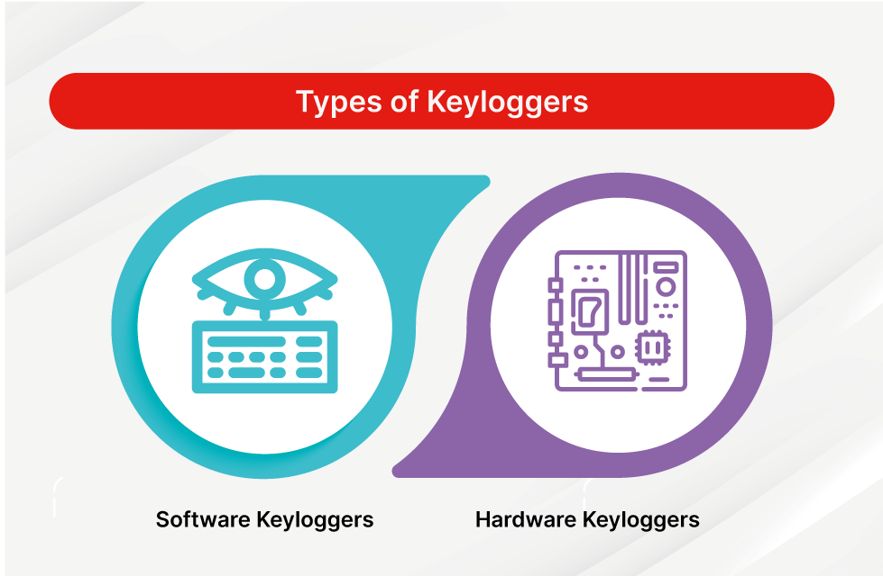
INTRODUCTION TO KEY LOGGERS AND SECURITY A keylogger or keyboard capturing is a form of malware or hardware that keeps track of and records your keystrokes as you type. It takes the information and sends it to a hacker using a command-and-control (C&C) server. The hacker then analyzes the keystrokes to locate usernames and passwords and uses them to hack into otherwise secure systems. Types of Keyloggers Software keyloggers Hardware keyloggers

Slide 5

PROBLEM STATEMENT
Keylogging techniques is helpful to emphasize the responsible use of these techniques in real life.
It is about developing an educational keylogger using Python. The purpose of this project is to explore how one can understand keylogging technology and its implementation on our daily basis.
We shall use pynput library to create a keylogger that captures keystrokes in real time and keeps them locally.
This tool would function as a learning tool for students and also who specialize in cybersecurity.
It helps in protecting sensitive information from keylogger attacks.
3/21/2024 Annual Review

Slide 6

PROJECT OVERVIEW
Keylogging is the action of capturing and recording keys struck on a keyboard. A keylogger is a program which captures and monitors all keylogs. Keyloggers can be both in the form of a built software program or directly downloaded onto a hardware module.
Build a keylogger in python which logs keys, gathers computer information, network information, gets the clipboard content, records the user microphone, and take screenshots of a computer screen.
3/21/2024 Annual Review

Slide 7

WHO ARE THE END USERS?
A wide range of customers and organizations with different objectives and aims are the end users of this Python-based keylogger. Cybersecurity experts, IT departments or any other security professional can use the keylogger for security monitoring purposes.
Categories of End Users:
Employee Monitoring
Security surveillance
Self-monitoring
Parental Monitoring
3/21/2024 Annual Review

Slide 8

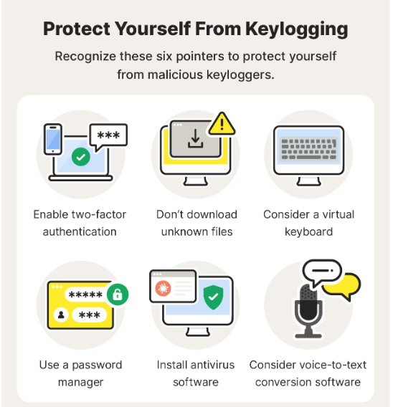
YOUR SOLUTION AND ITS VALUE PROPOSITION
The Solution For Keylogger is :
3/21/2024 Annual Review

Slide 9

THE WOW IN YOUR SOLUTION
Major wow factors are:
Ease to use
Keylogger is easy to use
Innovative approach
Design for user comprehensive approach
Detection accuracy
Almost 99% accuracy for known keylogger
3/21/2024 Annual Review

Slide 10
MODELLING
Teams cam add wireframes
Initialization:
Set up the main GUI window.
Initialize global variables for key logging.
Event Capture:
Start capturing key events when the "Start" button is pressed.
Log key press and release events.
Data Logging:
Continuously update text and JSON log files with captured key events.
Stop Logging:
Stop capturing key events when the "Stop" button is pressed.
Update the GUI status to indicate the keylogger is stopped.
3/21/2024 Annual Review

Slide 11
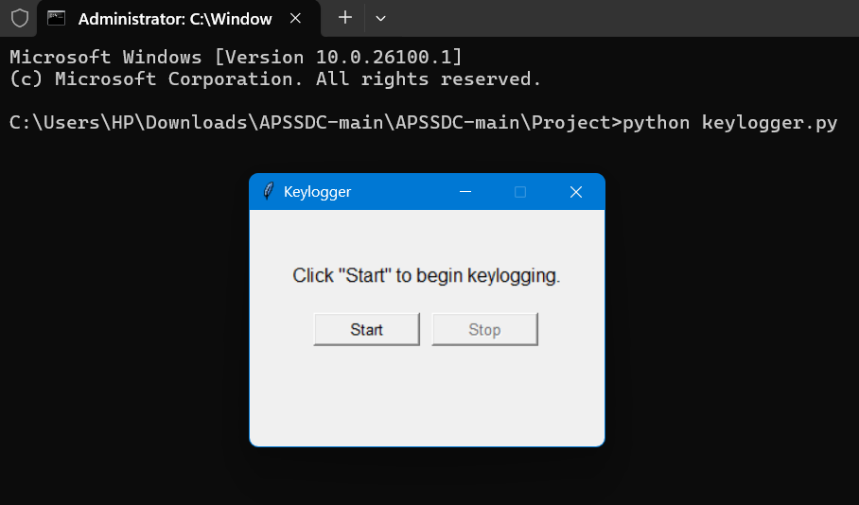
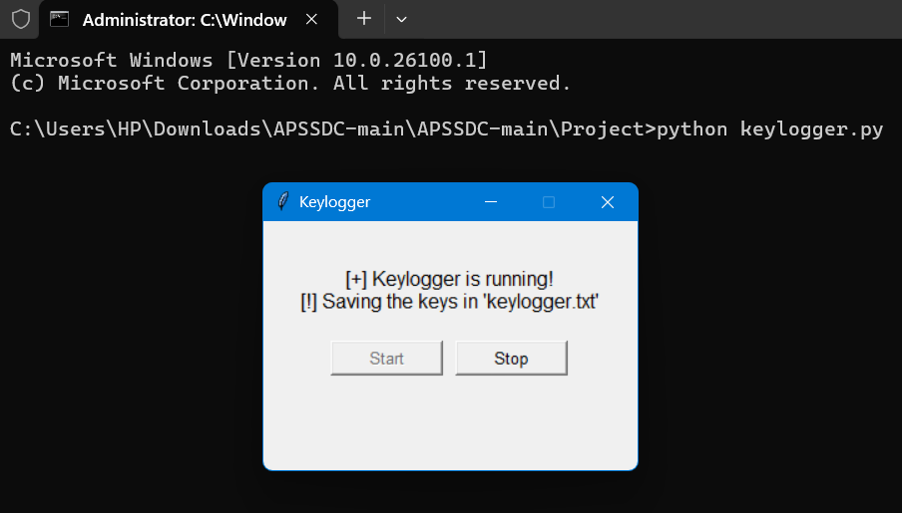
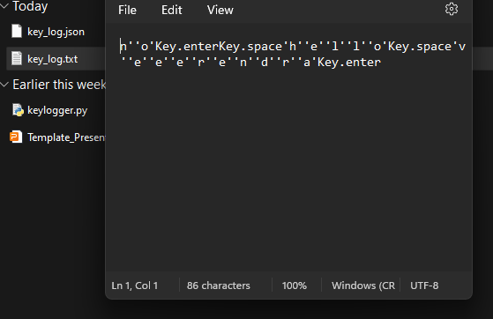
RESULTS
3/21/2024 Annual Review

Slide 12
RESULTS
KEY LOGGER RECORD KEYSTROKES
ONLY DEDICATION PROTECTION CAN DETECT THAT A KEY LOGGER IS BEING USED FOR SPHY PURPOSES
LEGITIMATE USE:MONITOR EMPLOYEE ACTIVITY
BE CONSCIOUS WHAT INSTALLED IN COMPUTER

Slide 13
PROJECT LINK
https://github.com/ramcharan-01/charan/upload

