Slide 1
ACADEMIC CAPSTONE PROJECT EVALUATION • BATCH 4
AttendIQ
Enterprise Human Resources Attendance Tracking & Absenteeism Intelligence System
A mathematically rigorous, dual-interface software platform solving the Averaging Trap, enforcing atomic batch transactions, and providing automated cohort intelligence.
PROJECT TEAM MEMBERS (BATCH 4)
1) V. Ramcharan Reddy (Lead) 2) Nikhil 3) Adarsh 4) Surekha 5) Madhavi
Target Audience: College Faculty & Academic Examiners | Framework: Python 3.14 · Flask · MySQL · Pandas · Matplotlib | 186 Tests Passing
Notes:
Respected faculty members and examiners, good morning. We are Team Batch Four—Ramcharan, Nikhil, Adarsh, Surekha, and Madhavi—and we are pleased to present AttendIQ, our enterprise attendance tracking and absenteeism intelligence system. This project was engineered to solve foundational mathematical distortion and transactional failures present in standard HR tracking systems. Across the next eight minutes, we will walk you through the system architecture, mathematical formulas, core features, and test-driven verification.

Slide 2
PROBLEM STATEMENT & MOTIVATION
Critical Flaws in Conventional Attendance Tracking
Why naive spreadsheet trackers and basic CRUD database scripts fail in enterprise environments
1. The Averaging Trap
Computing cohort attendance by averaging employee percentages creates massive mathematical distortion. A worker with 1 day is falsely given the exact same weight as someone with 22 days.
2. Conflating Leave with Absence
Naive systems treat authorized medical/annual leave as unexcused absenteeism, unfairly penalizing compliant staff, or omit it from scheduled working days, artificially inflating rates.
3. Partial Batch Inconsistencies
When submitting department-wide attendance, partial failures or unhandled duplicate record insertions leave the database in an inconsistent, corrupt state without rollback safety.
4. Audit Trail Destruction
Hard SQL deletes destroy historical compliance baselines. Furthermore, recording attendance on dates prior to employment commencement corrupts historical company analytics.
Notes:
In our research, we identified four structural flaws across traditional academic and corporate attendance systems. The most widespread flaw is 'The Averaging Trap': managers calculate department attendance by averaging individual percentages, mathematically distorting figures. Secondly, approved medical and annual leave are routinely conflated with unauthorized absenteeism. Finally, naive systems lack transactional rollback during bulk department updates and destroy audit trails through hard record deletions. AttendIQ systematically solves each of these vulnerabilities.

Slide 3
SYSTEM SOLUTION & MATHEMATICAL FOUNDATIONS
Authoritative Business Rules & Aggregate Cohort Principles
Decoupled, pure mathematical formulas implemented in calculations.py with zero division errors
CORE MATHEMATICAL FORMULATIONS
Eligible Working Days (The Denominator):
Eligible Days = Present + Absent + Leave
(Public Holiday rows are strictly excluded)
Individual Attendance & Absenteeism Rates:
Attendance % = (Present / Eligible Days) × 100
Absenteeism % = (Absent / Eligible Days) × 100
(Approved Leave is authorized; never counts as absence)
The Zero-Eligible-Days Invariant ('N/A'):
If Eligible Days = 0, division by zero is safely trapped. Raw function returns None; UI renders 'N/A' (never 0.00%).
NUMERICAL PROOF: THE AVERAGING TRAP
Scenario: Engineering team of 2 employees:
• Employee E001: 1 Present / 2 Scheduled Days (50.00%)
• Employee E002: 1 Present / 1 Scheduled Day (100.00%)
❌ Naive Average of Percentages:
(50.00% + 100.00%) / 2 = 75.00% [DISTORTED]
✓ AttendIQ Aggregate Sum of Days (Strict Standard):
Total Present = 1 + 1 = 2 days
Total Eligible = 2 + 1 = 3 days
Dept Rate = (2 / 3) × 100 = 66.67% [MATHEMATICALLY ACCURATE]
Notes:
Here we see the mathematical core of AttendIQ, implemented cleanly in calculations.py. Eligible working days strictly exclude holidays, while counting approved leave without penalizing the employee's absenteeism rate. On the right card, we provide our mathematical proof of the Averaging Trap. If Employee A has 1 out of 2 days and Employee B has 1 out of 1 day, averaging their percentages yields an erroneous 75.00%. AttendIQ aggregates raw day counts first—2 days out of 3—yielding the true rate of 66.67%.

Slide 4
TECHNOLOGY STACK & INVARIANTS
Modern Full-Stack Python Architecture
Zero external JavaScript frameworks; strictly decoupled with verified architectural constraints
Frontend & UI Design
• Semantic HTML5 & Vanilla CSS (Dark Slate + Royal Blue).
• Self-hosted Inter & Plus Jakarta Sans typography.
• Accessible HTML5 native datalists (zero JS injection risk).
• Full Content-Security-Policy (CSP) compliance.
Backend & Routing
• Python 3.14.6 core language and business logic runtime.
• Flask 3.1.3 WSGI web framework & Jinja2 templating.
• Dual Presentation: Web App + 15-option Terminal CLI.
• Session authentication & Werkzeug password hashing.
Database & Storage
• MySQL Server 8.0+ running the InnoDB ACID engine.
• mysql-connector-python 26.7.0 driver with 100% parameterized SQL.
• Foreign Key ON DELETE RESTRICT (prohibits employee row deletion).
• Composite Unique Key uq_employee_date prevents duplicate days.
Analytics & Testing
• Pandas 3.0.6: In-memory DataFrames, GroupBy & aggregations.
• NumPy 2.5.4: High-performance vectorized percentage calculations.
• Matplotlib 3.11.2: Headless (Agg) chart generation to PNG.
• pytest 9.1.1: 186 automated unit, integration, and security tests.
Notes:
Our technology stack was carefully selected to prioritize security, mathematical accuracy, and maintainability. The frontend uses semantic HTML5 and vanilla CSS with zero heavy JavaScript frameworks, ensuring complete Content Security Policy compliance. The backend is powered by Python 3.14 and Flask, connecting to MySQL 8.0 on the InnoDB engine using 100% parameterized queries. For analytical processing, we leverage Pandas and NumPy for in-memory vector calculations, while Matplotlib generates headless report charts. Every layer is verified by 186 automated pytest tests.

Slide 5
SYSTEM ARCHITECTURE
Decoupled Three-Tier Architectural Design
Rigorous separation of presentation, transactional business logic, analytics, and persistent storage
1. PRESENTATION TIER (DUAL INTERFACES — ZERO SQL & ZERO FORMULAS)
• Flask Web Application: routes.py & write_routes.py | Jinja2 Templates (Dark Slate) | Anti-CSRF Token Validation
• Interactive Console CLI: src/main.py (15 standalone terminal operations with keyboard input validation and traps)
2. BUSINESS LOGIC & ANALYTICAL PROCESSING TIER
• Domain Logic: employees.py (CRUD, joining date constraints) | attendance.py (atomic batch, weekend checks, holidays)
• Pure Calculations: calculations.py (raw float formulas, eligible days denominator, zero-day 'N/A' safe formatting)
• Analytics & Charts: analysis.py (SQL-to-DataFrame, cohort summaries) | visualizations.py (headless Matplotlib charts)
3. DATABASE & PERSISTENCE TIER (ACID COMPLIANT & ISOLATED)
• Database Engine: MySQL 8.0+ InnoDB | Connection factory & schema migration engine (src/db.py)
• Tables: employees (Indexed code, joining_date, is_active) | attendance (Composite UNIQUE uq_employee_date, FK RESTRICT)
• Governance & Security: users table (role ENUM, password_hash) | attendance_audit table (immutable action history)
Notes:
This diagram illustrates the three-tier architectural layout of AttendIQ. At the top tier, our web application and interactive CLI operate in parallel, completely decoupled from SQL queries or calculation formulas. The middle tier coordinates business rules—such as weekend validations and atomic bulk batching—while Pandas and NumPy handle data aggregation. At the bottom tier, MySQL InnoDB enforces referential integrity through foreign keys with ON DELETE RESTRICT and composite unique constraints, backed by an immutable audit table.

Slide 6
SYSTEM WORKFLOW
End-to-End User Flow & Atomic Transaction Lifecycle
Step-by-step request progression from authentication to atomic database commit
Step 1: Ingress & Auth
User submits credentials on /login. Evaluated by Dual-Cap Rate Limiter (max 5 fails/10m). Signed session initialized.
Step 2: RBAC Evaluation
Middleware checks user role (Admin vs HR). Admin grants user provisioning; HR grants operational logging.
Step 3: Roster Query
Operator selects Department + Date on /attendance/department. Queries active staff joined on or before date.
Step 4: Conflict Check
System performs pre-insert conflict query. If any staff member already has attendance, an alert warning blocks entry.
Step 5: Atomic Batch
Transaction starts (autocommit=False). Inserts all records via executemany(). If 1 fails, entire batch is rolled back.
Step 6: Audit & Analytics
Appends action to attendance_audit. Pandas recalculates cohort metrics. Output rendered with updated KPI cards.
Notes:
Here we trace the complete end-to-end user workflow during department attendance recording. The operator signs in through our rate-limited login gateway, where their role is validated. Upon choosing a department and date, AttendIQ queries eligible staff while filtering out employees who have not yet reached their joining date. A pre-submission query checks for duplicate entries; if clean, the batch executes atomically inside a single database transaction with automatic rollback protection.

Slide 7
CORE FEATURE SPOTLIGHT
Department Bulk Attendance & Atomic Transactions
Fast batch entry with collision detection and automated transactional rollback
TRANSACTIONAL BULK ROSTER CAPABILITIES
• Dynamic Active Roster:
Loads all active department staff whose joining_date is on or before selected date. Inactive staff are automatically excluded.
• Pre-Submission Conflict Alert:
Detects existing records on the chosen date, alerting the operator with conflicting codes before database submission.
• One-Click Productivity:
Defaults all roster staff to 'Present' with a one-click reset button and individual radio toggles (Present / Absent / Leave).
• Atomic Rollback Guarantee:
conn.autocommit = False wraps cursor.executemany(). Any MySQL error 1062 triggers immediate rollback—zero partial writes.
• Weekend & Date Safeguards:
Rejects attendance on Saturdays and Sundays (weekday >= 5) and validates ISO date formats.
📷 SCREENSHOT PLACEHOLDER
Department Bulk Attendance Roster
(/attendance/department)
Shows department selector, active roster, radio buttons, and conflict warning alert
Notes:
Department Bulk Attendance is one of our most critical operational capabilities, designed to streamline daily HR workflows. The operator selects a department and date, and AttendIQ dynamically generates a roster of all active employees eligible as of that date. All staff members default to 'Present' for speed, while radio toggles allow immediate adjustments for absences or approved leaves. To guarantee data integrity, the entire operation executes as an atomic transaction—if a duplicate key is detected, the database automatically rolls back.

Slide 8
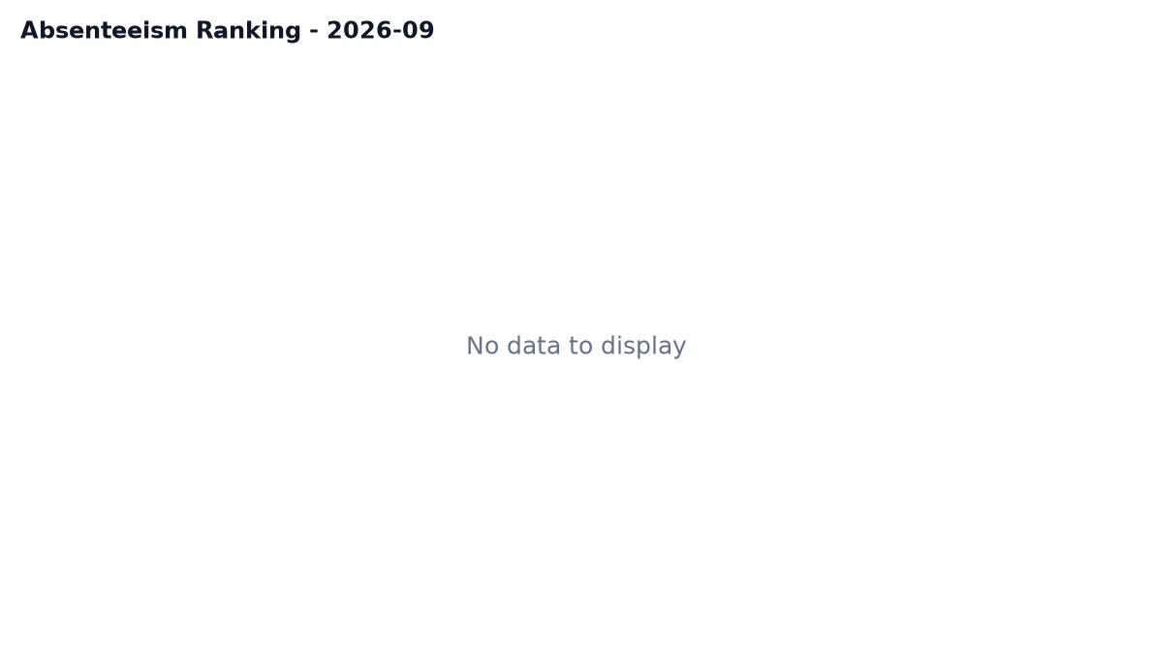
CORE FEATURE SPOTLIGHT
Analytics, Headless Visualizations & Drill-Down Profiles
Vectorized cohort aggregations, Matplotlib chart generation, and employee analytics
INTELLIGENCE & VISUAL ANALYTICS SUITE
• Executive KPI Dashboard:
Real-time metrics on /: Active Headcount, Overall Attendance %, Absenteeism Rate, Total Eligible Days, and Quick Actions.
• Department & Employee Summaries:
Dynamic cohort aggregation tables (/summary/employees, /summary/departments) with date-range filters and day totals.
• Absenteeism Ranking Leaderboard:
Ranks staff by absenteeism rate on /ranking with color-coded risk tiers (Green ≤5%, Amber ≤15%, Red >15%).
• Individual Analytics Profile:
Drill-down profile on /employees/<id>/analytics: monthly trend curves, status doughnut chart, and department benchmarks.
• Headless Matplotlib Generation:
Generates high-resolution PNG charts (absenteeism_YYYY-MM.png, monthly_attendance.png) headlessly using the Agg backend.
📷 SCREENSHOT PLACEHOLDER
Employee Analytics Profile (/employees/1/analytics)
Shows KPI cards, monthly trend lines, and department comparison
Notes:
AttendIQ delivers high-value business intelligence through our analytics module in analysis.py and visualizations.py. The system calculates cohort performance across departments and flags attendance exceptions without manual spreadsheet manipulation. On the right, we display an actual Matplotlib chart generated directly by our test pipeline for September 2026, categorizing employee absenteeism into color-coded risk tiers. Additionally, individual employee profile pages offer deep drill-down analytics, contrasting personal attendance against departmental averages.

Slide 9
GOVERNANCE & RELIABILITY
Security Architecture, Governance & 186 Automated Tests
Defense-in-depth protections and comprehensive test isolation verified with 100% pass rate
Authentication & RBAC
Role separation between Admin (user creation, account toggles) and HR (daily logging). Protects against deactivating the sole remaining Admin.
Dual-Cap Rate Limiter
In-memory sliding window limiter (src/rate_limiter.py) capping 5 failed attempts per user+IP and 20 per IP to thwart brute-force password guessing.
Immutable Audit Trail
Dedicated attendance_audit table records every CREATE and CORRECT action with operator identity, timestamp, and mandatory correction reasons.
Defensive Web Hardening
Anti-CSRF synchronizer tokens, 100% parameterized SQL queries (%s), Jinja2 auto-escaping (zero |safe filters), and nosniff / CSP / HSTS headers.
VERIFIED TEST EXECUTION SUITE: 186 / 186 PASSED (100%)
• Test Database Isolation: Enforces require_test_database()—tests strictly refuse to touch attendance_db.
• Comprehensive Coverage: Unit calculations, SQL injection safety, atomic rollback, CSRF enforcement, XSS auto-escaping, migration recovery, rate limiter, and reporting period regression.
Execution Evidence: 186 passed in 49.07s across 12 pytest modules with zero failures and zero warnings.
Notes:
Enterprise systems require rigorous governance and testing. AttendIQ incorporates a defense-in-depth model featuring role-based access control, an in-memory dual-cap brute-force rate limiter, and an immutable audit trail table tracking all corrections. Crucially, our engineering quality is proven by our automated test suite: 186 automated tests execute in under 50 seconds with a 100% pass rate. Safety guardrails strictly prevent tests from ever modifying the production database, verifying our mathematical and transactional guarantees under all edge conditions.

Slide 10
CONCLUSION & EVALUATION
Engineering Challenges, Limitations & Academic Conclusion
Key software engineering takeaways, future roadmap, and Q&A discussion
ENGINEERING CHALLENGES OVERCOME
• MySQL Repeatable Read Isolation:
During automated web test fixtures, MySQL's default REPEATABLE READ snapshot masked fresh inserts in test verification connections; resolved by enforcing autocommit on verification connections.
• Zero-Downtime Schema Migration:
Adding joining_date to pre-existing databases risked 1054 Unknown Column errors; built an idempotent migration function in db.py that backfills from earliest attendance rows with zero data loss.
• Strict Architectural Invariants:
Prevented developer slippage by adding automated pytest tests that scan code to ensure zero SQL keywords exist in routes and zero |safe filters exist in templates.
LIMITATIONS & FUTURE ROADMAP
• Current Limitations: Attendance is manually entered via Web/CLI; biometric/RFID hardware IoT integration is not yet connected.
• Planned Roadmap: Export to Excel/CSV (.xlsx), Azure Power BI App-Owns-Data DirectQuery embed, and mobile push notifications.
THANK YOU!
Batch 4: Ramcharan Reddy, Nikhil, Adarsh, Surekha, Madhavi
We welcome questions, suggestions, and feedback from the faculty!
Notes:
To conclude, developing AttendIQ provided our team with deep practical experience in transactional engineering and enterprise software architecture. We solved real-world concurrency challenges in MySQL, implemented fault-tolerant schema migrations, and established automated architectural guardrails. While future releases will incorporate hardware biometric webhooks and Excel exports, AttendIQ stands as a verified, production-ready attendance intelligence platform. On behalf of Team Batch Four—Ramcharan, Nikhil, Adarsh, Surekha, and Madhavi—we thank our faculty for their guidance, and we welcome your questions.

