Slide 1
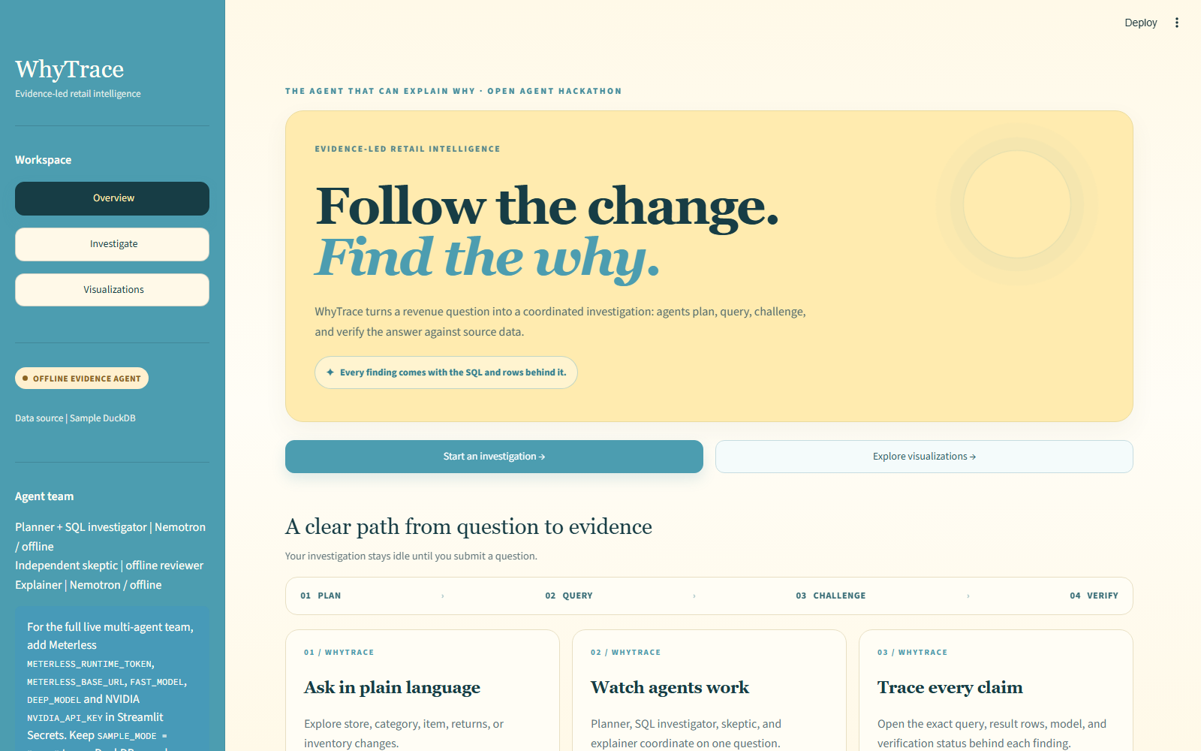
W
OPEN AGENT HACKATHON 2026
WhyTrace
Explain the change.
Show the evidence.
An agent team that investigates retail revenue shifts and traces each finding back to query evidence.
Ask naturally ? investigate ? verify
THE AGENT THAT CAN EXPLAIN WHY
WHYTRACE | OPEN AGENT HACKATHON
01 / 07

Slide 2
01 / THE PROBLEM
A KPI moved. The cause is still a hypothesis.
Retail analysts need to connect fragmented signals before they can recommend what to do.
01
02
03
Scattered investigations
Unproven explanations
Slow decisions
Sales, returns, item mix, and inventory often require separate queries and manual comparisons.
A convincing narrative can still be wrong when its numbers are not tied to source rows.
Teams need a clear view of what changed, what did not, and what to inspect next.
PROBLEM STATEMENT
How might retail teams explain a metric change with findings they can verify at the query level?
For retail analysts and operations teams responsible for acting on revenue movements.
WHYTRACE | OPEN AGENT HACKATHON
02 / 07

Slide 3
02 / THE AGENT WORKFLOW
From question to verified answer
01
02
03
04
PLAN
?
QUERY
?
CHALLENGE
?
VERIFY
A planner turns the question into 3?5 testable explanations.
SQL agents run read-only checks against retail tables.
A skeptic reviews result rows for unsupported conclusions.
The verifier reruns cited SQL and checks every reported number.
SHARED MEMORY
Meterless World Model stores query evidence, deterministic IDs, source, model, and provenance.
Evidence IDs are content-derived. The verifier uses a 0.5% numeric tolerance and flags mismatches.
WHYTRACE | OPEN AGENT HACKATHON
03 / 07

Slide 4
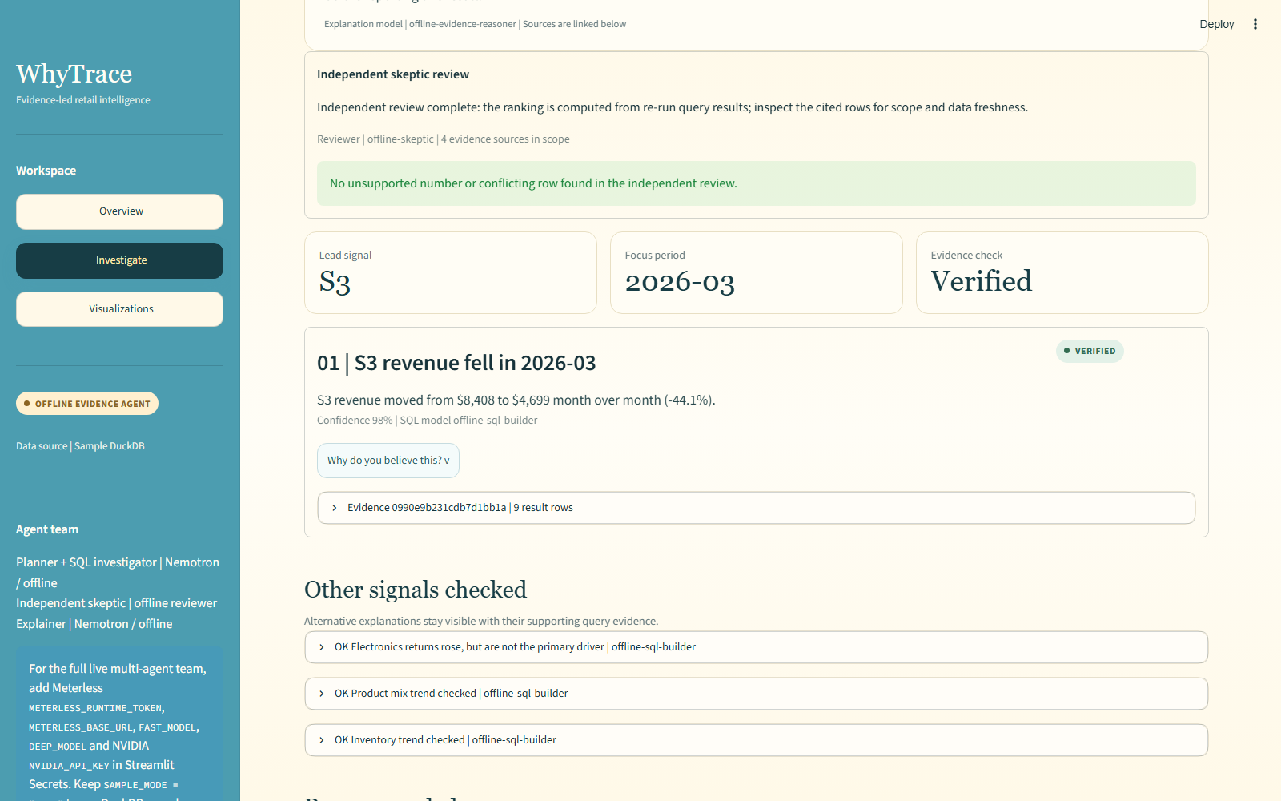
03 / SAMPLE INVESTIGATION
A 44.1% decline, traced to source rows
S3 ? MARCH 2026
$8,408 ? $4,699
?44.1% | VERIFIED
The report links the claim to the evidence ID, SQL, returned rows, and model used.
WHAT TO NOTICE
The claimed values are rechecked from the cited query.
WHYTRACE | OPEN AGENT HACKATHON
04 / 07

Slide 5
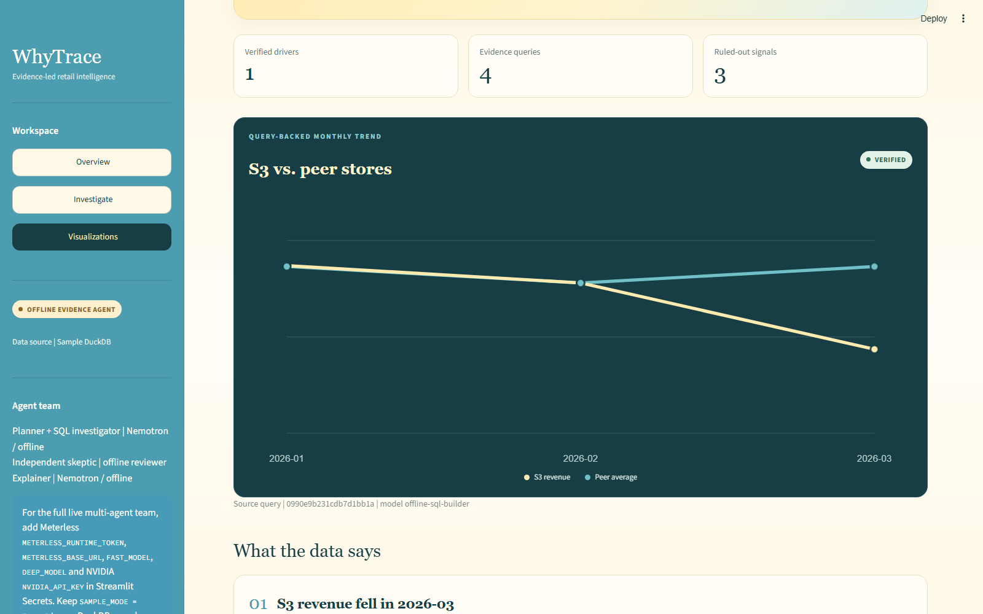
04 / EVIDENCE VISUALIZATION
The decoy stays visible?and gets ruled out
QUERY-BACKED TREND
S3 falls.
Peer stores hold.
The chart uses the same monthly store query as the written finding.
ALTERNATIVE CHECK
Electronics returns spiked, but were too small to explain the lost revenue.
WHYTRACE | OPEN AGENT HACKATHON
05 / 07

Slide 6
05 / TECHNOLOGY & SPONSOR INTEGRATION
Built for traceability, with honest mode boundaries
METERLESS WORLD MODEL
ZETARIS
NIGHTSHIFT + NEMOTRON
Local minimal evidence engine: idempotent ingest, JSONL records, deterministic evidence IDs, and provenance context.
Read-only JDBC adapter is configurable for real data. The captured demo uses the deterministic DuckDB sample dataset.
Nightshift provides planner / SQL / explanation roles and NVIDIA Nemotron the skeptic role when credentials are configured.
THIS SCREENSHOT RUN
SAMPLE_MODE uses DuckDB and the deterministic offline evidence agent here. Live Nightshift, Nemotron, and Zetaris access needs your own credentials and was not used for this capture.
No shared API keys or deployment secrets are included in the project or this deck.
WHYTRACE | OPEN AGENT HACKATHON
06 / 07

Slide 7
06 / DEMO CLOSE
A two-minute story, backed by a reproducible trace
00:00
Ask
?Why did S3 revenue drop in March 2026??
00:20
Investigate
Show plan, read-only SQL checks, skeptic review, and verification.
01:10
Explain
Show the verified $8,408 ? $4,699 change and inspect ?Why do you believe this??
01:40
Visualize
Compare S3 with peers; point out why the returns signal was ruled out.
WHYTRACE | Every explanation has a query. Every number can be checked.
WHYTRACE | OPEN AGENT HACKATHON
07 / 07

