Slide 1

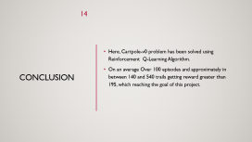
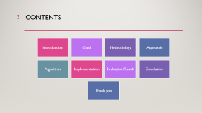
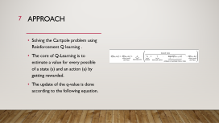
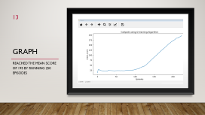
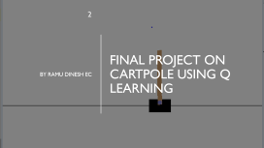
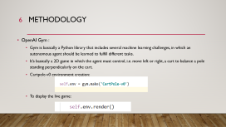
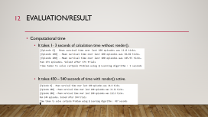
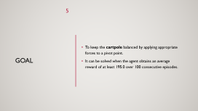
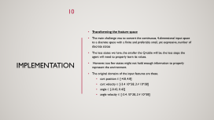
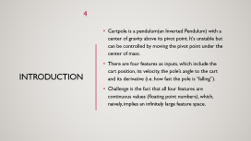
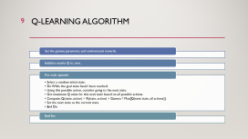

Final Project

Slide 2
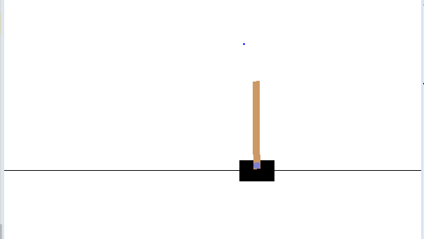
Final Project on Cartpole using Q learning
By Ramu Dinesh EC

Slide 3
Contents
Introduction
Goal
Methodology
Approach
Algorithm
Implementation
Evaluation/Result
Conclusion
Thank you

Slide 4
Introduction
Cartpole is a pendulum(an Inverted Pendulum) with a center of gravity above its pivot point. It's unstable but can be controlled by moving the pivot point under the center of mass.
It’s basically a 2D game in which the agent must control, i.e. move left or right, a cart to balance a pole standing perpendicularly on the cart.

Slide 5
Goal
To keep the cartpole balanced by applying appropriate forces to a pivot point.
To obtains an average reward of at least 195.0 over 100 consecutive episodes by an agent.

Slide 6


Methodology
OpenAI Gym :
Gym is basically a Python library that includes several machine learning challenges, in which an autonomous agent should be learned to fulfill different tasks.
There are four features as inputs, which include the cart position, its velocity, the pole’s angle to the cart and its derivative (i.e. how fast the pole is “falling”).
Challenge is the fact that all four features are continuous values (floating point numbers), which, naively, implies an infinitely large feature space.
Cartpole-v0 environment creation:
To display the live game:

Slide 7
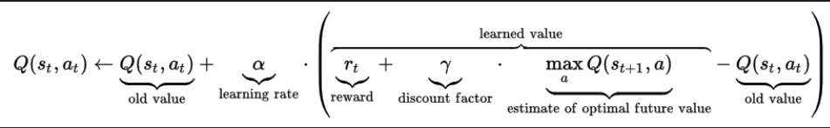
Approach
Solving the Cartpole problem using Reinforcement Q learning .
The core of Q-Learning is to estimate a value for every possible of a state (s) and an action (a) by getting rewarded.
The update of the q-value is done according to the equation shown.

Slide 8
Approach
Basically, a (S, A)-tuple’s new q-value depends on its old q-value, the immediate reward received for the action and the maximum q-value achievable in the following state.
So a (S, A)-pair’s q-value indirectly depends on all its successors’ q-values, which is expressed in the recursive function definition.
By repeatedly walking through all nodes and transitions, the agent can update any (S, A)-pairs q-value, while the results of good and bad actions are slowly “backpropagated” from terminal nodes to early nodes.
The agent ends up with a table mapping states and actions to q-values, so that given any state, the best action can be picked by choosing the highest respective q-value.

Slide 9
Q-Learning Algorithm
Set the gamma parameter, and environment rewards.
Initialize matrix Q to zero.
For each episode:
Select a random initial state.
Do While the goal state hasn't been reached.
Using this possible action, consider going to the next state.
Get maximum Q value for this next state based on all possible actions.
Compute: Q(state, action) = R(state, action) + Gamma * Max[Q(next state, all actions)].
Set the next state as the current state.
End Do
End For

Slide 10
The implementation of the actual Q-Learning algorithm consist of a function to fetch the best action for a state from the q-table and another function to update the q-table based on the last action.
Calculating algorithm’s hyperparameters, which include alpha (learning rate), epsilon (exploration rate) and gamma (discount factor).
By default, If the pole Angle is more than 12 degrees or cart position is more than 2.4 (center of the cart reaches the edge of the display) or episode length is greater than 200, the environment is going to reset.
Implementation

Slide 11
Transforming the feature space
The main challenge was to convert the continuous, 4-dimensional input space to a discrete space with a finite and preferably small, yet expressive, number of discrete states
The less states we have, the smaller the Q-table will be, the less steps the agent will need to properly learn its values.
The original domains of the input features are these.
cart position ∈ [-4.8, 4.8]
cart velocity ∈ [-3.4 10^38, 3.4 10^38]
angle ∈ [-0.42, 0.42]
angle velocity ∈ [-3.4 10^38, 3.4 10^38]

Slide 12
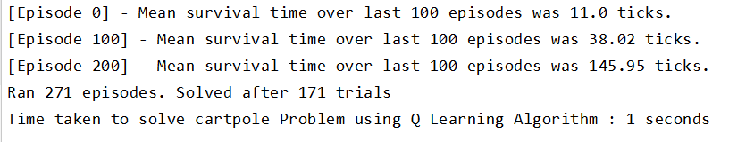
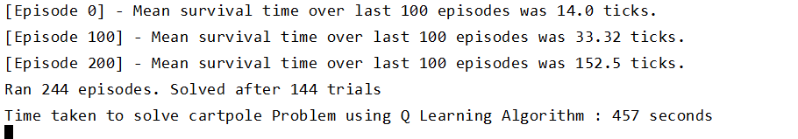
Evaluation/Result
Computational time
It takes 1- 3 seconds of calculation time without render().
It takes 450 – 540 seconds of time with render() active.

Slide 13
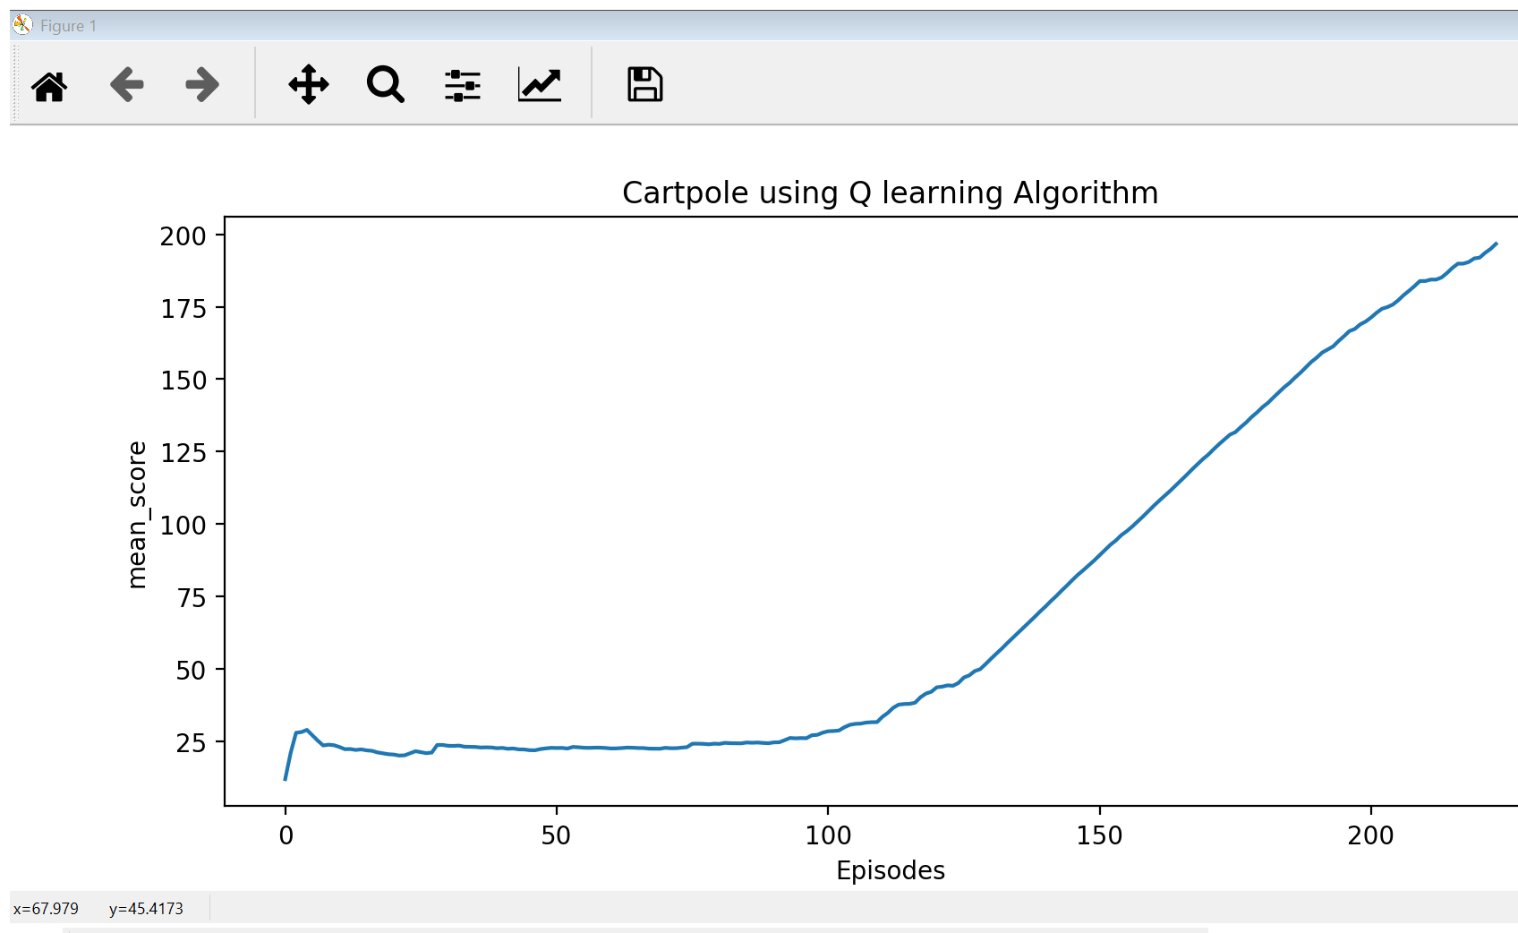
Graph
Reached the mean score of 195 by running 244 episodes and 144 trails,

Slide 14
Conclusion
Here, Cartpole-v0 problem has been solved using Reinforcement Q-Learning Algorithm.
On an average Over 100 episodes and approximately in between 140 and 540 trails getting reward greater than 195, which reaching the goal of this project.

Slide 15

Thank You

