Slide 1
4TH INTERNATIONAL AI CHAMPIONSHIP · AI IN HEALTHCARE
ClinicFlow AI
AI-assisted appointment review for clinics
A local Python and Streamlit prototype helps clinic staff review no-show risk, compare models, and plan follow-up capacity.
Team: Rameen · Noor Amna · Abdullah Ali Khan · Rana Ali Zain
Synthetic demo + public 2016 Brazil data. Retrospective results only; not clinical evidence.
Notes:
We are presenting a local Python and Streamlit prototype for appointment-risk review. It uses a retained synthetic demo and a separately selected public Brazil dataset from 2016. It is not a clinical system and contains no current clinic patient records.

Slide 2
THE PROBLEM
Missed appointments leave clinic time unused
Unused capacity
Staff time is limited
Risk is hard to see
When an appointment is missed, a slot is hard to fill at short notice.
Front-desk teams cannot contact every booking by hand.
A long booking list makes higher-risk visits difficult to prioritize.
ClinicFlow AI helps organize review. It must never decide who receives care.
Notes:
Missed appointments leave clinic capacity unused, and staff cannot manually check every booking. ClinicFlow AI organizes a list for optional follow-up. The score must never determine who receives care.

Slide 3
OUR IDEA
Review, rank, then a person decides
1
2
3
Review
Rank
Plan
Import one appointment source and check for missing or invalid values.
Compare model risks on a patient-group-disjoint held-out test set.
Staff explore a threshold or top-K queue. No reminder is sent.
The model informs review. People make decisions.
Notes:
The app validates one selected dataset, trains models on training records, then shows held-out predictions. Staff can explore a cutoff or a top-K queue. Nothing sends reminders or changes appointments.

Slide 4
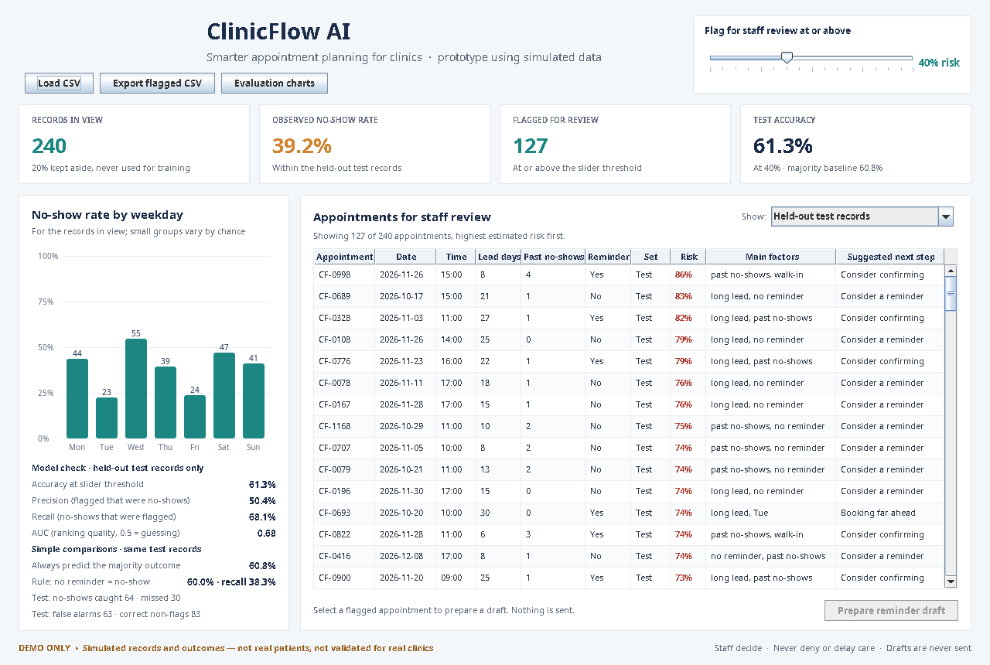
THE APP
A seven-section Python and Streamlit app
Seven sections
Dashboard, data quality, models, explanations, copilot, simulator and responsible AI.
Model laboratory
Train ten classifiers and compare actual held-out metrics.
Local explanations
Explain held-out examples and score matched CSV rows locally.
Capacity planning
Choose a probability threshold or a staff-sized top-K queue.
Data controls
Keep sources separate, review quality, and never send reminders.
Notes:
The seven sections are Executive Dashboard; Dataset and Data-Quality Intelligence; AI Model Laboratory; Individual Prediction Explanations; AI Copilot; Decision Simulator; and Responsible AI and Evaluation. After training in-session, users can upload a matching-schema CSV and score new rows locally. The copilot is deterministic and grounded in saved results because no LLM service credential is configured. No patient-level data leaves the app.

Slide 5
THE DATA
Two sources, evaluated separately
1,200
synthetic records
110,526
usable public rows
12
public model input fields
Brazil 2016 · Joni Hoppen/Kaggle (CC BY-NC-SA 4.0). One invalid row excluded; source results stay separate.
Notes:
The demo file has 1,200 generated synthetic appointments and is clearly labelled simulated. The public Kaggle dataset by Joni Hoppen has 110,527 original records and is licensed CC BY-NC-SA 4.0. One invalid row was excluded, leaving 110,526. We never concatenate these sources.

Slide 6
HOW THE EVALUATION WORKS
Group-safe holdout; preprocessing fit on training data only
1
2
3
4
Train
Compare
Hold out
Measure
Fit on 88,420 public training appointments.
Fit ten classifiers; cap KNN and SVM at 25,000 training rows.
Test on 22,106 appointments from patients unseen in training.
Report accuracy, precision, recall, F1 and ROC-AUC on the holdout.
Simulated split: 960 train / 240 test. IDs and labels are excluded; imputers and encoders learn from training rows only.
Notes:
For the public set, 88,420 rows train the models and 22,106 rows are held out; all appointments for a patient stay on one side. IDs and target labels are excluded from features, and preprocessing learns from training rows only. KNN and calibrated SVM use a stratified training sample capped at 25,000 on this dataset, then score the full holdout. The synthetic evaluation uses 960 training and 240 held-out records.

Slide 7
HOW WELL DOES IT WORK?
Ranking quality and the 0.50 cutoff tell different stories
0.740
Best public holdout ROC-AUC (HistGradientBoosting).
0.8 / 100
No-shows caught by that model at its 0.50 threshold.
10 / 10
Models trained. Random Forest catches 83.7%, but only 30.6% of its flags were no-shows.
Historical public records only. Threshold choice changes workload; no result validates use in a clinic.
Notes:
All ten classifiers trained on each source with no fit failures. On the public holdout, HistGradientBoosting has the highest ROC-AUC at 0.740. At a 0.50 cutoff it catches only 0.8% of no-shows. Random Forest catches 83.7% at that same cutoff, but only 30.6% of its flags are actual no-shows. This class imbalance and cutoff trade-off is why accuracy or ROC-AUC alone is not an operational recommendation.

Slide 8
CAPACITY SIMULATOR
HistGradientBoosting on 22,106 held-out records
Queue rule | Records flagged | No-shows caught | Flag precision
Top 5% | 1,106 | 502 (11.2%) | 45%
Top 10% | 2,211 | 940 (21.1%) | 43%
Top 20% | 4,422 | 1,708 (38.3%) | 39%
Risk ≥50% | 58 | 36 (0.8%) | 62%
Top-K selects the highest-risk share of the 22,106 held-out records. The 50% threshold selects only 58. All counts are retrospective, not a clinic-day workload forecast.
Changing the cutoff or capacity changes the review queue; it does not retrain the model.
Notes:
These are retrospective counts for the public holdout's 22,106 appointments, using HistGradientBoosting because it had the highest ROC-AUC. A top-5% queue flags 1,106 records, catches 502 no-shows (11.2% recall), and 45.4% of flags were no-shows. Top-10% flags 2,211, catches 940 (21.1% recall), and has 42.5% precision. Top-20% flags 4,422, catches 1,708 (38.3% recall), and has 38.6% precision. At a 0.50 threshold it flags 58, catches 36 (0.8% recall), and has 62.1% precision. The public holdout is not a clinic day's schedule, so these counts illustrate trade-offs only.

Slide 9
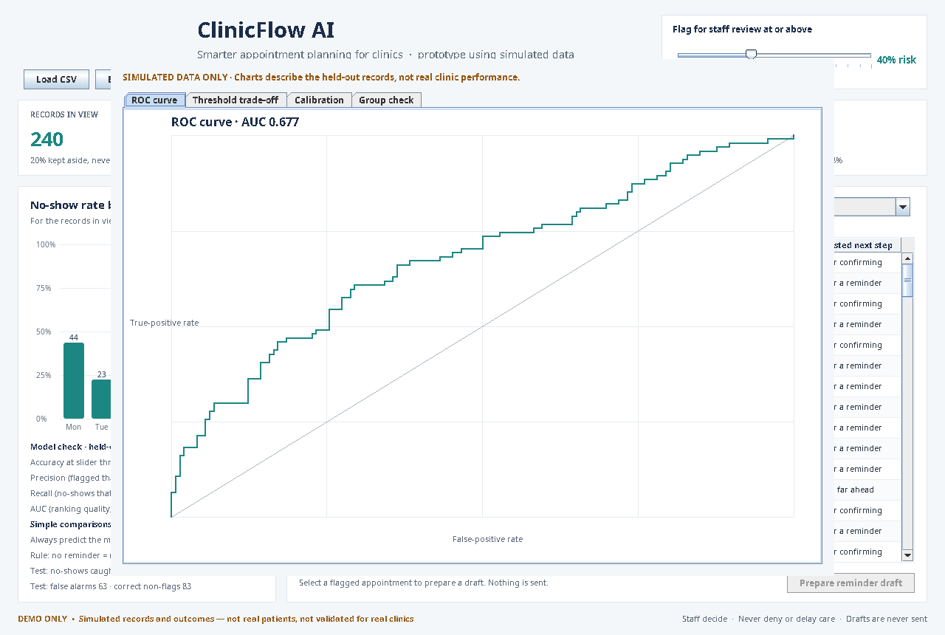
HONEST CHECKS
What the scores tell us — and what they do not
Evaluation views
Held-out ranking and classification metrics
Threshold and top-K review workload
Local perturbations, not causal effects
Source and data-quality audit
Limits
Brazil 2016 data is historical; it cannot validate present-day clinic performance.
At 0.50, the best-AUC model recalls only 0.8%; no safe cutoff is established.
Group comparisons are descriptive, not a fairness certification.
Notes:
This source is historical, geographically specific, and includes sensitive attributes. Results do not establish present-day clinic performance, calibration, fairness, or impact. Group comparisons are descriptive. One-feature perturbations are not causal effects or SHAP. There is no validated operational cutoff; any use would need authorized current data, independent prospective validation, privacy and governance review, and staff and patient involvement.

Slide 10
RESPONSIBLE USE AND NEXT STEPS
Prototype decision support — not ready for patient-care use
Built in
Next steps
Seven sections for review, comparison and workload exploration
A deterministic copilot grounded in saved results
IDs are excluded from model features
Never deny or delay care based on a score
Validate with authorized, current clinic data
Assess calibration, fairness and impact prospectively
Set review capacity with clinic staff and patients
Review privacy and governance before any pilot
Thank you. Questions?
Notes:
Never deny, delay, or reduce access to care because of a risk score. Nothing sends messages or changes appointments. Before any pilot, clinics would need permissioned data, privacy controls, subgroup and calibration assessment, workflow review, and prospective validation with staff oversight.

