Slide 1

Peter Boulos 26671187
Jacqueline Luo 26938949
Michael Mescheder 27202202
Sam Alexander Moosavi 27185731
Eric Payette 27008058
Rameen Rastan-Vadiveloo 27191863
Jason Tsalikis 25892120

Slide 2
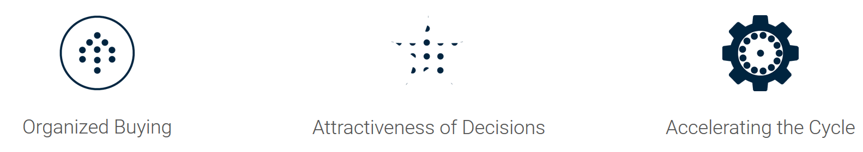
TRNDii: Project Purpose
Make online shopping a social experience
Make group buying more interesting and engaging through gamification
Token system lets users play with their digital funds to gamify their savings
Profits made through user purchases, tokens incentivize users to shop
Credit card information not stored on servers to ensure safety.

Slide 3
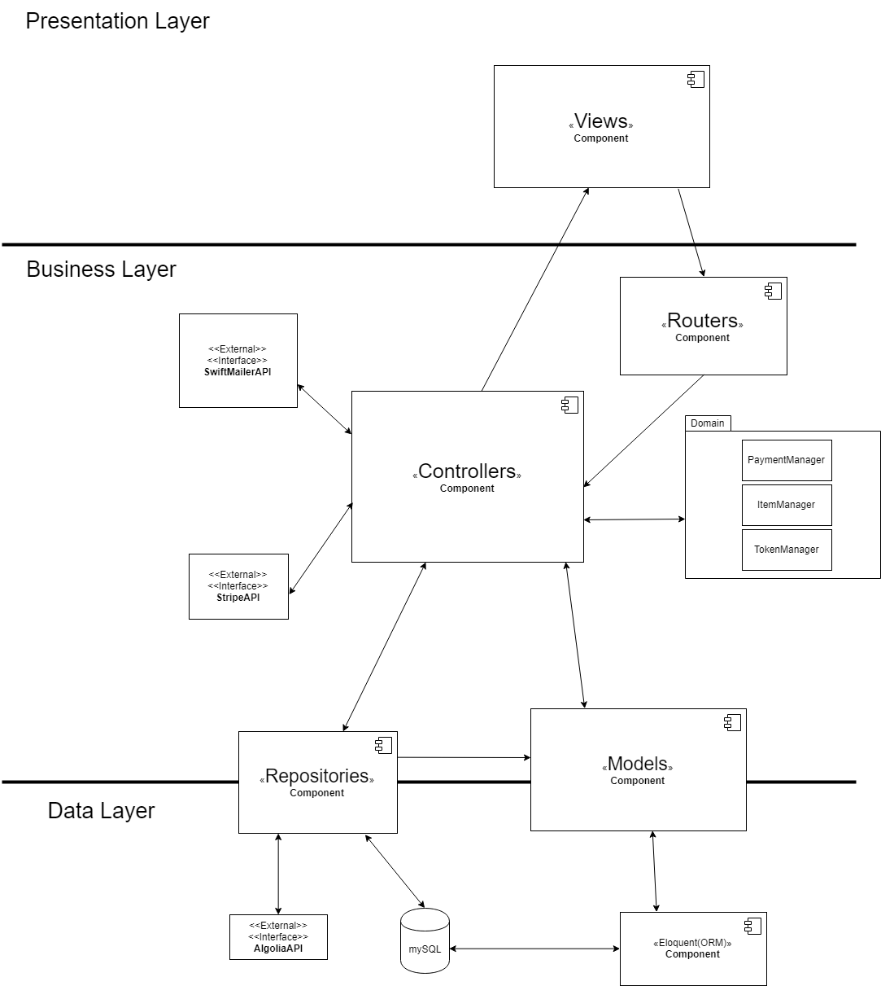
Overall Architecture
MVC Architecture
Three Layers:
Presentation
Business
Data

Slide 4
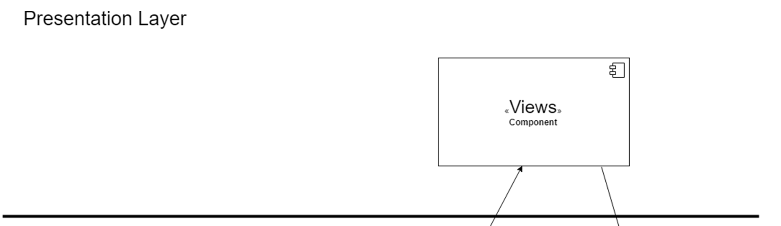
Presentation Layer
Contains the Views
Blade Templates in Laravel
Renders UI to users and maps user requests to Router

Slide 5
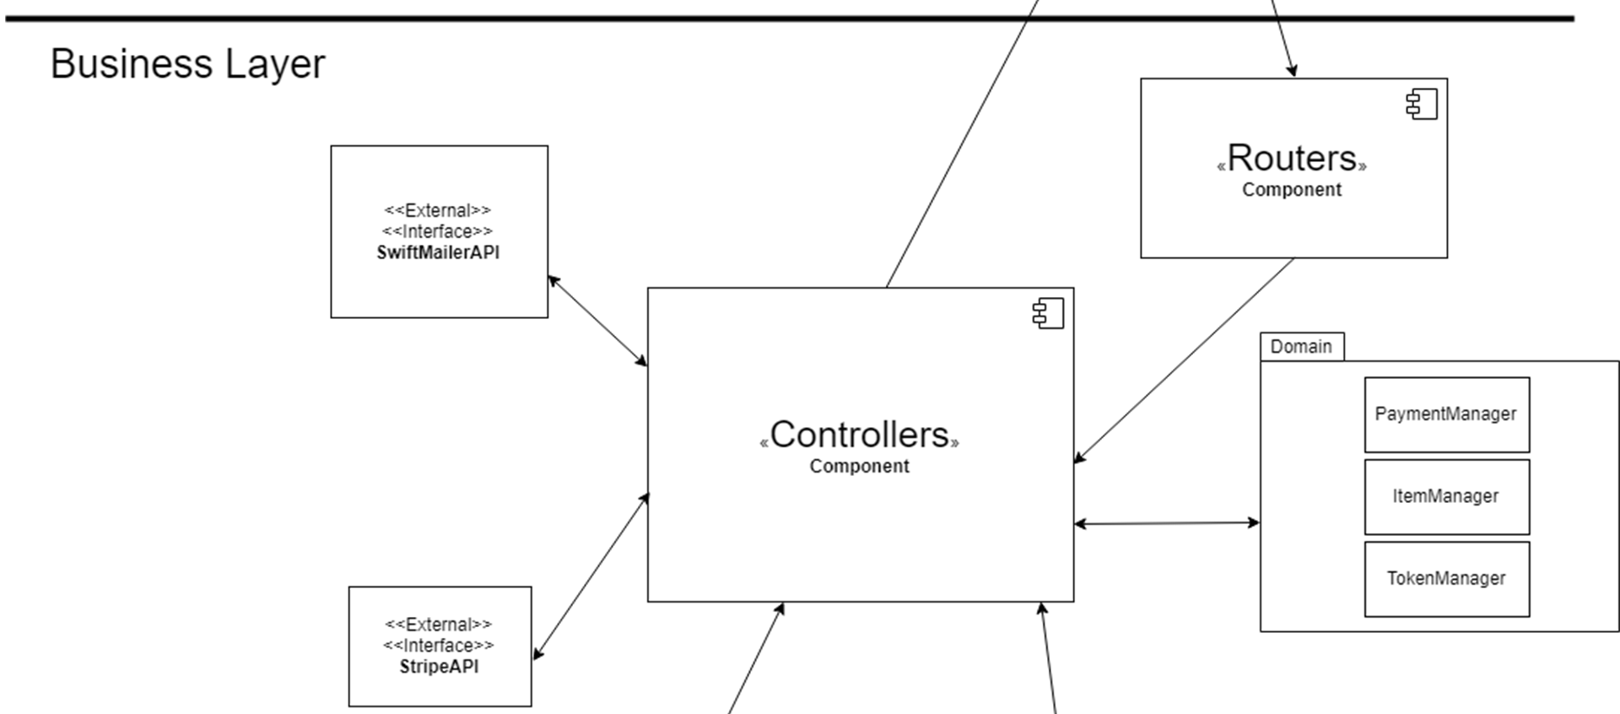
Business Layer
Controllers process and handle user requests
Domain package contains Classes that process business logic
APIs (Stripe and Swift Mailer)

Slide 6
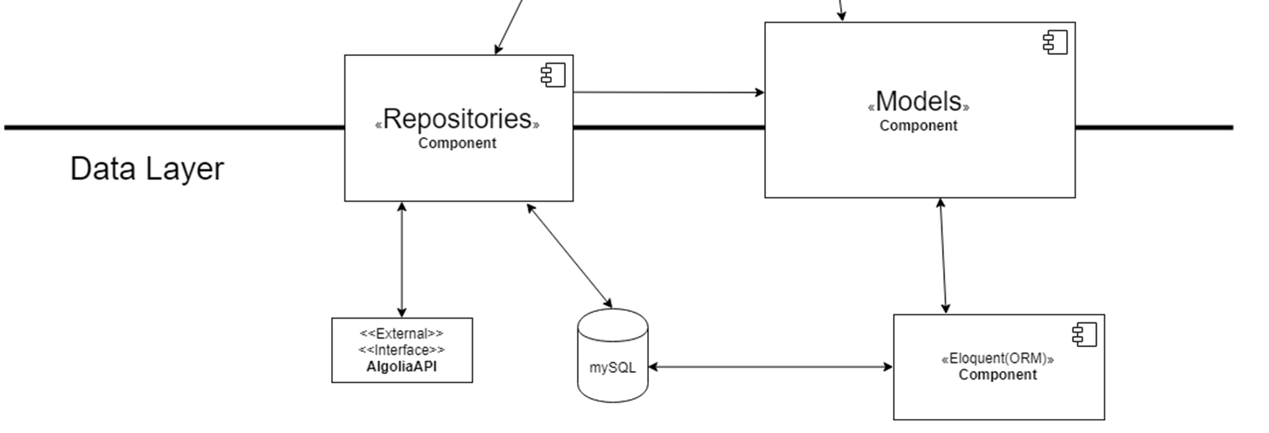
Data Layer
Repositories encapsulate data access logic
Eloquent ORM and Models provide easy way to interact with database tables
Algolia API used as database search engine for item search functionality

Slide 7
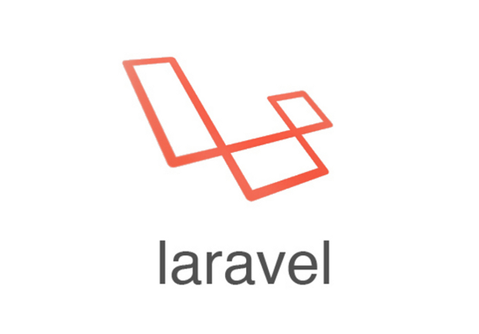
Framework: Laravel
Open-source PHP MVC Framework
Eloquent ORM and Models
Powerful and simple way to interact with database tables
Blade Templates: Powerful Templating Engine
Layout extensions and inheritance
Control structures to customize and personalize views
Tools to easily display data
Migrations, factories and database seeding
Authentication, routing and sessions

Slide 8
Key Stories
The following stories are part of the core requirements of the system:
Purchase Item
Cash from Tokens
Free Refund Lottery

Slide 9
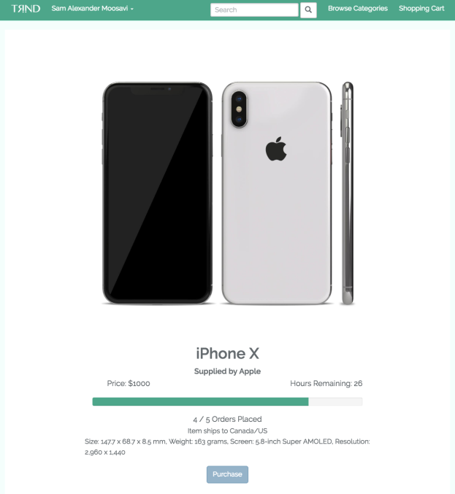
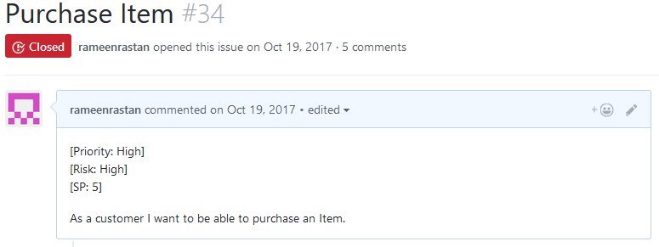
Purchase Item (Issue #34)
As a customer, I want to be able to purchase an item.

Slide 10

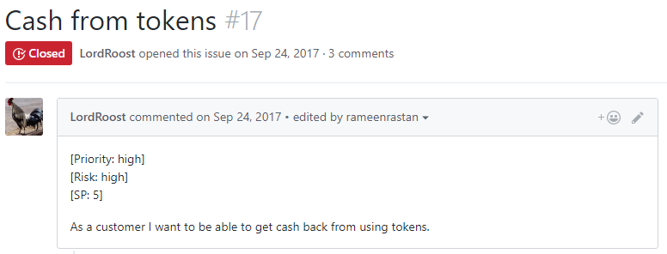
Cash from Tokens (Issue #17)
As a customer, I want to be able to get cash back from using tokens.

Slide 11
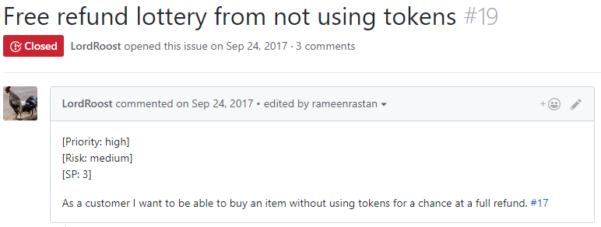
Free Refund Lottery (Issue #19)
As a customer, I want to be able to buy an item without using tokens for a chance at a full refund.

Slide 12
Lessons Learned
Standards and best practices
eCommerce web design
eCommerce development
Importance of understanding the end user
Critical role in success or failure of product
Gamification must be simple to understand (main risk)
Shouldn’t intimidate users with complexity

Slide 13
Summary
Purpose: make online shopping an engaging and social experience
Token system used to gamify the group buying experience.
Laravel provided powerful tools to simplify the development process.
Main risk: ensuring that gamification scheme will not keep users away.

Slide 14
Backup Slides for Q&A

Slide 15
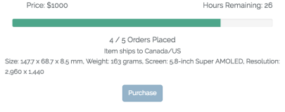
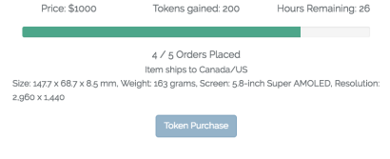
A/B Testing
A/B testing experiments defined in ExperimentHandler class
A/B testing currently used to test the Token System (main risk)
2 User Segments in Experiment: ‘Basic’ and ‘Token’
Basic users do not have access to the Token System (basic buying website)
Token users have full visibility of the token system.
Metrics gathered in Experiments table used to determine which experiment performs better.

Slide 16

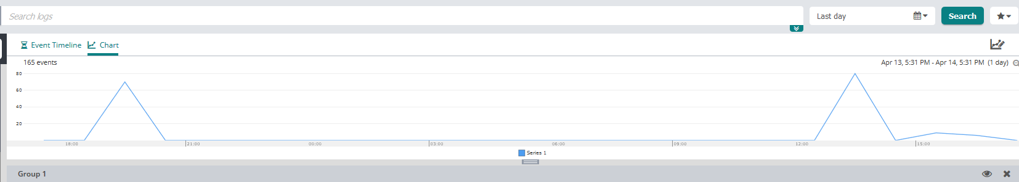
Logging
Logging Platform: Loggly
Used for Log Management and Analysis
Allows logs to be accessed via web interface
Functionalities offered to easily search and filter through logs
Log charts and dashboards
Log alerts

Slide 17
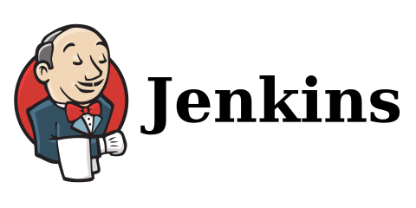
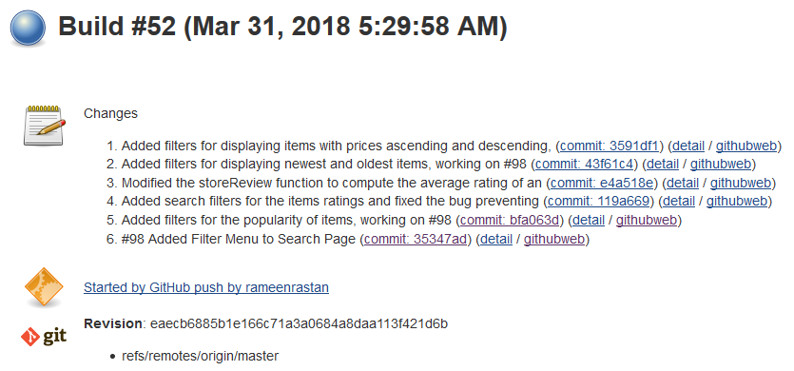
Continuous Integration (CI)
CI Server with Jenkins
Deployed on Amazon EC2 Instance
Alerted every time new commit is made on master branch of Github repository
via webhook and deploy key on github repository
Runs Unit Tests
Build Fails if any unit test fails
Continuous Deployment
Pulls changes on live server

