Slide 1

Healthcare Analytics for Doctor Visits -
[Name : S Ramees mohammad ]
[stu id:STU6a6a5995ea0541785354645]

Slide 2

PROBLEM STATEMENT
Healthcare providers and policymakers face challenges in predicting patient doctor visit frequency and resource demand.
Inefficient resource allocation leads to hospital overcrowding, improper insurance targeting, and gaps in healthcare access for vulnerable demographics.
Objective: Perform exploratory data analysis (EDA) on patient demographic, financial, and health records to identify primary drivers behind doctor visit frequency and optimize healthcare service delivery.

Slide 3
Project Description
Overview: A data analytics project examining 5,190 patient records across 13 key attributes to evaluate healthcare utilization behaviors.
Key Steps Executed:
  *Data Inspection & Cleaning: Verified data schema (5,190 rows, 13 variables); confirmed zero missing values across all columns.
  *Statistical Profiling: Evaluated numerical distributions for age, income, illness count, health status, and reduced activity days.
  *Univariate & Bivariate Analysis: Examined gender distributions, doctor visit frequency, and insurance types (private, freepoor, freerepat).
  *Health & Financial Correlation: Analyzed how chronic conditions (nchronic, lchronic), income levels, and government subsidies impact healthcare access.

Slide 4

WHO ARE THE END USERS?
Hospital & Clinic Administrators: For patient inflow forecasting, physician scheduling, and capacity planning.
Health Insurance Providers: To structure insurance coverage plans and assess patient risk tiers based on income and health indicators.
Public Health Policy Makers: To evaluate the effectiveness of subsidized healthcare programs (freepoor, freerepat) for low-income and elderly populations.
Healthcare Data Analysts: To develop predictive models for patient readmissions and medical intervention planning.

Slide 5

Technology Used
Programming Language: Python 3
Development Environment: Google Colab / Jupyter Notebook
Data Manipulation Libraries: Pandas, NumPy
Data Visualization Libraries: Matplotlib, Seaborn

Slide 6
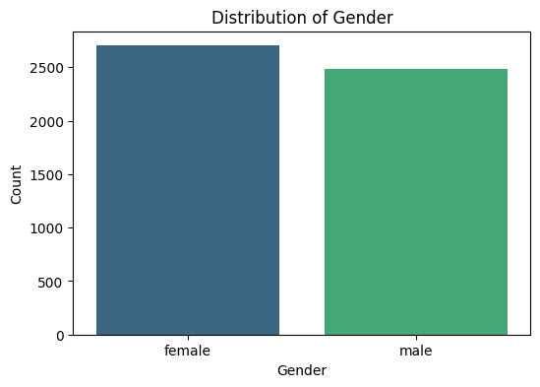
RESULTS
[Add screen shots of your code ]
Demo Link

Slide 7
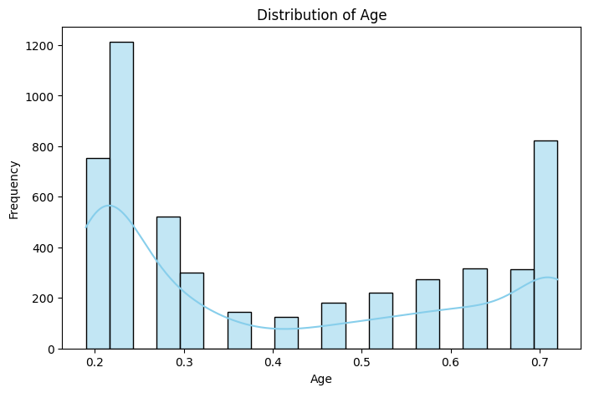
RESULTS
[Add screen shots of your code ]
Demo Link

Slide 8
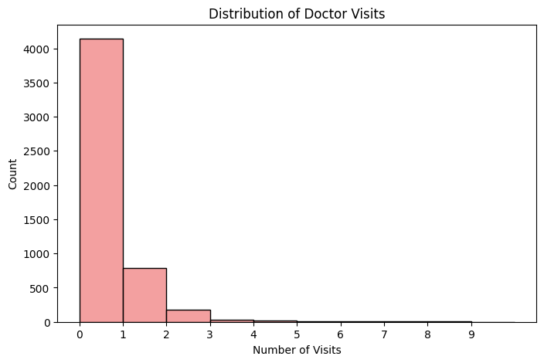
RESULTS
[Add screen shots of your code ]
Demo Link

Slide 9

RESULTS
[Add screen shots of your code ]
Demo Link

Slide 10

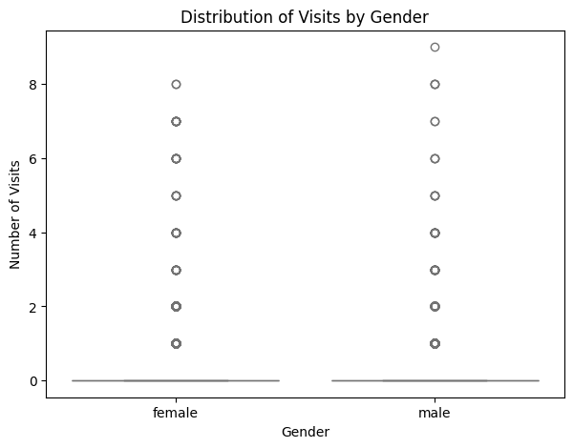
RESULTS
[Add screen shots of your code ]

Slide 11
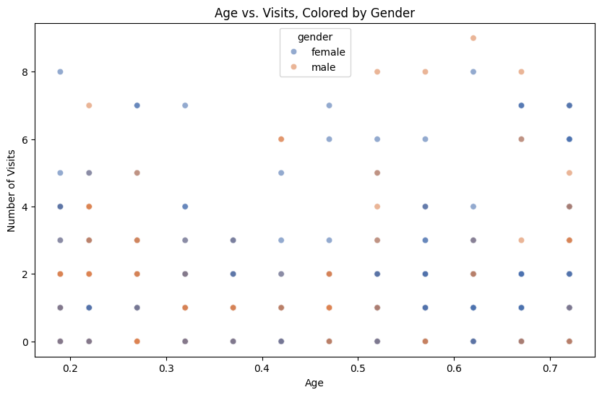
RESULTS
[Add screen shots of your code ]
Demo Link

Slide 12
Github link
https://github.com/rameesmohammad/Healthcare-Data-Science-Predictive-Analytics
.
.

Slide 13
Thank you
.
.

