Slide 1

Sprocket Central Pty Ltd
Data analytics approach
Data Analyst Intern

Slide 2
Agenda
Introduction
Data Exploration
Model Development
Interpretation

Slide 3
Introduction
Identify & Recommending High Value Customers
Outline Of Problem
Sprocket Central is a company that specializes in high quality bike and accessories.
The Marketing team is looking to boost sales
To target 1000 new customer that will bring the highest value to the business
Data Analysis Approach
Conducted Exploratory Data Analysis (EDA) involving feature engineering, univariate, bivariate, and multivariate analysis.
Analyzed bike-related purchases over the last 3 years, and profits categorized by age groups.
Investigated which age groups and wealth segments are more profitable.
Identified the top industries and states contributing to profit and bike sales.
Analyzed the profit in relation to the number of cars owned in each state.
Determined the most profitable product lines, and product classes.
Classified customers into predefined categories to determine which category has the highest number of customers.

Slide 4
Data Exploration
Data Quality Assessment
Table | Completeness | Validity | Accuracy | Consistency | Tidiness
Customer Demographic | Missing: DOB, job_title, job_industry_category,tenure | Drop : default Filter out : deceased_indicator | Inaccurate : Age | Inconsistency: gender ADD Column: Age, Age_category | Join with Transactions
Customer Address | N/A | N/A | Filter out extra : customer_id | Inconsistency: state | Join with Customer Demographic
New Customer List | Missing: DOB, job_title, job_industry_category | Data type: DOB | Filter out: Unnamed 16,17,18,19,20 | ADD Column: Age, Age_category | N/A
Transactions | Missing: online_order, brand, product_line, product_class, product_size, standard_cost, product_first_sold_date | Filter out : cancel order | Filter out extra : customer_id, cancel order | N/A | N/A

Slide 5
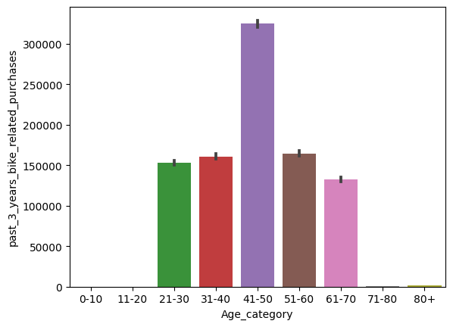
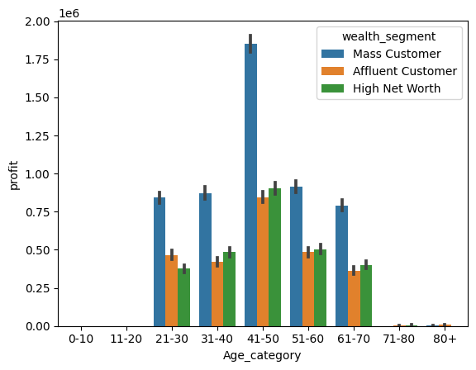
Data Exploration
Bike-Related Purchases Over the Past 3 Years and Profits Across Age Groups, Segmented by Wealth Segment
People aged between 40-50 make more bike-related purchases compared to other age groups. They also contribute the most to profit, as shown in both graphs.
This also indicates a trend in buying power. As we observe, buying power increases over the age of 50 and then gradually decreases as age increases, ultimately resulting in lower profit.
The 40-50 age group within the mass customer segment generates more profit.

Slide 6
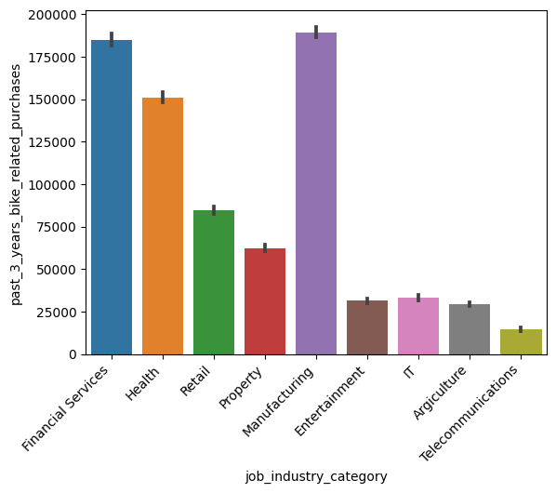
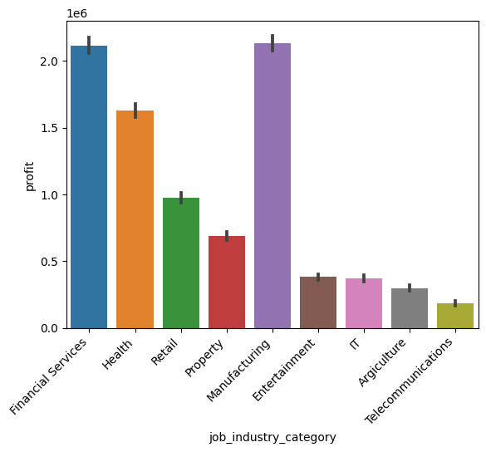
Data Exploration
Leading Job Industries Enhancing Profit and Bike-Related Purchases
The most significant profit contributions in the bike-related purchases area come from the top three industry sectors: Financial Services, Health, and Manufacturing, making up a total of 57%.
Notably, many of the industries we examined have generated profits of less than $1,000,000. This suggests there is untapped potential for growth in the market for bike-related products and services.

Slide 7
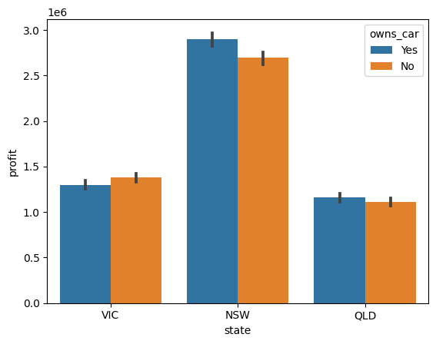
Data Exploration
Analyzing the Relationship Between Profit and Car Ownership by State
New South Wales, Australia is 50% more profitable than other regions, indicating significant regional disparities in bike-related profit.
Car owners in New South Wales contribute significantly more to profits compared to non-car owners, suggesting a correlation between car ownership and bike-related spending.
These findings suggest opportunities for regional market segmentation and targeted strategies to maximize profitability.

Slide 8
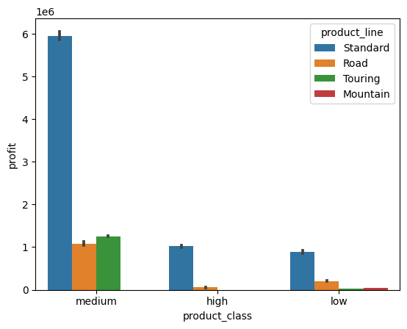
Data Exploration
Analyzing Profit Variation Among Product Lines and Classes: Opportunities for Improvement
"Medium Class" products in the standard product line generate over six times the profit compared to other product lines and classes, with earnings nearing $6,000,000.
There is a clear need for marketing improvements in the underperforming product lines and classes, which are currently generating less than $100,000 in profit.

Slide 9
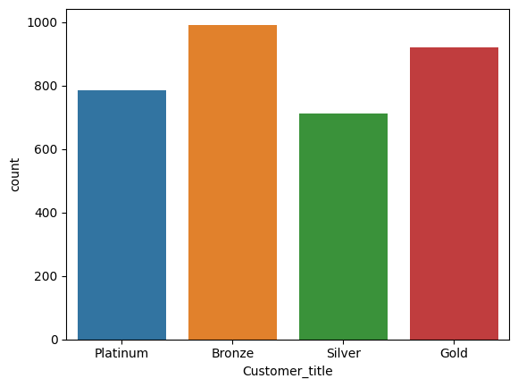
Data Exploration
Classified customers into predefined categories to determine which category has the highest number of customers
Customer segmentation based on RMF values reveals distinct categories, with "Platinum" representing the most valuable customers and "Bronze" the least profitable.
The majority of our customer base falls into the "Bronze" category, comprising 29% of our customers. The "Gold" category comes in second place, representing 27% of our customers.
It's worth noting that the number of "Platinum" customers is significantly lower in comparison to both "Bronze" and "Gold." This indicates a potential opportunity for growth by focusing on strategies to elevate more customers to the highly profitable "Platinum" category.

Slide 10
Model Development
Strategy for Profit Maximization
Targeted Focus: Prioritize the 40-50 age group for high-profit bike-related purchases.
Strategic Industry Optimization: Customize strategies for profit-rich sectors like Financial Services, Health, and Manufacturing.
Regional Profit Maximization: Exploit regional disparities, exemplified by New South Wales, to boost profits.
Product Line Enhancement: Enhance underperforming product lines and classes to boost overall profitability.
Customer Category Elevation: Develop RMF-based models to elevate customers into the highly profitable "Platinum" category, unlocking significant revenue potential. Opportunity lies in increasing "Platinum" customers despite current lower numbers compared to "Bronze" and "Gold."

Slide 11
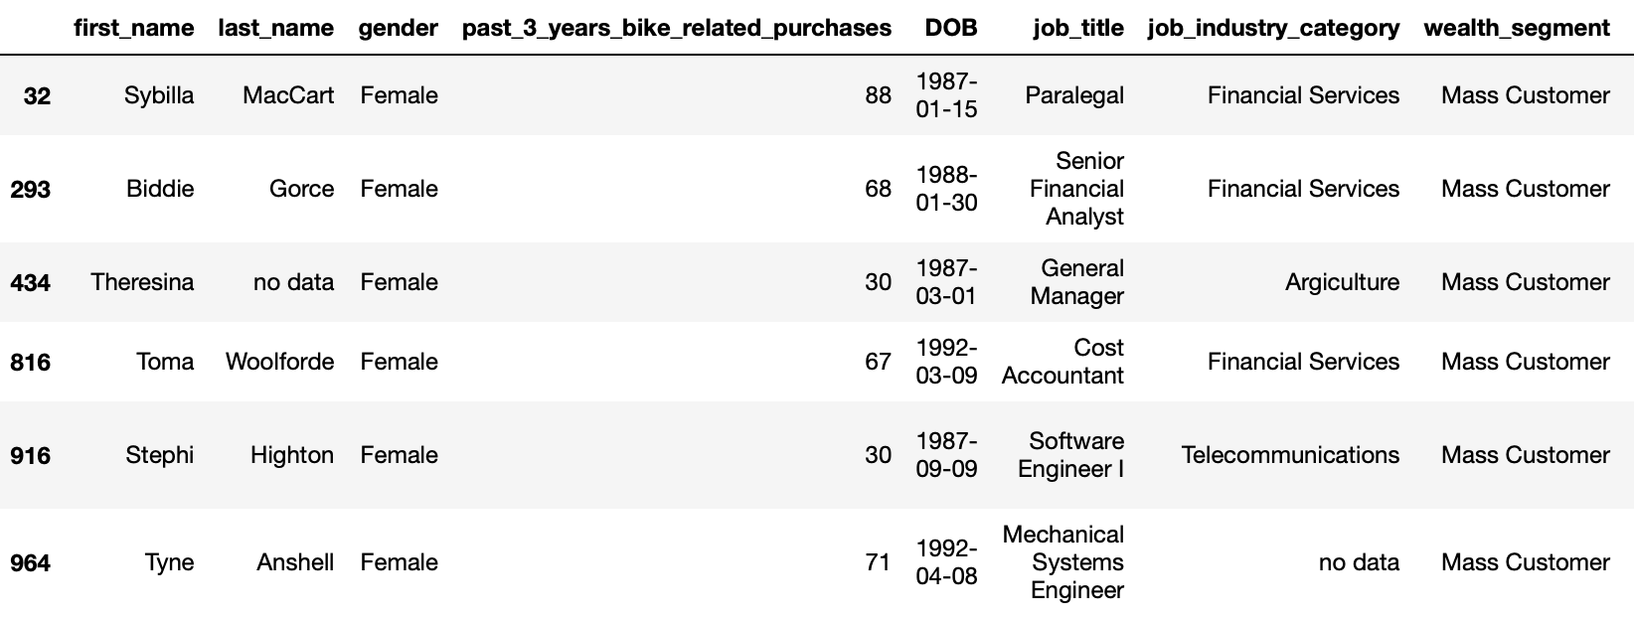
Interpretation
Targeted Customer in New customer list
Within New South Wales, the 40-50 age group, comprising individuals who own cars and work in sectors such as financial services, health, or manufacturing, predominantly falls within the mass customer wealth segment. Notably, our analysis reveals that among this demographic, female buyers exhibit a slightly higher level of profitability compared to their male counterparts. Consequently, it is advisable to prioritize this specific demographic as our primary customer base for strategic marketing initiatives. Below is a snapshot of these customers from the new customer list:

Slide 12
Thank You

