Slide 1
Synchronization Meeting
SocEnRep
Mon, 08.06.2026

Slide 2
Purpose of the meeting
Get to know each other
Overview the divergence in coding Bauer et al (2025)
…and changes to the codebook + gform
Introduce new decision rules in the codebook v2
Most importantly, it affects how to code the definition of computational reproducibility
Answer all questions you have

Slide 3
C1. Primary Contribution
What is the primary type of contribution the paper makes?
Ineke | Mehtab | Elisabetta
Educational/training resource | Educational/training resource | Guidelines/policy (but would have also chosen educational/training resource, if multiple answers are allowed)
C2. Secondary Contribution
Is there a clearly applicable secondary type of contribution?
Ineke | Mehtab | Elisabetta
blank | Guidelines/policy | blank

Slide 4
C1 & C2: My suggestions
In the abstract, it implies the paper is „a guideline“ but it is primarily a teaching resource.
Guideline/policy option is reserved for something more normative/enforced (e.g., a journal, association, institutional, community policy).
If the paper is about a university’s policy regarding teaching methods courses, then it falls under the guideline/policy category.

Slide 5
D1. Reproducibility Definition
Does the paper provide a definition of computational reproducibility?
Ineke | Mehtab | Elisabetta
No | No | No
Your answer is correct and we can see there is a perfect agreement. The paper indeed doesn‘t contain any definition on „computational reproducibility,“ however…

Slide 6

D1. Reproducibility Definition
There is a substantive definition of „reproducibility“ in p. 117, but the authors label it differently – „Analytical Replication“
This happens quite often as reproducibility (vs. replication) are conflated in the literature.
For this reason, I introduce a new decision rule for this item: „code the definition by meaning, not by the label.“
If the paper states something about reproducing results from the same data and code („same data, same code/methods/analysis“) counts as the definition of reproducibility, even if the paper calls it „replication.“

Slide 7
D1a. Copy-Paste Definition
For D1a. if other terms are used to describe computational reproducibility, please state the terms before the definition.
Example:
Analytical Replication: “Attempting to computationally reproduce previous findings using the same numerical data” (p. 117).

Slide 8
D2. Contextual Variation
D2a. Which types of contextual variation does the paper discuss?
Ineke | Mehtab | Elisabetta
blank | blank | Study design, License, Programming language or software
I made two mistakes in the Google Forms:
The form previously stated „if D1 = Yes, complete D2,“ while in fact, D2 is completely independent from D1.
According to the codebook, there should have been a D2. „Does the paper discuss how the meaning or practice of reproducibility varies across different contexts? (Yes/No)“ but it wasn‘t there.
All of these mistakes have been fixed✅

Slide 9
D2. Contextual Variation
D2a. Which types of contextual variation does the paper discuss?
Ineke | Mehtab | Elisabetta
blank | blank | Study design, License, Programming language or software
I also introduce a new decision rule:
Code only if the paper clearly says reproducibility differs across a context.
Therefore, only briefly naming a context (data type, software), without arguing that reproducibility may depend/be different across these contexts is not contextual variation.

Slide 10
E1a. Explicitness of Workflow
How explicitly is the workflow or guideline described?
Ineke | Mehtab | Elisabetta
Narrative (implicit) | Explicit (step-by-step) | Explicit (step-by-step)

Slide 11
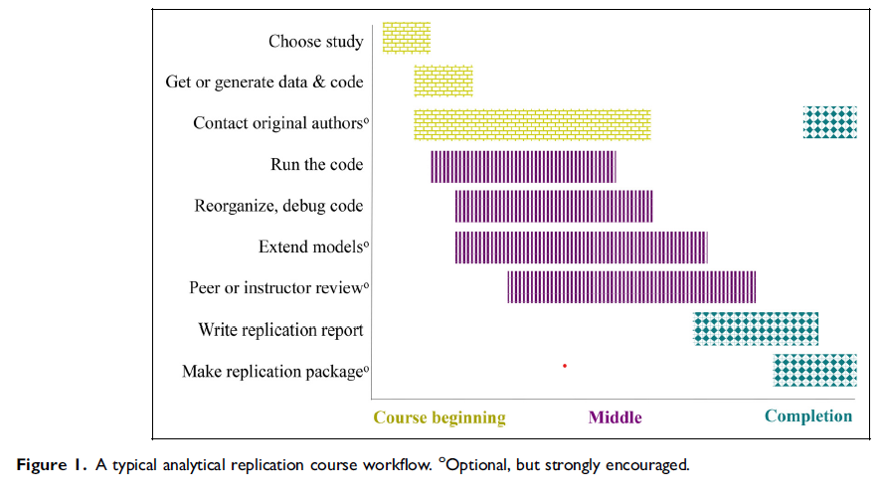
E1a: My suggestion
Explicit (step-by-step), as the authors provide Figure 1 (p. 120).
I add a new rule to make it clearer:
„A figure or a table with numbered list of ordered steps → Step-by-step, even when the text is narrative“

Slide 12
E1b and E1d
E1b. What computational environment does the paper focus on?
Ineke | Mehtab | Elisabetta
Multiple approaches | Multiple approaches | Not described
E1d. What data type(s) does the paper focus on?
Ineke | Mehtab | Elisabetta
Multiple approaches | Multiple approaches | Not described

Slide 13




My suggestion: E1b and E1d
„Not described“ for both
Article mentions briefly many things, but doesn‘t mean it focuses on these things
I add a new rule:
“Code data type/computational environment/programming language only when the paper actively recommends, adopts, or substantively discusses it”
Quick test: would the option still be true if you deleted that one sentence? If yes, it is a focus; if no, it is a brief mention
I also deleted “Multiple approaches,” as these are multi-select items.

Slide 14
E1e. Automation
Does the paper suggest or describe automated checking of reproducibility?
Ineke | Mehtab | Elisabetta
Not described | Manual only | Partial automation

Slide 15


My suggestion: E1e
Manual only
The confusion lies in these two sentences (p. 119 & p. 121) – but these are just casual mentions.
If we look again at the workflow suggested by the authors, all of these steps are fully manual.

Slide 16
F2. Who Runs the Check?
Who does the paper say should perform the reproducibility check?
Ineke | Mehtab | Elisabetta
Not described | Authors, peer-reviewers, third-party reproducers | Third-party reproducers

Slide 17

My suggestion: F2
Students are third-party reproducers
Classroom peer feedback (p. 119) doesn‘t refer to peer review process in a journal

Slide 18
F3. Timing
When does the paper suggest reproducibility should be verified?
Ineke | Mehtab | Elisabetta
Not described | Before submission, after publication | After publication

Slide 19

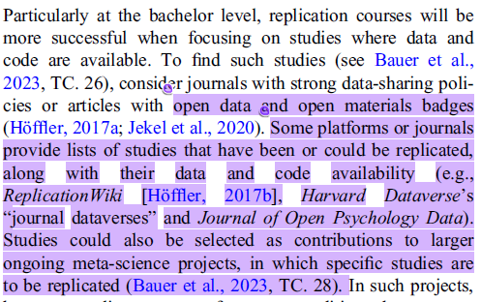
My suggestion: F3
After publication
Students reproduce already-published studies, so verification is inherently post-publication.

Slide 20
Conclusions
Always code reproducibility definition („same data, same methods/code/analysis“), even though it is labelled under different terms.
For multi-select items, I deleted „Multiple“ as an option to avoid confusion.
Threshold of „Focus“ – when the paper only briefly mentions about something, it doesn‘t mean it focuses on this thing.
Please do use AI! It helps you to efficiently locate information in the paper.
Do you already have an access to any pro AI account? If not, I will discuss it with Johannes, Arnim, or Gunther/Jörg.
Codebook v2 has been improved and has everything you need.
When in doubt, please check the codebook again.
…and of course, I‘m always available when you have any questions.

Slide 21
Happy coding!☺️

