Slide 1
Testing the Role of Context-Dependency in Accounting for the Heterogeneity of Effect Sizes in Replication Studies
Mario Gollwitzer
Amelia Zein

Slide 2
Background
Replication studies often yield heterogenous effect sizes (ES), despite the results (success/failure), even after accounting for sampling variability (Schauer & Hedges, 2020).
Two explanations of why ES heterogeneity persists:
  (1) False positive, ES never existed in the first place (John et al., 2012; Simmons et al., 2011; Vadillo et al., 2016; Inzlicht et al., 2015).
  (2) ES does exist, but only within a specific context in which it was detected (Gergen, 1973; Van Bavel et al., 2016; Gelman, 2013, 2018).
This mini-project scrutinizes the second possibility.

Slide 3
Gollwitzer & Schwabe (2022)’s Framework
Context that affects the heterogeneity of ES in rep studies (a) can be conceptually-relevant or irrelevant.
Conceptually-relevant context (c)
  Boundary conditions of the theory that should be explicitly modeled/specified as qualifiers (e.g., “people with high SES justify social systems more than those with lower SES”).
Conceptually-irrelevant context
  Related to the construct validity of the iv and dv.
  Experimental manipulation (iv) may have worked differently (b).
  The dv measures may have been non-invariant (d).
  Measurement errors in the dv measures may have been also different (e).
Notes:
While conceptually-irrelevant context is conceptually irrelevant, it can systematically drive heterogeneity in the effect sizes.

Slide 4
To what extent do conceptually-relevant and conceptually-irrelevant context explain away the heterogeneity of ES in (multi-sites) replication studies?

Slide 5
The challenges
To address this questions, we reanalyzed past multi-sites replication studies, and thus we needed…
  Two points of comparison, ideally between the original study and a (multi-site) replication study.
  To identify past replication studies that used both manipulation check (b) and item-based dv measures (d and e).
Technical problems: the replication packages are sometimes challenging/takes time to understand.
  Codebook is unclear
  Analysis pipeline is rather “cryptic”
  Inconsistencies between reported and reproduced analysis (but minor and is solvable)
Notes:
Two points of comparison allows us to estimate what worked in the original study that worked/did not work in the replication studies
Problem 1: sharing data, codes and material was not a norm before 2010, thus finding past projects that allowed us doing two points of comparison was super difficult
Problem 2: replication projects don’t always implement manipulation checks and/and or item-based measures simultaneously. A lot of studies either don’t have manipulation checks at all or implement non-item-based dv measures (e.g., error rates in cognitive tasks, reaction times, etc.)

Slide 6
What we did
Identified past multi-site replication studies that have both manipulation checks (b) and item-based measures (d and e).
  We recently also looked at FORRT Replication database (FReD).
  Our best candidates are ES tested in RP:P and ML5, allowing us to do two points comparison.
A meta-regression of the ES in multi-sites replications (ML5), where conceptually irrelevant context (b, d, and e) and conceptually relevant context (c, if any) were specified as moderators.
  b = absolute diff of manipulation effectiveness
  d = expected test score standardized difference (ETSSD) from DIF analysis
  e = absolute diff of marginal reliability
Notes:
For a background: RP:P tested 100 effect sizes in psychology where one lab directly replicated one ES. They used materials/analysis pipelines reported in the original studies.
ML5 tested 10 ES that failed to replicate in RP:P with two protocols: protocol used in the original study and RP:P and protocol reviewed and modified with the original authors’ input
We used absolute differences for b and e because it doesn’t matter if the manipulation was more/less successful or reliability of the dv is worse/better. We are just interested in the variance.
DIF analysis used RP:P as the reference group, and ML5 sites as the focal groups
Marginal reliability takes account error variances of each individual items plus distribution of the latent trait (e.g., some scales can be more reliable in high scorers than the lower scorers)

Slide 7
Reanalysis of Shnabel & Nadler’s (2008)
  “Victims are more likely to reconcile if they feel empowered, while perpetrators are more likely to do so if they feel accepted”
The only replication package that gives us everything we wanted.
  Manipulation checks (2 items) are there for calculating b.
  Item-based dv measure (willingness to reconcile, 10 items) fits well for calculating d and e.
We compared RP:P and ML5
  RP:P – replication was conducted in one site, using the original vignette.
  ML5 – 8 sites, all US unis, tested two protocols – the original vs. modified vignette.
  Protocol types here is used as conceptually-relevant context (c).
We decomposed the interaction effect into two contrasts: effects for victims and effects for perpetrators.
Notes:
Needs-based reconciliation model
RP:P failed to replicate the effect maybe because the sample was bachelor students, while the (original) manipulation vignette highlights a professional (workplace) relationship. The vignette also depicts an employee who got promoted due to their colleague being in a military draft or maternity leave --- not relatable to undergrads.
Revised ML5 vignette: a bachelor student gets kicked out of their apartment by their roommate after coming back from visiting family

Slide 8
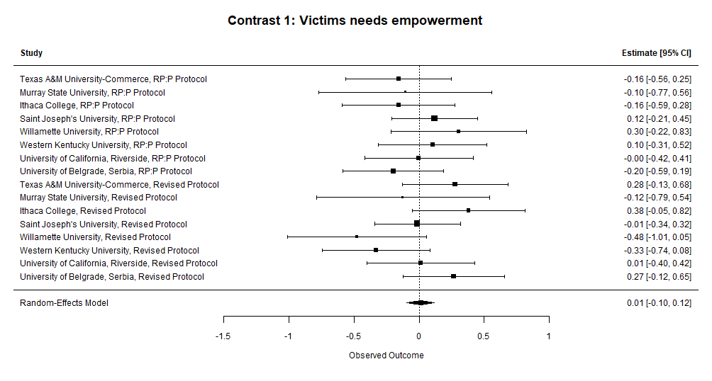
Results
Heterogeneity was low
(I² = 5.15%).
Conceptually-relevant (protocol types) and conceptually-irrelevant context (b, d and e) failed to explain ES heterogeneity.
The victims effect failed to replicate regardless of context.

Slide 9
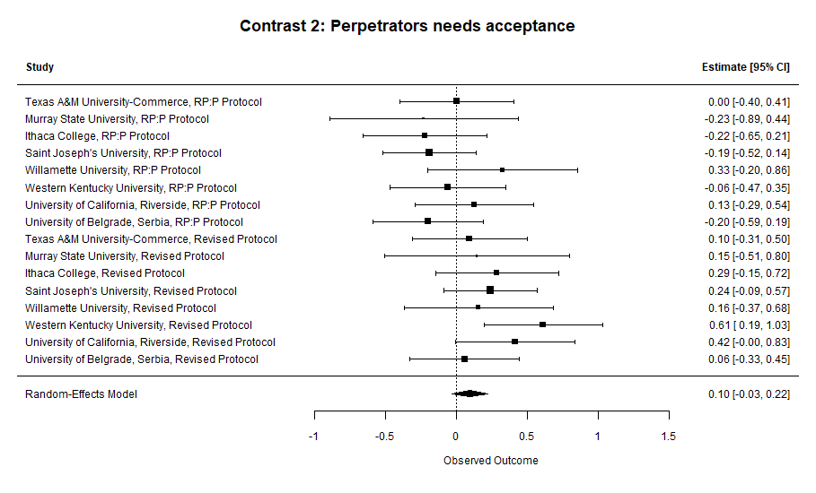
Results
Heterogeneity was moderate (I² = 25.67%).
Conceptually-irrelevant context (b, d and e) failed to explain ES heterogeneity, but protocol types significantly moderated the ES (B = 0.32, p = .002) and explained the heterogeneity entirely (R² = 100%).

Slide 10
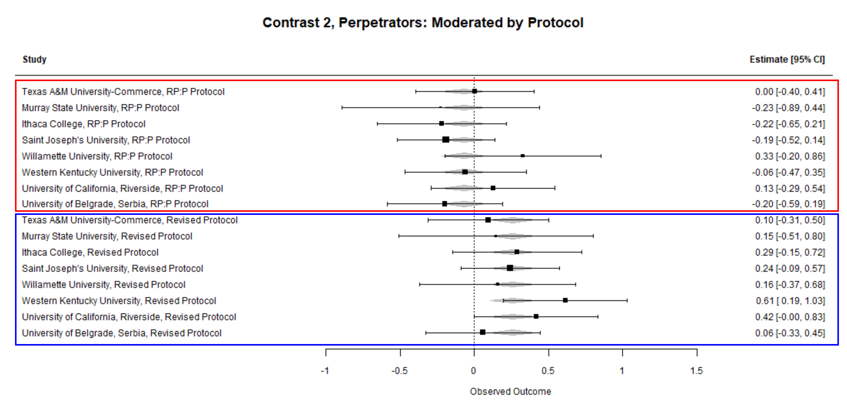
Results
ML5 samples that used original protocol led to more random ES, while the ES from revised protocol were consistently positive.
The perpetrator effect replicated depending on the protocol used.

Slide 11
Takeaways and what’s next?
We didn’t find evidence that conceptually-irrelevant context (b, d and e) can explain ES heterogeneity.
…but find a bit of evidence that conceptually-relevant context (protocol types) did explain ES heterogeneity.
  Maybe the need of acceptance for perpetrators are more pronounced in certain types of interpersonal (e.g., roommates) relationships but not in others (e.g., professional relationship in a workplace setting)?
How do we proceed from here?

