Slide 1

Challenging Religious Sectarianism Social Psychology Perspective
Rizqy Amelia Zein
Departemen Psikologi Kepribadian dan Sosial
Fakultas Psikologi Universitas Airlangga

Slide 2

Basic concepts (Hall, Matz, & Wood, 2010)
A meta-analytic study concerning on the relation between religiosity and racial prejudice identified several themes, such as;
Religious group identification
Religious affiliation as a firm boundary between ‘us’ and ‘them’
The discourse including the salience of religious identity
Are stronger religious identity linked to outgroup derogation?
Values enticing racial prejudice [conformity and tradition]
Fundamentalism → unquestioning, unwavering certainty in basic religious doctrines
Extrinsic religiosity → Extrinsically religious implies externally motivated rituals, desires for social status, security & acceptance from others (Allport & Ross, 1967)
Values promoting tolerance [benevolence and selflessness]
Humanitarianism
Intrinsic religiosity → people with intrinsic religiosity may appear more tolerant, but indirect measure shows its counterpart (Burris & Jackson, 2000).

Slide 3
…cont’d
According to the study, most previous research concluded greater religious identification, greater extrinsic religiosity, greater fundamentalism were associated with racism, while greater intrinsic religiosity was associated with tolerance.
There is a serious problem in measuring religiosity
Most research mostly used frequency of church attendance to measure religious motives
People who occasionally attend the mass indicates that they are extrinsically motivated for social benefit, while the regulars were thought to be intrinsically motivated
I argue that religious extremism are not different from any other ideology extremity
Underlying mechanism is completely similar
To some extent, I believe that ‘power struggle’ might be a crucial contributing factor in explaining extremism

Slide 4
Why do people become sectarian?
There are a number of research concerning on that question and addressed several determinants that may be connected to sectarianism, some of which are;
Genes
Brain structures
Social influences
Salient social identity
Personality
Power struggle (politicized) identity politics may also explain why people hold strong, if not extreme, political/social attitudes

Slide 5
Biopsychology perspective
A small component of our social attitudes is passed through our genes, including political attitudes and ethnocentrism (Barlow, Sherlock, & Zietsch, 2017)
A Minnesota Twins Political Survey (Orey & Park, 2012) showed that 18% of the variance of ethnocentrism was accounted from genetic factors
Another study in Germany (Kandler, et al., 2015) demonstrated that 38% general prejudice variance was accounted from genes
However, most twin studies have small effect that are only detectable by using a large sample size
Certain parts of our brain are also responsible… (Amodio, 2014)
Amygdala → triggering threat response to certain ‘threatening’ outgroups; flight of fight responses
Orbital frontal cortex → social cues function
Insula → somatosensory states (visceral responses of emotional states → disgust)

Slide 6
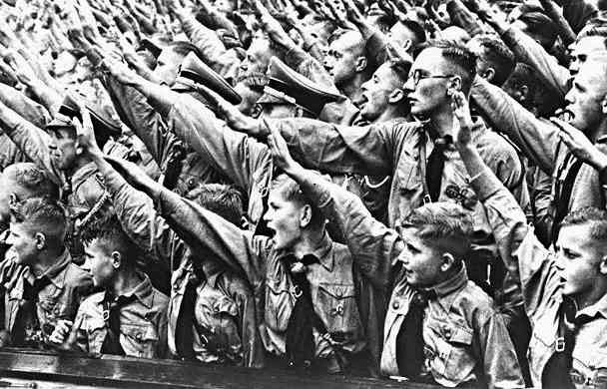
Social influences
Why Germans were so obedient to Hitler? What made them to voluntarily participate in genocide?
Agency vs agentic state
Banality of evil (Arendt, 1963)
Milgram’s experiment (1974)
“…people can help but obey orders from an authority..”

Slide 7
Can identity be overlapped?
Tajfel’s (1982) social identity theory (SIT) is capable to accommodate personal and social features of social identity, yet is unable to explain the ambiguity of identity
People belong to a number of different groups and therefore have more than one identity which all of those may be equally salient and mutually compatible in shaping intergroup behaviour (Billig, 1995; Liu, Lawrence, Ward, & Abraham, 2002).
SIT assumes that “at any moment, categorization at one level of identity, suppress identity at another level,” or later called as principle of functional antagonism (Liu et al., 2002, p. 4; Tajfel, 1982).
Overcoming the problem, social identity complexity (SIC, Roccas and Brewer (2002)), provides a more satisfying picture about multiple social identities as the consequence of individuals’ identification to more than one social group (Brewer, Gonsalkorale, & van Dommelen, 2012; Roccas & Berlin, 2016)

Slide 8
…cont’d
It is possible that individuals possess multi-layered social identities and how individuals define their ingroups can include a certain degree of overlap; those may be entirely embedded to each other, when some of those are completely orthogonal, yet most of the time those are only slightly coincided (Brewer et al., 2012; Prati, Crisp, Pratto, & Rubini, 2016; Roccas & Berlin, 2016; Roccas & Brewer, 2002).
When a high degree of ambiguity exists or, to put it another way, two or more social identities are only slightly overlap, group identification becomes even more complex (Hohman, Dahl, & Grubbs, 2016; Roccas & Brewer, 2002).
SIC has a very little to offer when it comes to integrating social and political circumstances of national/religious identification. SIT and SIC comprise a fragile argument that assumes the elements of identification are not different across various types of social groups (Roccas & Berlin, 2016).

Slide 9
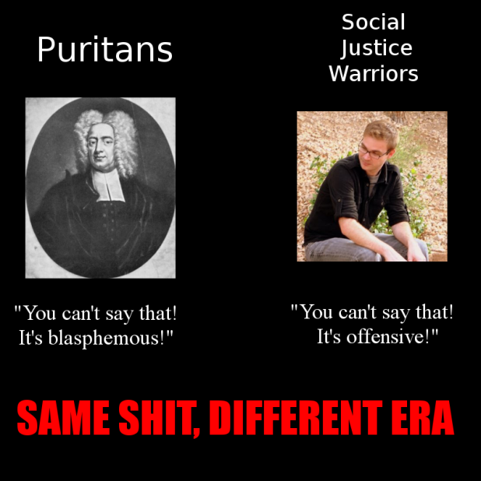
Personality
Right-wing authoritarianism (vs left-wing authoritarianism)
“A threat-driven attitudinal expression of the values or motivational goals of collective security, control, stability and order..” (Duckitt & Sibley, 2017)
LWA → authoritarian tendency in left-wing/liberal people (Conway, et al., 2017)
Fascist vs SJW
Social dominance orientation (SDO)
“A competition-driven attitudinal expression of the values and motivational goals of power, dominance, and superiority…” (Duckitt & Sibley, 2017)
Big Five personality
RWA was predicted by low Openness (strong) and higher Conscientiousness (weak)
SDO was predicted by low Agreeableness (strong)

Slide 11
The good, the bad, and the deadly (Iannaccone & Berman, 2006)
“…where governments and economies function poorly, sects often become major suppliers of social services, political action, and coercive force”
If theology strictness is important, why terrorist groups are ironically not religious?
Why ISIS bombed school, hospital, etc? Why are they so evil?
And conversely, why extreme religious sects devote their energy to benign and noble activities?
Iannaccone & Berman argue “the internal logic and social foundations of religious extremism are much the same, regardless the goals are good, bad or deadly”
Embedding comprehension that religious behavior is a rational (normal, reasonable) choice will foster a new direction in comprehending religious extremism, while seeing it as deviance, ignorance, even a form of psychopathology will lead us to misunderstanding

Slide 12
…cont’d
Why religious behavior is seen as rational choice?
Rational individuals will seek to understand and influence the supernatural to the extent that they remain uncertain of its non-existence
A good combination of social service provision, political representation, and nondiscriminatory treatment of religious denominations are more likely to reduce the ‘urges’ of more violent interventions

