Slide 1

How to write a Policy Brief
Community Mental Health
Faculty of Psychology Airlangga University

Slide 2

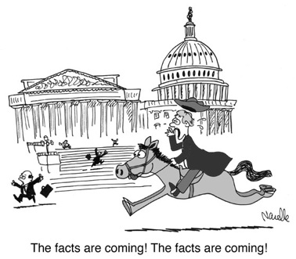
Outline
Planning your policy brief
Policy brief template
Checking your policy brief

Slide 3

Planning your policy brief
What is a policy brief?
A short document that presents the findings and recommendations of a research project to a non-specialized audience
A medium for exploring an issue and distilling lessons learned from the research
A vehicle for providing policy advice.
A policy brief is:
A stand alone document
Focused on a single topic
No more than 2-4 pages (1,500 words)

Slide 4
Audience
Who are your readers?
Who am I writing this brief for?
How knowledgeable are they about the topic?
How open are they to the message?
How can I reach the readers?
What questions need answers?
What are their interests, concerns?
What does it take to reach specific readers such as media or decision-makers?
Using the power of persuasion
Answer the question “What value does this have for me?”
Describe the urgency of the situation
Speak in terms of benefits and advantages

Slide 5
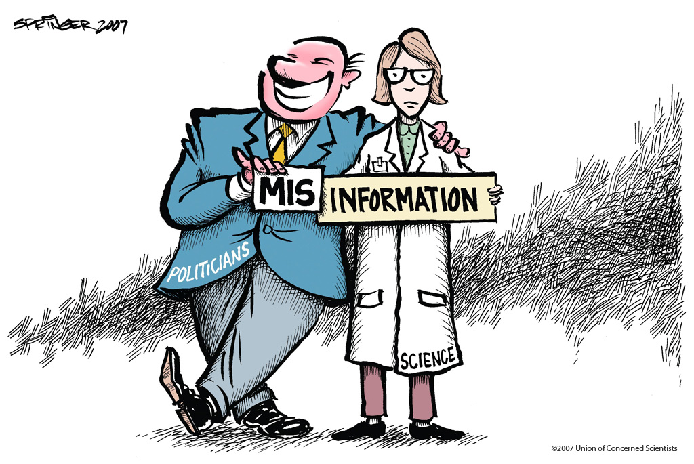
Policy brief template
Executive Summary
Introduction
Approaches and Results
Conclusion
Implications and Recommendations

Slide 6
Lead with a short statement
The executive statement will:
Distil the essence of the brief
Provide an overview for busy readers
Entice readers to go further
Appear on cover or top of first page
Be written last

Slide 7
Introduction
Answers the question why
Explains the significance/urgency of the issue
Describes research objective
Gives overview of findings, conclusions
Creates curiosity for rest of brief

Slide 8
Introduction – Example

Slide 9
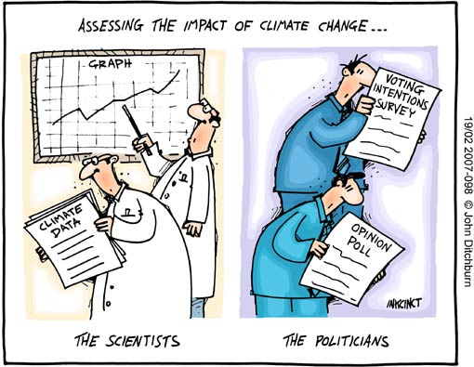
Approaches & result
Provides summary of the facts
Describes issue and context
Describes research and analysis
Should not be overly technical
Highlight benefits, opportunities

Slide 10
Approaches
Result: What did we learn?
Explains how study conducted
Relates who conducted study
Describes relevant background
Identifies method used to collect data
Make content easy to follow
Start by painting a general picture
Move from general to specific
Base conclusions on results

Slide 11
Result – Example

Slide 12
Conclusion
Use section to interpret data
Aim for concrete conclusions
Express ideas using strong assertions
Ensure ideas are balanced and defensible
If hypothesis abandoned, say why

Slide 13
Conclusion – Example

Slide 14
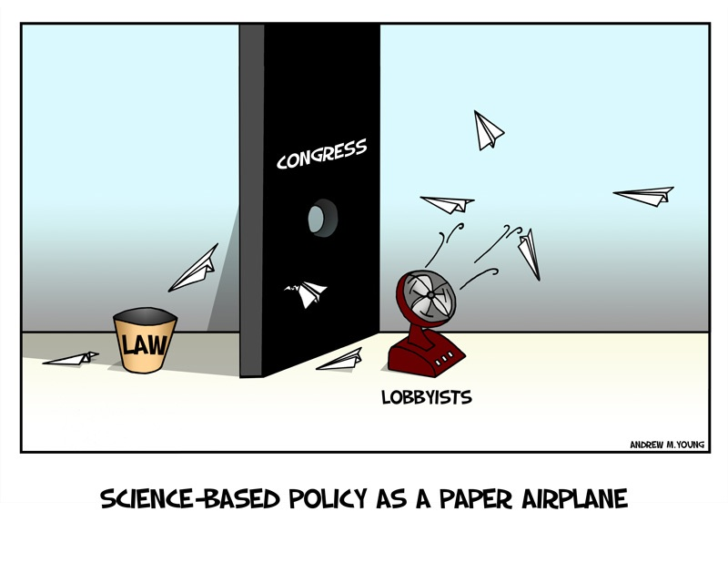
Implication & recommendation
Implications are what could happen
Recommendations are what should happen
Both flow from conclusions
Both must be supported by evidence

Slide 15
Implication: If…then…
Describe what researcher thinks will be the consequences
Less direct than recommendations
Useful when advice not requested
Softer approach but still can be persuasive

Slide 16
Recommendation: a call to action
Describe clearly what should happen next
State as precise steps
Ensure they are relevant, credible and feasible

Slide 17
Think ahead and look back…
Conduct a 20-second test – what stood out?
Try to make more user friendly
Go on a jargon hunt
Don’t overuse statistics
Check arguments, proof, persuasion
Build a Q & A (FAQ like) package

