Slide 1
MMA 869 Machine Learning & AI Session 3: Evaluating Classifiers
Nasrin Yousefi

Slide 2
Reminder: Machine Learning Terminology
Features
(inputs, independent variables, X, columns)
Target or Label
(response, output, dependent variable, Y)
Age | Income | Married | Citizenship | Default
55 | 36,765 | Yes | Canada | Yes
66 | 87,983 | Yes | Canada | Yes
21 | 24,354 | No | USA | No
24 | 56,654 | Yes | Canada | No
34 | 98,324 | No | UK | No
36 | 132,229 | No | Germany | Yes
28 | 35,000 | Yes | Canada | No
49 | 50,334 | Yes | Canada | No
Instances
(rows, cases, records)

Slide 3

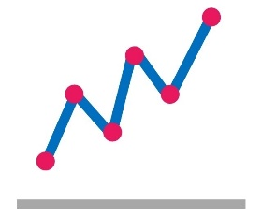

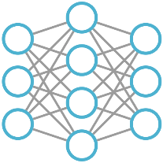


The Analytics Process: CRISP-DM
Business Understanding
Understand the business operations and customer experience
Data Exploration
Understand the data available and how it is related
Data Preparation
Organize and clean the data
Analysis / Modeling
Conduct the analysis using the appropriate techniques
Evaluation
Interpret the results within the business context
Deployment
Integrate the findings/model into the business decisions or processes
Notes:
CRISP-DM: CRoss-Industry Standard Process for Data Mining

Slide 4
In More Detail
Data Preparation
Organize and clean the data
Analysis / Modeling
Conduct the analysis using the appropriate techniques
Cleaning
Outliers
Missing data
Data types
Inconsistencies
Feature Engineering
Normalization
Discretization
Coding
Temporal, text, image
Feature Selection
Filter
Wrapper
Model Training
Algorithms
Ensembles
Hyperparameter tuning
Model Selection/ Evaluation
Performance metrics Cross validation

Slide 5
Performance Metrics

Slide 6
Performance Metrics
How good are a model's predictions?
testing data
predictions
model
Compare using metric:
Regression
Mean Squared Error
Mean Absolute Error
Root Mean Squared Error
Classification
Accuracy/Error
Precision, Recall
F1 score
Sensitivity, Specificity
ROC Curve and AUC
Log Loss
Recommendation
Mean Average Precision @ K
Coverage
Personalization
Intra-list similarity

Slide 7
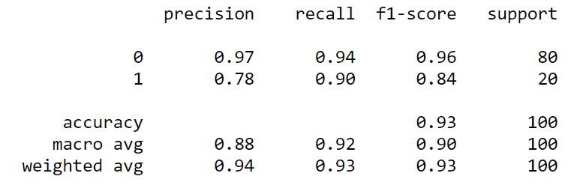
Classification Report
Scikit-learn has a function classification_report():
What do all these numbers mean? Which is most important?

Slide 8
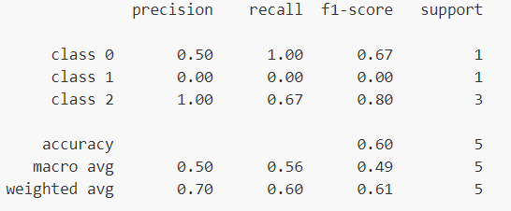
Multi-class Metrics
The same, just more of them

Slide 9
Classification Metrics
A model's predictions might be right or wrong, in two different ways each.
Predicted Target
Yes
Yes
No
No
Yes
No
No
Truth Target
Yes
No
No
Yes
Yes
Yes
No
True Positive (TP)
False Positive (FP) – Type I error
True Negative (TN)
False Negative (FN) – Type II error
…
compare

Slide 10
Exercise
Mark each of the following as TP, TN, FP, or FN
Predicted Target
Yes
Yes
No
No
Yes
No
No
Truth Target
Yes
No
Yes
No
Yes
Yes
No
TP
FP
FN
TN
TP
FN
TN

Slide 11
Confusion Matrix
Confusion matrix: a table comparing predictions against truth
Predicted Target
Yes
Yes
No
No
Yes
No
No
Truth Target
Yes
No
Yes
No
Yes
Yes
No
Predicted
TP
FP
 | Yes | No
Yes | 2 | 2 | 4
No | 1 | 2 | 3
 | 3 | 4 | 7
FN
TN
Truth
TP
FN
TN
2 TP
2 FN
1 FP
2 TN

Slide 12


Accuracy
Accuracy: percentage of instances that are classified correctly
1-Accuracy = Error
$$\text{Accuracy}= \frac{TP+TN}{TP+TN+FP+FN}$$
Predicted
Predicted
 | Yes | No
Yes | 15 | 5 | 20
No | 5 | 75 | 80
 | 20 | 80 | 100
 | Yes | No
Yes | 10 | 10 | 20
No | 30 | 50 | 80
 | 40 | 60 | 100
Truth
Truth
0.90
0.60
$$\text{Accuracy}= ?$$
$$\text{Accuracy}= ?$$

Slide 13


Accuracy is Usually a Bad Choice
Most datasets are imbalanced
Which model is better?
Model 1
Model 2
Predicted
Predicted
 | Yes | No
Yes | 0 | 10 | 10
No | 0 | 990 | 990
 | 0 | 1000 | 1000
 | Yes | No
Yes | 9 | 1 | 10
No | 9 | 981 | 990
 | 18 | 982 | 1000
Truth
Truth
$$\text{Accuracy}= \frac{990}{1000}=.99$$
$$\text{Accuracy}= \frac{990}{1000}=.99$$

Slide 14


Accuracy is Usually a Bad Choice
Assumes the costs of FPs and FNs are equal
Which model is better for detecting a deadly disease?
Model 1
Model 2
Predicted
Predicted
 | Yes | No
Yes | 80 | 0 | 100
No | 20 | 100 | 100
 | 100 | 100 | 200
 | Yes | No
Yes | 80 | 20 | 100
No | 0 | 100 | 100
 | 80 | 120 | 200
Truth
Truth
$$\text{Accuracy}= \frac{180}{200}=.90$$
$$\text{Accuracy}= \frac{180}{200}=.90$$
Notes:
For example, when a doctor makes a medical diagnosis that a patient has cancer when he doesn't (known as a false positive) has very different consequences than making the call that a patient doesn't have cancer when he does (a false negative).
Left – model never predicts yes – will never catch anyone with cancer!
Right – model makes a lot of false negatives – no good!

Slide 15
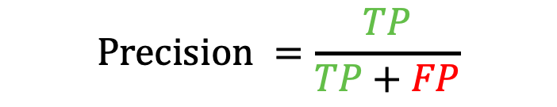


Precision
Precision: percentage of "yes" predictions that are correct
Also known as positive predictive value
Does model make precise "yes" predictions?
$$\text{Precision} =\frac{TP}{TP+FP}$$
Predicted
Predicted
 | Yes | No
Yes | 15 | 5 | 20
No | 0 | 80 | 80
 | 15 | 85 | 100
 | Yes | No
Yes | 15 | 5 | 20
No | 5 | 75 | 80
 | 20 | 80 | 100
Truth
Truth
$$\text{Precision}= ?$$
$$\text{Precision}= ?$$

Slide 16
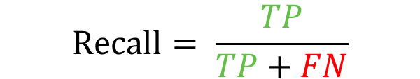


Recall
Recall: percentage of truth "yes" were correctly predicted as "yes"
Also known as true positive rate or sensitivity
Does model detect the most disease carriers?
$$\text{Recall}= \frac{TP}{TP+FN}$$
Predicted
Predicted
 | Yes | No
Yes | 20 | 0 | 20
No | 5 | 75 | 80
 | 25 | 75 | 100
 | Yes | No
Yes | 15 | 5 | 20
No | 0 | 80 | 80
 | 15 | 85 | 100
Truth
Truth
$$\text{Recall}= ?$$
$$\text{Recall}= ?$$
Notes:
R = 100%
R = 75%

Slide 17
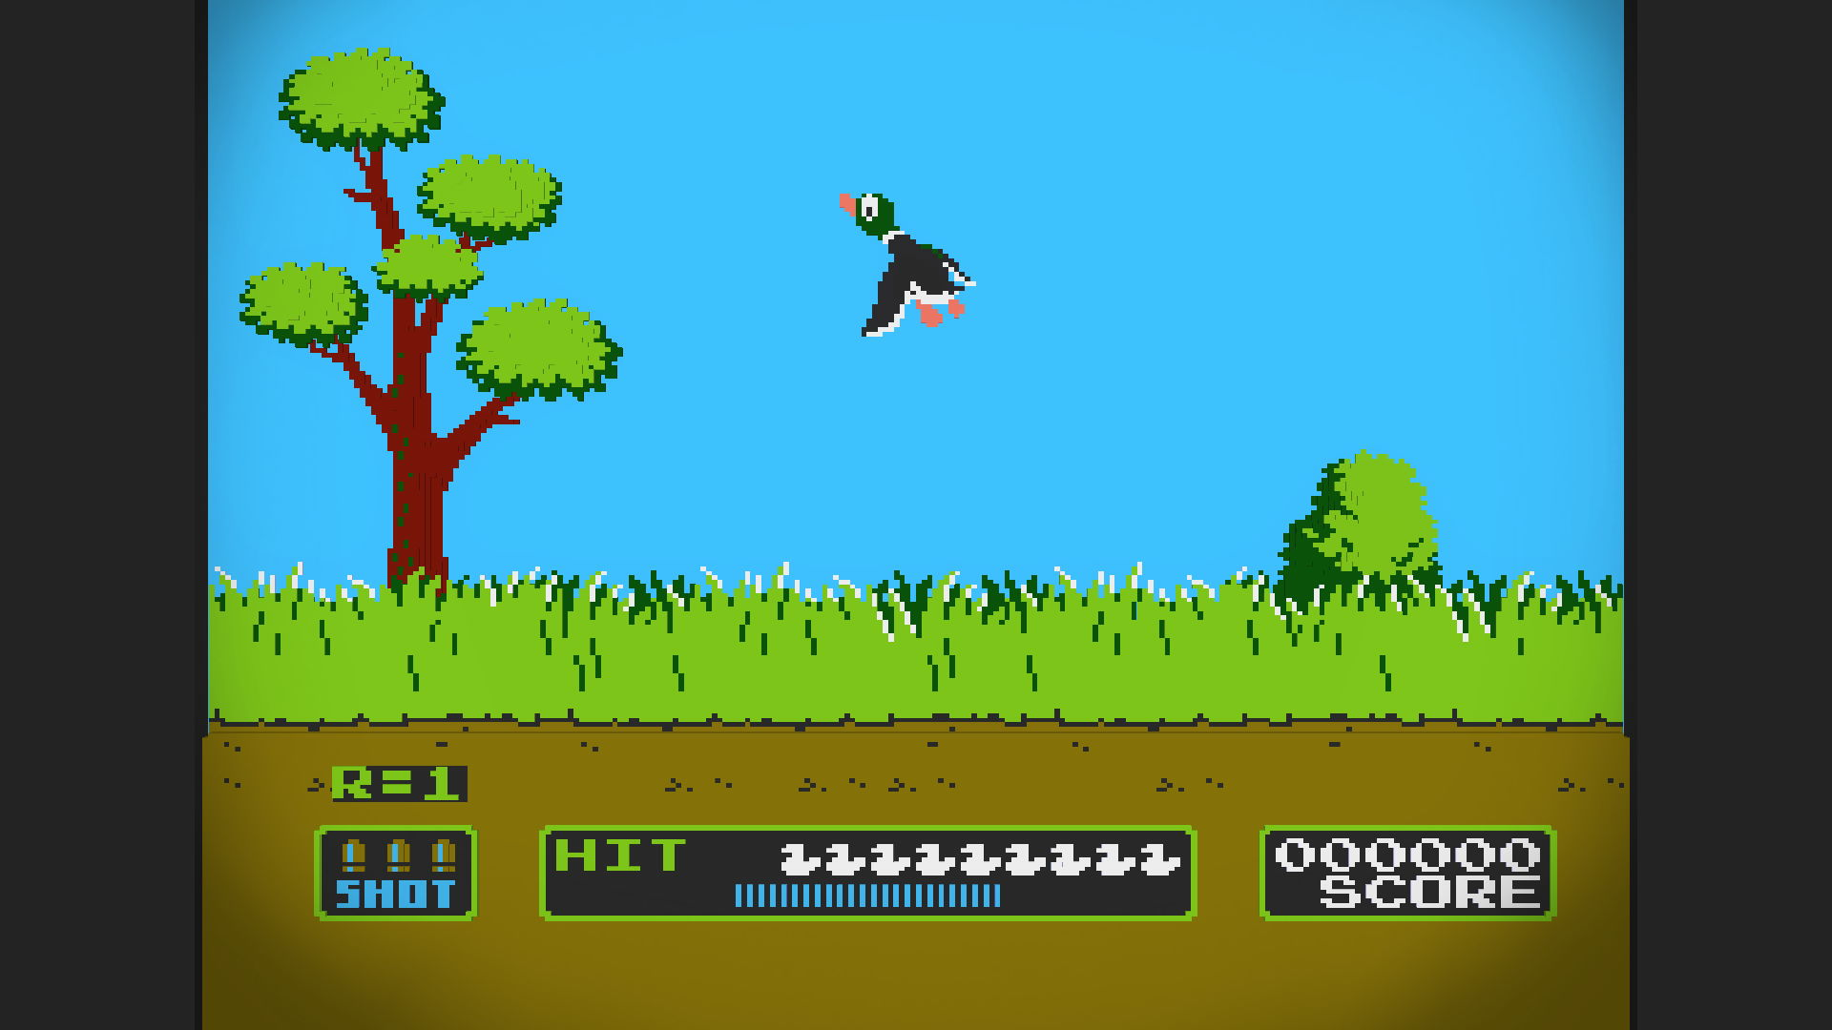
Example: Duck Hunt
High precision = ???
High recall = ???
High precision and recall = ???

Slide 18
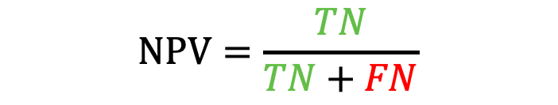


NPV: "Precision of no"
Negative Predictive Value: percentage of "no" predictions that are correct
$$NPV=\frac{TN}{TN+FN}$$
Predicted
Predicted
 | Yes | No
Yes | 15 | 5 | 20
No | 0 | 80 | 80
 | 15 | 85 | 100
 | Yes | No
Yes | 15 | 5 | 20
No | 5 | 75 | 80
 | 20 | 80 | 100
Truth
Truth
$$\text{N}PV= ?$$
$$NPV= ?$$

Slide 19
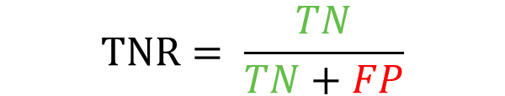


TNR: "Recall of no"
True Negative Rate: percentage of truth "no" were correctly predicted as "no"
Also known as specificity
$$\text{T}\text{NR}= \frac{TN}{TN+FP}$$
Predicted
Predicted
 | Yes | No
Yes | 20 | 0 | 20
No | 5 | 75 | 80
 | 25 | 75 | 100
 | Yes | No
Yes | 15 | 5 | 20
No | 0 | 80 | 80
 | 15 | 85 | 100
Truth
Truth
$$\text{TNR}= ?$$
$$\text{T}\text{NR}= ?$$
Notes:
R = 100%
R = 75%

Slide 20


F₁ Score
F₁ Score: Harmonic mean between precision and recall
$${\text{F}}_{1}=\frac{2×\text{Precision}×\text{Recall}}{\text{P}\text{recision}+\text{Recall}}$$
Predicted
Predicted
 | Yes | No
Yes | 18 | 2 | 20
No | 2 | 78 | 80
 | 20 | 80 | 100
 | Yes | No
Yes | 80 | 20 | 100
No | 80 | 120 | 200
 | 160 | 140 | 300
Truth
Truth
$${\text{F}}_{1}= ?$$
$${\text{F}}_{1}= ?$$
Notes:
P=.90, R=.90,F1=.90
P=.83,R=.5,F1=.62
Why the harmonic mean?
The harmonic mean of two numbers tends to be closer to the smaller of the two.
For F₁-value to be large, both p and r must be large.

Slide 21
Exercise
Predicted
 | Yes | No
Yes | 300 | 100 | 400
No | 20 | 580 | 600
 | 320 | 680 | 1000
Truth
Accuracy = ?
Precision = ?
Recall = ?
NPV (Precision of No) = ?
TNR (Recall of No) = ?
Notes:
88
93.7
75
85.3
96
Sensitivity = 300 / 400 = 75%
Specificity = 580 / 600 = 97%.
This model is very specific. Why? There were 600 no cases, and it correctly predicted no 580 (97%) of those.

Slide 22



Per-class, Macro, and Weighted
Predicted
$$\text{Precision}=\frac{18}{23}=0.78$$
 | Yes | No
Yes | 18 | 2 | 20
No | 5 | 75 | 80
 | 23 | 77 | 100
$$\text{Recall}= \frac{18}{20}=0.90$$
Truth
$${\text{F}}_{1}=\frac{2 ∗\text{0.78} ∗\text{0.90}}{\text{0.}78+\text{0.90}}=0.84$$
 | Precision | Recall | F1 Score | Support
Yes | 0.78 | 0.90 | 0.84 | 20
No | 0.97 | 0.94 | 0.96 | 80
Macro Avg | 0.88 | 0.92 | 0.90 | 100
Weighted Avg | 0.94 | 0.93 | 0.93 | 100
NPV
TNR
Notes:
Micro is just another name for accuracy

Slide 23
Decision Threshold
Most classifiers predict a probability between [0, 1]
We turn into a "yes" or "no" decision by using a threshold
E.g., threshold = 0.5
Truth target
Yes
Yes
No
No
Yes
Yes
Yes
Predicted Prob.
0.67
0.21
0.11
0.01
0.98
0.78
0.45
Predicted target
Yes
No
No
No
Yes
Yes
No
By changing the threshold value, we can trade-off precision and recall

Slide 24
Decision Threshold Trade-off
Example: Marketing campaign
Selling cars with profit of $5K/each
Want to snail-mail brochures to potential customers ($5/each)
Model predicts which customers will respond to offer
Yes = will buy car
No = will not buy car
If model predicts yes, then you will send brochure to customer
Which threshold is better?
Threshold = 0.30
Threshold = 0.70
Predicted
Predicted
 | Yes | No
Yes | 176 | 24 | 200
No | 153 | 647 | 800
 | 329 | 671 | 1000
 | Yes | No
Yes | 89 | 111 | 200
No | 19 | 781 | 800
 | 108 | 892 | 1000
Truth
Truth
Precision | = | 53%
Recall | = | 88%
Precision | = | 82%
Recall | = | 45%

Slide 25
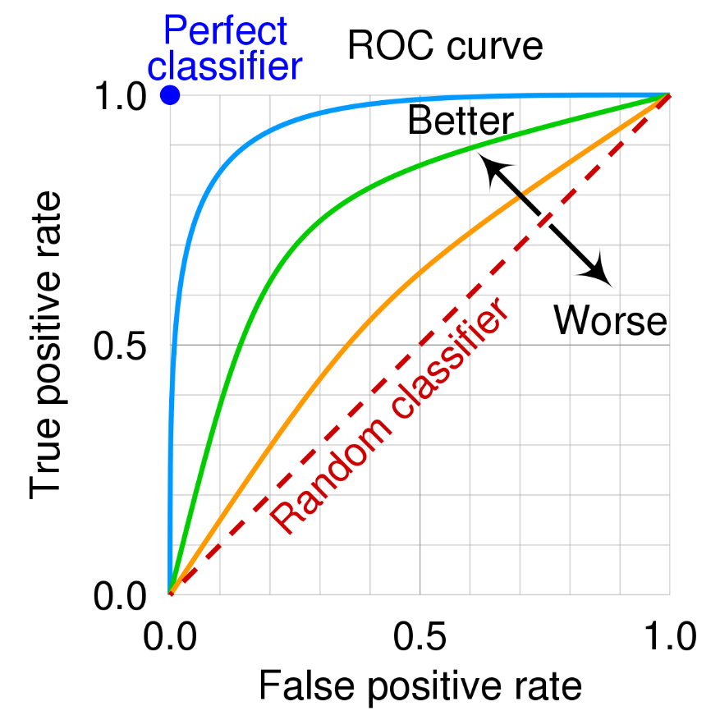
ROC Curve
ROC Curve: a graphical plot that simultaneously displays two metrics (i.e., TPR and FPR) for many different threshold values
Recall
1 – TNR (Recall of 0)
Shows recall (aka TPR) against the FPR (i.e., 1 – TNR)
Each point is calculated by choosing a different threshold
Notes:
Source: https://en.wikipedia.org/wiki/Receiver_operating_characteristic#/media/File:Roc_curve.svg
The name "ROC" is historic, and comes from communications theory. It is an acronym for receiver operating characteristics.
The ROC curve shows the sensitivity of the classifier by plotting the rate of true positives to the rate of false positives (see Figure 2-2). In other words, it shows you how many correct positive classifications can be gained as you allow for more and more false positives. The perfect classifier that makes no mistakes would hit a true positive rate of 100% immediately, without incurring any false positives—this almost never happens in practice.

Slide 26
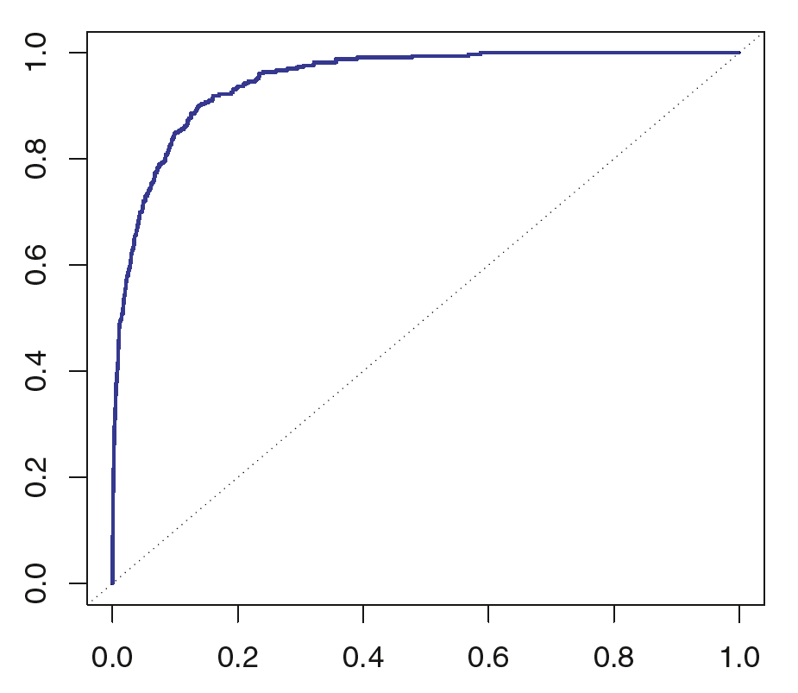
Drawing the ROC Curve
Model 1
Thresholds
 |  |  | Truth target | Prob.
 |  |  | Yes | 0.67
 |  |  | Yes | 0.21
 |  |  | No | 0.11
 |  |  | No | 0.01
 |  |  | Yes | 0.98
 |  |  | No | 0.78
 |  |  | Yes | 0.45
 |  |  | Yes | 0.53
 |  |  | No | 0.40
 |  |  | Yes | 0.60
0.0
Yes
Yes
Yes
Yes
Yes
Yes
Yes
Yes
Yes
Yes
100%
100%
0.2
Yes
Yes
No
No
Yes
Yes
Yes
Yes
Yes
Yes
50%
100%
0.4
Yes
No
No
No
Yes
Yes
Yes
Yes
Yes
Yes
50%
83%
0.5
Yes
No
No
No
Yes
Yes
No
Yes
No
Yes
25%
67%
0.6
Yes
No
No
No
Yes
Yes
No
No
No
Yes
25%
50%
0.8
No
No
No
No
Yes
No
No
No
No
No
0%
17%
1.0
No
No
No
No
No
No
No
No
No
No
0%
0%
TPR
FPR
FPR:
TPR:
Notes:
Note: thresholds of 0.0 never make sense!

Slide 27
Drawing the ROC Curve
Model 2
Thresholds
 |  |  | Truth target | Prob.
 |  |  | Yes | 0.96
 |  |  | Yes | 0.80
 |  |  | No | 0.11
 |  |  | No | 0.05
 |  |  | Yes | 0.98
 |  |  | No | 0.40
 |  |  | Yes | 0.30
 |  |  | Yes | 0.89
 |  |  | No | 0.40
 |  |  | Yes | 0.75
0.0
Yes
Yes
Yes
Yes
Yes
Yes
Yes
Yes
Yes
Yes
100%
100%
0.2
Yes
Yes
No
No
Yes
Yes
Yes
Yes
Yes
Yes
50%
100%
0.4
Yes
Yes
No
No
Yes
Yes
No
Yes
Yes
Yes
50%
83%
0.5
Yes
Yes
No
No
Yes
No
No
Yes
No
Yes
0%
83%
0.6
Yes
Yes
No
No
Yes
No
No
Yes
No
Yes
0%
83%
0.8
Yes
Yes
No
No
Yes
No
No
Yes
No
No
0%
67%
1.0
No
No
No
No
No
No
No
No
No
No
0%
0%
TPR
FPR
FPR:
TPR:
Notes:
Note: thresholds of 0.0 never make sense!

Slide 28
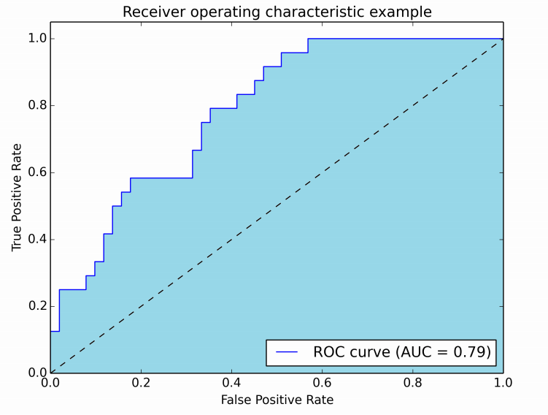
Area Under Curve (AUC)
ROC plots are cool, but a single number is really cool
Easier to compare two classifiers
Just like the F₁ Score combines Precision and Recall
AUC is the area under the ROC curve
1.0: perfect prediction
0.9: excellent prediction
0.8: good prediction
0.7: mediocre prediction
0.6: poor prediction
0.5: random prediction
< 0.5: something wrong!
Notes:
Image source: https://stats.stackexchange.com/questions/132777/what-does-auc-stand-for-and-what-is-it

Slide 29
Other Metrics (Not Covered Today)
Log Loss
Balanced Accuracy
Brier Score
Prevalence threshold
Informedness
Matthews Correlation Coefficient
Threat score
…

Slide 30
Terminology is Hard
Predicted Condition
Positive, Condition Positive
Predicted
Negative, Condition Negative
TP, hit
 | Yes | No
Yes | 18 | 2 | 20
No | 5 | 75 | 80
 | 23 | 77 | 100
FN, type II error, miss
Actual Condition,
True Condition
Actual
TN, Correct rejection
FP, type I error, No alarm
Total Population
 | Precision | Recall | F1 Score | Support
Yes | 0.78 | 0.90 | 0.84 | 20
No | 0.97 | 0.94 | 0.96 | 80
Macro Avg | 0.88 | 0.92 | 0.90 | 100
Weighted Avg | 0.94 | 0.93 | 0.93 | 100
NPV
FOR
FDR
Precision, PPV
FPR
Specificity, TNR
Recall, Sensitivity, hit rate, TPR
FNR
Notes:
Micro is just another name for accuracy

Slide 31
Careful About Axes Orientation!
These slides
Predicted
scikit-learn
Predicted
 | Yes | No
Yes | 30 | 2
No | 11 | 24
 | No | Yes
No | 24 | 11
Yes | 2 | 30
Truth
Truth
Truth
Truth
 | Yes | No
Yes | 30 | 11
No | 2 | 24
 | No | Yes
No | 24 | 2
Yes | 11 | 30
Predicted
Predicted

Slide 32
KCU’s Churn Prediction Model
Current situation:
2,000 customers
5% churn per month
Each churn costs an average of $400
Cost of current situation: 100*$400 = $40,000
Churn prediction model:
If model predicts Yes, will offer 20% discount offer
Average cost of $50
Assume everyone accepts offer
Current model has below confusion matrix
How much does the model save them per month?
Predicted
Predicted
Predicted
 | Yes | No
Yes | 90 | 10 | 100
No | 285 | 1615 | 1900
 | 375 | 1625
 | Yes | No
Yes | $50 | $400
No | $50 | -
 | Yes | No
Yes | $4,500 | $4,000
No | $14,250
=
⊙
Truth
Truth
Truth
Confusion Matrix
Cost Matrix
Cost per transaction
Total Cost
$22,750
Notes:
Element-wise multiplication

Slide 33
KCU's Model to Predict Fraudulent Transactions
Assume:
10,000 transactions per month
1% of transactions are fraudulent
Each fraudulent transaction costs $10,000
It costs $100 to investigate potentially fraudulent transactions
What is the cost of fraudulent transactions now (without model)?
KCU builds a model with below confusion matrix
If predicts Yes = Fraud, then investigate
If predicts No = Not Fraud, then don't investigate
How much money does model save per month?
Predicted
Predicted
Predicted
 | Yes | No
Yes | 76 | 24
No | 1485 | 8415
 | Yes | No
Yes
No
 | Yes | No
Yes
No
=
⊙
Truth
Truth
Truth
Confusion Matrix
Cost Matrix
Cost per transaction
Total Cost
Notes:
Element-wise multiplication

Slide 34
Resources – Performance Metrics
Coding Tutorial Files
slides_performance.ipynb

Slide 35
Summary - Table of Performance Metrics
Metric (Inverse) | Summary | Good when you want:
Accuracy (Error) | % of predictions that are correct | Simplicity, have balanced data and equal costs between FP and FN
Precision/PPV (FDR) | % of "yes" predictions that are correct | To measure how precise with "yes" the model is
NPV | % of "no" predictions that are correct | To measure how precise with "no" the model is
Recall/Sensitivity/TPR (FNR) | % of "yes" cases that were predicted as "yes" | To measure if the model misses any "yes"s
TNR/Specificity | % of "no" cases that were predicted as "no" | To measure if the model misses any "no"s
F1 Score | Harmonic mean of precision and recall | An overall measure of model performance
ROC Curve | Shows TPR vs FPR for all possible threshold values | An overall measure of model performance
AUC | Measures area under ROC curve | An overall measure of model performance
Log Loss | Like accuracy, but takes into account how right or wrong the predictions are | To penalize models for being very wrong
Recall/Sensitivity/TPR(FNR)
Predicted
Accuracy
(Error)
 | Yes | No
Yes | 18 | 2 | 20
No | 2 | 78 | 80
 | 20 | 80 | 100
Specificity/TNR
(FPR)
Truth
Precision/PPV
(FDR)
NPV
(FOR)
Notes:
False Omission Rate (FOR)

Slide 36
Cross-Validation

Slide 37
Outline
How to estimate a model's future performance?
How well does it generalize to new, unseen data?
How to choose the best model (out of many candidates)?
Answer: Cross-Validation

Slide 38
Why Cross-Validation?
When we have dozens of candidate models:
Some will overfit
Some will underfit
Some will be terrible
Some will be great
CV gives an accurate/robust estimate of F₁ score on unseen data
"A resampling technique for estimating model performance"

Slide 39
Model Validation Methods
K-fold Cross-Validation
Holdout Method
Repeated Holdout / Shuffle Split
Repeated K-fold Cross-Validation
Leave One Out
Generalized Cross-Validation
Bootstrapping
Recommended
Also good

Slide 40
Just Use All the Data to Find F₁ Score!
compare
max_depth=4
DT
Model 1
F1 Score = 75%
F1 Score = 79%
entire data
SVM
Model 2
C=0.6
Doesn't work! Why?
Notes:
Not a real test
No way to tell if model has overfit the training data.
No way to tell if model generalizes to future, unseen data
It's like in a Math class, if the teacher showed the students 2+2=4, and then the test only asks 2+2. Not sure if students really understand addition, or just memorized the one question.

Slide 41
K-Fold Cross Validation
Randomly split the data into K "folds" (i.e., subsets)
K times:
Set one fold for validation
Set all other folds for training
Train the model like normal, evaluate predictions like normal
training
fold 1
hyperparams
fold 2
algorithm
fold 3
validation
model
F1 Score = 0.78
fold 4
predictions
data
compare

Slide 42
K-Fold Cross Validation
Do the same thing, with the next fold as validation.
F1 Scores = [.78, .80]
training
fold 1
hyperparams
fold 2
algorithm
fold 3
validation
model
F1 Score = 80%
fold 4
predictions
entire
data
compare

Slide 43
K-Fold Cross Validation
Do the same thing, with the next fold as validation.
F1 Scores = [.78, .80, .71]
training
fold 1
hyperparams
fold 2
algorithm
fold 3
validation
model
F1 Score = 71%
fold 4
predictions
entire
data
compare

Slide 44
K-Fold Cross Validation
Do the same thing, with the last fold as validation.
F1 Scores = [.78, .80, .71, .85]
F1 score on future data will be 0.78 ± 0.05
training
fold 1
hyperparams
fold 2
algorithm
fold 3
validation
model
F1 Score = 85%
fold 4
predictions
entire
data
compare

Slide 45
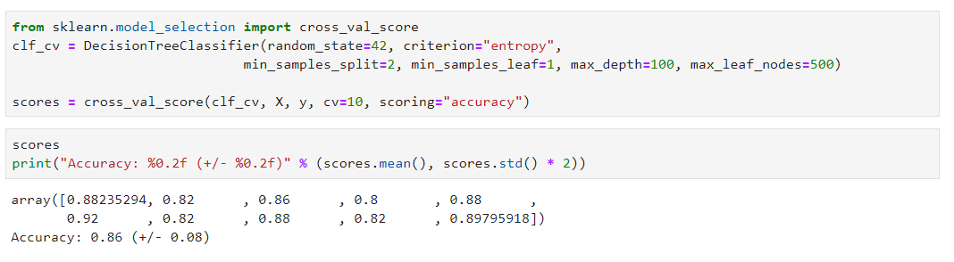
Coding Example

Slide 46
Final Model
During CV, K models will be created
Which do you use?
None!
After you've done CV and selected best model, retrain model "one last time" with full data
DT
Model
entire data

Slide 47
Resources
Coding Tutorial Files
https://github.com/stepthom/869_course/tree/main/classification

Slide 48
Bias and Variance

Slide 49
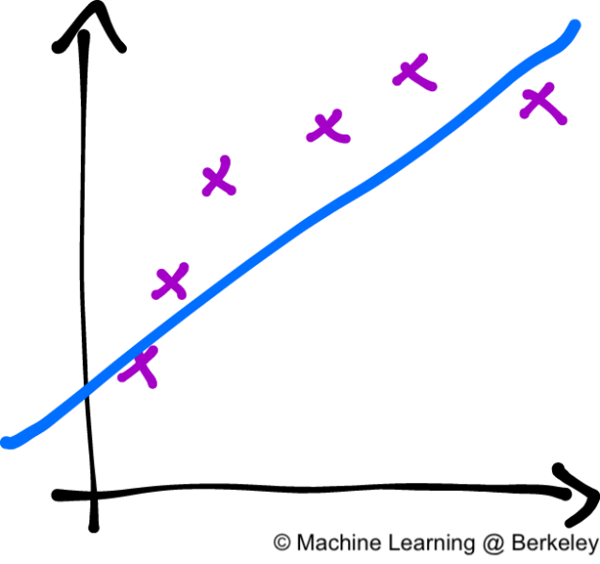
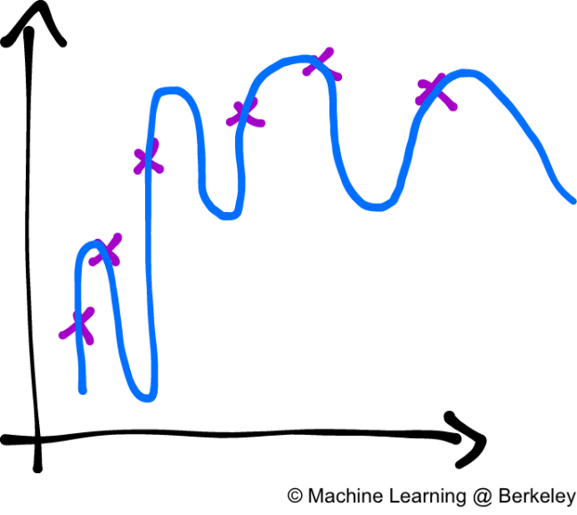
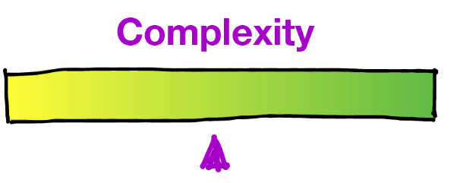
Bias/Variance Tradeoff
Want model to not miss anything; capture all the interesting trends
Don't want the model to be crazy, and risk over-interpreting every outlier and irregularity
It's a tradeoff
High Bias = Underfitting
High Variance = Overfitting
Model is too simple
High bias -> Unable to capture true relationship; performance will be not great
Model is too complex
High variance -> Captures noise and outliers; performance will not be great
https://ml.berkeley.edu/blog/2017/07/13/tutorial-4/
Notes:
Bias are the simplifying assumptions made by a model, meaning that the model can never capture the true relationship in the data.
Low Bias: Suggests less assumptions about the form of the target function.
High-Bias: Suggests more assumptions about the form of the target function.
Variance is the amount that the estimate of the target function will change if different training data was used.
Low Variance: Suggests small changes to the estimate of the target function with changes to the training dataset.
High Variance: Suggests large changes to the estimate of the target function with changes to the training dataset.

Slide 50
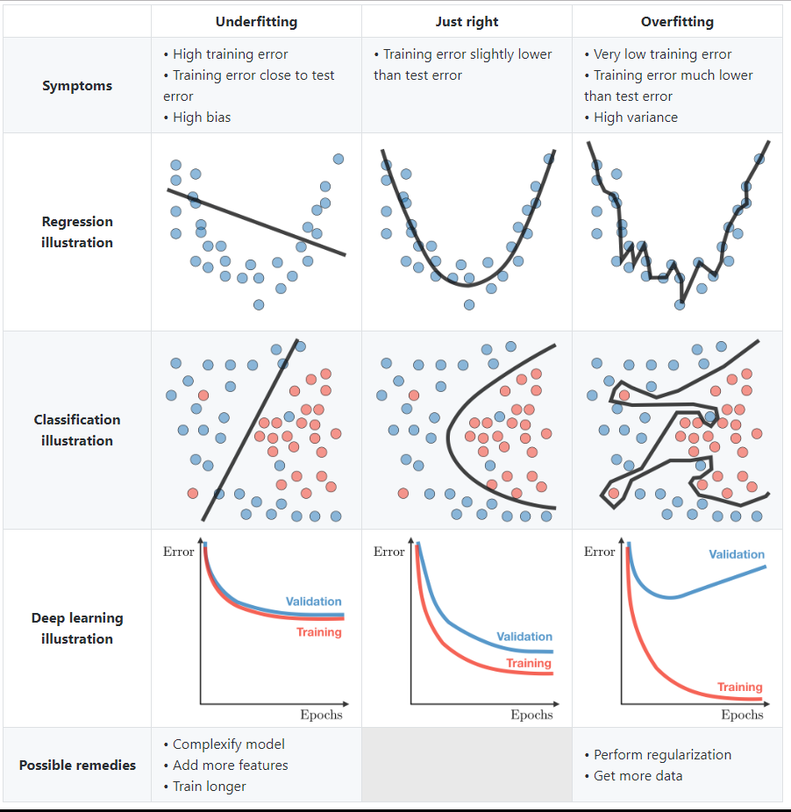
Regression Example
Stanford CS 229

Slide 51
Decision Tree Example
Which tree has high bias, and which has high variance?

Slide 52
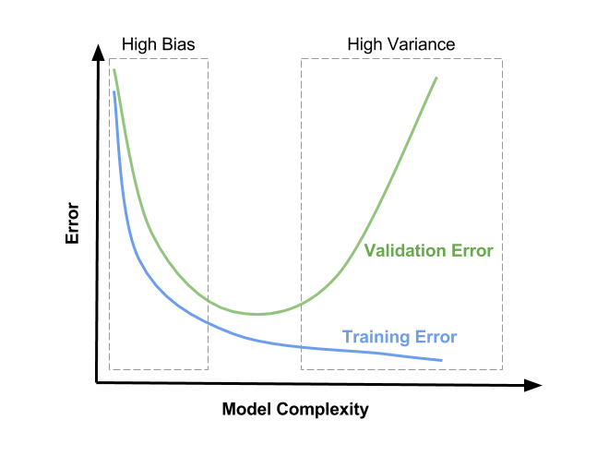
How to Tell?
https://www.learnopencv.com/bias-variance-tradeoff-in-machine-learning/
Notes:
https://www.learnopencv.com/bias-variance-tradeoff-in-machine-learning/

Slide 53
Summary – Bias-Variance
High Bias = Underfitting the training data
Model won't be good enough
High Variance = Overfitting the training Data
Model won't be good enough
Want somewhere in the middle

Slide 54
Ensembles

Slide 55
Combining Classifiers
Can we combine multiple models to produce a better model?
Yes! Called "ensembles" or "combinations"
In practice, ensembles are very effective
E.g., ensemble of DTs shown to be better than NNs for tabular data
Many popular ways:
Committee, aka Voting
Bagging (incl. Random Forests, Extra Trees)
Boosting (incl. Adaboost, GBM, XGBoost, LGBM)
While you can create an ensemble manually, you mostly just use one of the above

Slide 56
Committees

Slide 57
Committee
Committee is a parallel ensemble: each model is built independently
Training: train several models
Decision trees, NB, SVMs, whatever you want!
Each classifier gets full training data
Prediction: Each model votes, majority (or average) wins
training
SVM
NB
DT
model
model
model
Yes
No
Yes
new
Yes

Slide 58
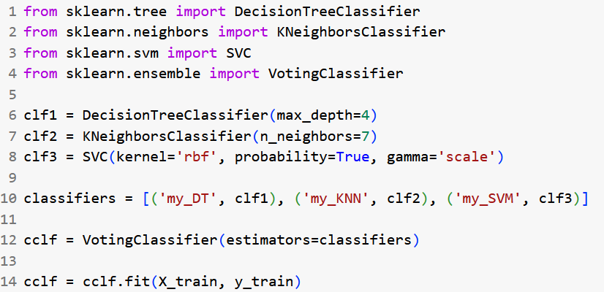
Example
Slides: https://github.com/stepthom/869_course/tree/main/ensemble

Slide 59
Bagging
Source: https://towardsdatascience.com/ensemble-learning-bagging-boosting-3098079e5422

Slide 60
Bagging
Bagging is the same as committees, except:
Instead of getting the full training data, each model only gets a bootstrap sample of the training data
Popular examples: Random Forests, Extra Trees
1 | 2 | 3 | 4
Sample 1
Sample 2
Sample 3
training
1 | 2 | 3 | 4
1 | 2 | 3 | 4
1 | 2 | 3 | 4
SVM
DT
KNN
model
model
model
Yes
No
Yes
new
Yes
Notes:
Bagging is short for "bootstrap aggregating"
Bootstrapping is a random sample of the data that is taken with replacement. The bootstrap sample is the same size as the original data set. As a result, some samples will be represented multiple times in the bootstrap sample while others will not be selected at all. The samples not selected are usually referred to as the "out-of-bag" samples.

Slide 61
What is a Bootstrap Sample?
Bootstrap sampling: random with replacement
 | F1 | F2 | F3 | T
5
3
3
1
2
5
Sample 1
 | F1 | F2 | F3 | T
1
2
3
4
5
6
 | F1 | F2 | F3 | T
4
1
6
5
6
6
Sample 2
Original
 | F1 | F2 | F3 | T
4
1
6
5
6
6
Sample 3
From mlxtend

Slide 62
Bagging Properties
Helps to decrease variance
E.g., DTs
Fast because model training can be parallel
Almost always helps

Slide 63
Random Forests
Random Forests are a bag of trees, but also:
Each DT gets a random subset of features
Why?
1 | 2 | 3 | 4
training
1 | 4
2 | 4
3 | 4
Bootstrap sample
Bootstrap sample
Bootstrap sample
DT
DT
DT
model
model
model
Yes
No
Yes
Yes
new
Notes:
Usually, each tree gets sqrt(p) features, where p is the number of features
Suppose that we have a very strong predictor in the data set along with a number of other moderately strong predictor, then in the collection of bagged trees, most or all of them will use the very strong predictor for the first split!
All bagged trees will look similar. Hence all the predictions from the bagged trees will be highly correlated
Averaging many highly correlated quantities does not lead to a large variance reduction, and thus random forests "de-correlates" the bagged trees leading to more reduction in variance

Slide 64
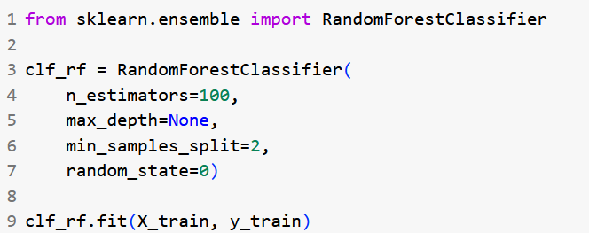
Example

Slide 65
Main RF Hyperparameters
Name | Description | Default | Uncle Steve's Recommendation
n_estimators | Number of trees | 100 | Set to big number; don't tune
max_depth | Max depth of each tree | None | Don't tune; tune other hyperparams to control size
max_features | How many features each tree sees | 'sqrt' | Don't tune; default is good
max_samples | % of instances each tree sees | None | Usually want 0.5 – 0.7. OK to tune
min_samples_split | Min number of instances in node to consider splitting | 2 | Higher = less overfitting. Good to tune
Other hyperparameters exist, but these are the main ones

Slide 66
BOOSTING

Slide 67
Boosting
Boosting: train models sequentially to improve previous models
Very popular! Great results in many domains
Variants:
Adaptive Boosting (e.g., AdaBoost): Original, but not the best anymore
Gradient Boosting (e.g., XGBoost): Very popular! Great results
Bootstrap sample
Bootstrap sample
Bootstrap sample
training
DT
DT
DT
model
model
model
new
0.86
+
0.04
+
-0.02
=
0.88

Slide 68
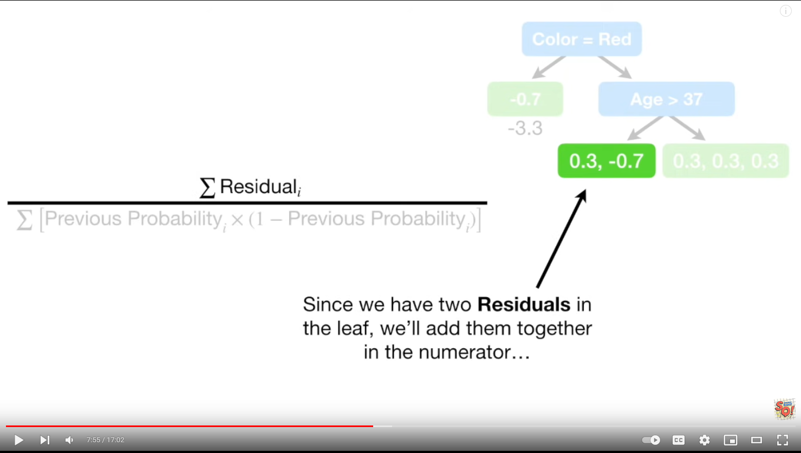
StatQuest
4-part series on Gradient Boosting

Slide 69

XGBoost
Popular gradient boosting algorithm from DMLC at CMU
But more than just a boosting algorithm!
Key features:
Built-in regularization
Memory efficient
Parallel/Distributed Learning
Sparsity-Aware Split Finding
Supports missing values
Weighted Quantile Sketch
…
Notes:
https://www.packtpub.com/mapt/book/big_data_and_business_intelligence/9781788295758/4/ch04lvl1sec34/comparison-between-adaboosting-versus-gradient-boosting

Slide 70
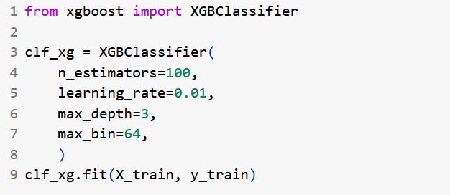
Example

Slide 71

LightGBM (LGBM)
Gradient boosting package from Microsoft
Key Features:
Faster
Lower memory usage
Better accuracy (?)
Support for parallel and GPU learning
Built-in support for categorical features

Slide 72
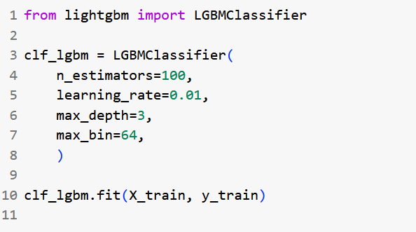
Example

Slide 73
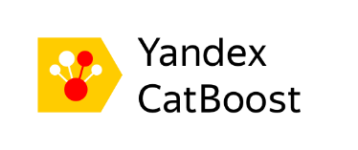
Catboost
Gradient boosting package from Yandex
Key Features:
Support for categorical features
Support for textual features
Less hyperparameter tuning required

Slide 74
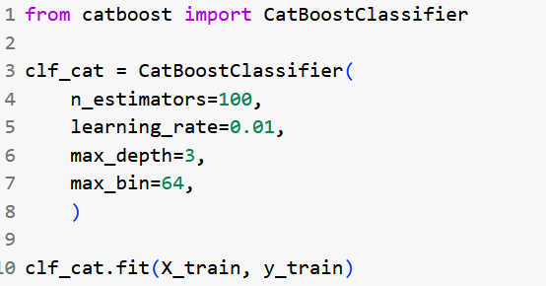
Example

Slide 75
Main Boosting Hyperparameters
Name | Description | Default | Uncle Steve's Recommendation
n_estimators | Number of trees | 100 | Set to medium number; don't tune
learning_rate | Amount each tree contributes | 0.1 | smaller -> bigger n_estimators larger -> smaller n_estimators Good to tune
num_leaves | Max number of leaves in one tree | 31 | Lower = less overfitting. Good to tune
max_depth | Max depth of each tree | -1 | Lower = less overfitting. Good to tune
min_samples_leaf | Min num of instances in leaf | 20 | Higher = less overfitting. Good to tune
max_bin | Max number of bins to bucket features in | 255 | Lower = less overfitting. Good to tune
lambda_l1, lambda_l2 | L1 and L2 regularization | 0.0 | Higher = less overfitting. Good to tune
Many other hyperparameters exist that can be tuned
https://lightgbm.readthedocs.io/en/latest/Parameters.html

Slide 76

Ultimate Boosting Comparison
 | Adaboost | XGBoost | LightGBM | Catboost
Developer | Freund and Schapire | Tianqi Chen (CMU) | Microsoft | Yandex
Initial Release | 1997 | 2014 | 2016 | 2017
Base learner | Stumps | Trees | Trees | Trees
Uses gradients? | No | Yes | Yes | Yes
Parallel learning? | No | Yes | Yes | Yes
GPU learning? | No | Yes | Yes | Yes
Handles categorical internally? | No | No | Yes | Yes
Grows trees via: | Levels | Levels | Leaves | Levels
Built-in regularization | No | Yes | Yes | Yes
All help decrease bias
Prone to overfitting
More hyperparameters compared to Random Forests

Slide 77
Resources
slides_ensemble.ipynb
slides_ensemble_study.ipynb

Slide 78
Summary - Ensembles
Ensembles: Combining classifiers to increase performance
Committee: parallel model building with full training data
Not used much in practice
Bagging: parallel model building with bootstrap samples
Great choice overall
Boosting: sequential models predict errors of previous models
Best choice, but requires more tuning and watch out for overfitting

