Slide 2
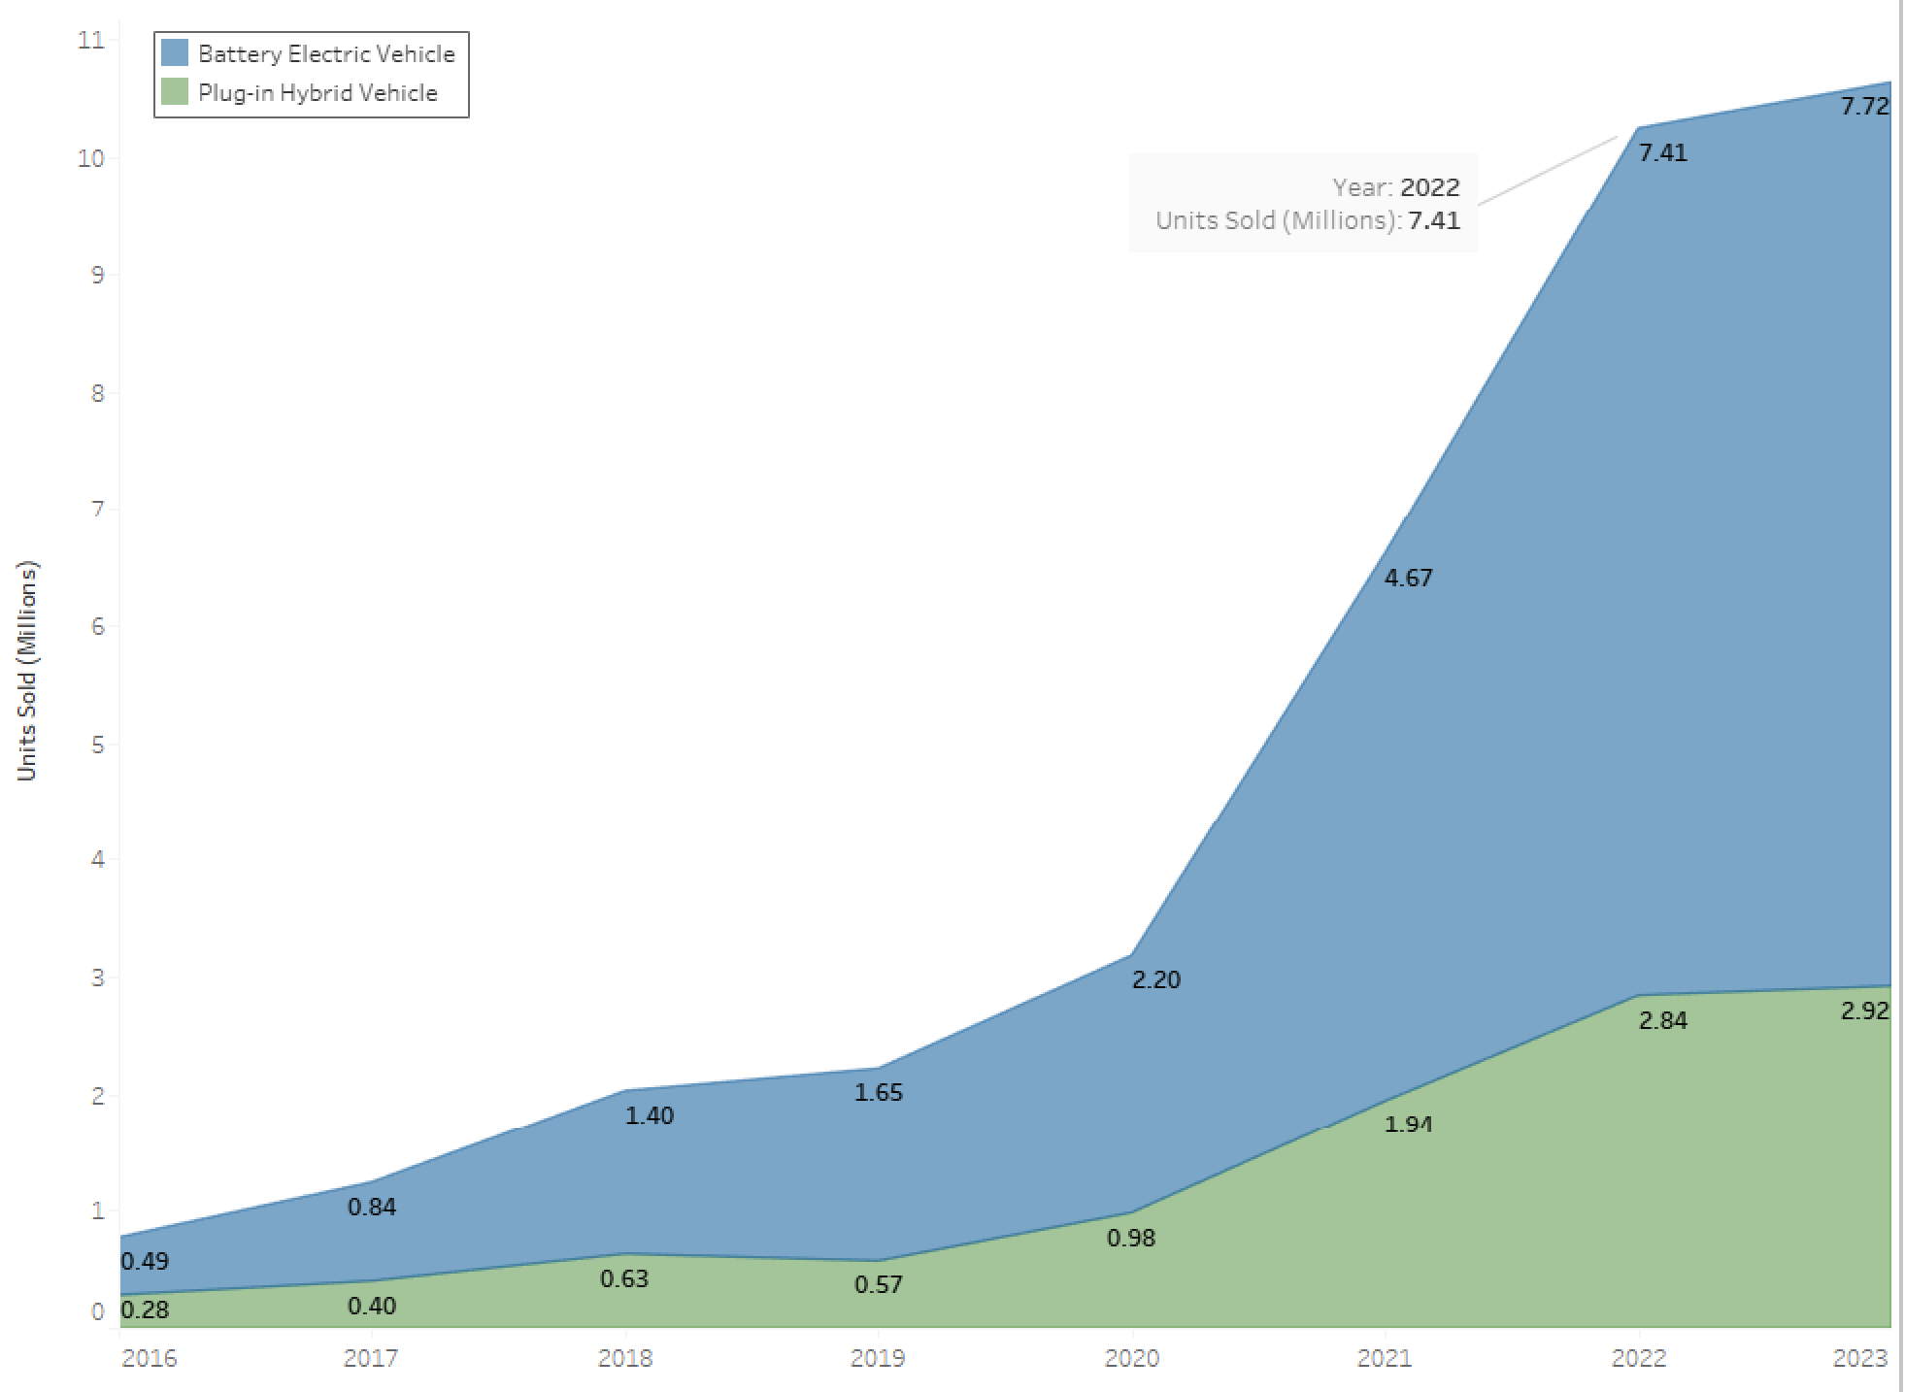


Overview of Electric Vehicle Industry
FACTORS INCREASING DEMAND
Financial Benefit
Environmental
Social Influence
AREAS OF RESISTANCE
Range Conscious
Charging Infrastructure
Cost
Notes:
Electric vehicles - worldwide: Statista market forecast. Statista. (n.d.). https://www.statista.com/outlook/mmo/electric-vehicles/worldwide#unit-sales
Answers Industry Q2 & Q3

