Slide 1
Lab sheet (DS and Algo - session3)
Nagur Ramesh

Slide 2
Sorting Algorithms
Agenda:
Insertion Sort Selection Sort Bubblesort Mergesort Quicksort
Goals:
Understand the above sorting algorithms.
Get an idea that there are differences in efficiency. Get used to recursion.
We won’t talk about complexity theory in this lecture.

Slide 3
Swapping two items of a list
How can we swap two items of a list?
1 a = [5, 3]
2
3 <your code here>
Today, we always assume that our list is called a.

Slide 4
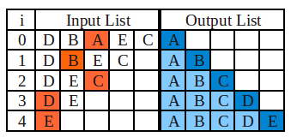
Selection Sort
Selection Sort
Until list is empty:
Find the smallest element of the remaining list. Append it to a new list.

Slide 5
Selection Sort: Code
def selection_sort(a):
""" sorting algorithm, creates a NEW list """
3 b = []
4 # Why is the list a copied here?
5
# Find minimum of the list
# Remove the minimum from the list
# and append it to the new list

Slide 6
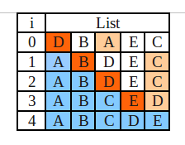
Selection Sort - in place
Selection Sort
For each i from 0 to N − 2:
Find the smallest element of the remaining list.
If this element is smaller than a[i ], exchange it with a[i ].

Slide 7
Selection Sort (in place): Code
def selection_sort_in_place(a):
""" sorting algorithm, works in-place"""
# point to element at position i
# Find the smallest element in the
# rest of the list
# exchange elements

Slide 8
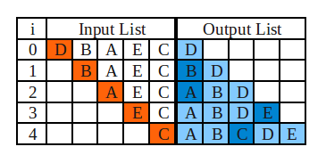
Insertion Sort
Insertion Sort
Look at one element after the other and insert it into the list at the correct position.

Slide 9
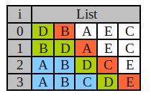
Insertion Sort - in-place
Insertion Sort
Look at one element after the other and insert it into the part of the list already dealt with at the correct position.

Slide 10
Insertion Sort: Code
def insertion_sort_in_place(a):
""" sorting algorithm, works in-place"""
# go through list
# Remember value of a[i]
# Go backwards in list and shift to
# the right if element > value to be
# inserted
# insert the value at its correct position

Slide 11
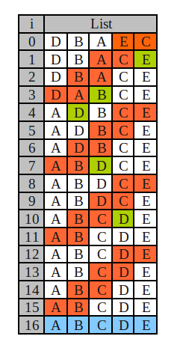
Bubble Sort
Bubble Sort
Go through the list again and again and exchange neighboring elements (if necessary).
Stop if no changes have been made while going through the list once.
Implementation: Your task. Try not to just copy it from the web. :)

Slide 12
Recursion: Base Case
def factorial(x):
# base case1
# recursive call
7
8 print("factorial(4) =", factorial(4))
’Execute’ above function call ON BOARD
Don’t forget to code the base case in recursive functions. Otherwise, you create an infinite number of function calls.

Slide 13
Recursion: Base Case
Base cases for sorting algorithms: empty lists are sorted.
lists with only one element are sorted.
All other lists may still need sorting.
if len(a) <= 1:
# base case
# a is sorted by definition
return a
else:
# need to sort a (recursively)

Slide 14
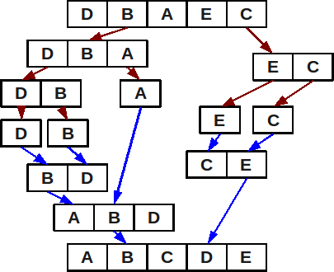
Mergesort: Divide & Conquer
Divide
lists & sort them recursively.
Merge
sorted lists. on board

Slide 15
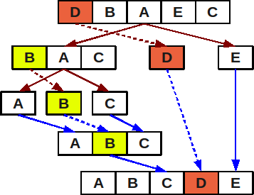
Quicksort: Divide & Conquer
Divide
lists using a pivot element from the list:
items < pivot
items > pivot
Sort (a) and (b) recursively.
Merge
sorted lists:
(a) + [pivot] + (b)

