Slide 1
Introduction to Deep Learning and Its Applications
Nagur Ramesh
Guvi Geeks Network Pvt. Limited

Slide 2
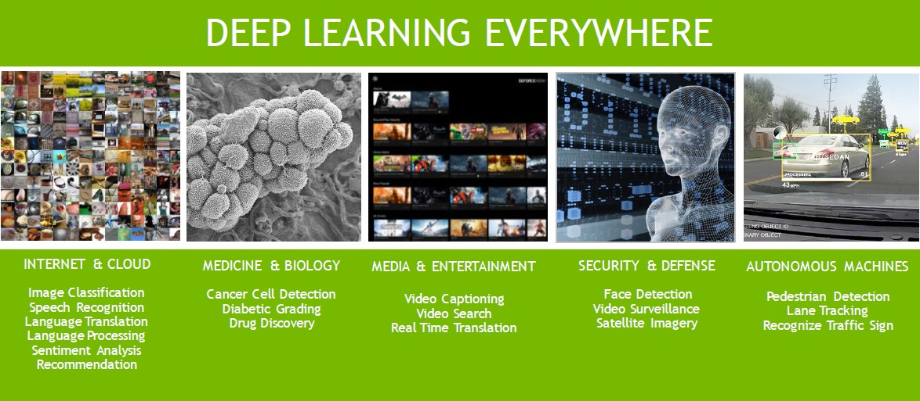
source:developer.nvidia.com/deep-­‐learning-­‐courses

Slide 3
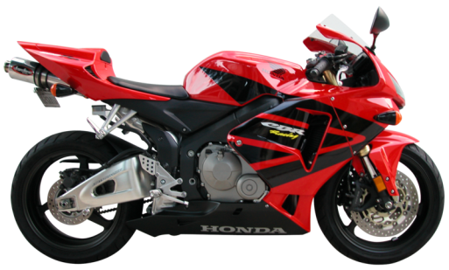
Machine Learning
Input: X
Output: Y
Label”motorcycle”

Slide 4

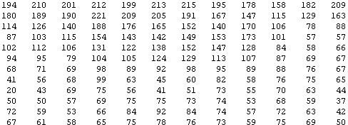
Why is it hard?
You see this
But the camera sees this:

Slide 5

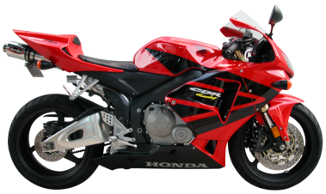





Raw Image Representation
pixel 1
Learning Algorithm
pixel 2
pixel 2
Cars
“Non”-­‐Cars
pixel 1

Slide 6
Raw Image Representation
pixel 1
Learning Algorithm
pixel 2
pixel 2
Cars
“Non”-­‐Cars
pixel 1

Slide 7
Raw Image Representation
pixel 1
Learning Algorithm
pixel 2
pixel 2
Cars
“Non”-­‐Cars
pixel 1

Slide 8
Better Feature Representation?
handles
Learning Algorithm
wheel
Cars
“Non”-­‐Cars
pixel 2
handles
pixel 1
wheel

Slide 9
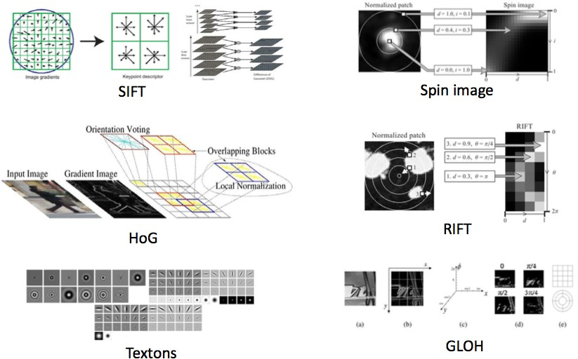
Feature Representations
Expert Knowledge!
Source: feature representations in computer vision(Honglak lee)

Slide 10
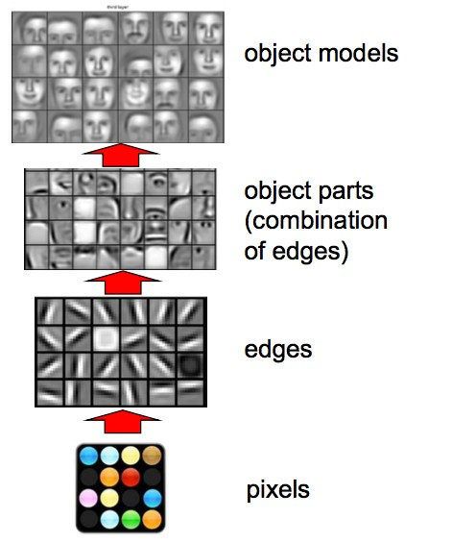
Deep Learning: learn representations!
Source:Lee et.al. ICML2009

Slide 11
So, 1. what exactly is deep learning ?
And, 2. why is it generally better than other methods on image, speech and certain other types of data?
The short answers
‘Deep Learning’ means using a neural network
with several layers of nodes between input and output
the series of layers between input & output do feature identification and processing in a series of stages, just as our brains seem to.
Sources: https://www.macs.hw.ac.uk/~dwcorne/Teaching/introdl.ppt

Slide 12
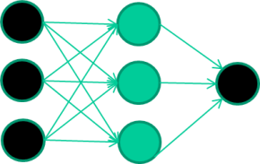
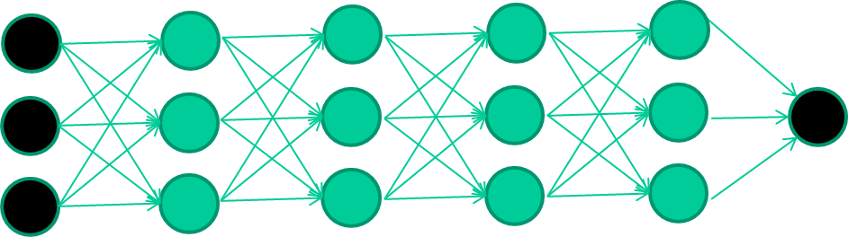
hmmm… OK, but:
3. multilayer neural networks have been around for 25 years. What’s actually new?
we have always had good algorithms for learning the weights in networks with 1 hidden layer
but these algorithms are not good at learning the weights for networks with more hidden layers
what’s new is: algorithms for training many-­‐later networks
https://www.macs.hw.ac.uk/~dwcorne/Teaching/introdl.ppt

Slide 13
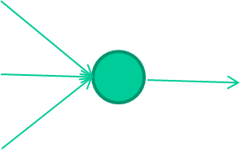
Single Unit, Input, weights, activation function, output
Bias x0
w0
f(x) = g(w₀ x₀+ w₁ x₁+ w₂ x₂ )
w1
f(x)
Input x1
output
w2
Activation functions:
linear
Sigmoid
Tanh
Relu
Softmax etc.
Input x2
https://www.macs.hw.ac.uk/~dwcorne/Teaching/introdl.ppt

Slide 14
A dataset
Fields class
1.4 2.7 1.9 0
3.8 3.4 3.2 0
6.4 2.8 1.7 1
4.1 0.1 0.2 0
etc …
Train the deep neural network
https://www.macs.hw.ac.uk/~dwcorne/Teaching/introdl.ppt

Slide 15
A dataset
Fields
class
1.4 2.7 1.9 0
3.8 3.4 3.2 0
6.4 2.8 1.7 1
4.1 0.1 0.2 0
etc …
Initialize with random weights
1.4
2.7
0.7 (0)
Error=0.7
1.9
Compare with the target output
https://www.macs.hw.ac.uk/~dwcorne/Teaching/introdl.ppt

Slide 16







Adjust weights based on error
1.4
2.7
0.7 (0)
Error=0.7
1.9
Repeat this thousands, maybe millions of times – each time taking a random training instance, and making slight weight adjustments
Algorithms for weight adjustment are designed to make changes that will reduce the error
https://www.macs.hw.ac.uk/~dwcorne/Teaching/introdl.ppt

Slide 17
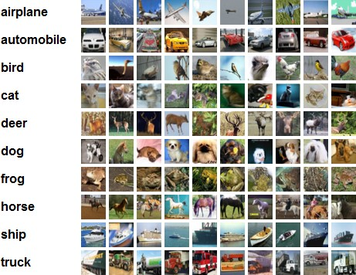
CIFAR 10 and Convolutional Neural Network
CIFAR 10 dataset:
50,000 training images
10,000 testing images
10 categories (classes)
Accuracies from different methods: Human: ~94%
Whitening K-­‐mean: 80%
……
Deep CNN: 95.5%
http://karpathy.github.io/2011/04/27/manually-­‐classifying-­‐cifar10/ https://www.kaggle.com/c/cifar-­‐10/leaderboard

Slide 18
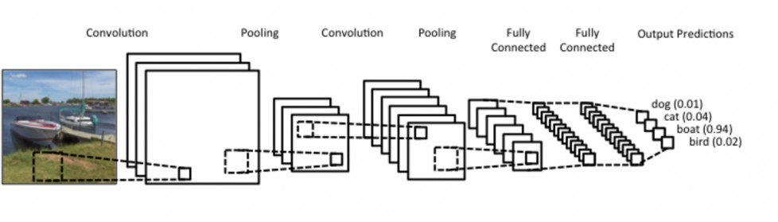
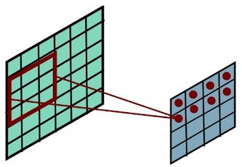
Deep Convolutional Neural Networks on CIFAR10
convolution2D
MaxPooling2D
convolution2D
Fully-­‐connected
output
Dropout
MaxPooling2D
Convolutional Layer: filters work on every part of the image, therefore, they are searching for the same feature everywhere in the image.
Input image
Convolutional output
http://www.slideshare.net/perone/deep-­‐learning-­‐convolutional-­‐neural-­‐networks

Slide 19
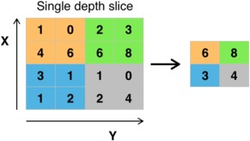
Deep Convolutional Neural Networks on CIFAR10
convolution2D
MaxPooling2D
convolution2D
Fully-­‐connected
output
Dropout
MaxPooling2D
Convolutional output
MaxPooling: usually present after the convolutional layer. It provides a down-­‐sampling of the convolutional output
MaxPooling
(2,2)
http://www.slideshare.net/perone/deep-­‐learning-­‐convolutional-­‐neural-­‐networks

Slide 20
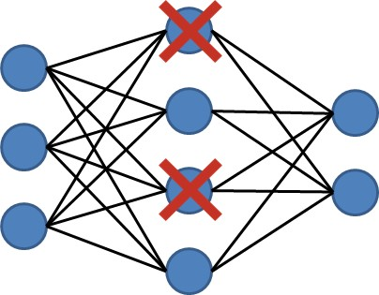
Deep Convolutional Neural Networks on CIFAR10
convolution2D
MaxPooling2D
convolution2D
Fully-­‐connected
output
Dropout
MaxPooling2D
Dropout: randomly drop units along with their connections during training. It helps to learn more robust features by reducing complex co-­‐adaptations of units and alleviate overfitting issue as well.
Srivastava et al. Dropout: A Simple way to Prevent Neural Networks from Overfitting. Journal of Machine Learning Research 15(2014):1929-­‐1958

Slide 21
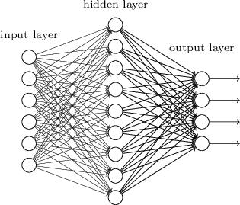
Deep Convolutional Neural Networks on CIFAR10
convolution2D
MaxPooling2D
convolution2D
Fully-­‐connected
output
Dropout
MaxPooling2D
hidden
input
Fully-­‐connected layer (dense): each node is fully
output
connected to all input nodes, each node computes
weighted sum of all input nodes. It has one-­‐ dimensional structure. It helps to classify input pattern with high-­‐level features extracted by previous layers.
http://www.slideshare.net/datasciencekorea/5-­‐20141107deeplearning

Slide 22
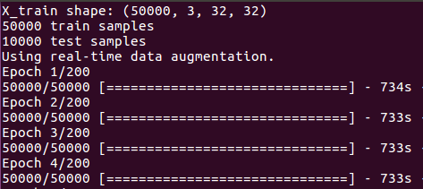
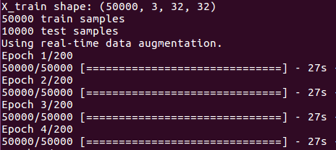
Why GPU Matters in Deep Learning?
vs
Running time without GPU Running time with GPU
With GPU, the running time is 733/27=27.1 times faster then the running time without GPU!!!
Again, WHY GPUs?
Every set of weights can be stored as a matrix (m,n)
GPUs are made to do common parallel problems fast. All similar calculations are done at the same time. This extremely boosts the performance in parallel computations.
Blankevoort T., Neural Networks and Deep Learning, slides

Slide 23
Summary: Deep Learning
Make it deep (many layers)
Way more labeled data (1 million)
A lot better computing power (GPU clusters)

