Slide 1
ETRACS
Report Development
July 4-8, 2022
Rameses Systems Inc
Cebu City, Cebu

Slide 2
ETRACS
Report Development

Slide 3
To do
How to define reports (report definition)
How to edit and upload report templates
Simple Jasper Report editing (using iReport)
How to deploy reports
Sample report: PSIC report for business

Slide 4
Two Types of Reports
OLTP (Online Transaction Processing )
  For: Users, Managers, etc.
OLAP (Online Analatyical Processing)
  For: Executives, Decision Makers

Slide 5
Report Tables
sys_report_def
sys_report_subreport_def
sys_report_template

Slide 6
Role
ENTERPRISE.REPORT_EDITOR = for ETRACS server
REPORT_EDITOR = for other plugin modules

Slide 7
sys_report_def
name = unique name of report
title = Title of report
description = optional text
category = used for categorizing reports. Used on app developer
querytype = SQL or SCRIPT
statement = sql or script statement to fetch data
parameters = basic or custom parameters for filtering reports
state = DRAFT or DEPLOYED
sortorder = for sorting order of how reports are displayed
role = only users assigned this role will be able to view reports
template = printable view of the report

Slide 8
sys_report_subreport_def
name = name of dataset. also name of the field
querytype = SQL or SCRIPT
statement = sql or script statement. Use $P{fieldname} for filtering

Slide 9
Report Def
Go to Master > Enterprise > Report Definition
Create a report
Specify report
  name = entitylist
  title = List of Individual Taxpayers
  category = reports/enterprise
  sort order = 1
Click Save

Slide 10
Report Def
Click Edit button and go to Data Tab
Specify SQL in Query Type
Type in sample statement
  SELECT e.*, e.address_text as addresstext FROM entity e
Click Save and Click View Data

Slide 11
Adding Sub Report
Under Data Tab, go to Sub Reports Tab
Click Add
Enter the ff:
  name = businesses
  querytype = SQL
Type in statement
  SELECT tradename FROM business WHERE owner_objid = $P{ objid }
Click Save, go back to Statement Tab and click View Data

Slide 12
sys_report_template
name = name of report. Must be unique
filepath = where actual report template is located. The root path is /report-files in the server

Slide 13
Report Template
Setup docker-compose and mount the report-files root directory. Restart docker
Go to Master > Enterprise > Report Templates
Add New. Enter the ff:
  name = individual_entitylist
  filename = entitylist
  folder = reports/enterprise
Click on save
Investigate the report files
Use iReport to edit report template

Slide 14
Install IReport-3.0.0 IDE
Create folder c:\Applications
Copy {TRAINING_CD}/installers/ iReport-3.0.0 folder to c:\Applications
Launch iReport-3.0.0
Click Options -> Settings
Select Compiler tab
  Check User Reports Directory to Compile
  Check Auto-save before compiling
  Uncheck keep .java file (if available)
Select Backup tab
  Select No Backup from the options
Click Save

Slide 15
Mount iReport Tool
Update the platform to include iReport
Run application and click on System > Preferences > iReport Designer
Browse to the folder where iReport is located
Try Test Launch. Click OK when done
Shutdown client and restart

Slide 16
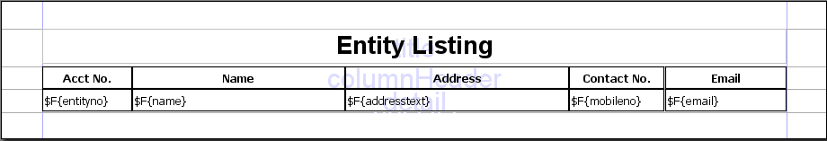

The Entity Listing Report (cont.)
Go to Master > Enterprise > Report Templates
Select report from list and click Edit Report
Design the report
Click on Upload button in iReport when complete

Slide 17
Testing Report with Data
Go to Master > Enterprise > Report Definition
Select entitylist report
Click on Edit
Edit Template and lookup the individual_entitylist template. Click Save when done
Click on Edit Report to edit report.
Run active connection to view output within iReport

Slide 18
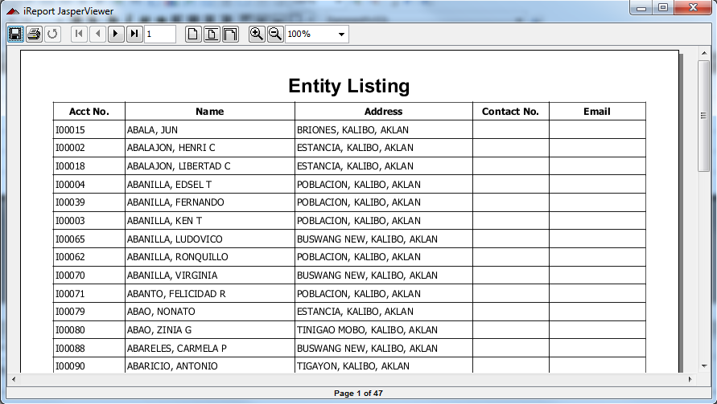
Testing Report with Data

Slide 19
Jasper Report and IReport Concepts

Slide 20
Report Bands
Title – displayed only once
PageHeader – displayed on every page
ColumnHeader – displays column header
Detail – appears once per record
ColumnFooter – displays column footer
PageFooter – displayed once per page
LastPageFooter – displayed if last page
Summary – displayed when end of report
NoData – displayed if there are no data

Slide 21
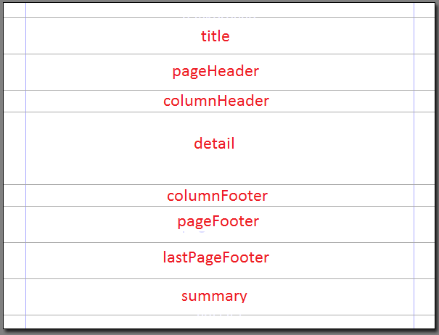
JasperReport Bands

Slide 22
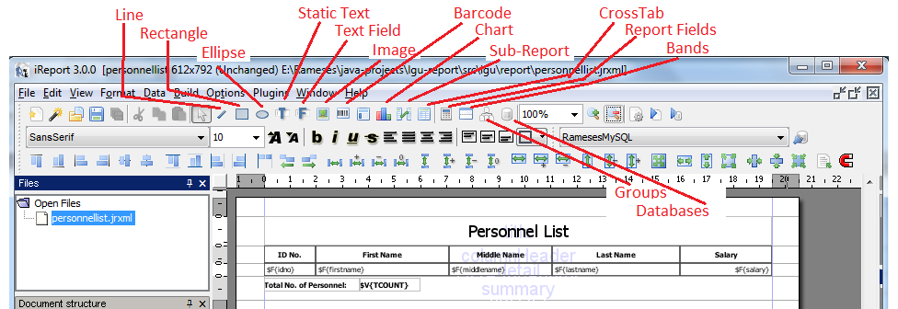

Object Types

Slide 23
Report Fields, Variables and Parameters
Field – refers to the data source field
  referenced by $F{fieldname}
Variable – use for calculation purposes
  referenced by $V{varname}
Parameter – use to pass parameters to the report
  referenced by $P{paramname}

