Slide 1

WELCOME
Topic : People count using AI

Slide 2
Agenda
⇒Human Vs Ai
⇒Method of Working
⇒Features
⇒ Future development’s
⇒Question and Answer

Slide 3

What do u mean by people count ?

Slide 4

Human Vs Ai

Slide 5

Human
Count : 17 Time : 10sec

Slide 6
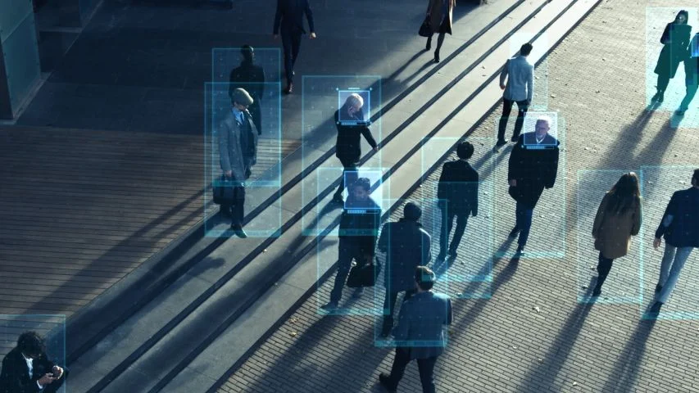
AI
Count : 15 Time : 2sec

Slide 7
Method of Working
Start
Analyse
Count
Output
Video Sample:
Analysing Video:
Count people’s:
Display count:
Upload video or img file through offline or by using IP Cam’s.
The video is been analysed and changed into img/pixels.
Pixel video was been processed and no.of people’s was been counted.
Total no.of people’s was been counted and displayed.

Slide 8
Features
GUI
Using of Graphical User Interface to run and use the program.
05
Remove of Duplicate count:
Same person was not been counted as an new user or new count.
01
04
Both offline and online:
Using of both Offline and Online videos. (i.e)Recorded videos, IpCam connected videos etc…
Good UI & UX
Better User Interface and User Experience to develop project for both technical and non-technical peoples.
02
03
Security features:
The program will be tested with P1-P5 of security and with all security authentication.

Slide 9
Future Development’s
Bug reductions and feature enhancement:
Some of security and ui or ux bug was been patched and featured with new developments.
Upgrades:
Upgraded to WebApps, Applications with new features in devops.
2
4
1
3
Facial Recon’s:
It will be chained with Facial recognition, Person detection’s etc…
Wait for future enhancement

Slide 10

Any Question’s and Answer’s

Slide 11

Thank You!

