Slide 1
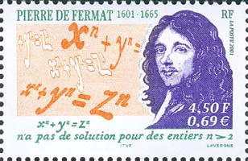
Fermat’s Last Theorem
By: Andy Smith

Slide 2
Fermat’s Professional life
Lived 1601-1665
Law school
Councilor at the parliament of the French city of Toulouse
Judge with a reputation for a good mind but being somewhat distracted
Mathematics was a hobby
maxima, minima, and tangents

Slide 3
Fermat’s mathematical interests
Restored a book written by the Greek geometer Apollonius including full proofs.
Created his own form of coordinate geometry.
We know a lot about his work in geometry because he wrote many detailed letters to his friends explaining his work.
Interested in “perfect numbers”
  Numbers that equal the sum of their proper divisors.
Which whole numbers can be written as a sum of two squares.

Slide 4
Problems about numbers
Started by looking at work done by the Greek mathematician Diophantus
  Show that no cube can be a sum of two cubes
  Show that every number can be written as the sum of four squares
Colleagues showed little interest so there are not many details written down
These questions are what lead Fermat to write Fermat’s Last Theorem

Slide 5
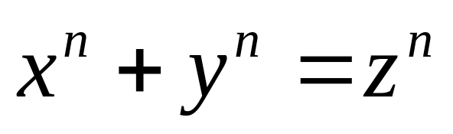
Fermat’s Last Theorem
After Fermat’s death, his son went through his notes.
In 1670 Fermat’s son Samuel published a new edition of Diophantus including his father’s notes.
One of the problems in Diophantus said
write a given square as the sum of two
squares.
Fermat wrote a note next to this problem saying it is impossible, in general, to divide any power beyond the square into powers of the same degree, but the proof he found is too large for the margin of the page.
Fermat’s Last Theorem : There is no solution to
when n>2

Slide 6
No one cares
No one was interested in Fermat’s work with numbers for quite a while.
About 100 years goes by before anyone makes any effort to work with Fermat’s Theorem.

Slide 7
Euler’s contribution
In the 18th century Euler went through Fermat’s number theory.
He organized Fermat’s work and found proofs for most of the claims Fermat made.
In fact Euler only found one mistake Fermat had made in all of his notes.
Later Euler proved the case when n=3, but since his proof for it was very different than the proof for n=4, which was proven during Fermat’s lifetime, he couldn’t use it to find a general proof.

Slide 8
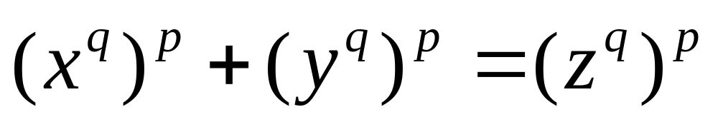
Early 19th century
In the early 19th century several mathematicians made small contributions to the problem
It was clear that proving the case for n prime would be enough to prove the theorem

Slide 9
Germain
The most important contribution in the 19th century was made by Sophie Germain
Germain looked at the problem split into two cases
  Case 1: x, y, and z are not divisible by n
  Case 2: one of x, y, or z is divisible by n

Slide 10
Germain cont’d
Germain was the first person to show any general results
She showed that the first case is true if n is prime, and 2n+1 is prime
That is if n is prime, and 2n+1 is prime, then FLT is true when x, y, and z are not divisible by n
This eventually led to the proof of the first case of FLT for all n up to 100
In the 19th century it was hard for women to get work published in mathematics, so Germain’s theorem was first published in a book written by Legendre in 1808 with credit to Germain

Slide 11
Other contributions
Dirichlet found a partial proof for the second case for n=5.
Legendre finished the proof.
Lame proved it for n=7.
The method Lame used to show it for n=7 was difficult and not promising for larger numbers.
A new method had to be found.

Slide 12
Lame’s mistake
Lame thought of a new way to prove it.
Lame decided to use complex numbers to factor the equation, and then wrote a proof based on that.
One of the men reviewing his proof didn’t know if complex numbers would share the same properties as other whole numbers, and so asked a fellow mathematician named Kummer.
Kummer knew that they didn’t necessarily share those properties, and therefore the proof was invalid.
The problem drew Kummer’s attention and he proved it for “regular primes”.

Slide 13
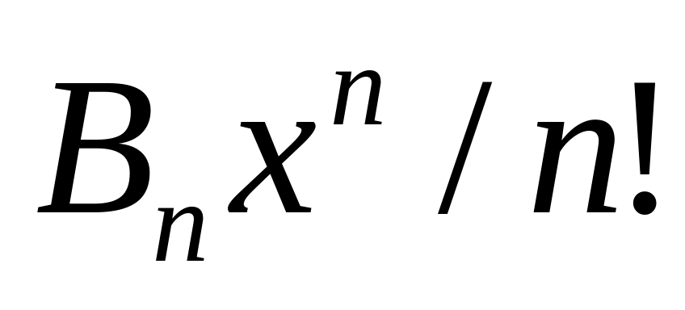
Kummer
Regular primes are primes that do not divide the numerator of any Bernoulli number
A Bernoulli number is in this form
The only primes under 100 that aren’t regular are 37, 59, and 67

Slide 14
FLT is proven
After Kummer’s proof in 1847, very little headway was made
In 1909, Paul Wolfskehl offered 100,000 marks to anyone who could find a proof which lasted until WWI when the mark became almost worthless
People continued working on it but to no avail until 1993
In 1993 Andrew Wiles announced that he found a proof for FLT
He sent the proof to a journal which found a gap in the proof
Several months later he had fixed the gap and had a correct proof to Fermat’s Last Theorem

Slide 15
Fermat’s last tango
Wiles said that the first six years working on the proof were enjoyable, but the last few months trying to fix the gap in the proof were terrible.
There was a musical play about Wiles’ struggle to finish the proof called Fermat’s last tango.
It took more than 300 years to prove Fermat’s Last Theorem

Slide 16
Timeline
Fermat lived 1601 – 1665
Marginal note stating Fermat’s Last Theorem 1630
Euler shows for n=3 1770
Sophie Germain found first general results 1808
Dirichlet and Legendre proved FLT for n=5 1825
Lame proved FLT for n=7 1839
Kummer proved FLT for “regular primes” 1847
Paul Wolfskehl offered 100,000 Dm reward 1909
Andrew Wiles proved FLT 1993-1994

Slide 17
References
O’Connor, J. Robertson, F. “Fermat’s last theorem” February, 1996 http://www-groups.dcs.st-and.ac.uk/~history/HistTopics/Fermat's_last_theorem.html

