Slide 1
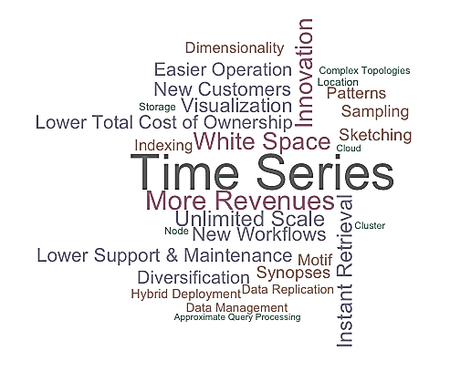

Squigglee Summary
(Confidential)
Squigglee
Contact:
Dr. Ramesh K. Raghunathan
ramesh.k.raghunathan@gmail.com
214.620.1863

Slide 2
What is Squigglee?
…Time Series Done Right
A new time series platform
Single offering to manage the entire lifecycle of time series data
A collection of time series managers that store and share any data type at any frequency
Seamless integration via data virtualization and APIs
Lowest cost of ownership at large scale
Squigglee

Slide 3
Squigglee’s Pitch
What is the market for time series data management?
Enormous enterprise target market (e.g. 10000 customers X $1000 per TB X 100 TB = $1 billion)
Why should it leverage Squigglee to enter this market?
Currently large enterprises incur costs from $10k to 60k per TB to manage such data
Many domain specific vendors & software each with their own feature sets & product road-maps
A lot of time series data is not being targeted for the cloud due to privacy & data locality challenges
Why should you enter this market?
No other services competitor has such a dedicated offering
Disrupt the legacy vendors & rapidly gain market share
Attract new customers, new / additional data from extant customers
Improve margins, negate competitor margin pressure
Addresses many unaddressed customer pain points – ownership, sharing, privacy, data locality, fast real-time response across multiple data centers, pattern matching, data synopses
Fast time to market for since version 1 is already built
Applicable for all domains & industries
Be the first to introduce a generic time series management product

Slide 4
Squigglee Basics

Slide 5
Deploying Squigglee
Data Center
Data Center
Data Center
Data Center
Data Center
Data Center
Consolidation
Data Center
Storage Layer
View Layer
Overlay Layer
Data Node
NODE
Replica Node

Slide 6
Squigglee Architecture
Squigglee
Visualization Layer
Services Layer
Monitoring Layer
Overlay Layer
View Layer
Data Access Layer
Configuration Layer
Translation Layer
Sampling Layer
Indexing Layer
Sketching Layer
Data Storage Layer
Data Replication Layer

Slide 7
Fundamental Usage Patterns
Deployment
Users create time series managers across data centers
Users group time series managers to create replica sets
Users decide who can query or access their data (entitlements)
Users manage data and time series manager lifecycle, including termination and removal
Configuration
Users configure time series data sets at a time series manager (unique name, frequency, data type, and duration)
Users upload data into the cluster, update or delete existing data
Users configure indexes for pattern matching
Users configure sketches for data synopses
Retrieval
Users retrieve time series data from time series managers per entitlements
Users query for matches for a given pattern within a search radius
Users capture and store patterns of interest for use by entitled users
Entitled users select multiple time series from multiple locations for matching and querying
Synopses
Users obtain complete summary statistics for sketched time series
Users issue queries on sampled data
Users issue point, range, and inverse queries on sketched time series
Users obtain the frequency distribution for sketched or sampled data

Slide 8

Squigglee Deployment Scenarios
Sample Industry Applications
A conglomerate can ensure data replication occurs only to permitted or desired locations across countries (pursuant to local government regulations) while still enabling entitlement driven shared access. An oil field services company accessing its own shared data for queries from multiple client locations, each of whom may have different data center providers (e.g. BP or Shell data centers located in Amazon or Google cloud locations respectively) Governmental agencies sharing data for queries while still maintaining ownership and control over their data. Medical industry institutions sharing data for specific research purposes without having to violate any patient or country health regulation.
Store once use everywhere
Comply with varying regulations
A distributed application platform
Control data location & sharing

Slide 9
Squigglee Value Proposition

Slide 10

Squigglee Differentiators
…Time Series Done Right
Multi-dimensional (pattern) indexes
Sketch based data synopses
On demand sampling
Data locality – one time series entirely at one logical location
Speed
Columnar schema
Multi-frequency and high frequency support
Node sets across heterogeneous data centers can be added or removed as desired
Scale
Unique data configuration
Data virtualization layer w/ entitlement support
Overlay network of views for data local query routing
Data API w/ bulk upload and download
Access
Global real-time replication -- variable by owner, data type, frequency, or need
Incremental indexing & sketching
Real-Time

Slide 11
Value Proposition to Investors
…Time Series Done Right
Time Series data management needed across all verticals
Thousands of companies routinely manage such data in excess of 100 TB
Companies license multiple products & employ numerous workarounds to manage such data
Huge Market
Strong Product
Right Pricing
.
On Cloud – can hit gross profits of $20 million annually at pricing $6000/TB & $40 million at $8000/TB with just 100 customers managing 100 TB
On Premise – can hit gross profits of $20 and $40 million annually at pricing of $1600 and $3300/TB respectively for 100 customers
Unique IP
Patent Pending
Numerous Differentiators
Scale
Speed
Real-time
Access
Flexible Pricing Model
Pass hosting costs to customer
Metered cloud hosted instances
Cloud, On- premise, and Hybrid licensing options
Massive Revenue

Slide 12
Value Proposition to Customers
…Time Series Done Right
Top Line Benefits
Introduce new integrated workflows & capabilities
Bottom Line Benefits
Experience dramatic cost savings in managing high volume time series data with costs << $10,000 per TB
Share real-time data with full control over data lifecycle
Dramatically decrease response times for extreme scale time series data using indexing, sketching, and sampling
Experience benefits, in real-time, globally across heterogeneous data centers
Seamless integration with other repositories and systems
Deploy flexibly in internal, cloud, and hybrid data centers globally with any desired topology
Greatly ease the creation and management of networked time series managers

Slide 13
Feature Comparison
 | Squigglee | KairosDB | Open TSDB | InfluxDB | Tempo DB | Historians | Notes
Storage & Basic Retrieval | ✔ | ✔ | ✔ | ✔ | ✔ | ✔ | Squigglee is Cassandra based, KairosDB is either Cassandra or HBase, Open TSDB and InfluxDB are HBase, rest are proprietary
High Frequency Support | ✔ | ✖ | ✖ | ✖ | ✖ | ✔
Meta-data Framework | ✔ | ✖ | ✔ | ✔ | ✖ | ✔ | In Squigglee data virtualization provides a meta-data framework far richer than tag-value pairs, which others utilize for grouping & selection
Non-numeric data types | ✔ | ✔ | ✖ | ✔ | ✖ | ✖ | Only Squigglee supports blob time series e.g. for multi-media feeds
Data Replication | ✔ | ✖ | ✔ | ✔ | ✖ | ✔ | Only Squigglee provides automated configuration driven fine grained replication for complex topologies
Multi-dimensional Retrieval | ✔ | ✖ | ✖ | ✖ | ✖ | ✖ | Exclusive to Squigglee
Sketching & sketch queries | ✔ | ✖ | ✖ | ✖ | ✖ | ✖ | Exclusive to Squigglee
Summarization | ✔ | ✖ | ✔ | ✔ | ✔ | ✔ | Squigglee provides a complete frequency distribution via sketches in addition to summary statistics like the others
Real-time indexing | ✔ | ✖ | ✖ | ✖ | ✖ | ✖ | Exclusive to Squigglee
On Demand Sampling | ✔ | ✖ | ✖ | ✖ | ✖ | ✖ | Exclusive to Squigglee
Data Virtualization | ✔ | ✖ | ✖ | ✖ | ✖ | ✖ | Squigglee provides many view layers including an overlay network for data local query routing
Data APIs | ✔ | ✔ | ✔ | ✔ | ✔ | ✔
Bulk Data Operations | ✔ | ✖ | ✔ | ✖ | ✖ | ✔ | Squigglee uses a binary serialization protocol to provide bulk operations and matching clients

Slide 14
Squigglee Economics

Slide 15
Revenue Potential

Slide 16
Detailed Pricing Strategy

Slide 17
Squigglee In Action

Slide 18
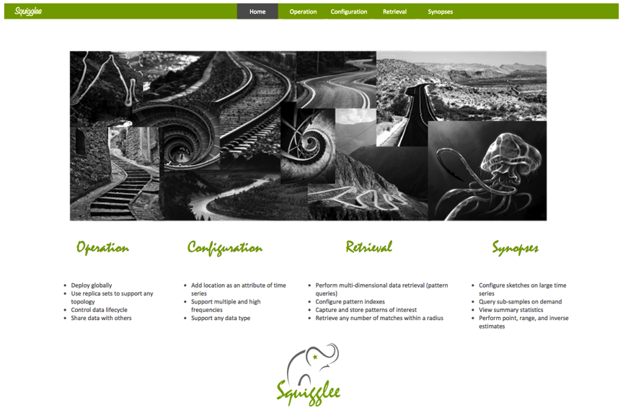
Home

Slide 19
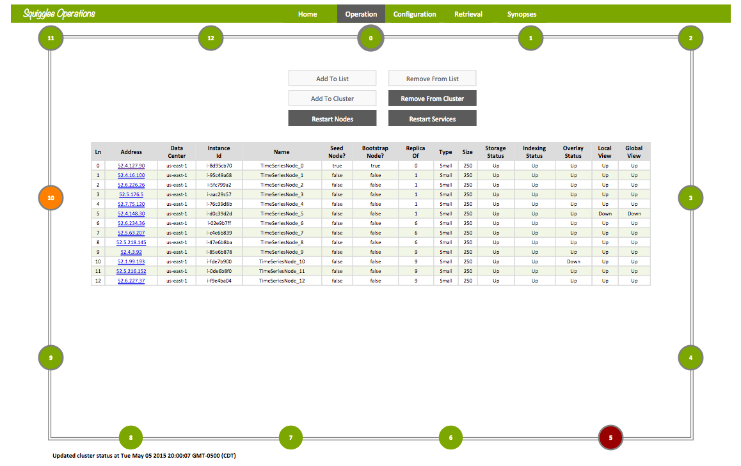
Operation

Slide 20
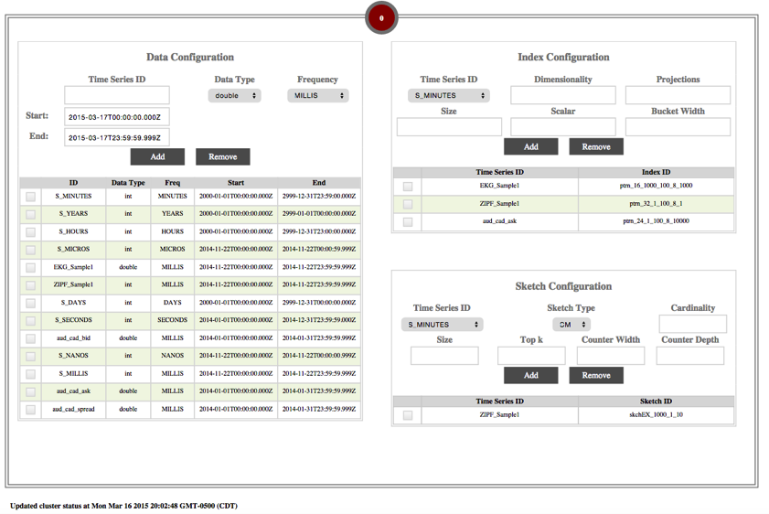
Configuration

Slide 21
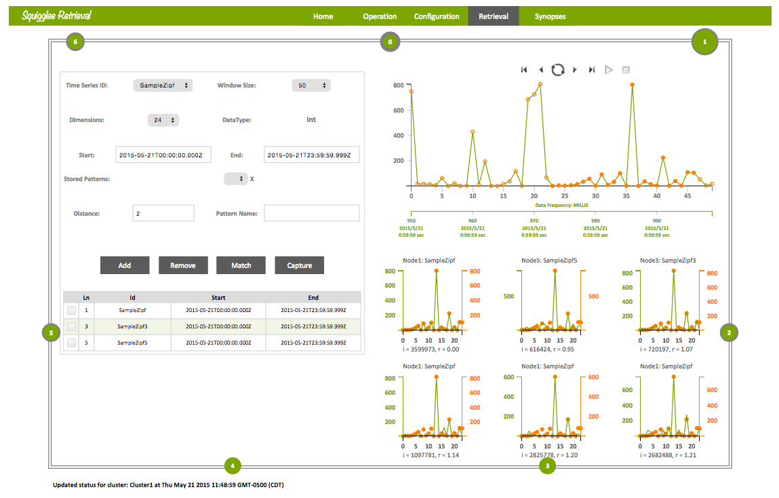
Retrieval

Slide 22
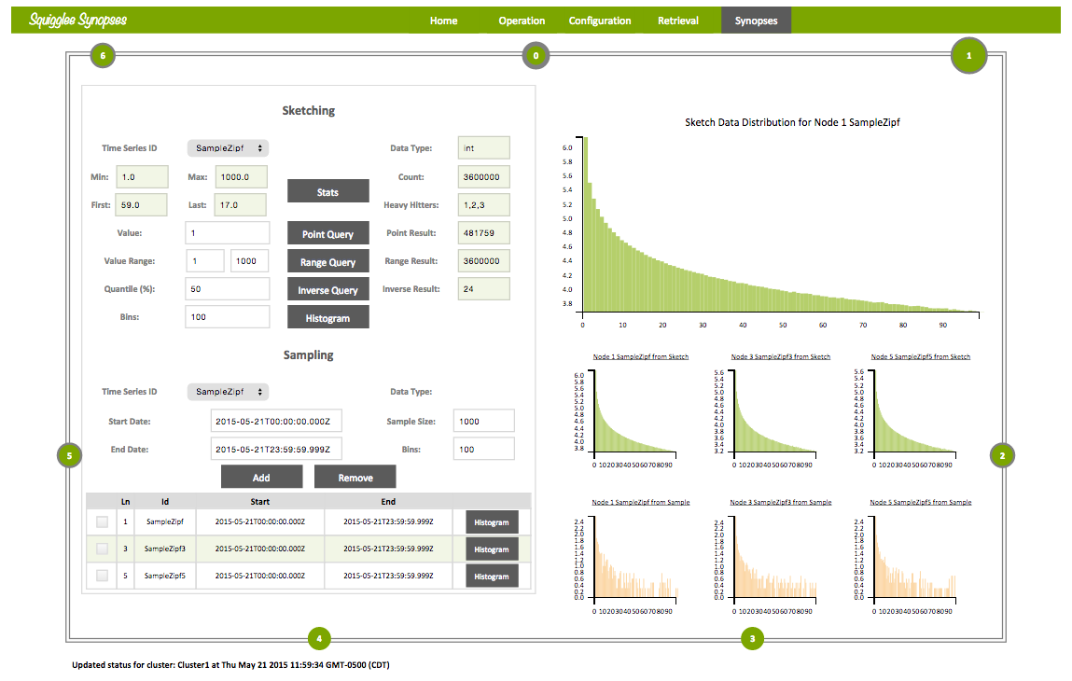
Synopses

Slide 23
Thank You
For More Information Contact:
Dr. Ramesh K. Raghunathan
@ 214-620-1863
ramesh.k.raghunathan@gmail.com

