Slide 1


Data Governance @ SneakerPark
Prepared by: Rameshkumar Shanmugam
Submitted on: 08th Oct 2023

Slide 2
Background
SneakerPark is an online shoe reseller that allows people to buy and sell used and new shoes. Buyers can bid for shoes or buy them outright, and sellers can set a price or sell to the highest bidder.
Each buyer and seller must have an active account in order to sell, bid, or purchase sneakers using SneakerPark’s website.
SneakerPark authenticates the shoes before shipping them to the buyer, so before listing an item, the seller must ship it to SneakerPark’s warehouse. Upon receipt, SneakerPark assigns an item number to each pair of sneakers and notifies the seller that they are now free to list their item. If the item is not listed within 45 days, SneakerPark returns it to the seller and sends an invoice to the seller for the shipping cost.
If the item is found to be inauthentic or in an unacceptable condition, it is also returned back to the seller in a similar fashion.
When the item sells, the buyer’s account is credited with the purchase price minus the SneakerPark service fee and shipping fees to deliver the item to the buyer.
Currently, SneakerPark only supports sales within the United States.

Slide 3
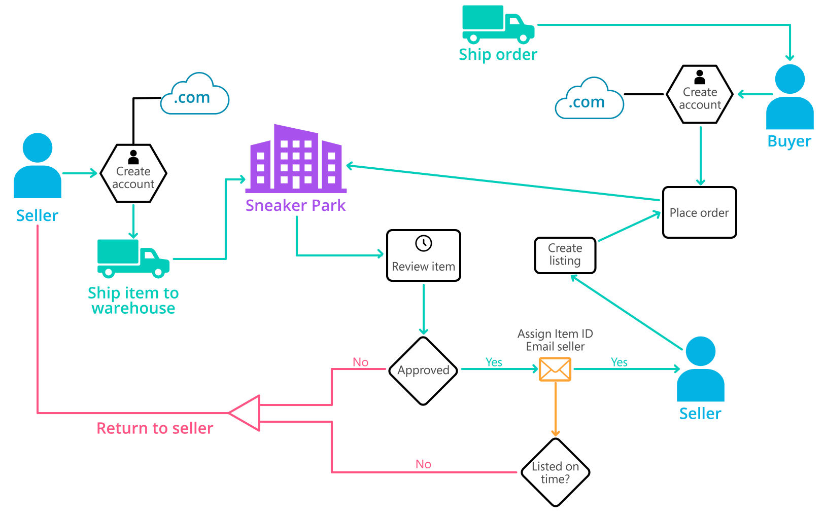
Background (cont’d)
Below you can see a diagram that will hopefully help you visualize some of SneakerPark's business processes. Keep in mind that it does not capture ALL processes and every nuance, but simply serves as another artifact to use in your project.

Slide 4
Step 1
Enterprise Data Catalog Part 1: Enterprise Data Model

Slide 5
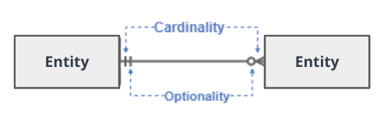
Create a conceptual data model that will provide SneakerPark with a holistic view of its data systems and help you grasp the organization's important entities and relationships, which will be instrumental as you move further in the project. You can use Lucidchart or any other diagramming tool of your choice, but please use the Crow’s Foot/IE Notation and please be sure to indicate both cardinality (the type of a relationship such as 1:N or N:N) and optionality (whether the relationship is optional or mandatory).

Slide 6
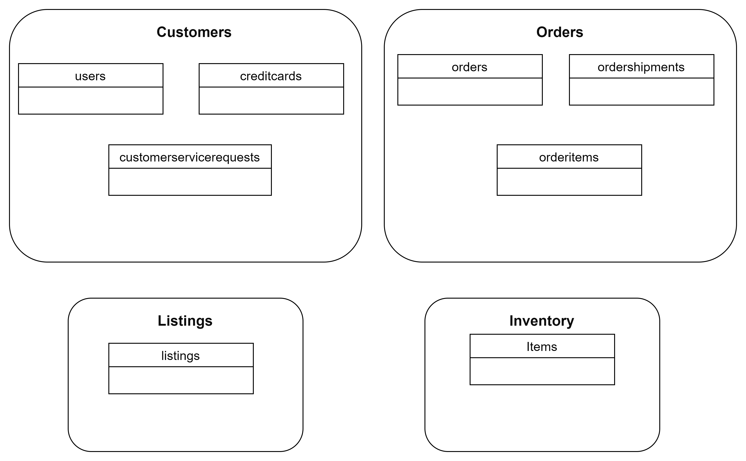
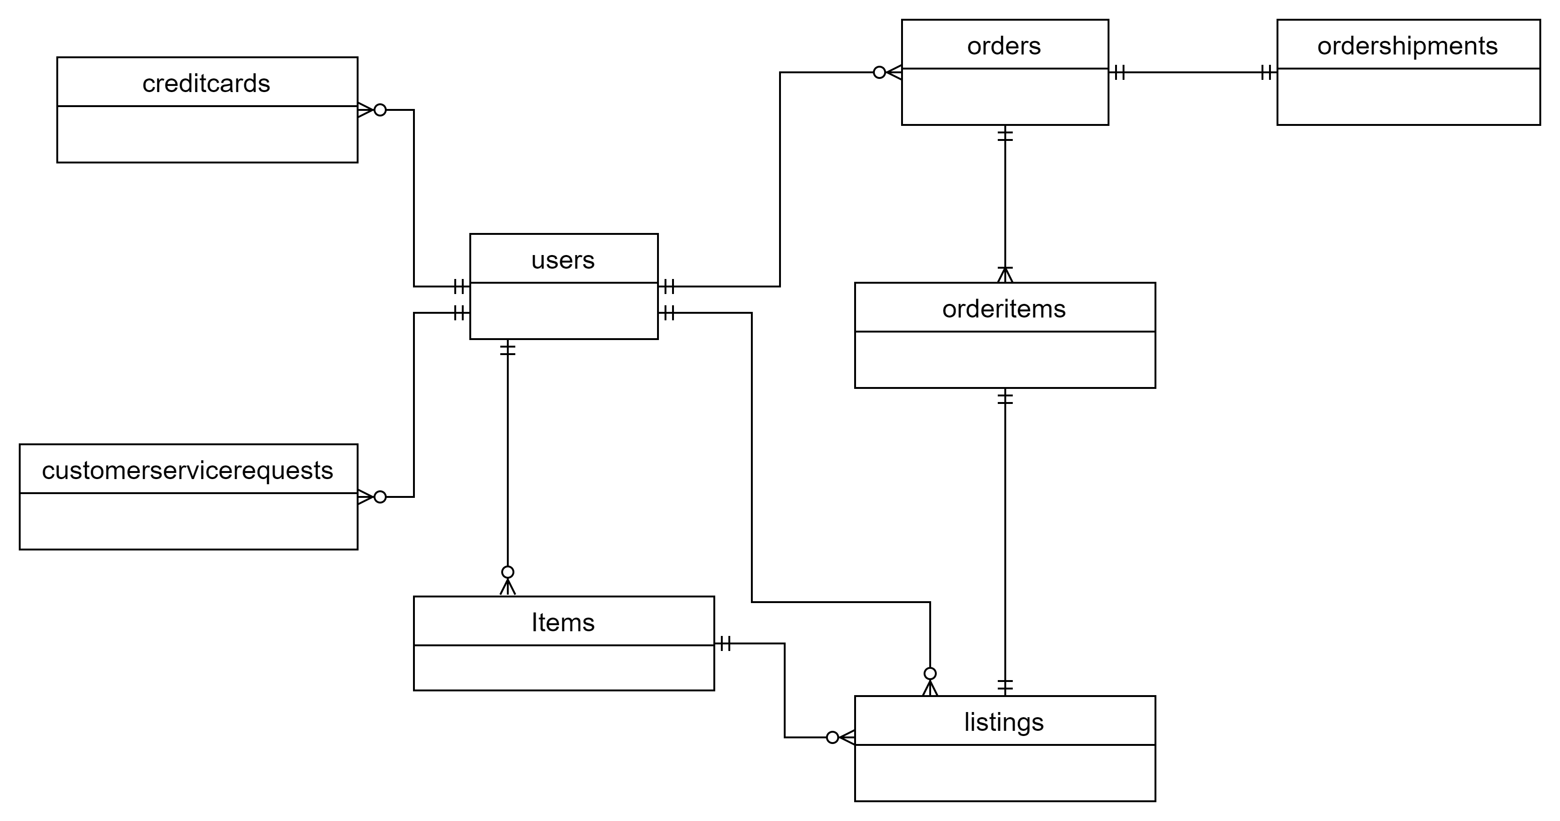

Slide 7
Step 2
Enterprise Data Catalog Part 2: Metadata

Slide 8
Create the first version of the Metadata Catalog by documenting the metadata from all systems in the "Data Dictionary" and the “Enterprise Data Catalog” tabs of the provided Sheets template.
Please note that you are required to fill out all fields in both tabs.

Slide 9
Step 3
Data Quality
Part 1: Profiling and Cleansing

Slide 10
Profile the data to identify at least 3 data quality issues you see in the data. Also provide at least 1 data quality issue that you haven’t yet seen in the data, but can foresee occurring in the future. Based on the issues you’ve identified, come up with the data quality rule for each data quality issue, including for the one that you foresee.
Make sure you fill out all columns in the "Data Quality Issues" tab with your answers in the provided Sheets template.

Slide 11
Step 4
Data Quality
Part 2: Monitoring

Slide 12
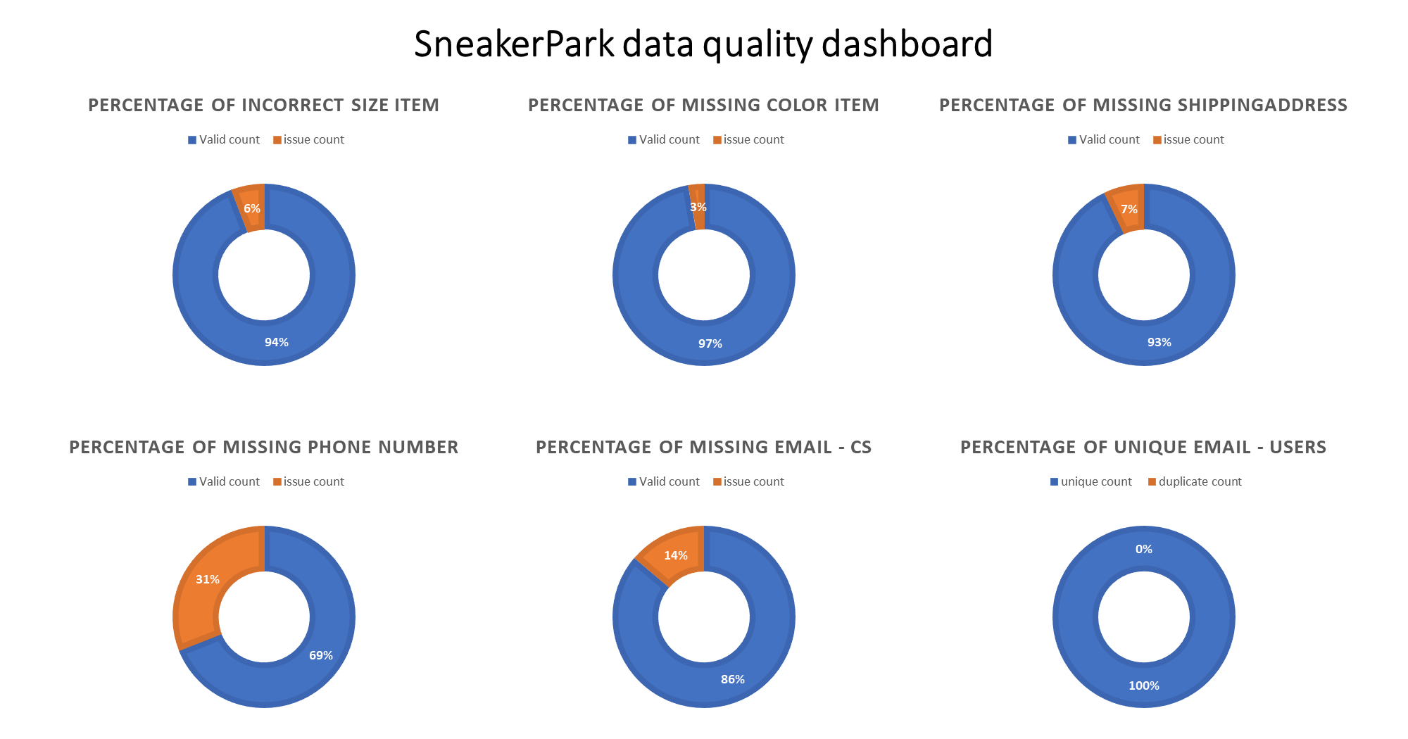
Using the metrics you've created in the last step, please create a mock-up of a data quality monitoring dashboard that will be used to monitor the data to ensure compliance with your data quality rules.
Please make sure to label your metrics clearly on your mock-up.
Replace the example dashboard below with your own. (obviously feel free to take more space).

Slide 14
Step 5
Master Data Management
Part 1: MDM Architecture

Slide 15

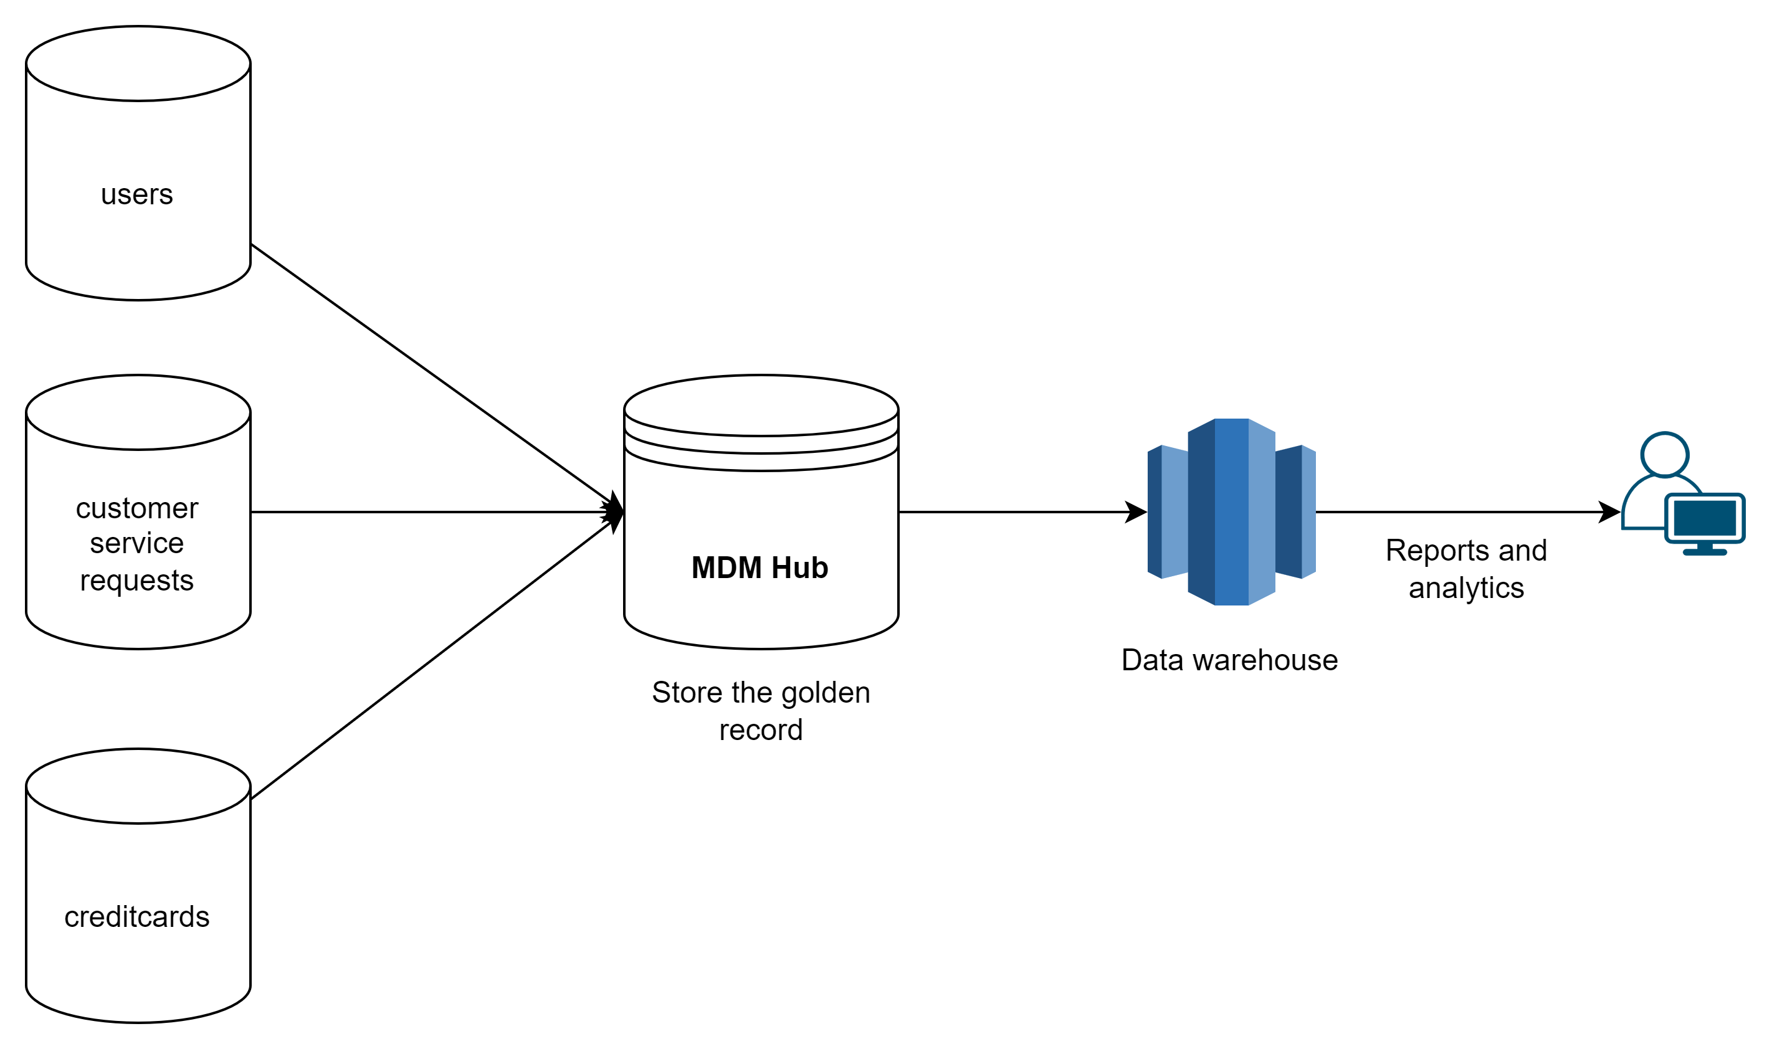
Based on what you’ve read about SneakerPark’s systems and business model, sketch out a proposed MDM implementation architecture, and write a detailed explanation of why you chose this specific approach.
Tip: Think about how your plan and its implementation might affect existing systems.
Replace example screenshot below with your own solutions (obviously feel free to take more space).
Next, please write at least a paragraph explaining your choice.

Slide 16

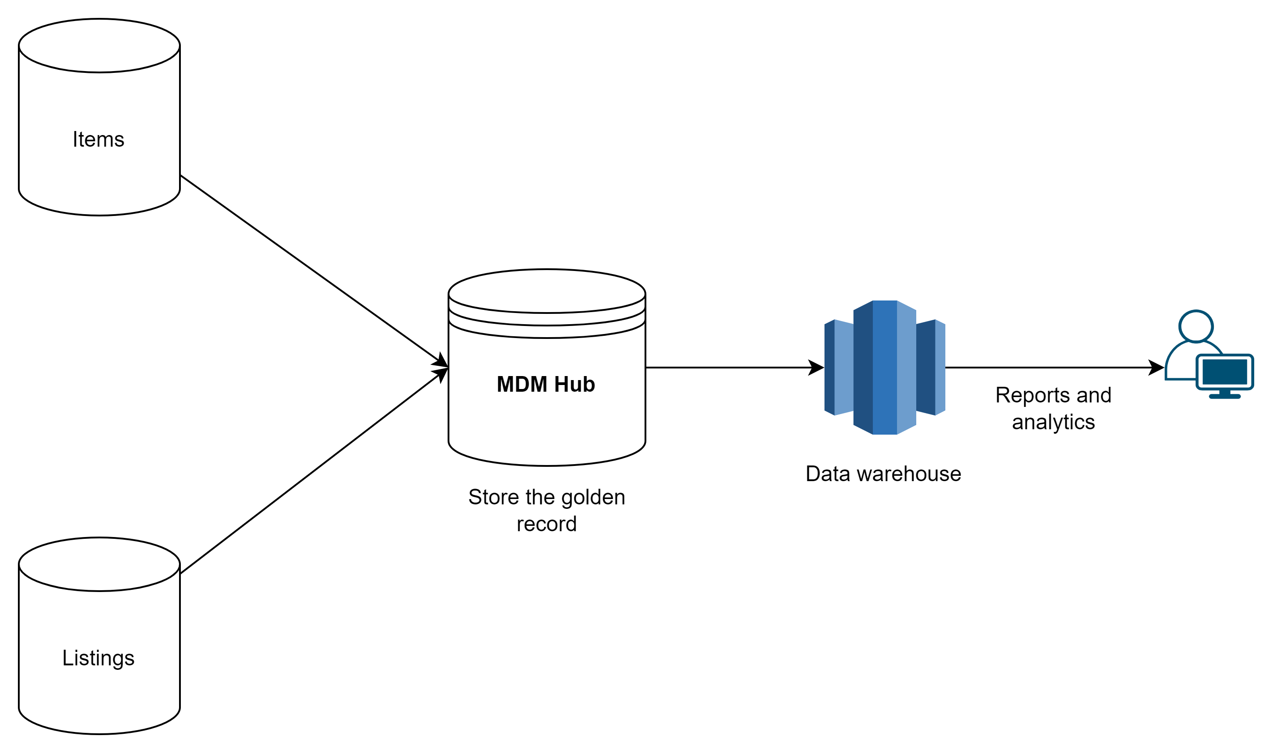
Explanation:
SneakerPark has its data distributed in a variety of sources. According to the Technical Details document, Inventory Management and Customer Service Application are largely isolated from the other systems and from each other. For the SneakerPark, the MDM system architecture should be Consolidated given nature of SneakerPark business the proposal has to be minimally disruptive. This is achieved with the Consolidated MDM because it won't affect existing source systems and it is not expensive to implement at sneakerPark

Slide 17
Step 6
Master Data Management
Part 2: Master Record

Slide 18
In this step, you will define a set of matching rules that will be used by the SneakerPark's MDM Hub to match item and customer entities between the company's different systems.
Please come up with 4 rules - 2 for Items and 2 for Customers and list them below.
Table | Rules
Item | Match itemid from Items with productid from listings and sellerid from items with sellerid from listings
Item | Match Itemid, brandname, color and sex from items with productid, brand, color and gender from listings
Customer | Match userid from users table with userid from customerservicerequests
Customer | Match userid from users table with userid from creditcards

Slide 19
Step 7
Data Governance:
Roles and Responsibilities

Slide 20
Write 1-2 paragraphs discussing what data governance roles and responsibilities will be necessary to oversee this new Data Management initiative. Please be sure to discuss the responsibilities in the context of at least 3 different aspects of Data Governance (such as Data Quality Management, Metadata Management, MDM, etc). Based on what you know, do SneakerPark's current employees have the necessary skills for these roles or should the company make new hires?
Data Engineer should be responsible for data pipeline management and monitoring, data quality tracking and management and MDM . Jake is currently playing as IT support and good experience on handling all systems at sneakerPark. since he does not much exposure to data engineering domain, he can upskill himself in data engineering/analytics domain through online trainings to support this role
Data Steward should be responsible for updating the data dictionary business context in the SneakerPark’ s Metadata Management in case of either a new addition (tables or columns) as well as business description changes. Jessica has business understanding of every part of the organization .Jessica can take up this role
Data Architect should be responsible for defining the workflow of the Data Quality Management and Metrics, as well as the Master Data Management architecture for the entire system, in order to find an automated and smart way to identify breaches and data quality issues. This role can be taken up Rameshkumar Shanmugam since he has a solid experience building data platforms, MDM and data governance at enterprise level

Slide 21
Standout Suggestions

Slide 22
Create a Business Glossary for SneakerPark and define common terms such as Item, Buyer, etc. Think and discuss how SneakerPark can improve on the consistency of the terms that its systems currently use. (You can use the “Business Glossary” tab of the same Sheets template you’ve been using for the other parts of this project to get you started.)
Document SneakerPark’s current naming conventions. Can you think of any improvements? (You can use the “Standard Naming Conventions” tab of the same Sheets template you’ve been using for the other parts of this project to get you started.) Some examples of Naming Conventions include;
Do not use spaces or special characters.
Use only LOWERCASE.
All identifier fields should end in “_id”.
Avoid acronyms and abbreviations.
Write SQL scripts for the matching rules that you’ve created in Step 6.

