Slide 1


Tech ABC Corp - HR Database
[Rameshkumar Shanmugam & 26th July 2023]

Slide 2
Business Scenario
Business requirement
Tech ABC Corp saw explosive growth with a sudden appearance onto the gaming scene with their new AI-powered video game console. As a result, they have gone from a small 10 person operation to 200 employees and 5 locations in under a year. HR is having trouble keeping up with the growth, since they are still maintaining employee information in a spreadsheet. While that worked for ten employees, it has becoming increasingly cumbersome to manage as the company expands.
As such, the HR department has tasked you, as the new data architect, to design and build a database capable of managing their employee information.
Dataset
The HR dataset you will be working with is an Excel workbook which consists of 206 records, with eleven columns. The data is in human readable format, and has not been normalized at all. The data lists the names of employees at Tech ABC Corp as well as information such as job title, department, manager's name, hire date, start date, end date, work location, and salary.
IT Department Best Practices
The IT Department has certain Best Practices policies for databases you should follow, as detailed in the Best Practices document.

Slide 3
Step 1
Data Architecture Foundations

Slide 4
Step 1: Data Architecture Foundations
Hi,
Welcome to Tech ABC Corp. We are excited to have some new talent onboard. As you may already know, Tech ABC Corp has recently experienced a lot of growth. Our AI powered video game console WOPR has been hugely successful and as a result, our company has grown from 10 employees to 200 in only 6 months (and we are projecting a 20% growth a year for the next 5 years). We have also grown from our Dallas, Texas office, to 4 other locations nationwide: New York City, NY, San Francisco, CA, Minneapolis, MN, and Nashville, TN.
While this growth is great, it is really starting to put a strain on our record keeping in HR. We currently maintain all employee information on a shared spreadsheet. When HR consisted of only myself, managing everyone on an Excel spreadsheet was simple, but now that it is a shared document I am having serious reservations about data integrity and data security. If the wrong person got their hands on the HR file, they would see the salaries of every employee in the company, all the way up to the president.
After speaking with Jacob Lauber, the manager of IT, he suggested I put in a request to have my HR Excel file converted into a database. He suggested I reach out to you as I am told you have experience in designing and building databases. When you are building this, please keep in mind that I want any employee with a domain login to be have read only access the database. I just don't want them having access to salary information. That needs to be restricted to HR and management level employees only. Management and HR employees should also be the only ones with write access. By our current estimates, 90% of users will be read only.
I also want to make sure you know that am looking to turn my spreadsheet into a live database, one I can input and edit information into. I am not really concerned with reporting capabilities at the moment. Since we are working with employee data we are required by federal regulations to maintain this data for at least 7 years; additionally, since this is considered business critical data, we need to make sure it gets backed up properly.
As a final consideration. We would like to be able to connect with the payroll department's system in the future. They maintain employee attendance and paid time off information. It would be nice if the two systems could interface in the future
I am looking forward to working with you and seeing what kind of database you design for us.
Thanks,
Sarah Collins
Head of HR

Slide 5
Data Architect Business Requirement
Purpose of the new database: Currently employee records are maintained in Excel sheet. It is being shared with all employees now , so current data storage system is not capable to maintain data integrity and security characteristics . New database required to maintain data integrity ,security and consistency
Describe current data management solution:Current method of data storage/management format is excel work sheet
Describe current data available: Current data consists of employee ID, employee Name, email, Hire date, job title, department, salary, manager,employment start date and end date, work location, address, city, state, education level
Additional data requests: it has to be integrated with payroll management in the future.
Who will own/manage data : Employees from HR department and Management team
Who will have access to database. Employee with domain login can have only read access to data except salary information. Employees from HR department and management team should have access to all data with read and write premissions

Slide 6
Data Architect Business Requirement
Estimated size of database
Current data size is 205 rows and 15 columns
Estimated annual growth
It is expected to growth 20% per year for the next 5 years
Is any of the data sensitive/restricted
Salary data should not be shown to all employees except HR and management team.
All employees should have read only access to data except HR and Management team

Slide 7
Data Architect Technical Requirement
Justification for the new database
Data integrity , security and availability
Database objects
The following tables will be created
Employee_details , Employment_details ,Salary, Department, location, Address, Education_level_Details, Job_Title
Data ingestion
Based on current data structure , ETL would be the right data ingestion method

Slide 8
Data Architect Technical Requirement
Data governance (Ownership and User access)
Ownership: Employees from HR team
User Access: All employees should have read only access to data except salary information. HR employees and management team should have both read and write access
Scalability : replication would be used to ensure scalability based on user needs
Flexibility: it is able to handle additional data like direct feed from Payroll system in the future, additional characteristics like employee performance and leave details…etc
Storage & retention
Storage (disk or in-memory): Disk based storage approach
Retention: As per federal regulations to maintain this data for at least 7 years
Backup
incremental backup should happen on daily basis
full backup should happen on weekly basis

Slide 9
Step 2
Relational Database Design

Slide 10
Step 2: Relational Database Design
This step is where you will go through the process of designing a new database for Tech ABC Corp's HR department. Using the dataset provided, along with the requirements gathered in step one, you are going to develop a relational database set to the 3NF.
Using Lucidchart, you will create 3 entity relationship diagrams (ERDs) to show how you developed the final design for your data.
You will submit a screenshot for each of the 3 ERDs you create. You will find detailed instructions for developing each of the ERDs over the next several pages.

Slide 11
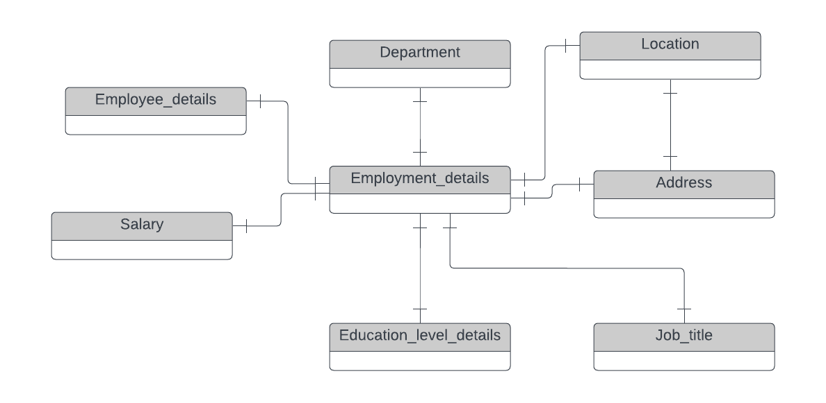
ERD
Conceptual
This is the most general level of data modeling. At the conceptual level, you should be thinking about creating entities that represent business objects for the database. Think broadly here. Attributes (or column names) are not required at this point, but relationship lines are required (although Crow's foot notation is not needed at this level). Create at least three entities for this model; thinking about the 3NF will aid you in deciding the type of entities to create.
Use Lucidchart’s built-in template for DBMS ER Diagram UML.

Slide 12
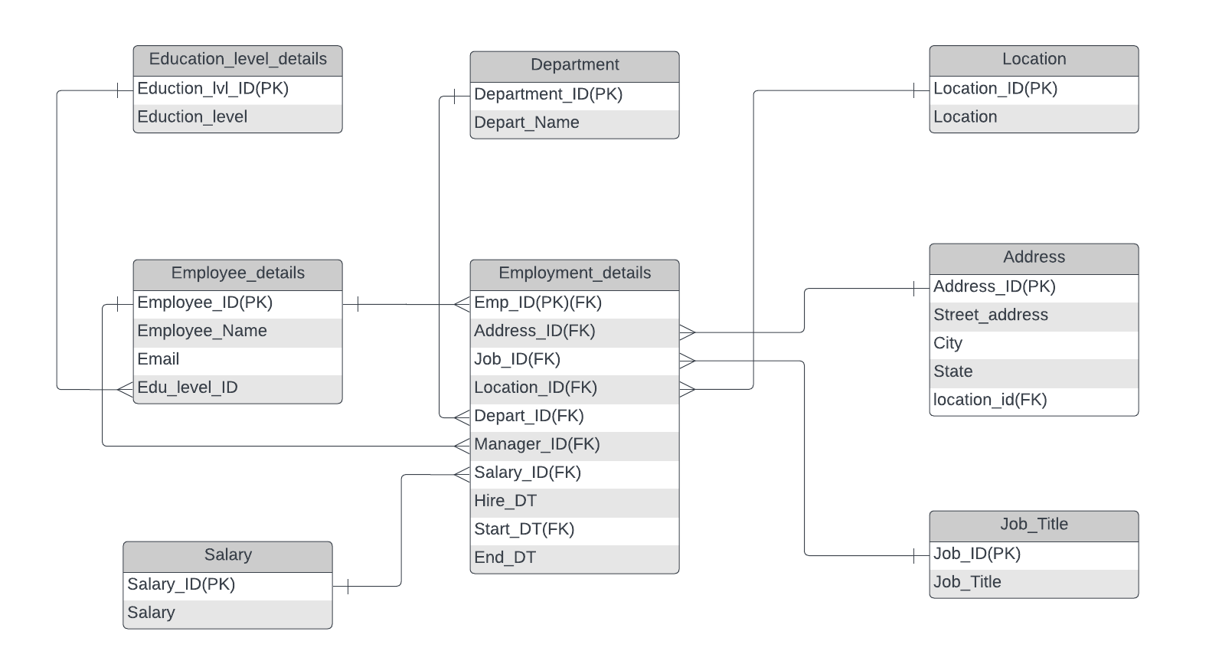
ERD
Logical
The logical model is the next level of refinement from the conceptual ERD. At this point, you should have normalized the data to the 3NF. Attributes should also be listed now in the ERD. You can still use human-friendly entity and attribute names in the logical model, and while relationship lines are required, Crow's foot notation is still not needed at this point.
Use Lucidchart’s built-in template for DBMS ER Diagram UML.

Slide 13
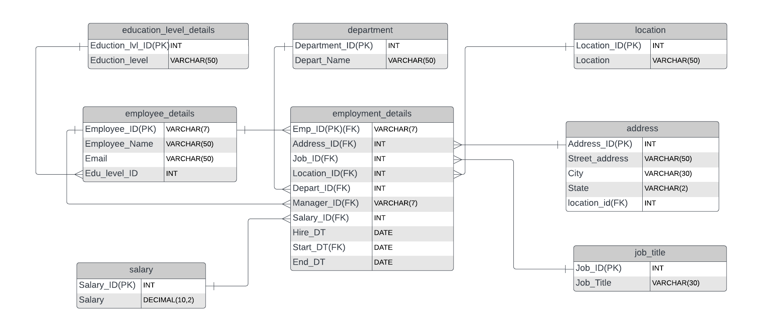
ERD
Physical
The physical model is what will be built in the database. Each entity should represent a database table, complete with column names and data types. Primary keys and foreign keys should also be represented here. Primary keys should be in bold type with the (PK) designation following the field name. Foreign keys should be in normal type face, but have the designation (FK) after the column name. Finally, in the physical model, Crow's foot notation is important.

Slide 14
Step 3
Create A Physical Database

Slide 15
Step 3: Create A Physical Database
In this step, you will be turning your database model into a physical database.
You will:
Create the database using SQL DDL commands
Load the data into your database, utilizing flat file ETL
Answer a series of questions using CRUD SQL commands to demonstrate your database was created and populated correctly
Submission
For this step, you will need to submit SQL files containing all DDL SQL scripts used to create the database.
You will also have to submit screenshots showing CRUD commands, along with results for each of the questions found in the starter template.
Hints
Your DDL script will be graded by running the code you submit. Please ensure your SQL code runs properly!
Foreign keys cannot be created on tables that do not exist yet, so it may be easier to create all tables in the database, then to go back and run modify statements on the tables to create foreign key constraints.
After running CRUD commands like update, insert, or delete, run a SELECT* command on the affected table, so the reviewer can see the results of the command.

Slide 16
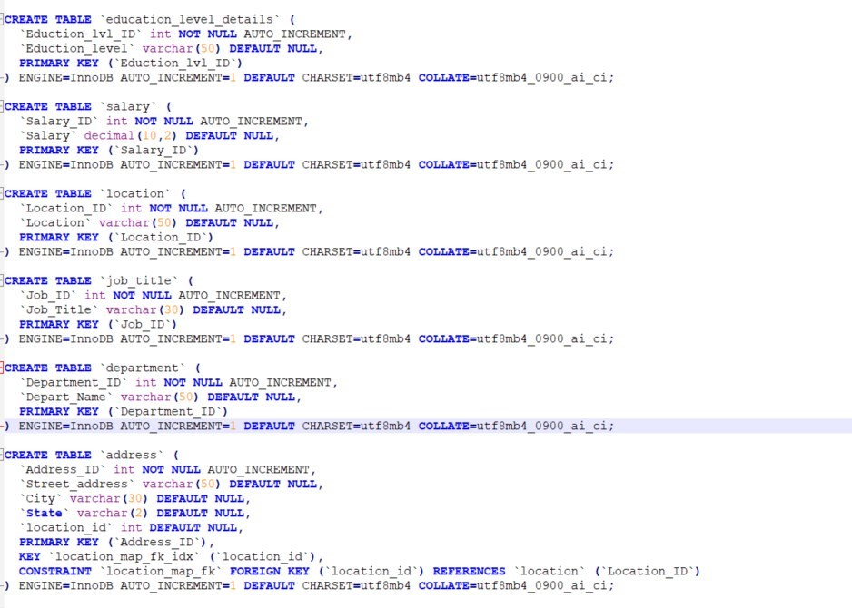
DDL
Create a DDL SQL script capable of building the database you designed in Step 2. Had some challenges setting up PostgreSQL database in my machine . MySQL Database has been used to setup tables and performed rest of the CRUD activities.

Slide 17
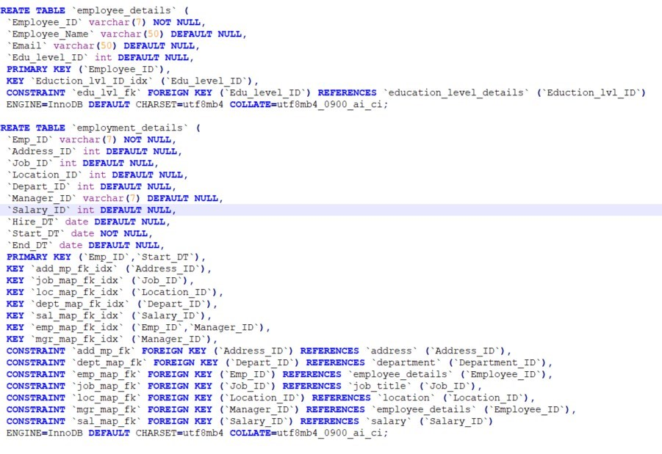
DDL – contd..
Create a DDL SQL script capable of building the database you designed in Step 2

Slide 18
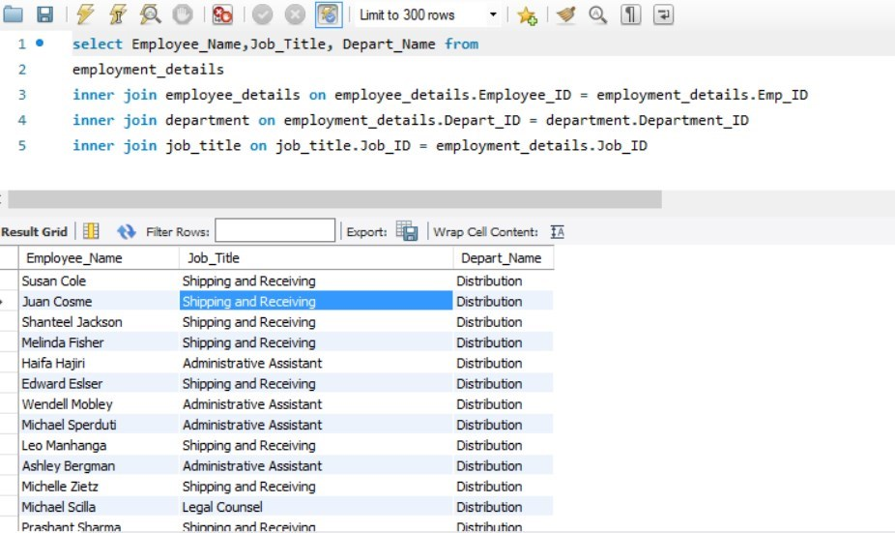
CRUD
Question 1: Return a list of employees with Job Titles and Department Names

Slide 19
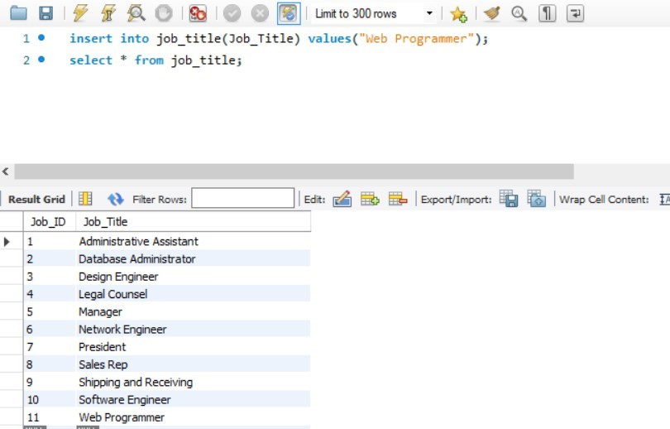
CRUD
Question 2: Insert Web Programmer as a new job title

Slide 20
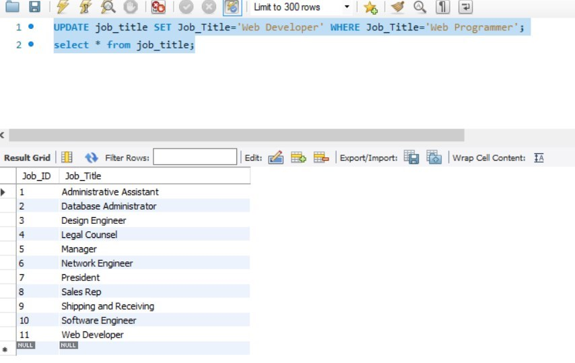
CRUD
Question 3: Correct the job title from web programmer to web developer

Slide 21
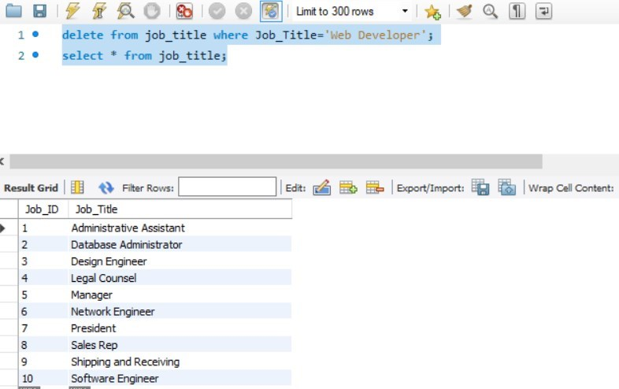
CRUD
Question 4: Delete the job title Web Developer from the database

Slide 22
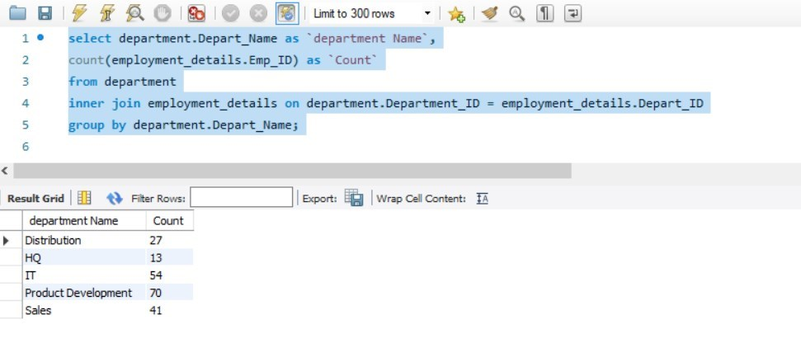
CRUD
Question 5: How many employees are in each department?

Slide 23
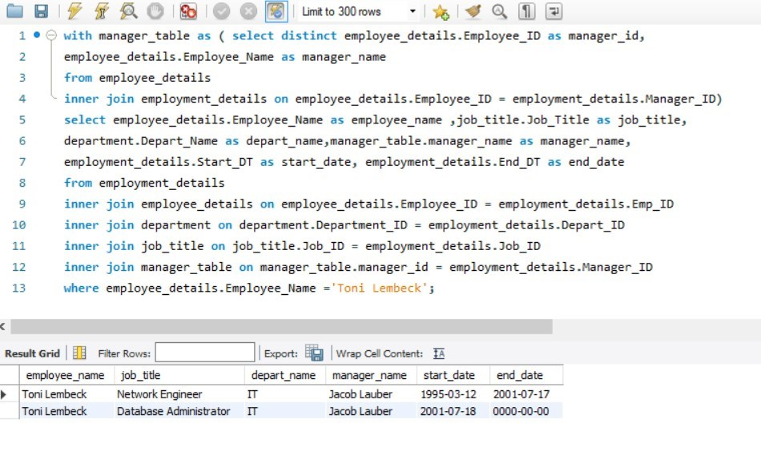
CRUD
Question 6: Write a query that returns current and past jobs (include employee name, job title, department, manager name, start and end date for position) for employee Toni Lembeck.

Slide 24
CRUD
Question 7: Describe how you would apply table security to restrict access to employee salaries using an SQL server.
there are two ways to restrict the access to salary table
Option 1:
Access level can be controlled from application level where employee from HR department or management team if they are then they have access to salary details otherwise they do not
Option 2:
two groups will be created in backend system, one group will complete read/write access (HR and Management team)
Other group read only access to all table except salary table. It will be managed through GRANT/REVOKE comments in MySQL

