Slide 1


Design a DHW for reporting and OLAP
[Rameshkumar Shanmugam & 24th Aug 2023]

Slide 2
Business Scenario
Problem statement
In this project scenario, students will use actual YELP and climate datasets in order to analyze the effects the weather has on customer reviews of restaurants. The data for temperature and precipitation observations are from the Global Historical Climatology Network-Daily (GHCN-D) database. Students will use a leading industry cloud-native data warehouse system called Snowflake for all aspects of the project.\
Students will then apply the skills they have acquired in the preceding Designing Data Systems Course to architect and design a Data Warehouse DWH for the purpose of reporting and online analytical processing (OLAP).
Data set
There are two data sets will be utilized in this project
Yelp data (https://www.yelp.com/dataset/download)
Weather data ( download in resource page)
Precipitation Data - USW00023169-LAS VEGAS MCCARRAN INTL AP-PRECIPITATION-INCH
Temperature Data - USW00023169-TEMPERATURE-DEGREEF

Slide 3
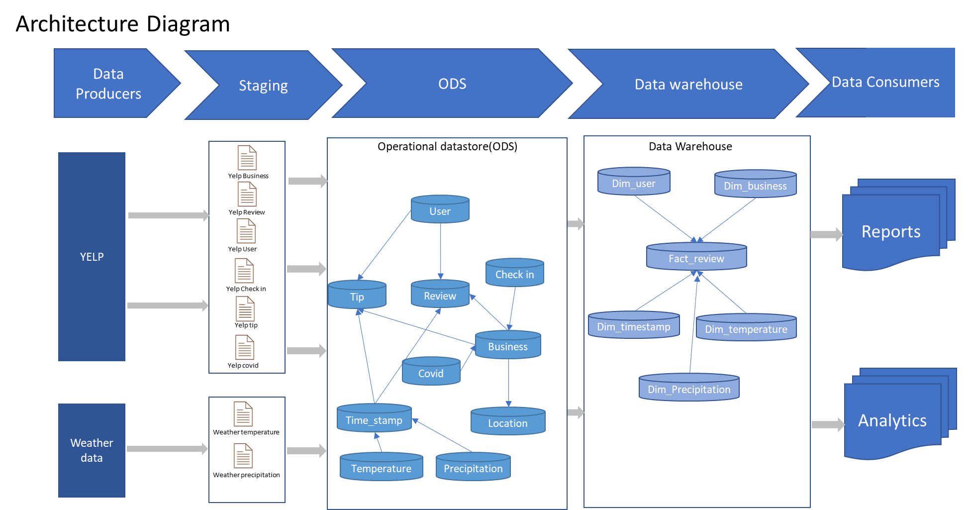
1. Data architecture diagram

Slide 4
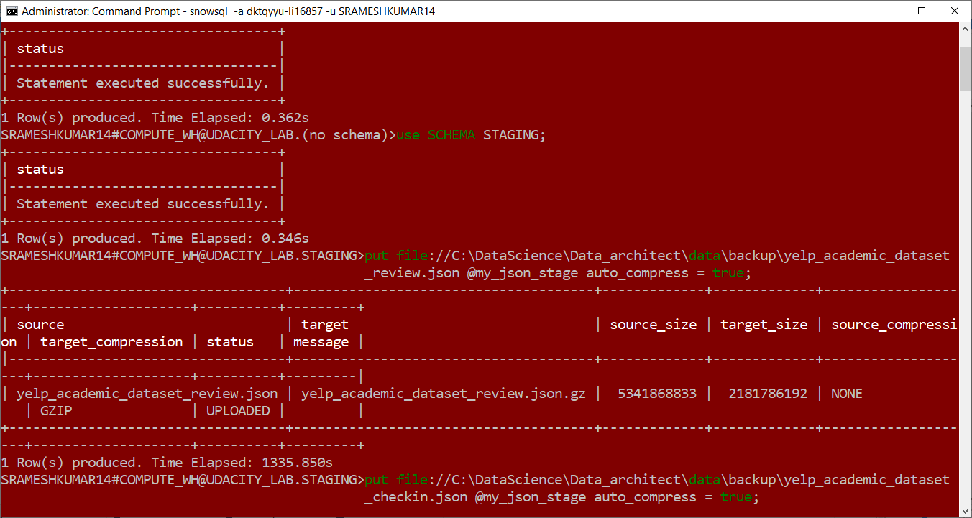
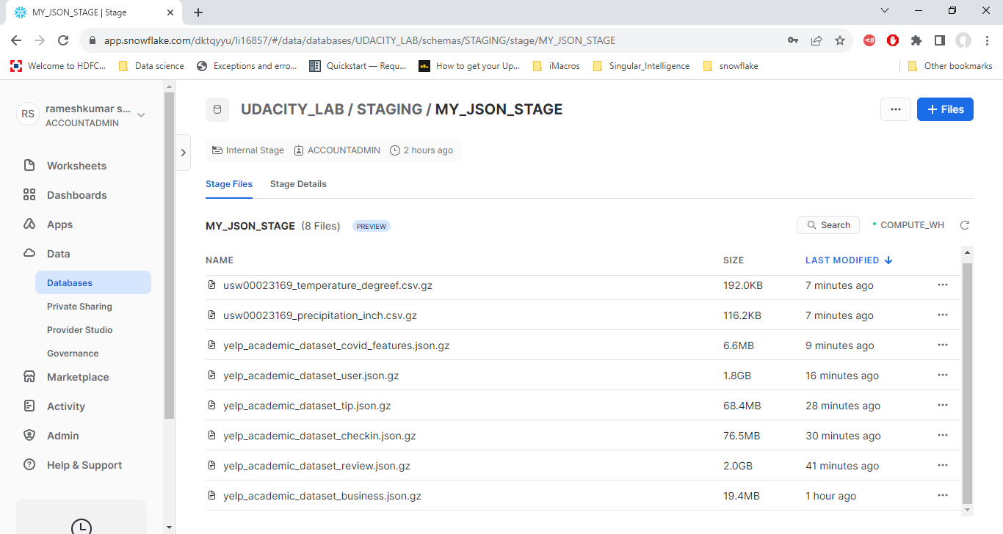
2. Screenshot of 6 tables uploading of yelp data

Slide 5
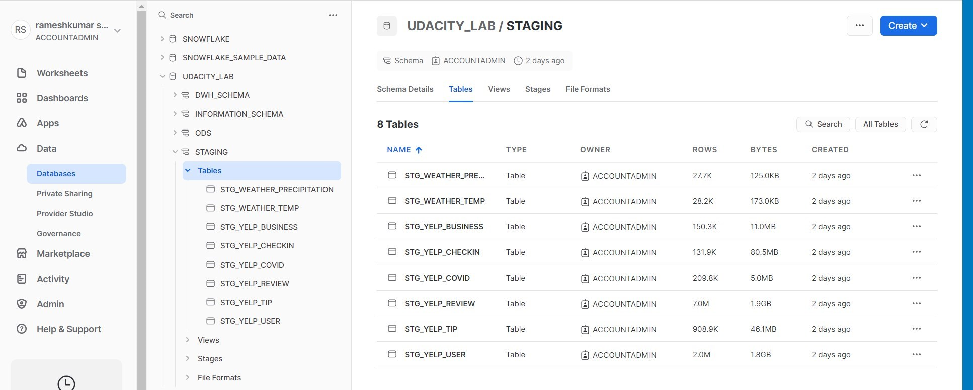
2. Screenshot of 6 tables uploading of yelp data

Slide 6
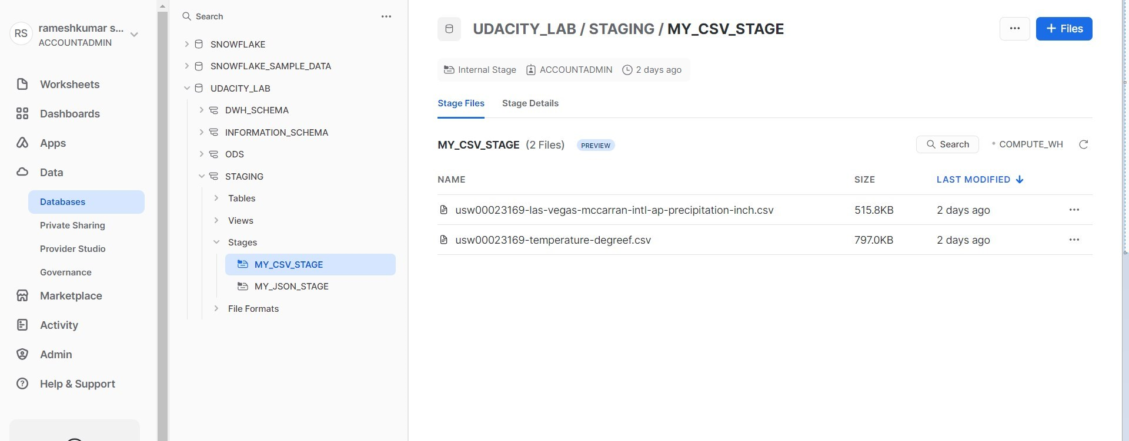
3. Screenshot of 2 tables uploading of climate data

Slide 7
4. SQL queries code to transform from staging to ODS
5. SQL queries code that use JSON functions to transform data from a single structure to multiple columns of ODS

Slide 8
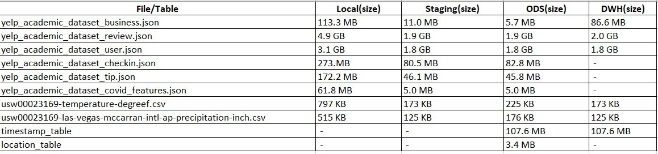
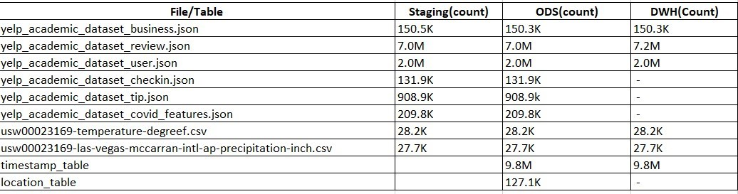
6. Screenshot that communicates different sizes/row_counts of raw, staging, and ODS tables in database

Slide 9
7. Data architecture diagram
8. SQL queries to integrate climate and yelp data

Slide 10
9. Star schema (DWH)
10. SQL queries move data from ODS to DWH

Slide 11
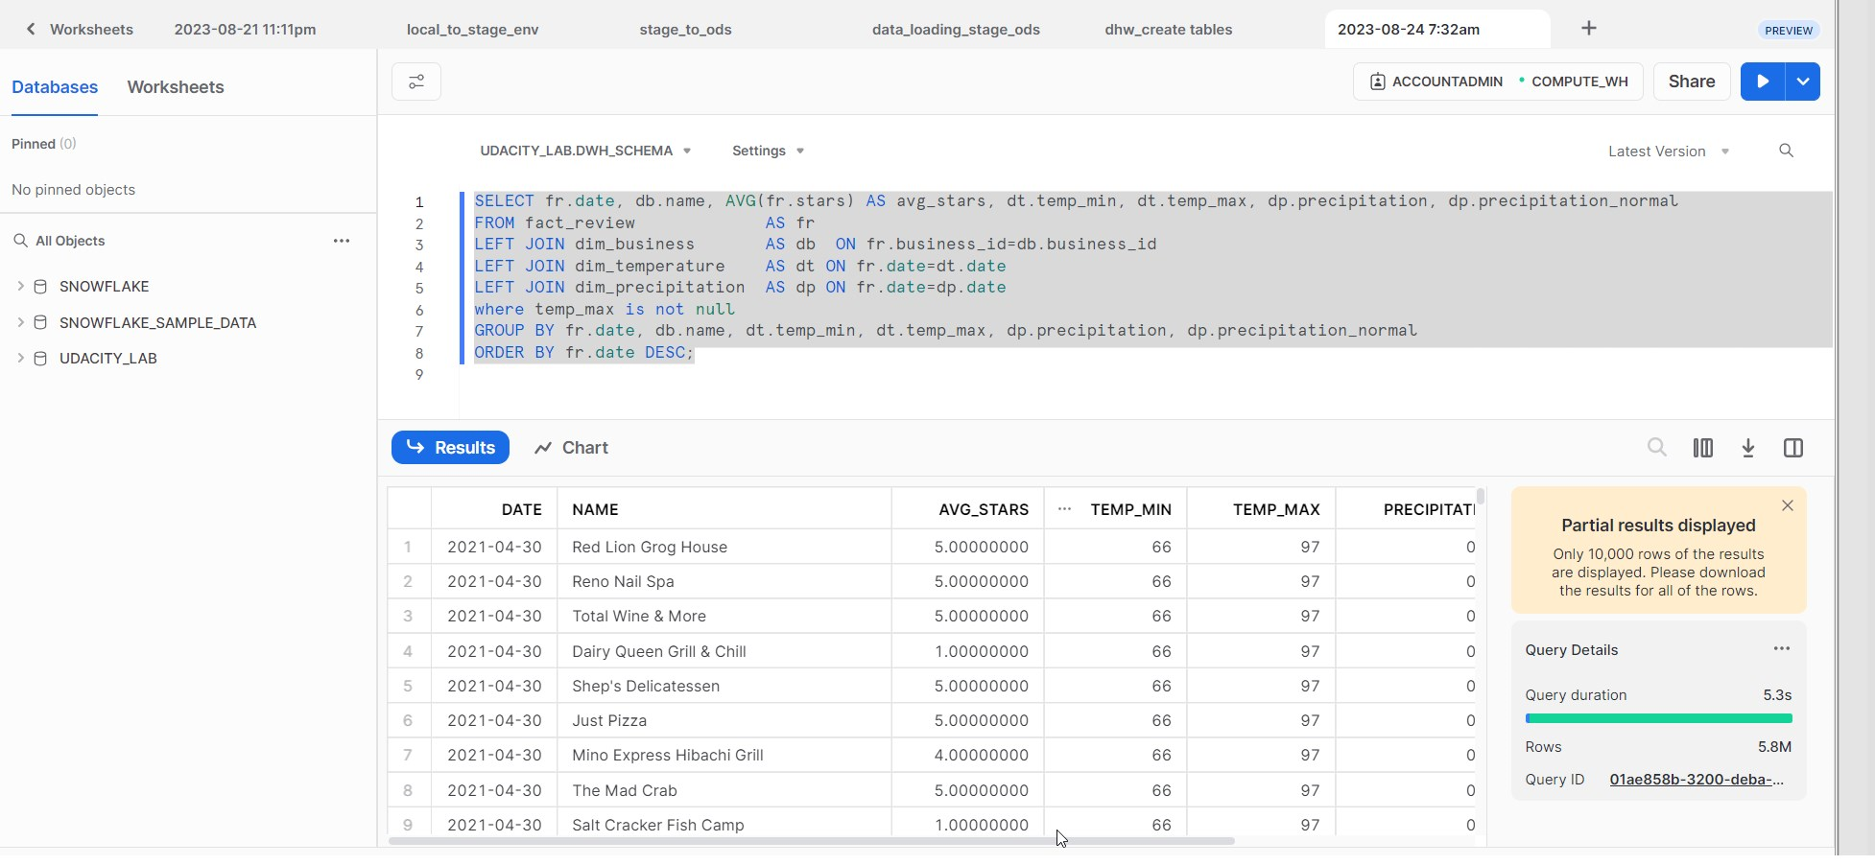
11. SQL queries code that report business name, temperature , precipitation, and ratings

