Slide 1
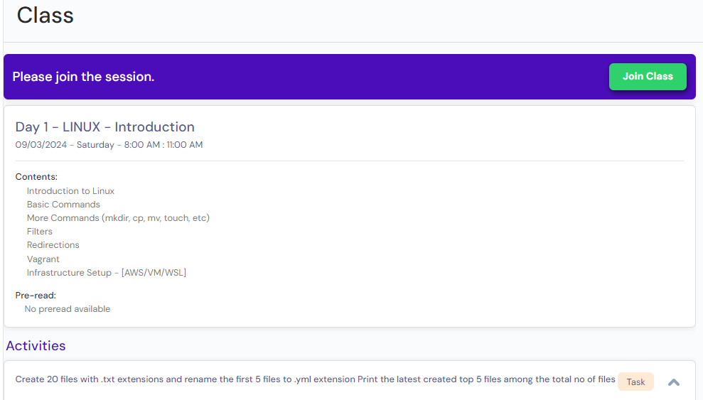
Mentor: Sanjay {technical mentor}
AWS Cloud Practioner
Consistency + Planning(Preparation - Practice) + Hard Work + FAQ preparation== Result

Slide 2
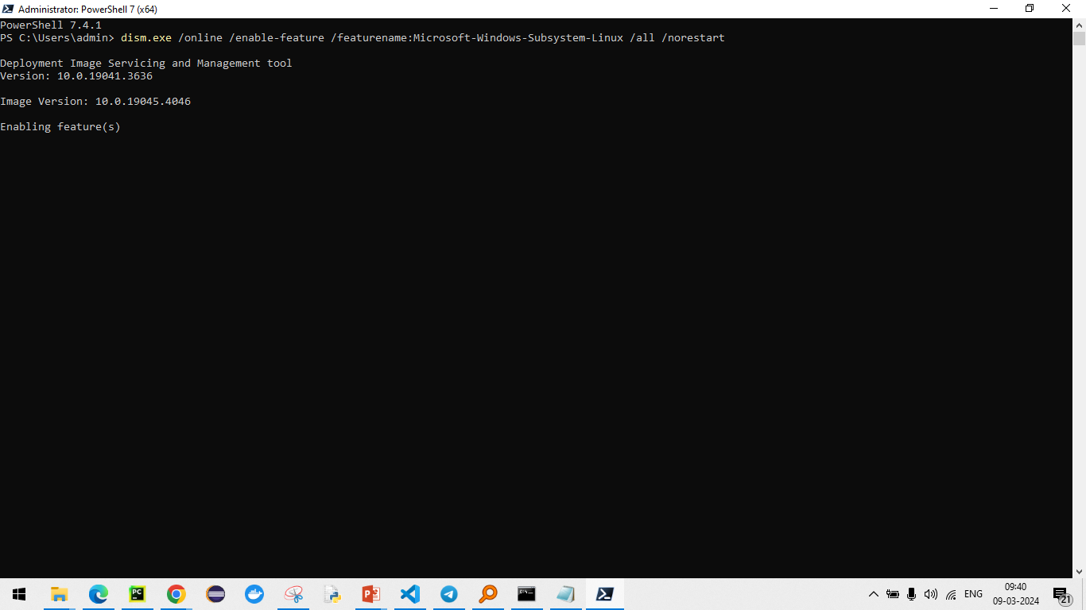

Slide 3
https://kernel.org/
GPL – General Public License
https://learn.microsoft.com/en-us/windows/wsl/install-manual

Slide 4
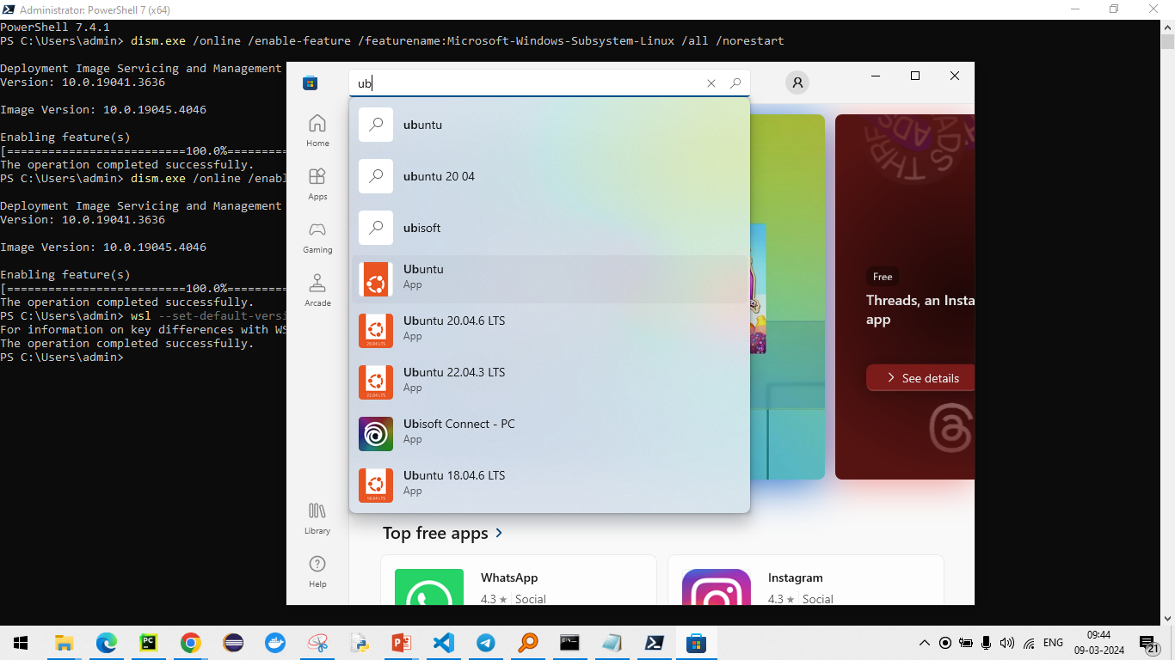

Slide 5
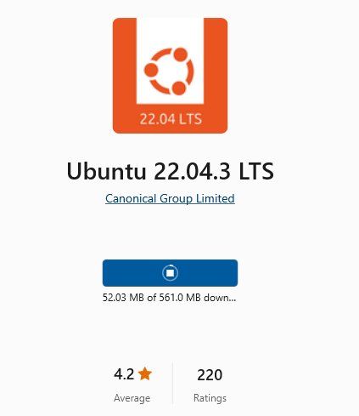
Ubuntu
Windows
Laptop

Slide 6
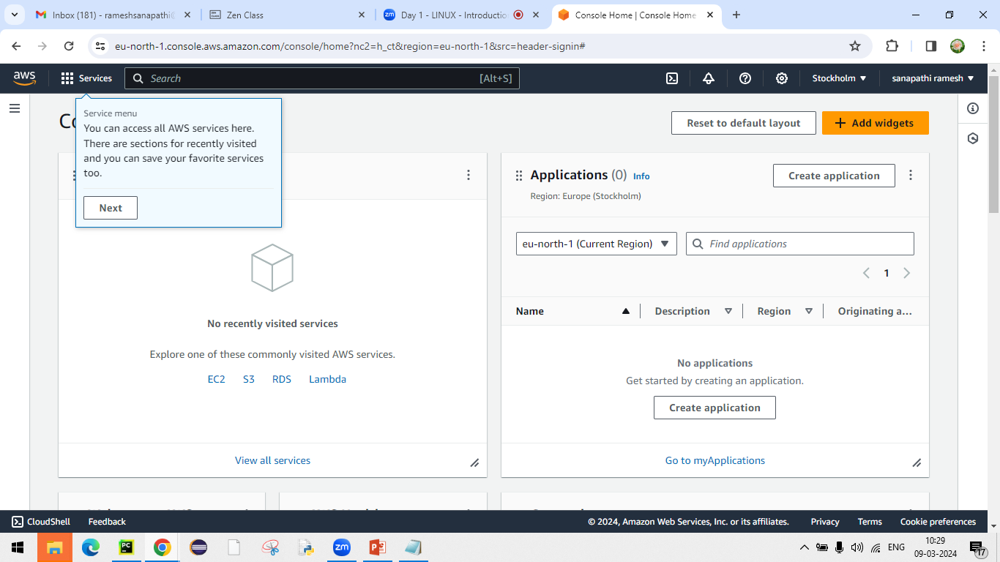

Slide 7
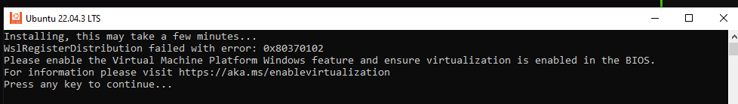
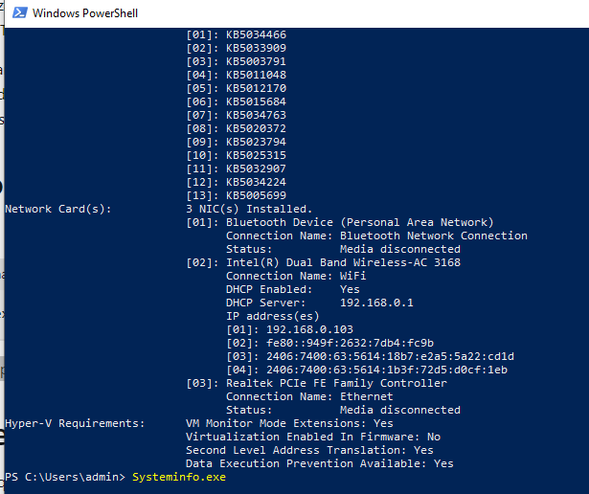

Slide 8
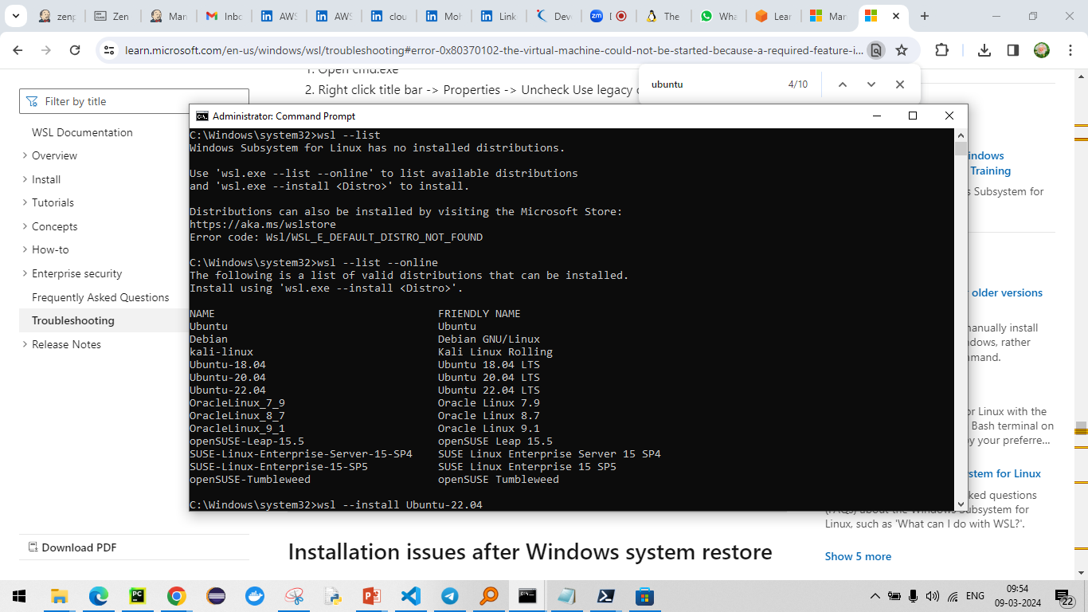

Slide 9
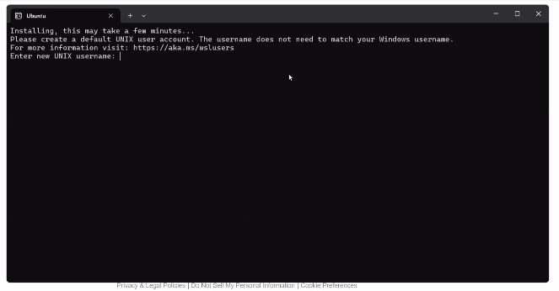

Slide 10
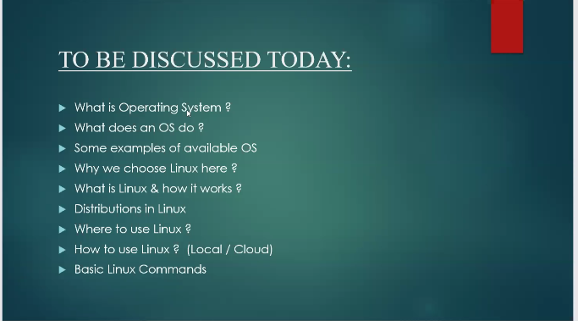
DevOps is very crucial
What is DevOps ? Before DevOps, How it works ?
Before DevOps, Teams are working alone/separately,
It led communication gap.
Each team working as individual responsibility but not collaboration
Dev
Test
Deployment
Operational
Provide RCA
DevOps: is a setup of standard practices/procedures which are followed in order to achieve smooth deployment in automated way.
Why this issue occurred ?
How this issue occurred ?
When this issue occurred ?
Provide RCA

Slide 11
DevOps: is a setup of standard practices/procedures which are followed in order to achieve smooth deployment in automated way.
Development and Operations.
It is not language or tool.
It is a standard practice or way to improve collaboration between dev and operations to delivery software from development to user in better and fastest way.

Slide 12
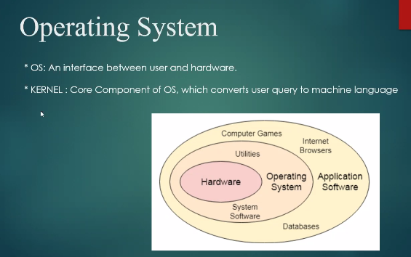

Slide 13
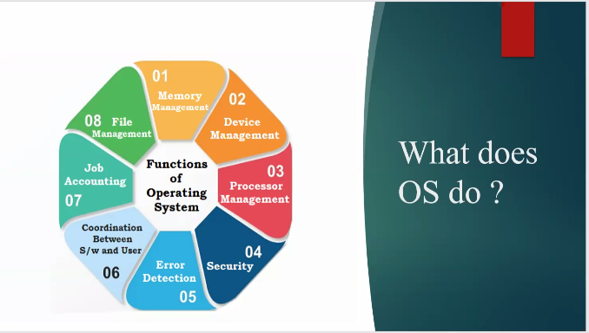
Operating system is a platform software which is used to run multiple applications
Operating system is a responsible to allocate hardware resources for upper layer individual running software's.

Slide 14
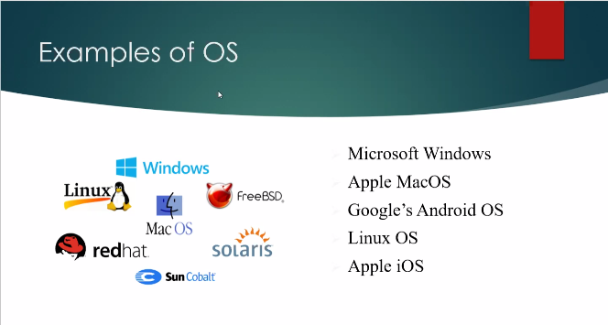
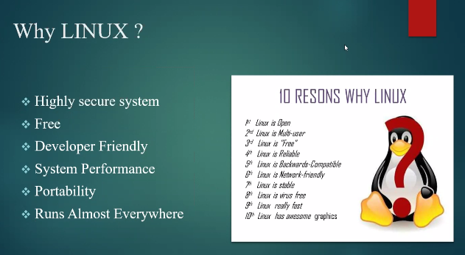
Why Linux is selected ?
Linux Portability – Runs anywhere

Slide 15
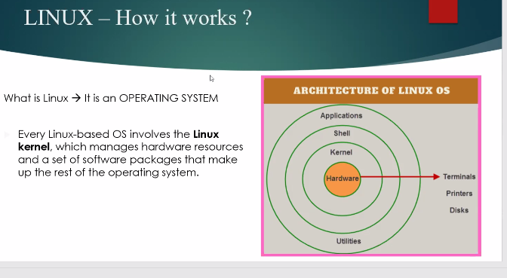

Slide 16
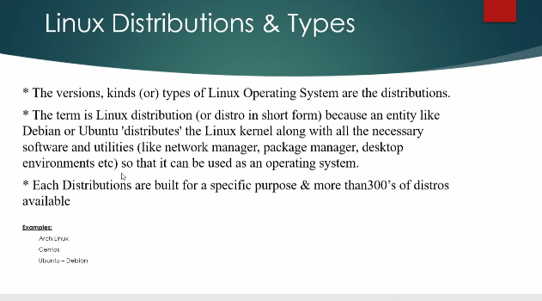

Slide 17
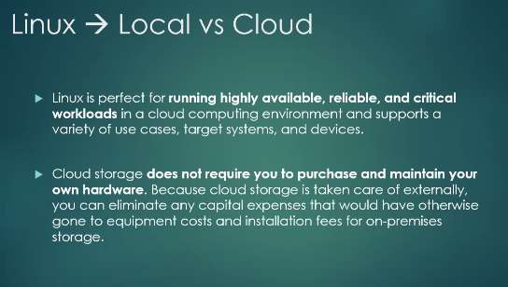

Slide 18
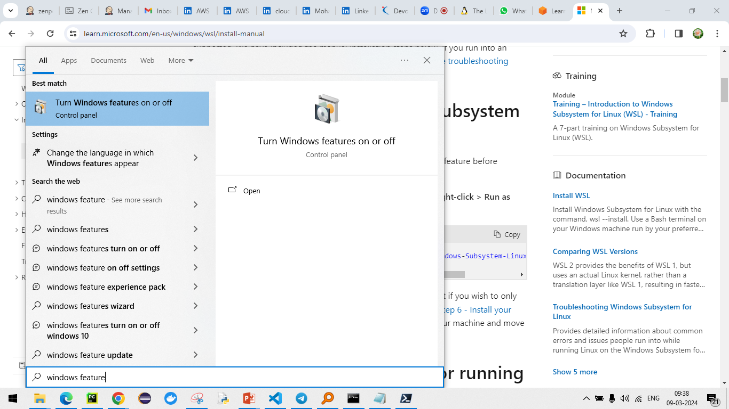

Slide 19
