Slide 1
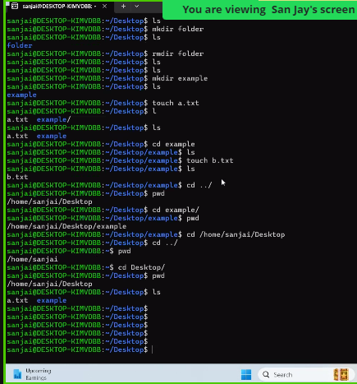

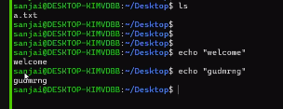
Absolute path: full working path from the root.
Relative path: take path from middle.
rmdir – is used to delete only empty directory
rm –rf directory name
here, rf – recursively and forcibly.
How to clear the history. history -c
Echo – whatever user give within “”, it will print the same.

Slide 2
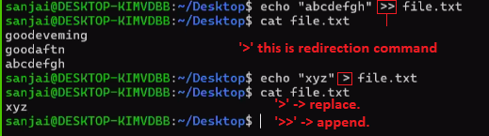


Need to give only 2 dots {..}
Inside curly brackets -> we need to give only numbers and alphabets.
When we copy a file from one path to another path, if target path has same file name, in that case, file content gets replaced.

Slide 3
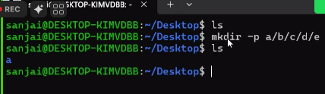
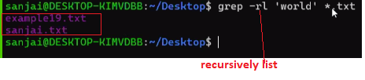
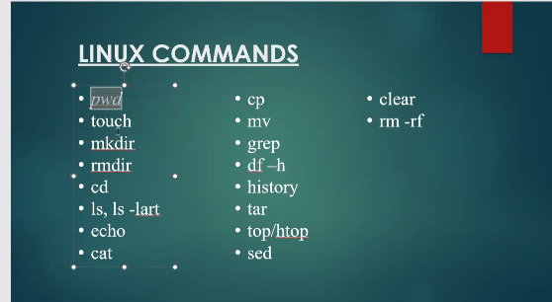

parent
find . –iname *.txt
. == ./
find / –iname *.txt
‘grep’ command will apply on the output of previous command.

Slide 4
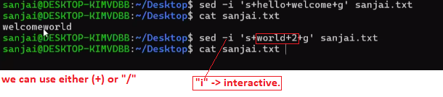

find | grep
1) find a file. | 1) ‘grep’ will search a specific content/word among all files.
global means -> entire file

Slide 5
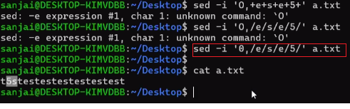
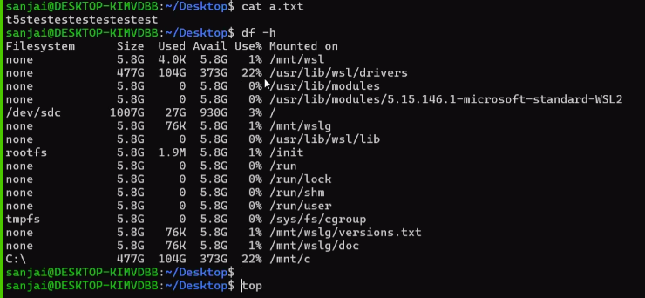

Slide 6
