Slide 1
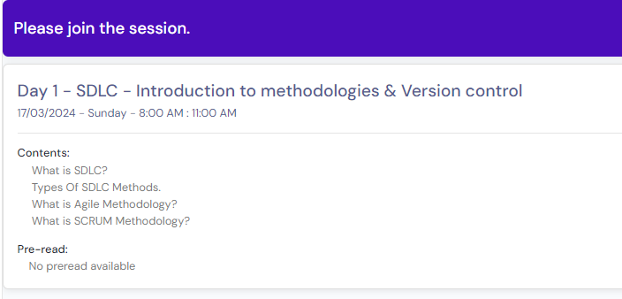
crontab.guru

Slide 2
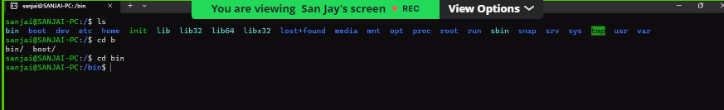
Linux files structure
bin -> all commands are available in binary format.
dev -> all device files.
home -> created users will be available under home directory.
tmp (temp) -> temporary directory.

Slide 3
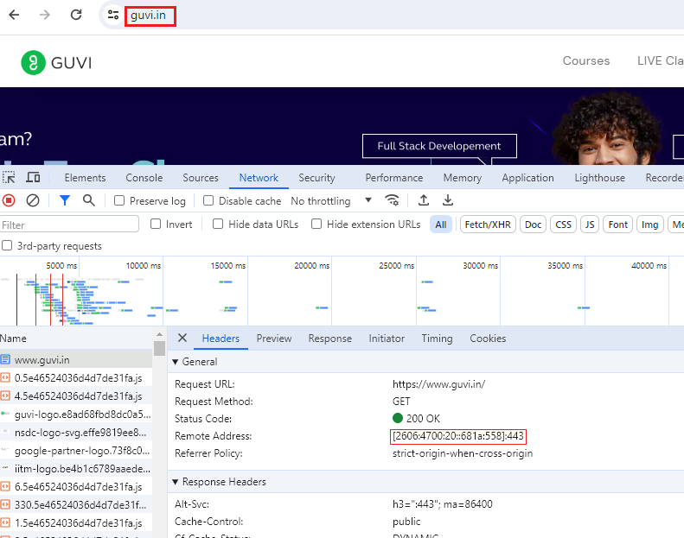

Slide 4
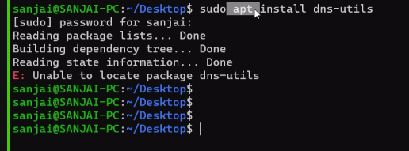

Slide 5
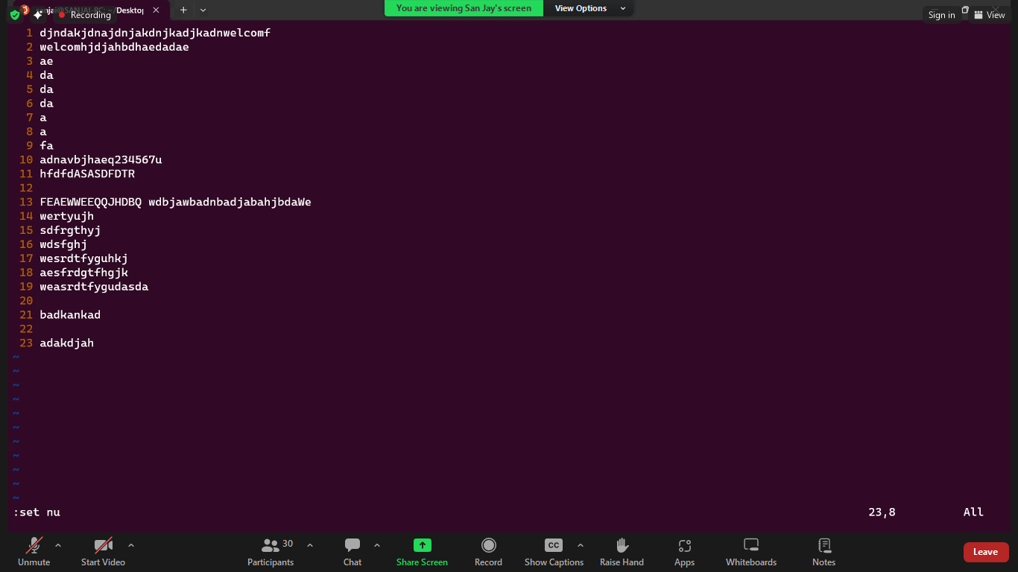

Slide 6
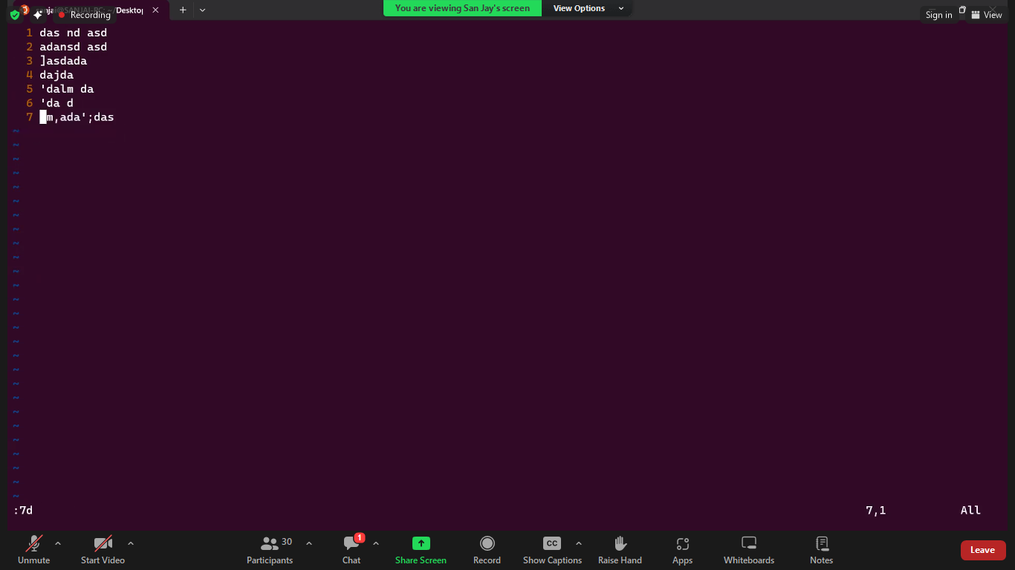

Slide 7
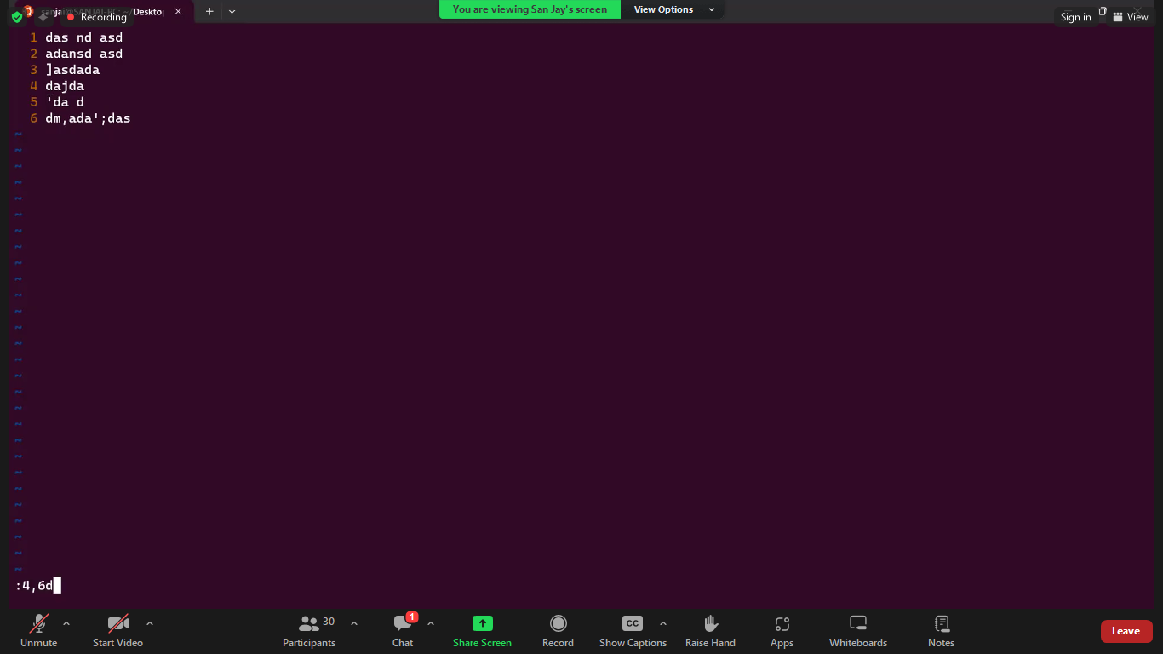

Slide 8
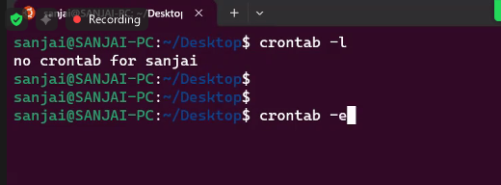

Slide 9
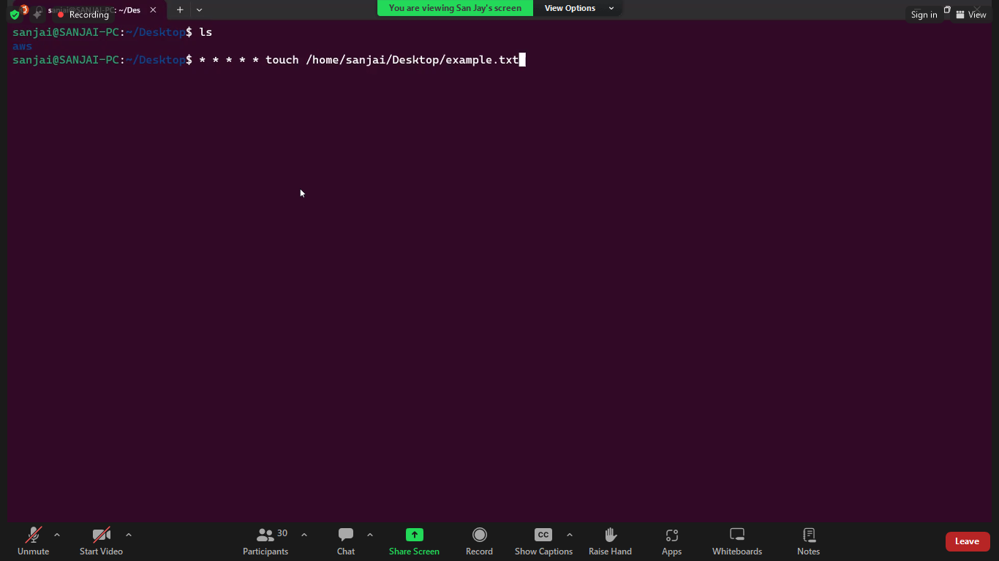

Slide 10
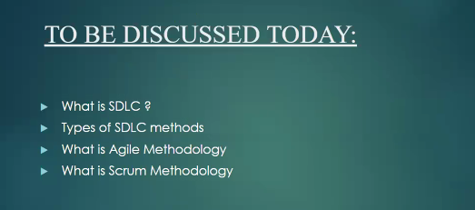
crontab –l
crontab –e
crontab -r
SDLC -> it is for development.
STLC -> (Software Test Life Cycle) -> it is for test.

Slide 11
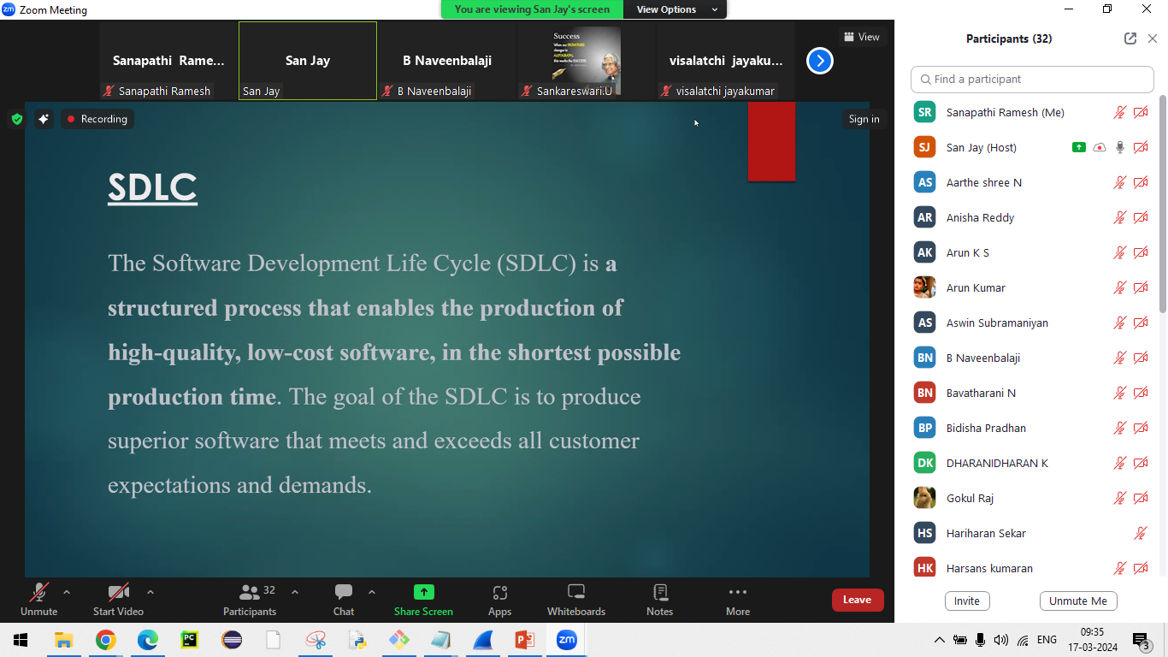

Slide 12
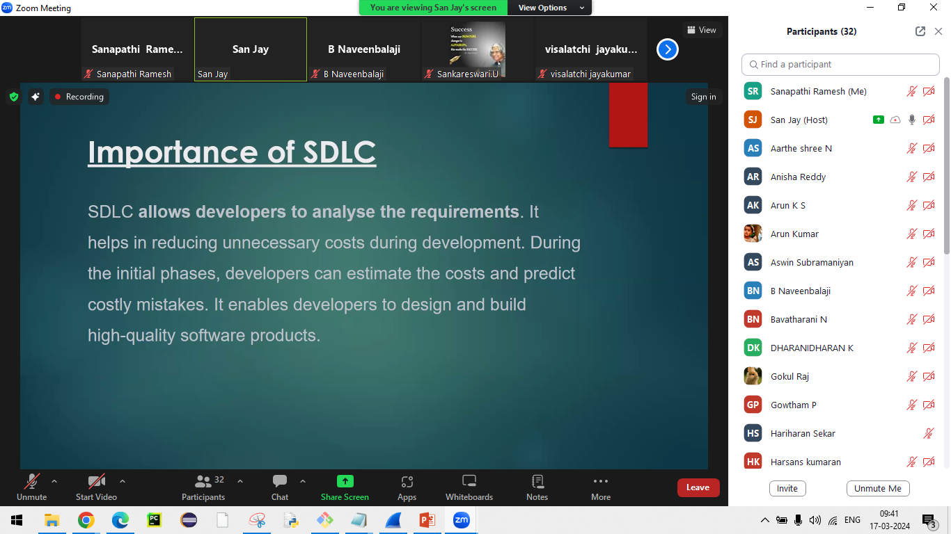

Slide 13
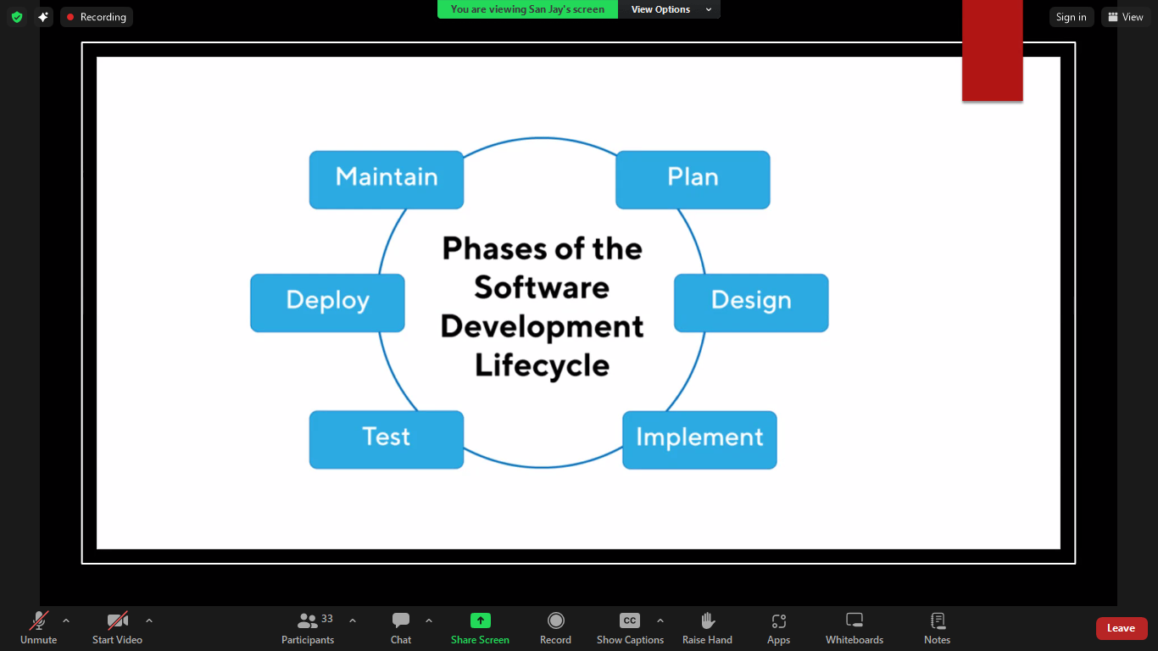

Slide 14
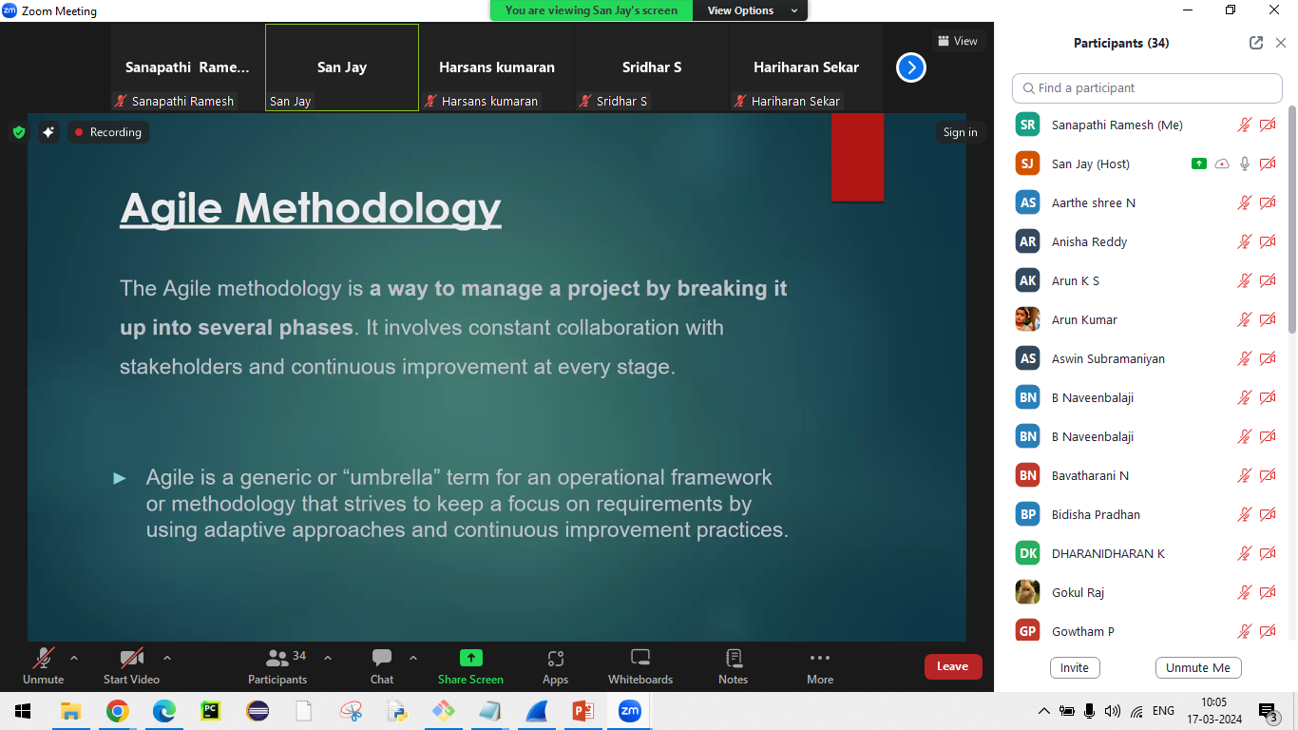

Slide 15
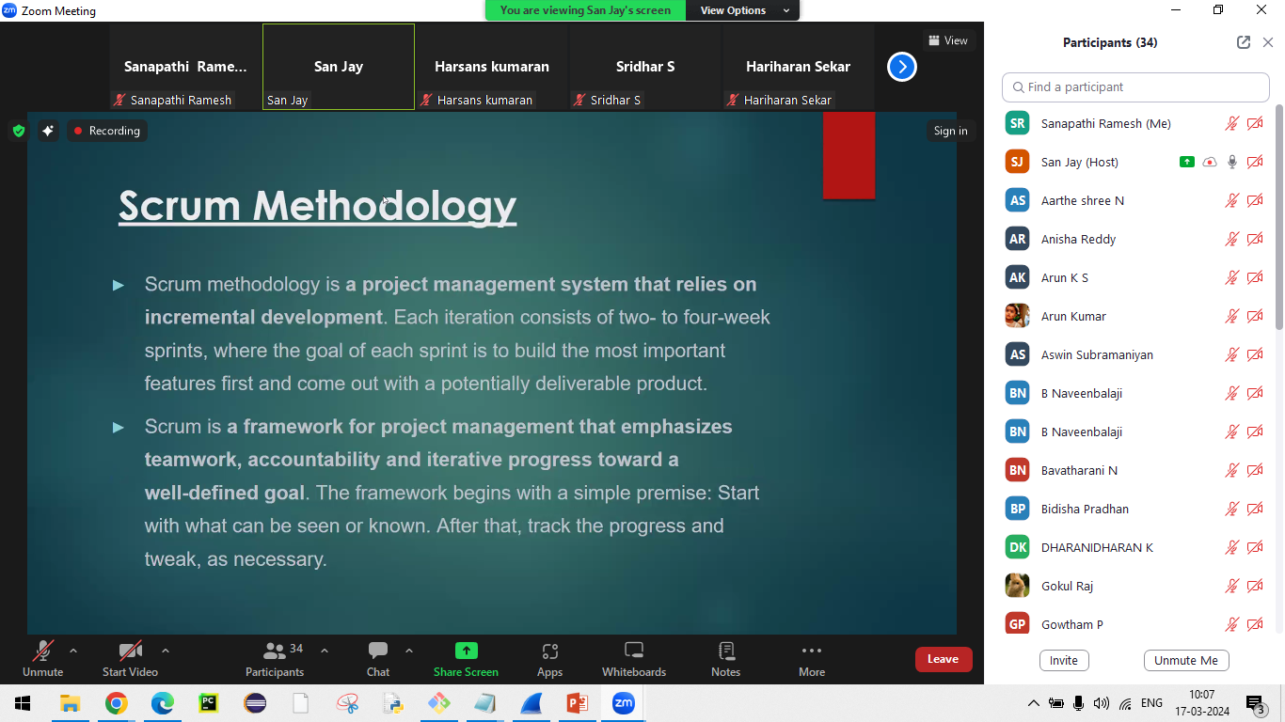

Slide 16
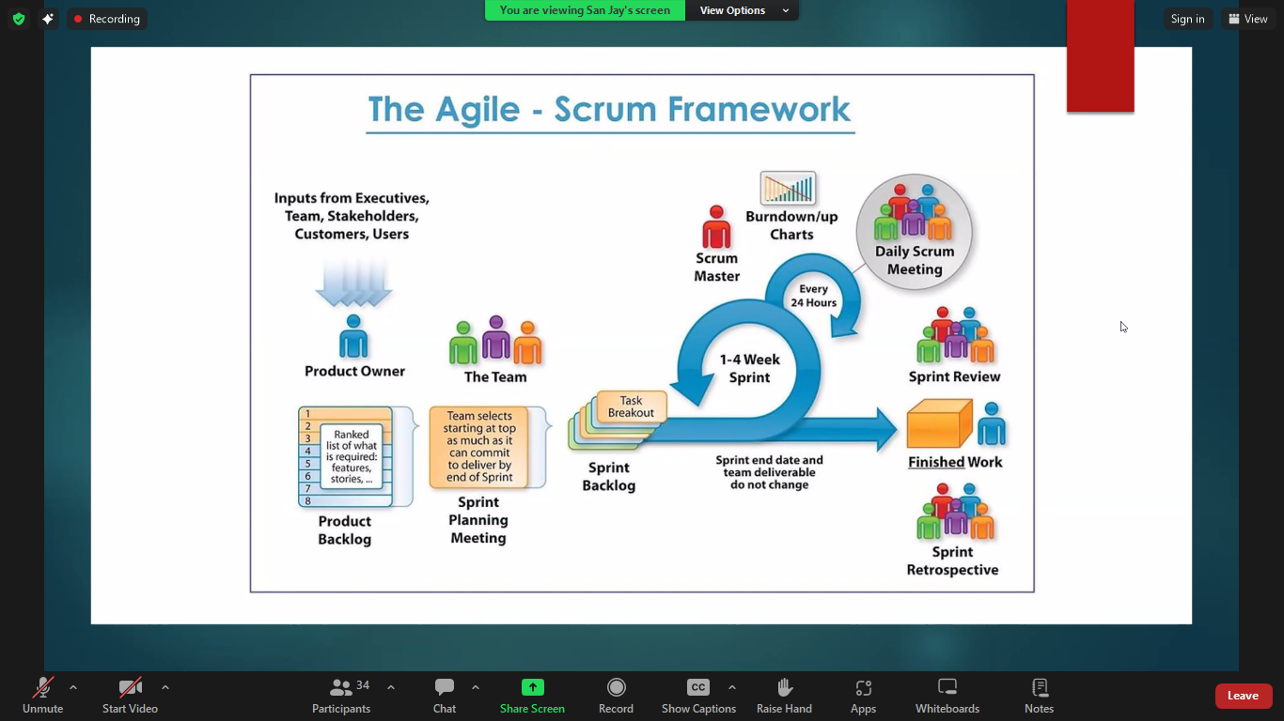

Slide 17
git-hub :
Most widely used.
Version control:-
Version wise, maintain or manages the versions.
Record or manage all code changes.
The place where we save our all code changes – is github.

Slide 18
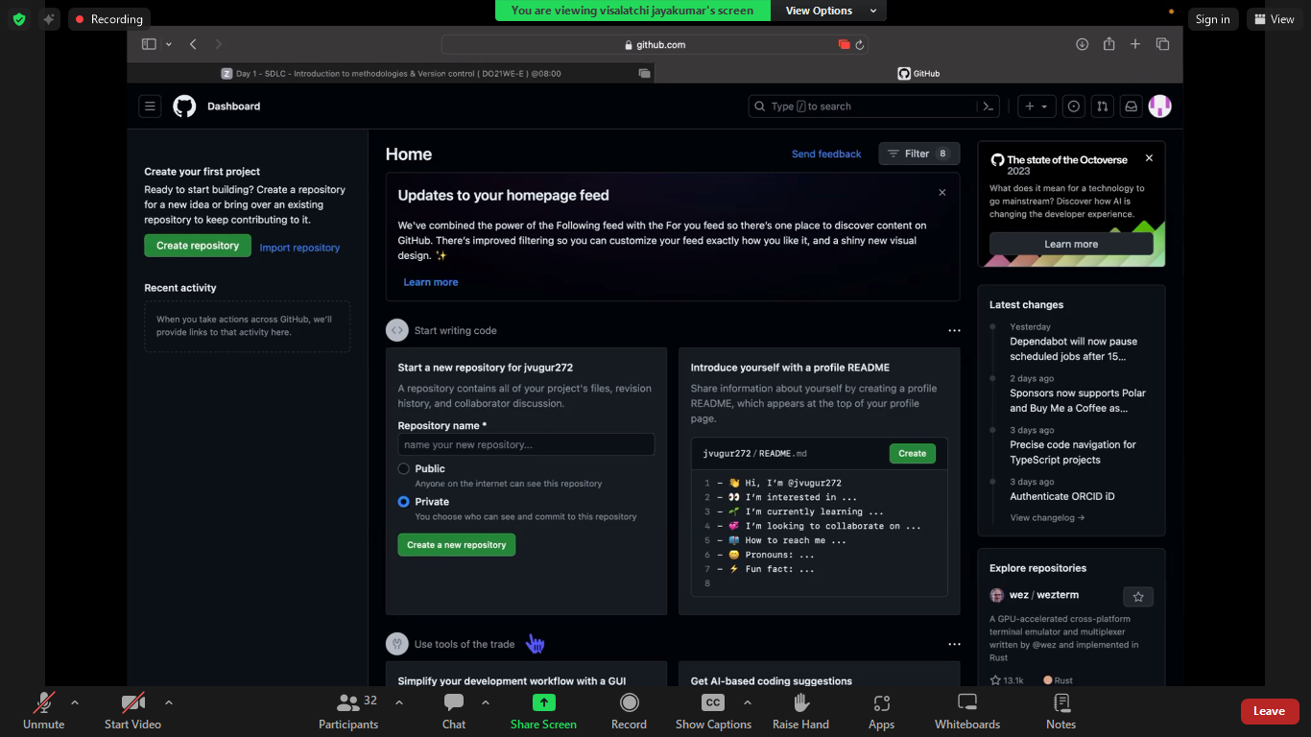

Slide 19
