Slide 1
OCI DNS

Slide 2

Agenda
OCI DNS – Custom Resolver
OCI DNS – Reference Diagram
OCI DNS – Custom Resolver – Topology
Oracle Cloud Private DNS
Requirements for DNS Labels and Hostnames
Questionnaire

Slide 3
1. OCI DNS – Custom Resolver
Custom Resolver: This uses Oracle DNS servers to resolve hostnames
Use DNS servers of your choice for resolution (maximum three). They could be DNS servers that are:
Available through the internet. For example, 216.146.35.35 for Dyn's Internet Guide.
In your VCN.
In your on-premises network, which is connected to your VCN by way of a Site-to-Site VPN or FastConnect (through a DRG ).

Slide 4






2. OCI DNS – Oracle Reference Diagram
DNS resolution between On-Prem and OCI
On-Premises Location
Oracle Cloud Infrastructure (Region)
On-Premises Network
10.0.1.0/24
Virtual Cloud Network
Customer
Data Center
Zones
Zones
VCN Subnet
10.0.0.0/24
On-Perm Internal
FastConnect
Oraclevcn.com
srv01 – A – 10.0.0.2
App3 – A – 10.0.1.2
App4 – A - 10.0.1.3
On-Premises DNS
Server
10.0.1.5
CPE
Private DNS
Resolver Forwarder
10.0.0.5
Private DNS
Resolver Listener
10.0.0.4
ocizone.Internal
Oracle VCN
CPE
DRG
app1 – A – 10.0.0.2
app2 – A - 10.0.0.3
Site-to-Site VPN
App3
x.2
App4
x.3
SRV1
x.2
SRV2
x.3
DNS Policy: Oraclevcn.com: (Forward 10.0.0.4)
ocizone.com.internal: (Forward 10.0.0.4)
Else: (Resolve locally)
DNS Policy:
Onprem.internal: (Forward 10.0.1.5)
Else: (Resolve locally)

Slide 5
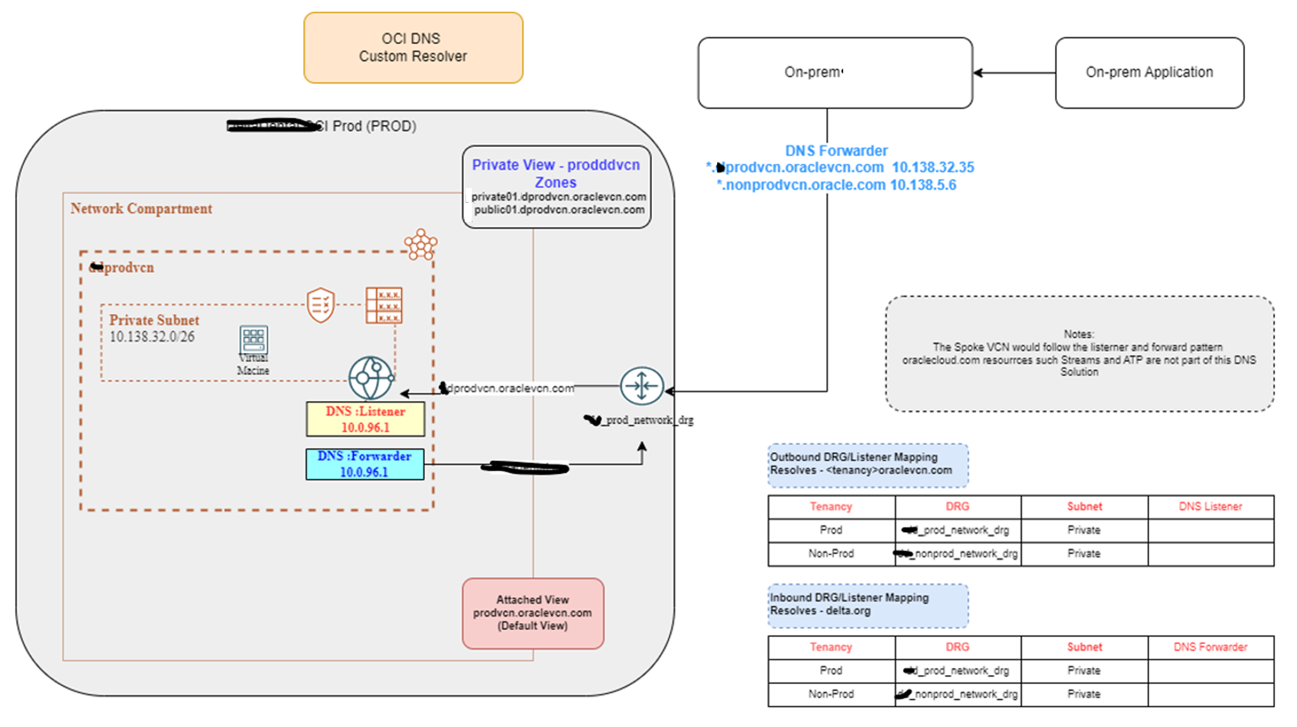
3. OCI DNS – Custom Resolver - Topology

Slide 6
4. Oracle Cloud Private DNS
Clints wants to specify their own private DNS domain names to manage their private assets in OCI, as well as support DNS resolution between VCNs and between VCNs and on-premise networks.
Private DNS will give them the ability to:
Create private DNS zones with their desired names and create records for their private resources
Private DNS resolver for DNS resolution to and from other private networks
Resolve queries for custom private zones and system generated zones (oraclevcn.com)
Support for DNS views and conditional forwarding for split-horizon environments

Slide 7
5. Requirements for DNS Labels and Hostnames
VCN and subnet labels: Max 15 alphanumeric characters and must start with a letter. Notice that hyphens and underscores are NOT allowed. The value cannot be changed later.
Hostnames: Max 63 characters, letters and numbers are allowed. Hyphens are allowed. Notice that periods are NOT allowed, hyphens aren't allowed at the beginning or end of the hostname, and the hostname can't be all numbers.
Uniqueness
VCN DNS label should be unique across your VCNs (not required, but a best practice)
Subnet DNS labels must be unique within the VCN
Hostnames must be unique within the subnet

Slide 8
6. Questionnaire
 | Question | Answer
1 | Would you want to resolve OCI resources using private DNS? (E.g. customerwesite.com or customer.net etc) | Yes or no
2 | What are your (IP Address) On-Perm DNS Listener & DNS Forwarders? | These are the application will be connecting to OCI: EFS, SAP Bods, Ebill pay IDS DB, DD SFTP,
3 | What is domain and Sub-Domain names to be used in OCI (If the answer to #1 is yes)
4 | What are your Oracle SAAS application URL (customer.com, customer.com, etc.)
5 | Are the SAAS applications accessible over internet or only Internally (Organization’s network only) | SAAS applications restrict accesses at the AD level (using conditional access implementation and challenges - MFA). SAAS applications are accessible over the internet.
6 | Do you want to retain these application URLs’ in OCI? | Yes

Slide 9
Thank You

