Slide 1
OCI Security & Storage Architecture

Slide 2
OCI Security, Storage & File Transfer Services
Topology - Oracle Integration Cloud(OIC) On Oracle Cloud Infrastructure (OCI)
OCI Security Services
2.1 Identity and Access Management (IAM)
2.2 Cloud Guard
2.3 Security Zones
2.4 Vault
2.5 Audit Service
2.6 SSH Public Key/Private keys
3. OCI Cloud Storage Services
3.1 Benefits Of OCI Cloud Storage
3.2 Cloud Storage Services
3.2.1 Block Volumes
3.2.2 Object Storage
3.2.3 Archive Storage

Slide 3
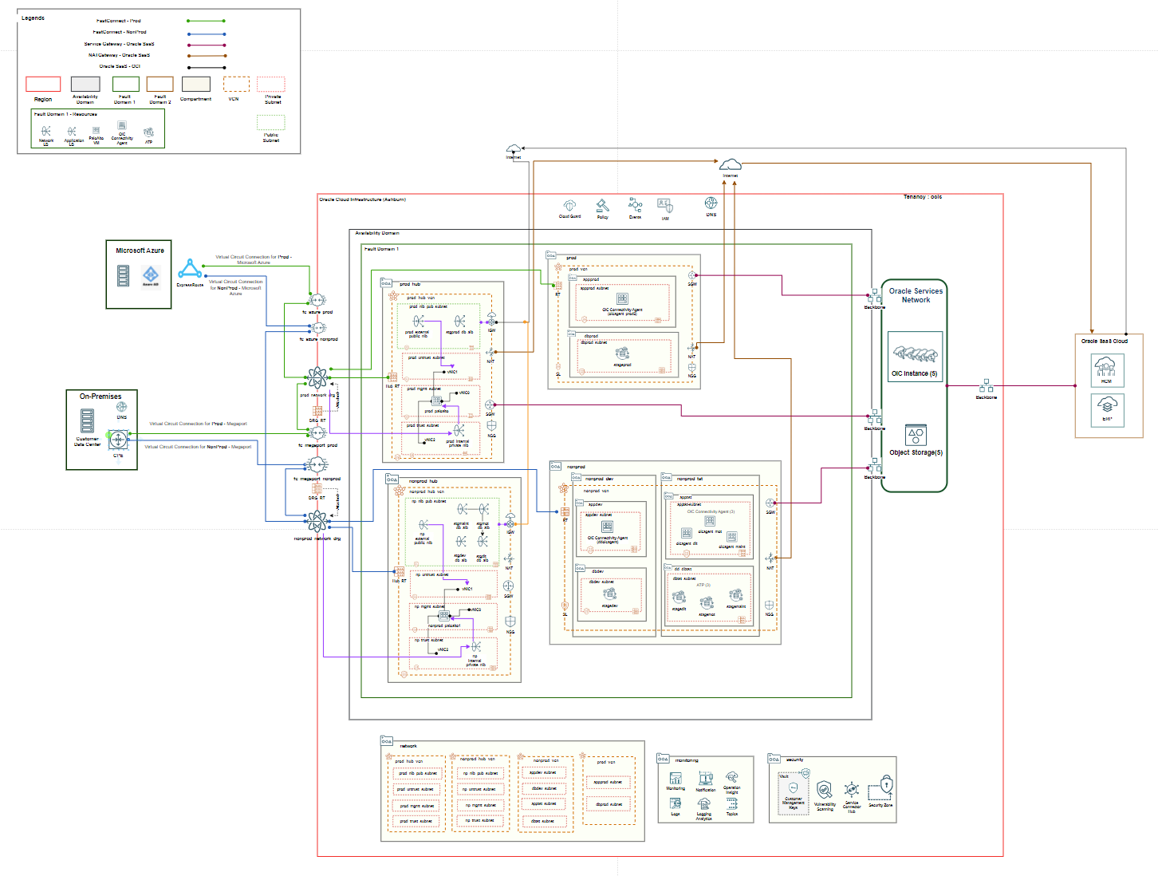
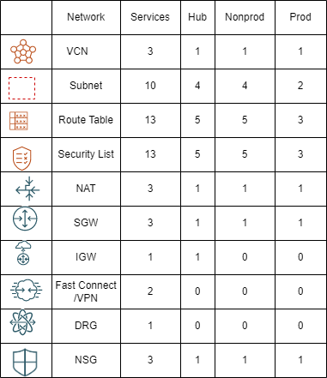
OCI Architecture
1. Topology – OIC on OCI

Slide 4













OCI - Security Services
OCI Security services needs to be enabled as part of Oracle Cloud enablement as below:
Compartment
Security Zone
IAM
Cloud Guard
Auditing & Monitoring - Log Analytics
Key Vault
Auditing
Monitoring
Cloud Guard Vulnerability Scanning
Region
Region
VCN
Public subnet
Private subnet
VM
ATP
VCN
Private subnet
Security Zone
VM
ATP
Vault
Identity & Access Management (IAM)
Identity cloud Service (IDCS)

Slide 5




OCI - Identity and Access Management (IAM)
Compartment : A heterogeneous collection of resources for the purposes of security isolation and access control.
Tenancy : The root compartment that contains all resources. With one or more compartments, users and groups are assigned policies that grants ability to use resources within a compartment.
User : Users are added to groups to access resources. Federated users are also supported.
Group : A collection of users who share a similar set of access privileges.
Identity Domain : A logical grouping of users, groups, roles, and credentials in a tenancy.
Role : A set of administrative privileges that can be assigned to a user in an identity domain.
Identity Provider : Federated users who are authenticate to the Oracle Cloud Infrastructure console are redirected to configured identity provider.
Azure Active Directory (AD) : The Azure Active Directory (AD) Bridge provides a link between your AD enterprise directory structure and Oracle Identity Cloud Service.

Slide 6



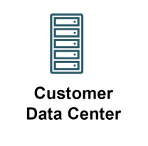



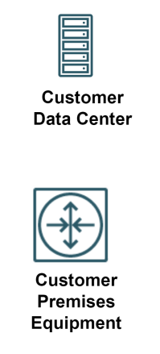
OCI - Identity and Access Management (IAM)
Tenancy
User
Group
Policy (tenancy)
IAM
Compartment
The OCI IAM service provides authentication and authorization for resources and services; it uses a tenancy shared by various business teams, and individuals and maintaining security, isolation, and governance.
Resource : A cloud object created for interacting with OCI services.
Policy : A set of authorization rules that define access to resources within a tenancy.
Policy (Landing Zone)
On-Premises
IAM
LDAP Connection
Compartment
AD Bridge
LDAP Connection
Oracle (Identity Cloud Service)
AD
Queue
HTTP Connection
Authentication
/Synchronization
/Write back
HTTP Connection
AD Bridge

Slide 7




OCI - Cloud Guard
Cloud Guard examines OCI resources for security weakness related to configuration, operators and users for risky activities.
Upon detection, Cloud Guard suggests corrective actions that can be configured automatically to take certain actions.
Target: Target is associated with detector recipes, which defines specific user actions or resource configurations that cause Cloud Guard to report a problem.
Threat Detector: Threat Detector recipe in Cloud Guard contains a set of rules designed specifically to detect subtle patterns of activity in the tenancy that could eventually pose a security problem.
Recipe: A Cloud Guard responder recipe defines the action or set of actions to take in response to a problem that a detector has identified.
Oracle Vulnerability Scanning: Improves security posture by routinely checking compute instances and container images for potential vulnerabilities and generates reports with metrics and details about these vulnerabilities, and assigns the risk level.
Tenancy (San Jose)
Cloud Guard Recipes(Oracle Management)
OCI Configuration Detector Recipe
OCI Activity Detector Recipe
OCI Responder Recipe
On-Premises
Cloud Guard
Parent Compartment
Target of Cloud Guard & Vulnerability Scanning- Detected Problem
Cloud Guard
Child Compartment
Cloud Guard Recipes – Cloned Recipe (user managed) definition
Cloud Guard
Oracle Services Network
Vulnerability Scanning (definition)
- Scan recipe
- Scan target
Object
Storage

Slide 8




OCI - Security Zones
A security zone is associated with one or more compartments and a security zone recipe. When creating and updating resources in a security zone, Oracle Cloud Infrastructure validates these operations against security zone policies in the zone's recipe. If any security zone policy is violated, then the operation is denied.
Security Advisor:
Security Advisor creates cloud resources that align with Oracle's security principles and best practices. It also ensures that resources meet the requirements enforced by security zone policies.
Tenancy (San Jose)
Availability Domain
Cloud Guard
Compartment
VM
ATP
On-Premises
Security Zone
Compartment
Private subnet
Oracle Services
Network
VM
ATP
Object
Storage

Slide 9

OCI - Security Zones
Tenancy (San Jose)
Availability Domain
Threat Intelligence:
Threat Intelligence aggregates data across many different sources and curates this data to provide actionable guidance for threat detection and prevention in Oracle Cloud Guard and other services.
Malicious actors often use known techniques to attack target environments. Contextual information about the threat indicators found can help prioritize alerts and understand threat landscape. When the Threat Detector recipe is enabled in Cloud Guard, it compares data from Threat Intelligence to Audit logs and telemetry to detect suspicious activity and report it as a problem.
Cloud Guard
Compartment
VM
ATP
On-Premises
Security Zone
Compartment
Private subnet
Oracle Services
Network
VM
ATP
Object
Storage
Security Zone
Recipe

Slide 10


OCI - Vault
Tenancy (San Jose)
Cloud Guard
Compartment
Vault services manages the Vaults, keys and Secrets. A vault includes the encryption keys and secret credentials that protects data and connect to secured resources. Customer-managed resources have complete control over access to vaults, keys, and secrets.
Keys are stored on highly available and durable hardware security modules (HSM) that meet Federal Information Processing Standards (FIPS) 140-2 Security Level 3 security certification.
Compartment
Archiving immutable audit log in bucket
Locked time-bound retention policy
On-Premises
Bucket
User- Managed key
Visual private vault (HSM partition)
Storage of master key (MEK)
Key Vault

Slide 11
OCI - Vault
Secrets and secret versions are base64-encoded and encrypted with master encryption keys, but do not reside within the HSM.
Vault service supports the key Encryption algorithm, includes the Advanced Encryption Standard (AES), the Rivest-Shamir-Adleman (RSA) algorithm, and elliptic curve digital signature algorithm (ECDSA).
Services that support to use customer-managed keys for resource encryption are:
Block Volume,
Container Engine for Kubernetes,
Database,
File storage.

Slide 12








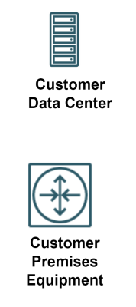

OCI - Audit Service
Tenancy (San Jose)
Auditing
The Oracle Cloud Infrastructure Audit service records all API calls to resources in a customer’s tenancy and login activity from the Console. Achieves security and compliance goals by using the Audit service to monitor all user activity within the tenancy.
Audit records are available through an authenticated, filterable query API or they can be retrieved as batched files from Oracle Cloud Infrastructure Object Storage. Audit log contents include what activity occurred, the user that initiated it, the date and time of the request, as well as source IP, user agent, and HTTP headers of the request.
Cloud Guard
Compartment
Compartment
Service connector Hub
- Audit log stream for functions and SIEM solution Integration
Service connector Hub
Streaming
On-Premises
Virtual Machine
ATP
Archiving immutable audit log in bucket
Locked time-bound retention policy
Buckets

Slide 13
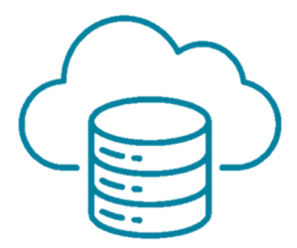
OCI Cloud Storage Services
High-performance computing and low-cost cloud storage.
Key storage workload requirements and use cases can be addressed through on-demand local NVMe storage, object storage, file storage, block volume, and archive storage in Oracle Cloud.
To safely and securely move the On-Premises data to the cloud, Storage gateway and Data Transfer service can be used.
Oracle’s Storage products enable high application performance while protecting crucial on-premises customer data against cyber attacks and failures.

Slide 14


OCI Cloud Storage Services
WARM DATA
Block Volumes
Object Storage
Archive Storage
Block Volumes
FROZEN DATA
Object Storage
COLD DATA
Archive Storage

Slide 15

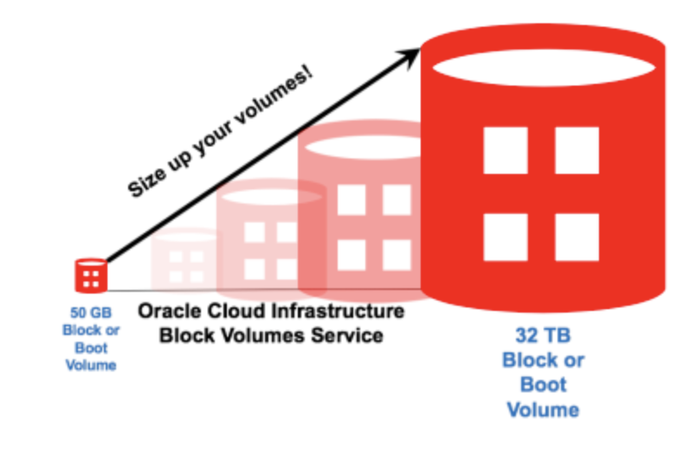
OCI - Block Volumes
High-performance block storage at any scale:
Oracle Cloud Infrastructure storage platform is an ideal complement to Oracle compute and networking services to support the highest performance requirements. Oracle Cloud Infrastructure Block Volumes use the latest NVMe SSDs and provides nonblocking network connectivity to every host. Oracle delivers consistent, low-latency performance of up to 225 IOPS/GB to a maximum of 300,000 IOPS and 2,680 MB/s of throughput per volume.
Block
Volumes
Features :
Cross-region asynchronous block volume replication
Consistent high performance
Scales volumes from 50 GB to 32 TB
Attach volumes to reach 1 PB per compute instance
Supports dynamic scaling of volumes
Encryption at rest by default using AES 256
Encryption in transit supported by TLS 1.2
Automatic monitoring for data integrity

Slide 16

OCI - Object Storage
Flexible object storage that scales:
Object Storage enables customers to store any type of data in its native format. This is ideal for building modern applications that require scale and flexibility, as it can be used to consolidate multiple data sources for analytics, backup, or archive purposes.
Object Storage
Features:
Auto Tiering
Distributed, durable object storage
Highly available and scalable
Access via API, SDK, console, or CLI
Archive storage option
Encryption at rest by using AES 256
Automatic monitoring
Self-healing
Limitations:
Number of Object Storage namespaces per root compartment: 1
Maximum object size: 10 TiB
Maximum object part size in a multipart upload: 50 GiB
Maximum number of parts in a multipart upload: 10,000
Maximum object size allowed by PutObject API: 50 GiB
Maximum size of object metadata: 2 K

Slide 17

OCI - Archive Storage
Long-term, low-cost data storage
Archive Storage provides reliable and durable long-term data at one-tenth the cost of Oracle Object Storage, while using the same APIs for easy setup and integration. Data is monitored for integrity, automatically healed, and encrypted at rest. Data can be restored about an hour from the time a request is made. Data can be downloaded within 24 hrs(by default), or from 1 to 240 hours.
Archive Storage
Features :
Easy to use and integrate
Highly reliable and durable
No cost for inbound data transfer
Encryption at rest by default using AES 256
Automatic monitoring for data integrity

Slide 18
OCI - Archive Storage
Limitations:
Number of namespaces per root compartment: 1
Maximum object size: 10 TiB
Maximum object part size in a multipart upload: 50 GiB
Maximum number of parts in a multipart upload: 10,000
Maximum object size allowed by PutObject API: 50 GiB
Maximum size of object metadata: 2 K
Archive Storage

Slide 19
Thank You

