Slide 1

Pariwesh Gupta

Slide 2
What’s Typescript?
JavaScript is not originally designed for large complex applications (mostly a scripting language, with functional programming constructs), lacks structuring mechanisms like Class, Module, Interface.
Typescript is a typed superset of JavaScript that compiles to plain JavaScript.
Adds additional features like Static Type (optional), Class, Module etc. to JavaScript
Microsoft technology.
Open Source.
Versions.
First made public in October 2012.
Notes:
TypeScript compiler, named tsc, iswritten in TypeScript that can be compiled into regular JavaScript that can be executed in any JavaScript engine in any host.
Typescript 0.9, released in 2013, added support for generics
Typescript 1.0 was released at Build 2014

Slide 3
Context
Writing large applications in JavaScript is difficult, not originally designed for large complex applications (mostly a scripting language, with functional programming constructs)
Lacks structuring mechanisms like Class, Module, Interface
TypeScript is a language for application scale JavaScript development.
TypeScript is a typed superset of JavaScript that compiles to plan JavaScript.
TypeScript adds Static Typing and structuring (class, module) to JavaScript.

Slide 4
Fix/Improve JavaScript – different approaches
Through Library and Frameworks
jQuery, AngularJS, Knockout, Ext JS, Bootstrap …. (new libraries are being created and getting popular everyday)
New language that extend/improve language features of JavaScript. Superset of JavaScript. Compiles to JavaScript
CoffeeScript, TypeScript
Entirely new language with many new features that compile to JavaScript
GWT (Google Web Toolkit), Dart
https://github.com/jashkenas/coffeescript/wiki/list-of-languages-that-compile-to-js

Slide 5
What is TypeScript
Helps in large scale JavaScript application development.
Adds additional features like Static Type (optional), Class, Module etc (that are not present in JavaScript) to JavaScript
TypeScipt is superset of JavaScript. Any valid .js file can be renamed .ts and compiled with other TypeScript files.
Runs on Any browser, Any OS.
Open Source
The compiler is an open source project and released under the Apache 2.0 license.
TypeScript purposefully borrows ideas from EcmaScript 6 (ES6 Harmony) spec – class, module

Slide 6
Bit of History
Typescript was first made public in October 2012 (at version 0.8), after two years of internal development at Microsoft.
TypeScript 0.9, released in 2013, added support for generics
TypeScript 1.0 was released at Build 2014. Visual Studio 2013 Update 2 provides built-in support for TypeScript.
In July 2014, the development team announced a new TypeScript compiler, claiming 5x performance gains.
Source code, which was initially hosted on Codeplex, was moved to GitHub

Slide 7
Features
Optional Static Type Annotation / Static Typing
Additional Features for Functions
Types for function parameters and return type, optional and default parameter, rest parameter, overloading
Class
Field, Property, Method, Constructor, Event, Static methods, Inheritance
Interface
Module
Generics
Declaration Merging
Few other features (Enum) …
TypeScript comes with
TypeScript Compiler (tsc)
TypeScript Language Service (TLS) / Visual Studio extension
Playground (http://www.typescriptlang.org/)
Declaration files (*.d.ts) for DOM, jQuery, node.js …
Language Spec (1.0) and code examples

Slide 8
Types / Optional Type Annotation

Slide 9

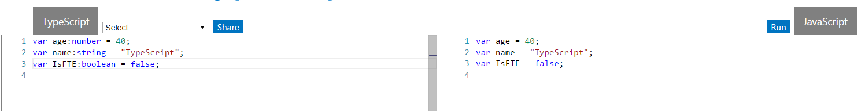

Optional Type Annotation
TypeScript allows annotating variables with types
Purely a design time feature. No additional code is emitted in the final JavaScript that TypeScript compiler produces.
If there’s a type mismatch TypeScript shows a warning.

Slide 10
Types / Optional Type Annotation
Optional Static Types
Any
Primitive
Number
Boolean
String
Void
Null
Undefined -> same as JavaScript “undefined” type
Array
Enum

Slide 11
Datatypes
Does not have separate integer and float/double type
All numbers in TypeScript are floating point values. These floating point numbers get the type 'number'.
var x:number = 55
var y:number = 123.4567
boolean – true/false value
var hasPassport:boolean = true // or false
string - Both single quote or double quote could be used
var msg1 = 'hello from TypeScript'
var msg2 = "hello from TypeScript"
No separate char type
var character = 'a'

Slide 12
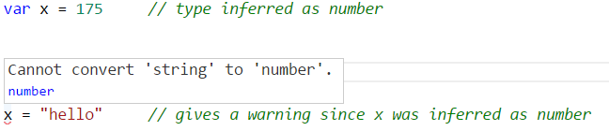

Optional Type Annotation
TypeScript tries to infer type

Slide 13
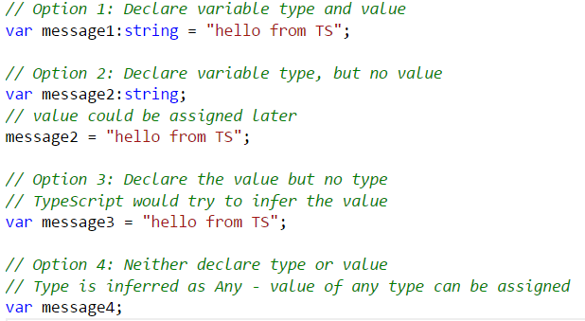
Type Inference
TypeScript tries to infer type
Four ways of variable declaration -
Declare its type and value (as a literal) in one statement.
Declare its type but no value. The value will be set to undefined.
Declare its value but no type. The variable will be of type Any (that is, an old-school dynamic JavaScript variable), but its type may be inferred based on its value.
Declare neither value nor type. The variable will be of type Any, and its value will be undefined.

Slide 14
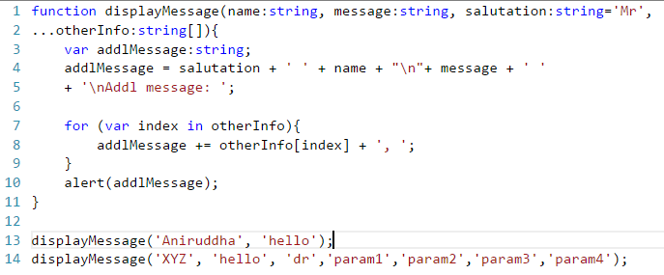
Array
var cities:string[] = ["Berlin","Bangalore","New York"]
var primes:number[] = [1,3,5,7,11,13]
var bools:boolean[] = [true,false,false,true]

Slide 15
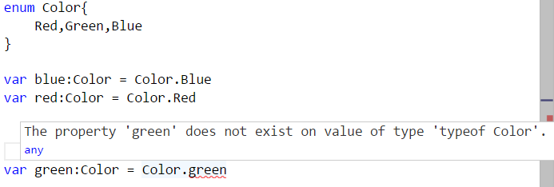
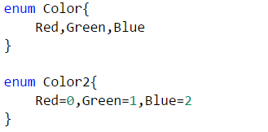
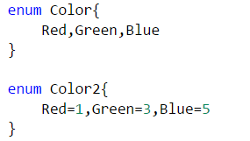
Enum
Addition to JavaScript datatypes. Similar to C# enum
Like languages like C#, an enum is a way of giving more friendly names to sets of numeric values.
By default, enums begin numbering their members starting at 0. You can change this by manually setting the value of one its members.

Slide 16
Any
Useful to describe the type of variables that we may not know when we are writing the application.
May come from dynamic content, eg from the user or 3rd party library.
Allows to opt-out of type-checking and let the values pass through compile-time checks.
Same as not declaring any datatype – uses JavaScript’s dynamic nature
var notSure: any
var list:any[] = [1, true, "free"]
list[1] = 100

Slide 17
Void
Perhaps the opposite in some ways to 'any' is 'void',
the absence of having any type at all.
Commonly used as the return type of functions that do not return a value
function warnUser(): void {
alert("This is my warning message");
}

Slide 18
Function

Slide 19
Function Overview
Functions are the fundamental building block of any applications in JavaScript.
JavaScript is a functional programming language, and so supports first class functions.
Allows build up layers of abstraction, mimicking classes, information hiding, and modules (JavaScript does not support class, module, private members).
In TypeScript, while there are classes and modules, function still play the key role in describing how to 'do' things.
TypeScript adds some new capabilities to the standard JavaScript functions to make them easier to work with.
Type Annotation for parameter and return type
Optional and Default Parameter
Rest Parameter
Function Overloads

Slide 20
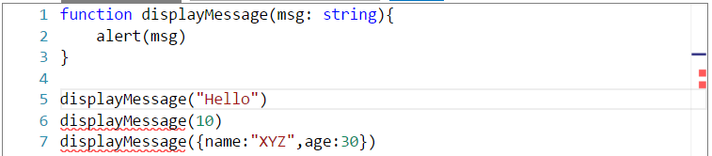
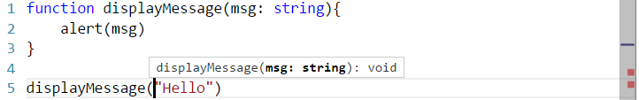
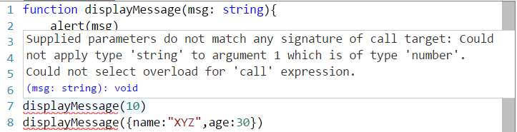
Function
Allows parameter and return type annotation

Slide 21
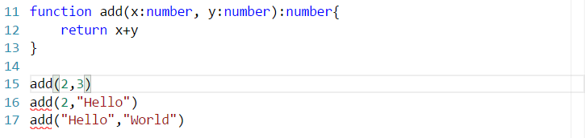
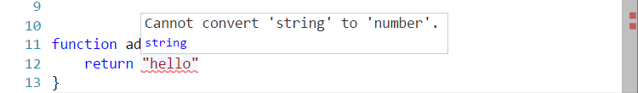

Function (2)
Shows warning for type mismatch

Slide 22
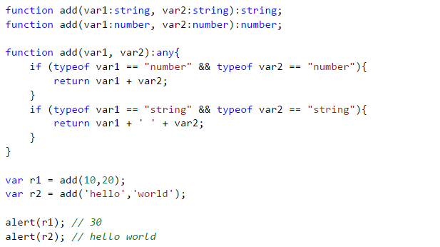
Function Overloads
Allows function overloads

Slide 23
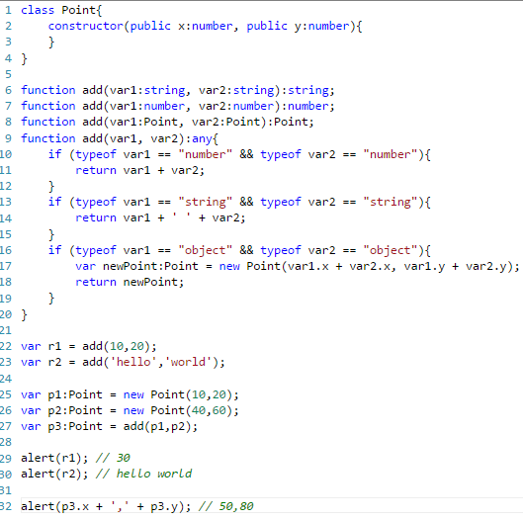
Function Overloads (2)

Slide 24
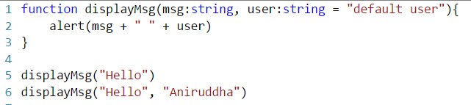
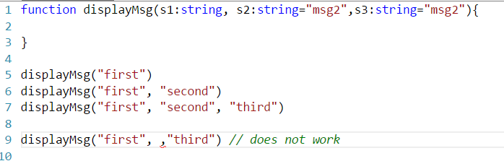
Optional & Default Parameter
Optional Parameters should have default value that would be used if the value is not specified while invoking the function
Should be the last arguments in a function

Slide 25

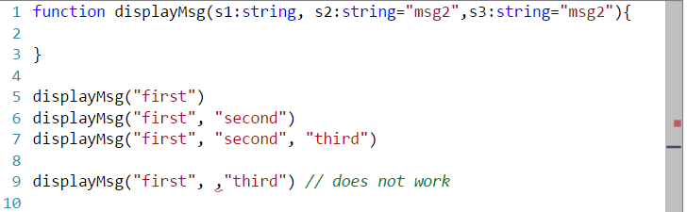

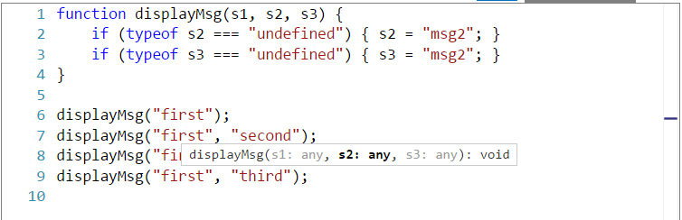
Optional Parameter Implementation
Optional Parameters should have the default value that would be used if the value is not specified while calling the function

Slide 26
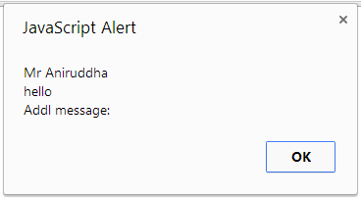
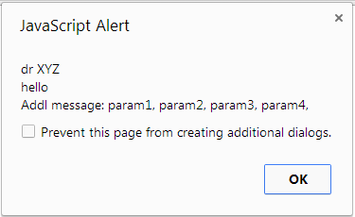
Rest Parameter
Declared as … paramName:[paramType]

Slide 27
Class

Slide 28
Class
Properties and fields to store data
Methods to define behavior
Events to provide interactions between different objects and classes

Slide 29
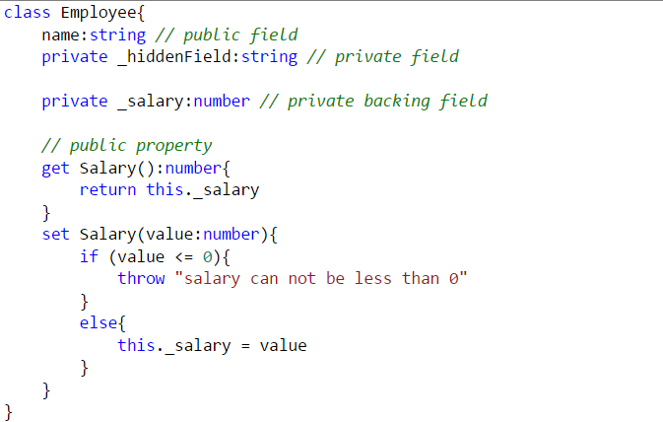
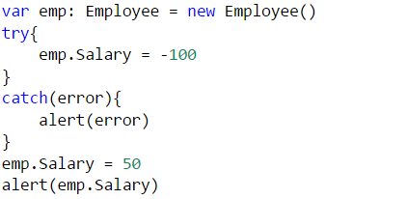
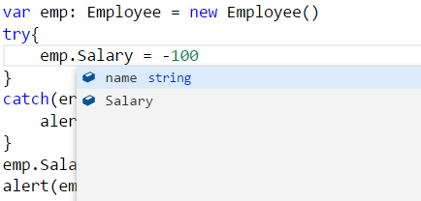
Field and Property

Slide 30
Method and Constructor

Slide 31
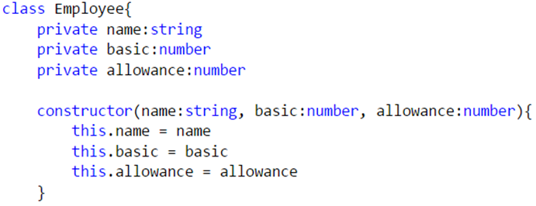
Constructor
Uses constructor keyword
public by default, can not be private

Slide 32
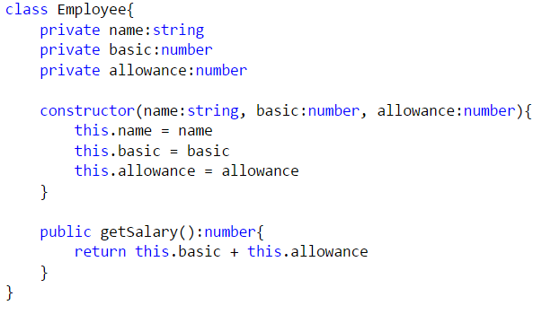
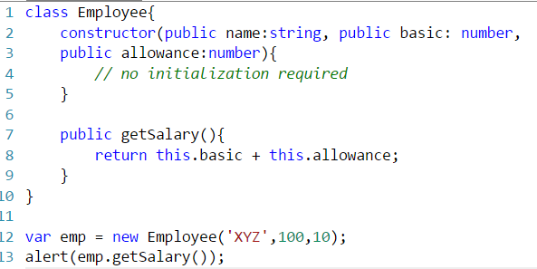
Constructor shortcut

Slide 33
Events

Slide 34
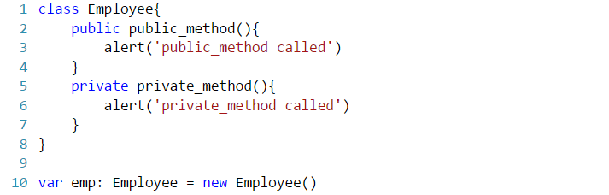
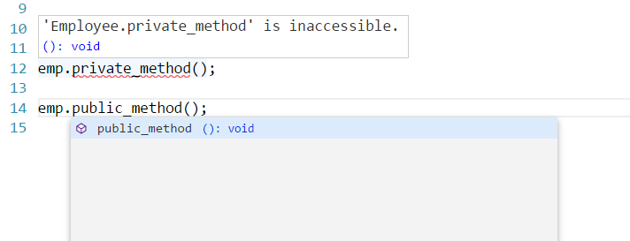
Access Modifiers
public (default) - member is available to all code in another module.
private - member is available only to other code in the same assembly.

Slide 35
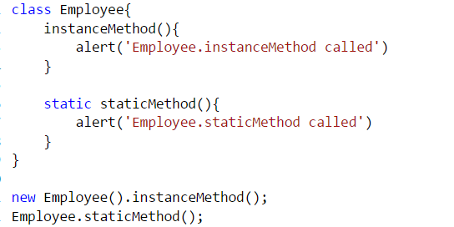
Static Methods
TypeScript supports static members (methods)
static methods are visible on the class itself rather than on the instances

Slide 36
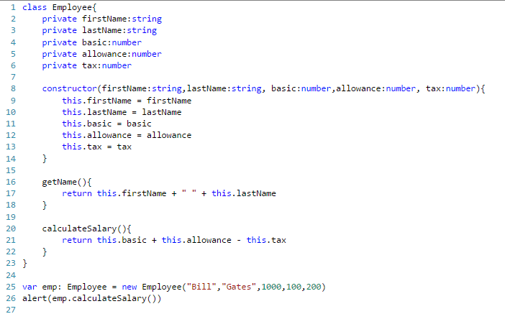
Class

Slide 37
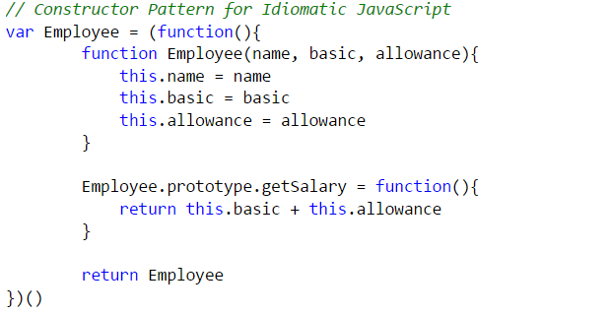

JavaScript Constructor Pattern

Slide 38
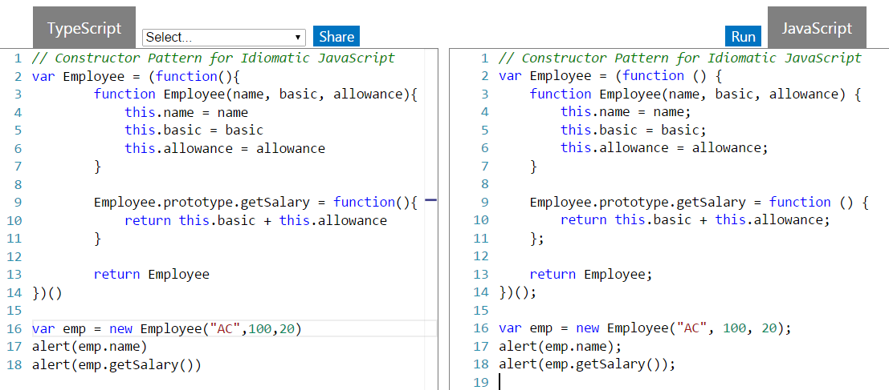
JavaScript Constructor Pattern (2)

Slide 39
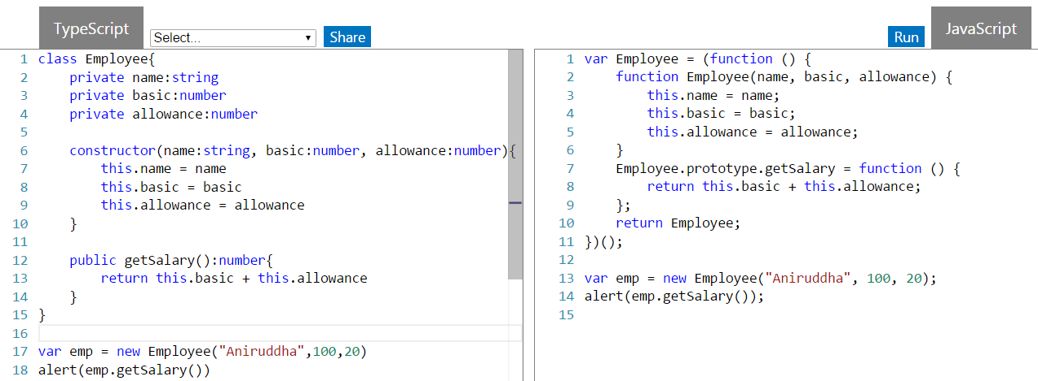
Class – TypeScript uses same Constructor Pattern

Slide 40
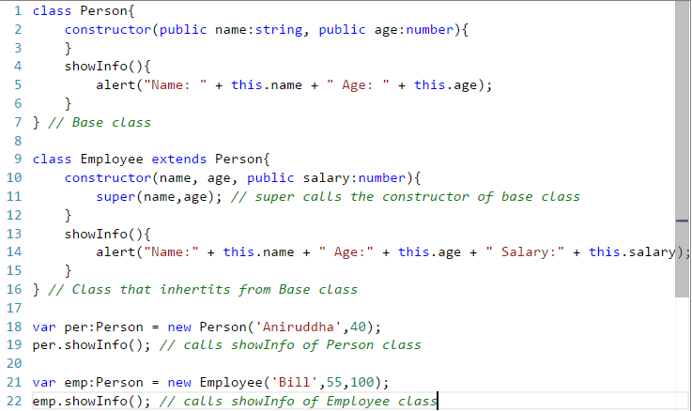
Inheritance
TypeScript supports inheritance of class through extends keyword

Slide 41
Module

Slide 42
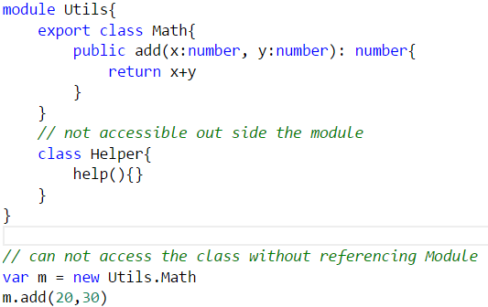
Module
Modules can be defines using module keyword
A module can contain sub module, class, interface or enum. Can not directly contain functions (similar to C#, Java)
Modules can be nested (sub module)
Class, Interfaces can be exposed using export keyword

Slide 43
Interface

Slide 44
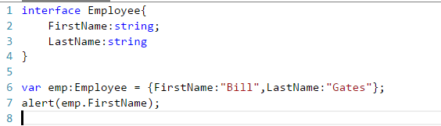
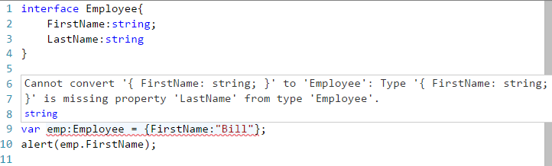
Interface
Declared using interface keyword
Like many other TypeScript feature it’s purely a Design time feature. No additional code is emitted for this!
TS compiler shows error when Interface signature and implementation does not match

Slide 45
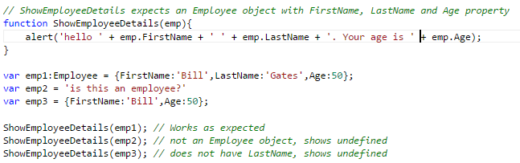
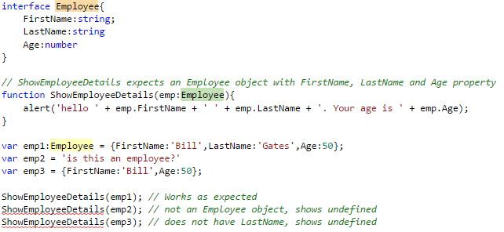
Interface (Cont’d)

Slide 46
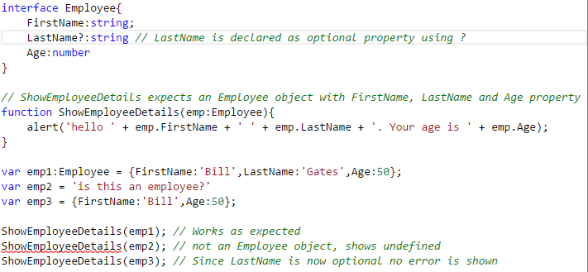
Optional Property
Optional properties can be declared for an interface (using ?)
Optional properties need not be implemented

Slide 47
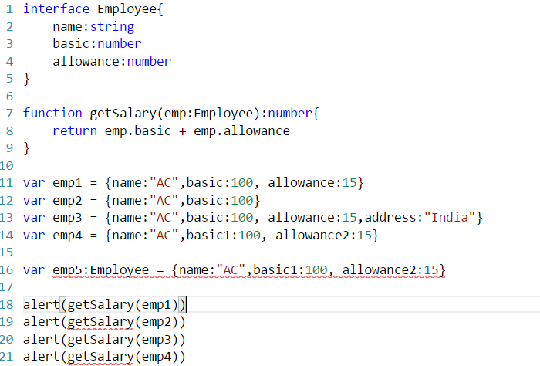
Interface

Slide 48
Mixin

Slide 49
Mixin
In object-oriented programming languages, a mixin is a class which contains a combination of methods from other classes.
Mixin - Wikipedia, the free encyclopedia
Along with traditional OO hierarchies, another popular way of building up classes from reusable components is to build them by combining simpler partial classes – called Mixin
Several languages support Mixin (e.g. Trait in PHP and Scala).
This pattern in popular in JavaScript community, so TypeScript provides language support.

Slide 50
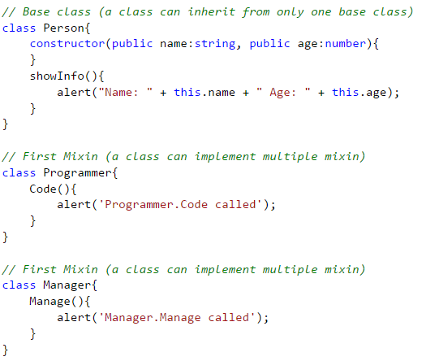
Mixins
Person
Programmer
Manager
Employee

Slide 51
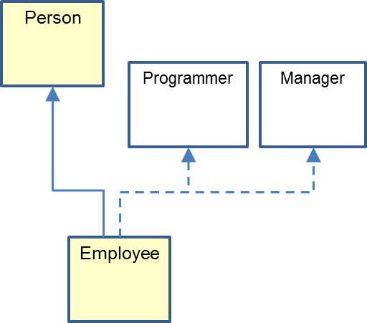
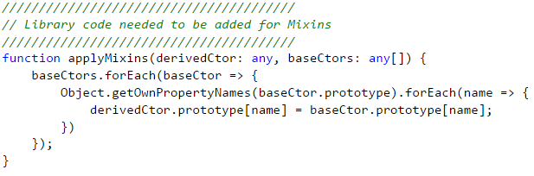
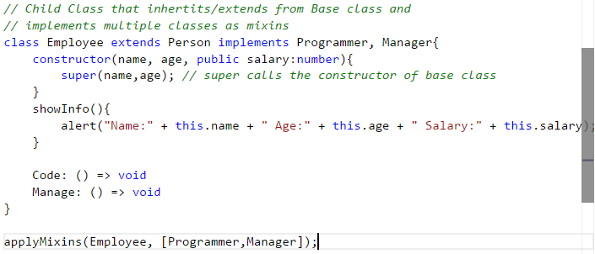
Mixins (Cont’d)

Slide 52
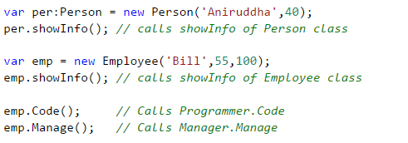
Mixins (Cont’d)

Slide 53
JavaScript gochas (not fixed in TS)
TypeScript does not introduce block scope (JavaScript only supports function scope)
; is still optional in TypeScript also (; is not mandatory in JavaScript and it tries to infer ; and sometime does it differently than expected)
== vs === (and != vs !==)
== checks for value equality only
=== checks for both type and value equality
global variables (variables declared outside of function), implied global (variables declared within function without var keyword)
issues with floating point (.1 + .2 != .3, it’s something like .3000…00004)

