Slide 1

CUSTOMIZED QR GENERATOR
SUMMER INTERNSHIP-2
PROJECT REVIEW
Presented by:
A.Manish 21E51A6702
R.P.Kaushik Naidu 21E51A6744
V.Ramesh 21E51A6762
Faculty Guide:
Mrs.P.Swathy
Professor
ET Department

Slide 2
ABSTRACT
The "Customized QR Generator" project aims to develop a web application that allows users to generate various types of QR codes. The application is designed to offer four main features: Basic QR, Colour QR, Social Media QR, and Image QR. Each feature provides users with different customization options, expanding the traditional use of QR codes for diverse purposes. The project utilizes HTML, CSS, JavaScript, and Flask to create a user-friendly interface and efficiently handle QR code generation and customization.

Slide 3
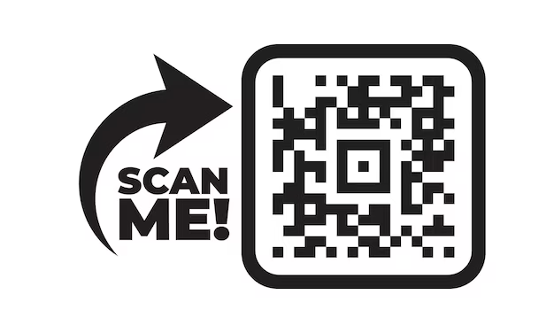
INTRODUCTION
The quick response, or QR, Code is a two-dimensional version of the Barcode able to convey a wide variety of information almost instantly with the scan of a mobile device.
Able to store up to 7089 digits or 4296 characters, including punctuation marks and special characters, the Code can equally encode words and phrases such as internet addresses.
Custom domains turn each interaction into a captivating journey.
The advantages of custom domains in QR codes go beyond branding. They enhance credibility, in still trust, and exude professionalism. Users perceive custom domains as reliable and secure, boosting their confidence in the content they're about to explore.

Slide 4
OBJECTIVE OF THE PROJECT
Developing a user-friendly interface for generating Basic QR codes:
Allowing users to easily create standard QR codes by entering text.
Implementing customizable options for Colour QR codes:
Enabling users to customize the appearance of QR codes with various colours and patterns.
Integrating social media logos into QR codes for various platforms:
Enhancing QR codes with embedded logos for popular social media platforms.
Allowing users to generate QR codes with embedded images :
Providing a feature for users to upload images and generate QR codes with both image and text components.

Slide 5
SOFTWARE REQUIREMENTS
Web Development Framework :
HTML, CSS, JS for the frontend
Python Flask Framework :
Flask is a small and lightweight Python web framework that provides useful tools and features that make creating web applications in Python easier.
The Programming Language :
Python is an interpreter, high-level, general-purpose dynamic programming language used for everything, from server automation to data science. It is an open source software.

Slide 6
HARDWARE REQUIREMENTS
Processor:
A modern multicore processor (e.g., Intel Core i5 or AMD Ryzen 5) for smoother performance.
RAM:
At least 8GB of RAM, but 16GB or more is recommended for seamless multitasking.
Hard Disk:
A solid-state drive (SSD) with at least 256GB of storage for faster load times and efficient project management.
Monitor:
A larger and high-resolution display (e.g., 24" Full HD or higher) for better design and development work.
Keyboard and Mouse:
Standard keyboard and mouse should suffice, but consider investing in ergonomic peripherals for comfort during long work sessions.

Slide 7
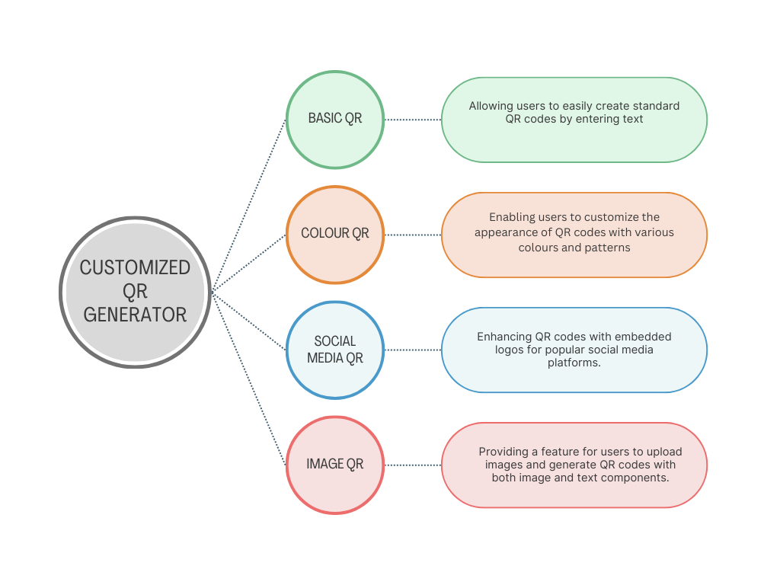
FLOW DIAGRAM

Slide 8
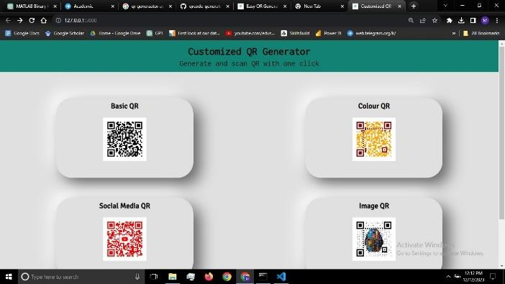
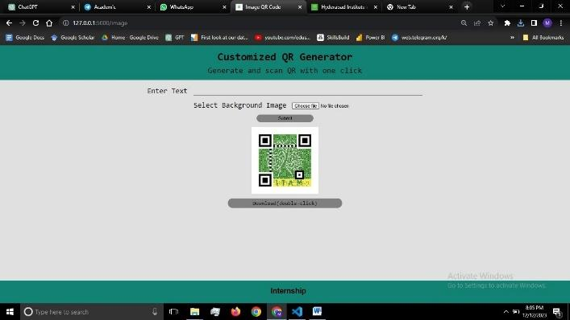
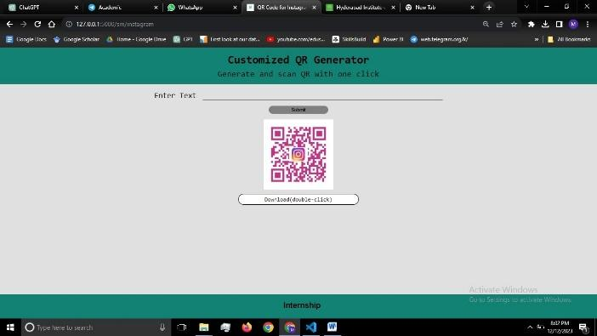
CUSTOMIZED QR GENERATOR
WEB PAGE INTERFACES
Main Page Image QR page
Social Media QR Page Colour QR Page

Slide 9
Benefits of QR Codes with Custom Domains
QR codes with custom domains offer a range of remarkable benefits that can transform your brand's digital presence and user experiences.
Enhanced Branding and Recognition
Increased Trust and Credibility
Seamless User Experience
Streamlined Offline-to-Online Transition
Data-Driven Insights
Versatile Applications

Slide 10
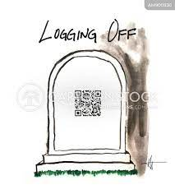
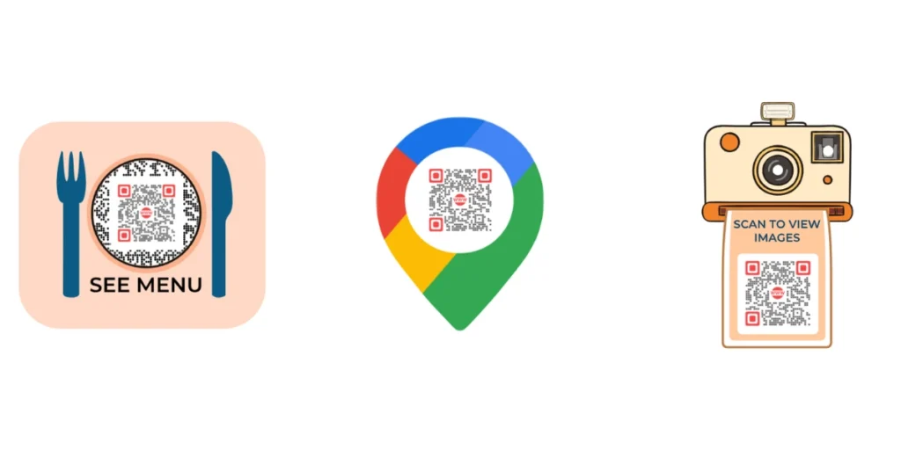
IMPLEMENTATION
QR codes with custom domains offer a wide array of practical applications across various industries.
Marketing and Advertising
Event Management
Inventory and Tracking Systems
Product Packaging and Labels
Education
Healthcare
Art and Exhibitions:

Slide 11
CONCLUSION
QR codes with custom domains revolutionize marketing efforts, enhance user experiences, and bridge the physical and digital realms. You create a memorable user journey by infusing your brand's identity into QR codes. Custom domains simplify user experiences, providing an easy-to-remember gateway to your digital content and increasing engagement and conversions. Across industries, QR codes with custom domains find practical applications in marketing, event management, product packaging, and inventory systems. They streamline processes, elevate user experiences, and drive brand engagement.Unlock the potential of QR codes with custom domains and watch your brand thrive!

Slide 12
