Slide 1
AI is intelligence demonstrated by machines, as opposed to natural intelligence displayed by animals including humans.
Artificial Intelligence (AI) Machine Learning (ML) Deep Learning (DL)
ML is the study of computer algorithms that can improve automatically through experience and using data. It is seen as a part of artificial intelligence.
DL is part of a broader family of machine learning methods based on artificial neural networks.

Slide 2



Relationship of AI, ML and DL
Artificial Intelligence (AI) is anything about man-made intelligence exhibited by machines.
Machine Learning (ML) is an approach to achieve AI.
Deep Learning (DL) is one technique to implement ML.
Artificial Intelligence
Machine Learning
Deep Learning

Slide 3
Types of ML Algorithms
Supervised Learning
  trained with labeled data; including regression and classification problems
Unsupervised Learning
  trained with unlabeled data; clustering and association rule learning problems.
Reinforcement Learning
  no training data; stochastic Markov decision process; robotics and self-driving cars.
Machine Learning
 | Supervised Learning
 | Unsupervised Learning
 | Reinforcement Learning

Slide 4
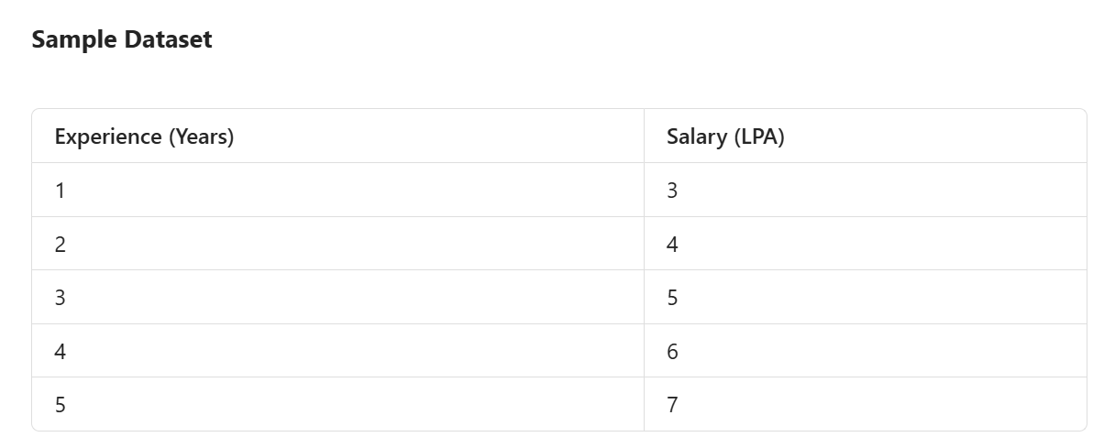
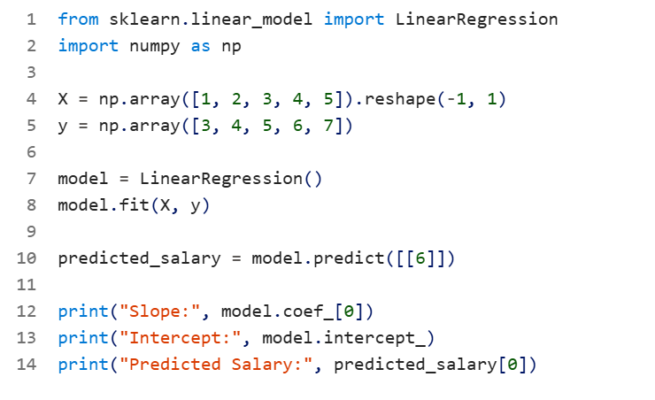
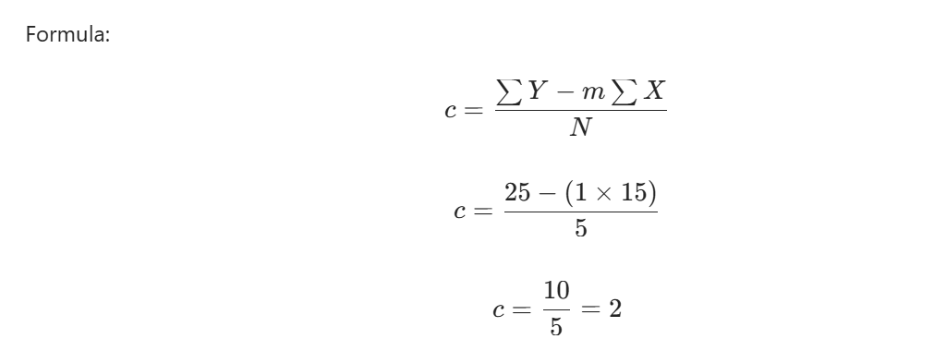
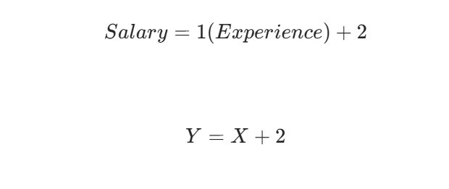
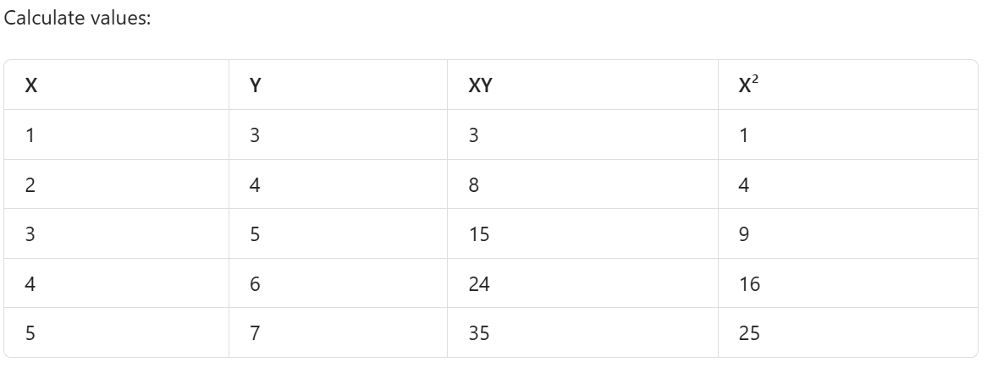
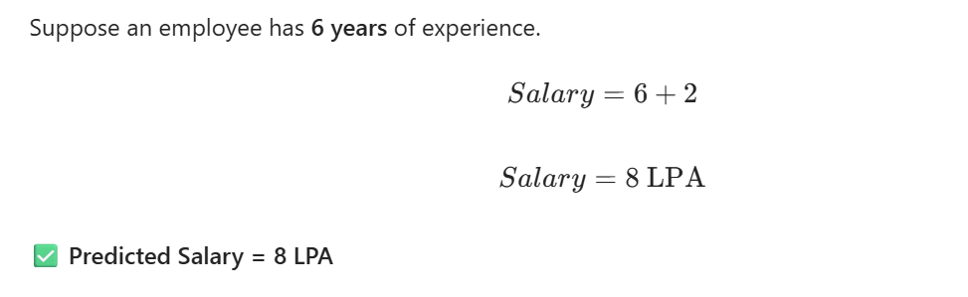
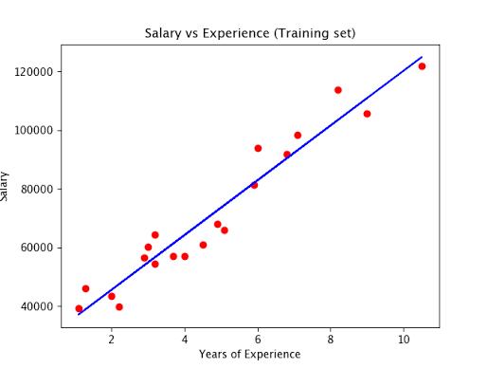
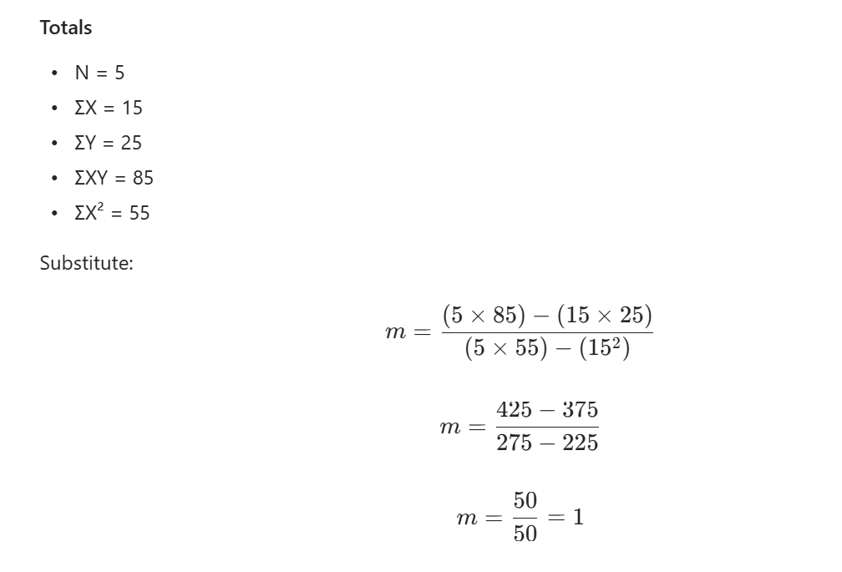

Slide 5
What is Deep Learning?
Deep learning is a class of machine learning algorithms that:
use a cascade of multiple layers of nonlinear processing units for feature extraction and transformation. Each successive layer uses the output from the previous layer as input.
learn in supervised (e.g., classification) and/or unsupervised (e.g., pattern analysis) manners.
learn multiple levels of representations that correspond to different levels of abstraction; the levels form a hierarchy of concepts.

Slide 6
Why Deep Learning?
Limitations of traditional machine learning algorithms
  not good at handling high dimensional data.
  difficult to do feature extraction and object recognition.
Advantages of deep learning
  DL is computationally expensive, but it is capable of handling high dimensional data.
  feature extraction is done automatically.

Slide 7
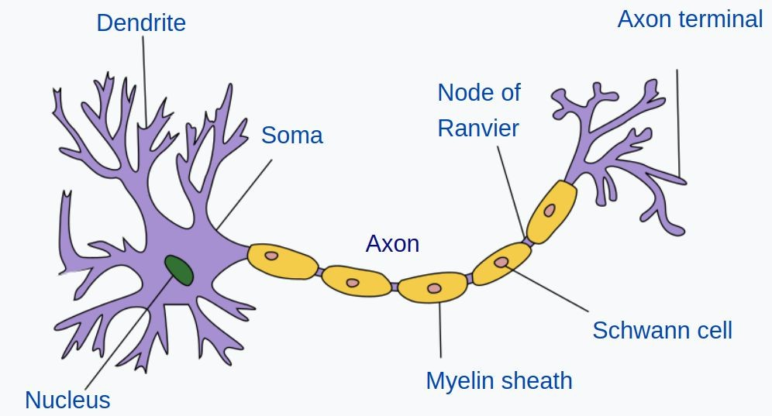


Artificial Neural Network
Input
Hidden Layers
Output

Slide 8
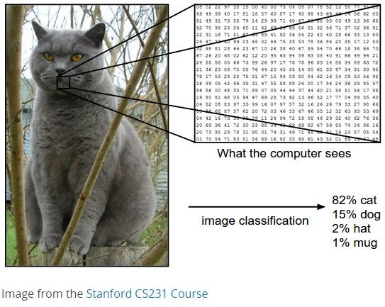
Inputs and Outputs
256 X 256
Matrix
DL model
4-Element Vector
X
Y
1
2
3
4
5
6
A C T G
M F
With deep learning, we are searching for a surjective
(or onto) function f from a set X to a set Y.

Slide 9
Learning Principle
Dataset
Output/Prediction
Target Output
x x
1 2
…..
x
n
Error:
-
= 5
(Image Credit: NVIDIA Deep Learning Institute)

Slide 10
Learning Principle
Output/Prediction
Target Output
x x
1 2
…..
x
n
Error:
-
= 15
(Image Credit: NVIDIA Deep Learning Institute)

Slide 11
Learning Principle
Output/Prediction
Target Output
x x
1 2
…..
x
n
Error:
-
= 2.5
(Image Credit: NVIDIA Deep Learning Institute)

Slide 12

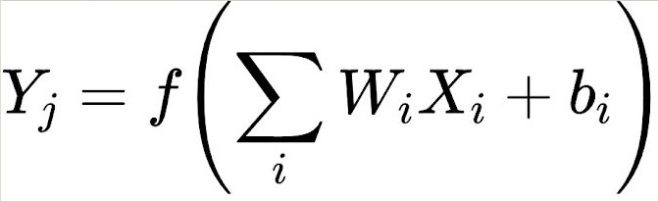



Supervised Deep Learning with Neural Networks
Input Hidden Layers
Output
From one layer to the next
X₁
W₁
X₂
W₂
f is the activation function, W_{i} is the weight, and b_{i} is the bias.
Y₃
X₃
W₃

Slide 13

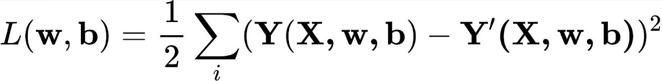

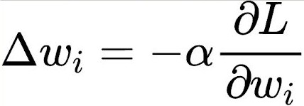
Training - Minimizing the Loss
The loss function with regard to weights and biases can be defined as
Input
Output
W₁, b₁
X₁
Y₂
The weight update is computed by moving a step to the opposite direction of the cost gradient.
W₂, b₂
X
2
L
W₃, b₃
X₃
Iterate until L stops decreasing.

Slide 14
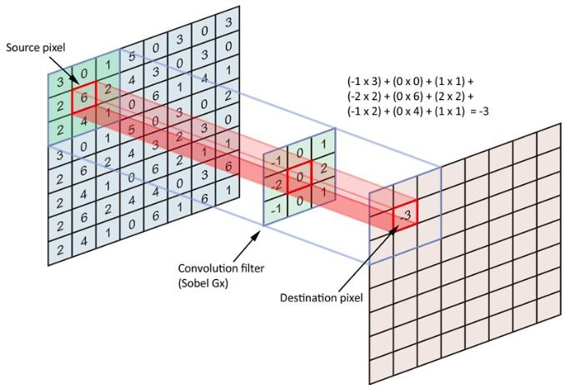
Convolution in 2D
(Image Credit: Applied Deep Learning | Arden Dertat)

Slide 15

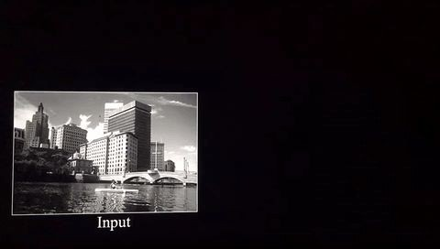
Convolution on Image
Image Credit: Deep Learning Methods for Vision | CVPR 2012 Tutorial

Slide 16
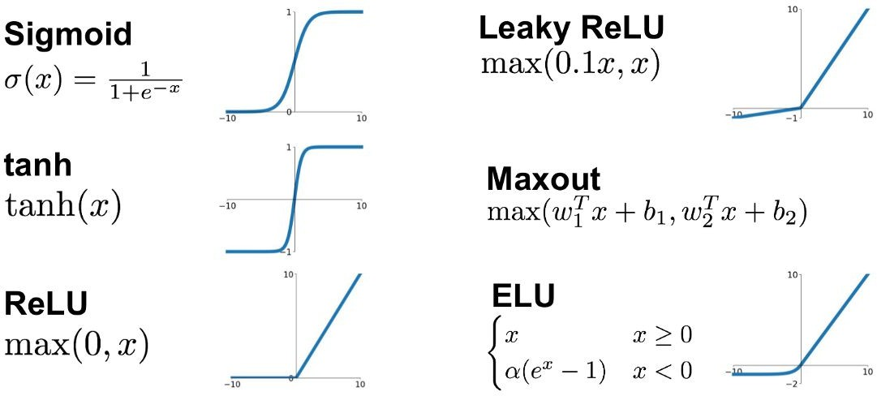
Activation Functions
Image Credit: towardsdatascience.com

Slide 17

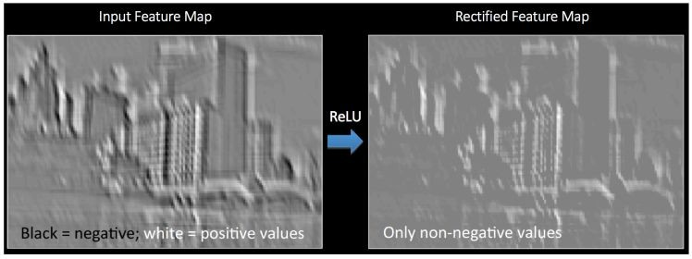
Introducing Non-Linearity (ReLU)
Image Credit: Deep Learning Methods for Vision | CVPR 2012 Tutorial

Slide 18
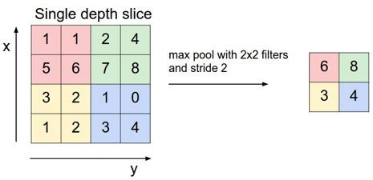
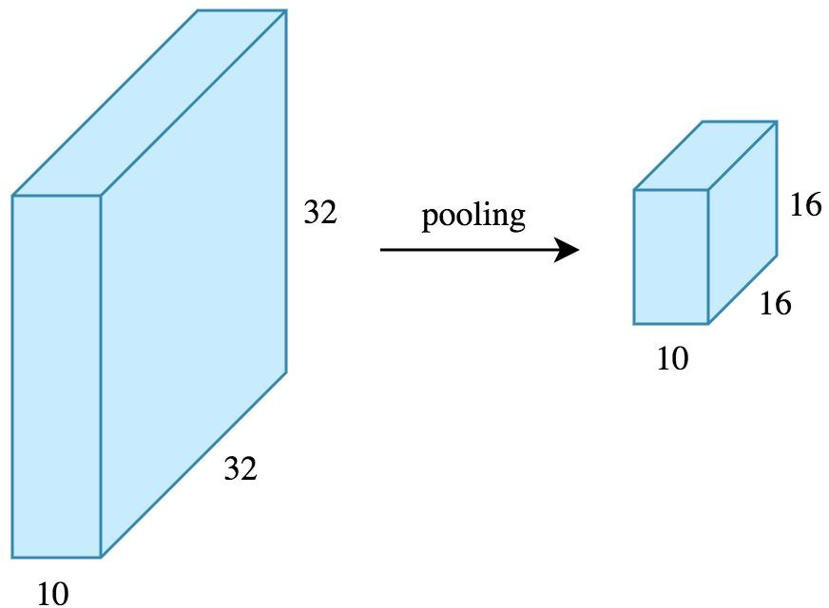
Max Pooling
(Image Credit: Applied Deep Learning | Arden Dertat)

Slide 19

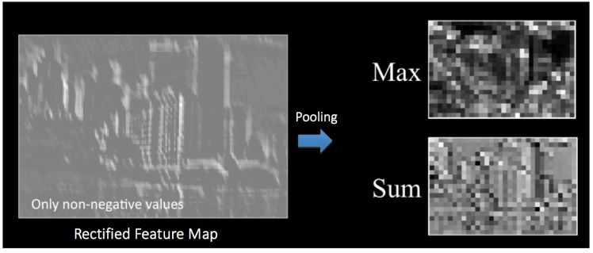
Pooling - Max-Pooling and Sum-Pooling
Image Credit: Deep Learning Methods for Vision | CVPR 2012 Tutorial

Slide 20
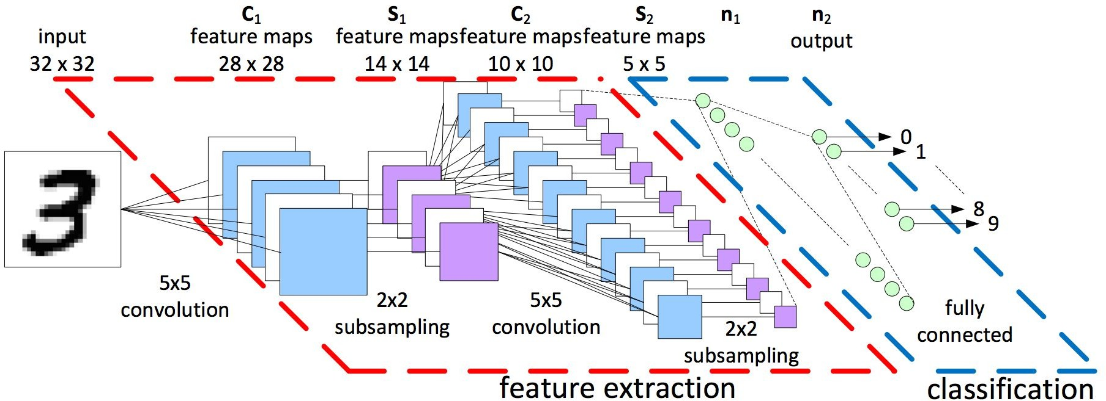
Convolutional Neural Networks
A convolutional neural network (CNN, or ConvNet) is a class of deep, feed-forward artificial neural networks that explicitly assumes that the inputs are images, which allows us to encode certain properties into the architecture.
LeNet-5 Architecture (Image Credit: https://becominghuman.ai)

