Slide 1
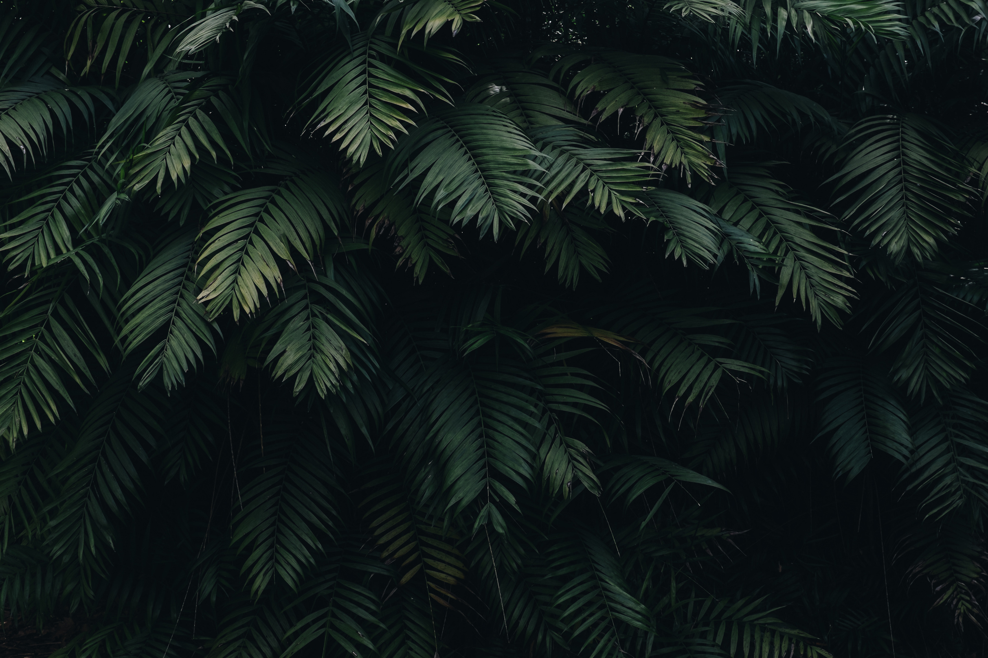


HYDERABAD INSTITUTE OF TECHNOLOGy AND MANAGEMENT
SUBJECT : DOING ENGINEERING - 2
PROJECT : LEAF DISEASE DETECTION USING IMAGE
PROCESSING
LAB INCHARGE
Dr. G. OMPRAKASH
ASSISTANT PROFESSOR
DEPARTMENT OF ECE, HITAM
PRESENTED BY :
N.SAKETH REDDY 21E51A6731
V.RAMESH 21E51A6762
V.ESHWAR 21E51A6764
[ CSE - DATA SCIENCE ]

Slide 2



ABSTRACT
Plant diseases are one of the main reasons for the decline in the quality and quantity of agricultural produce. Farmers have a lot of trouble recognizing and controlling plant diseases. As a result, it is critical to diagnose plant diseases at an early stage so that farmers may take accurate and timely action to avert future losses. The study focuses on a method for identifying plant diseases based on image processing and machine learning. A set of algorithms in the system can detect leaf disease. The input image given by the user to the system undergoes various image processing steps to detect the disease

Slide 3
LITERATURE SURVEY
[1]Plant scanner: Efficient and scalable 3D reconstruction of plants" by P. F. Giguère, J. V.ontelez, L. Roux, et al.
[2] "Plant phenotyping using multi-view stereo vision" by J. Shi, R. Song, Y. Guo, et al
[3] "Combining visible and near-infrared reflectance imaging spectroscopy for plant phenotyping" by Y. Liu, M. Li, and Q. Li
[4]"Automated high-throughput plant phenotyping using machine learning-based analysis of RGB images" by F. Tsaftaris, S. Azzari, A. Danesi, et al.
[5] "A review of plant phenotyping techniques and their applications in agricultural research" by H. Araus and G. Kefauver.

Slide 4

OBJECTIVE OF PROJECT
To implement leaf diseases detection with improvement
accuracy.
To get the processed leaf image as an input.
Segmentation of diseases part of leaf
To detect unhealthy regions of plant leaves..
Finally provide the type of disease attacked in the
leaf using SVM classifier

Slide 5
DESIGN METHODOLOGY
Methodology of the system integrates image processing techniques, texture extraction through GLCM, and machine learning with SVM classification to automate the identification of plant diseases based on standard benchmark images. The output, naming the detected disease, facilitates informed decision-making in agricultural practices.
Input: Standard benchmark images in RGB scale.
Output: Name of the disease
Step 1: The RGB color components of the image are transformed into Grayscale components
Step 2: Adaptive Histogram Equalization is applied to enhance the picture contrast.
Step 3: Application GLCM for texture extraction
Step 4: Classification of disease using SVM classifiers
Step 5: Display the results

Slide 6

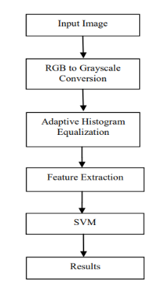
FLOW CHART

Slide 7
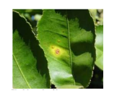
IMPLEMENTATION
For a complete implementation, you would need to take sample images from dataset of the project reported, and are used for the testing of the various operations that are done
The image of the leaf that is to be given as the input is put into the folder and then the GLCM values of the image has to be loaded into the database. Let us assume an input leaf as shown below.

Slide 8
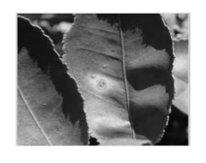
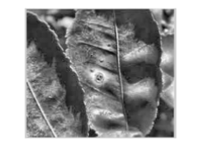
According to theaflow of the project, the above input image is converted into its grayscale image. The result obtained upon converting is the figure shown below.
This grayscale image is then subjected to Adaptive histogram equalization to enhance the contrast of the image. The result of the adaptive histogram equalization is as follows.

Slide 9
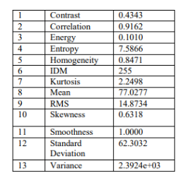
The values for the 13 statistical parameters calculated using the GLCM matrix is given below

Slide 10
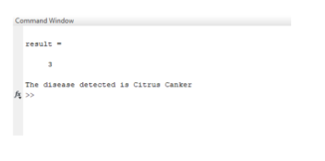
And finally, the output is given as the disease infecting the leaf

Slide 11
ADVANTAGES
It is easy to implement and gives quick results.
Good potential with ability to detect plant leaf disease..
Efficient and User friendly
Eco-friendly
Reliable
Low cost
Accuracy

Slide 12
APPLICATIONS
This project can be implemented at –
Early recognition of plant diseases and pests
Detecting diseases on plants at early stages gives strength to overcome it and treat it appropriately by providing the details to the farmer about which prevention action should be taken.
Agriculture crop diseases detection for treatment.

Slide 13
CONCLUSION
The color constituents of the image are deformed into grayscale. Adaptive Color Histogram is applied so as to reduce the overall contrast of the image. Textural feature extraction is done using GLCM. The dataset is trained using SVM classifiers, and thus the system identifies the disease that the leaf is affected. This project focuses on simple revelation of diseases in leaves at a relatively lower cost and time than conventional methods. In the future work, Convolutional Neural Networks can be used for the image classification. Also, Image Compression can be applied so that the processing time is lower than conventional methods.

Slide 14


