Slide 1

ADVANCEMENTS IN 3D OBJECT CLASSIFICATION USING POINTNET
Presenting by
V Ramesh

Slide 2

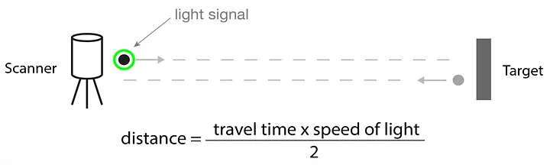
PREREQUISITE
LIDAR
(light detection and ranging)
PYTHON LIBRARIES
Open3D
Pandas & NumPy
Matplotlib
TensorFlow/PyTorch

Slide 3
INTRODUCTION
What is Point Cloud Data?
3D representation of objects using points in space.
Why is it important?
Used in robotics, self-driving cars, medical imaging, and more.
Objective of this project
Classify 3D objects into different categories using deep learning.

Slide 4
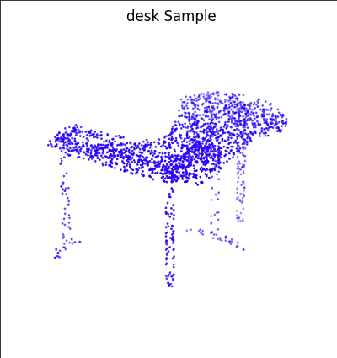
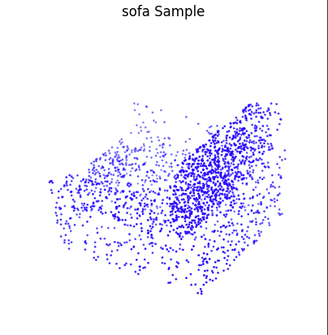
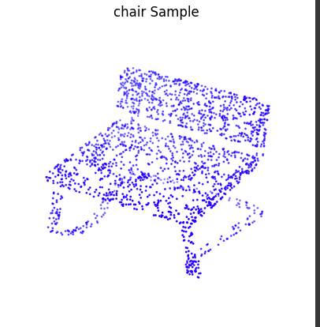
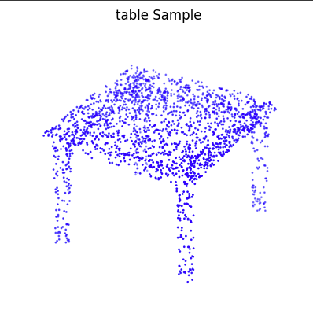
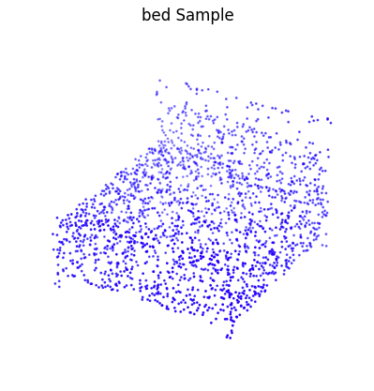
DATASET AND PREPROCESSING
Dataset Used: ModelNet10
Number of Classes: 10 (e.g., chair, table, bed, sofa, etc.)

Slide 5
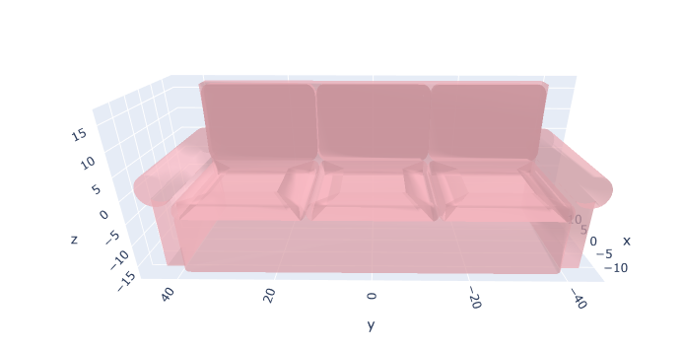
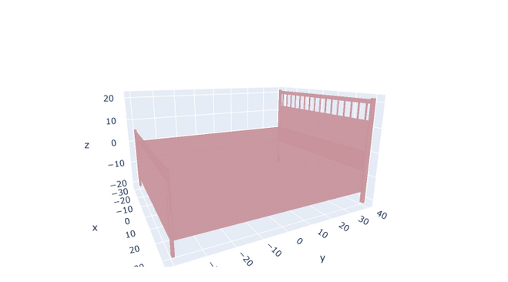
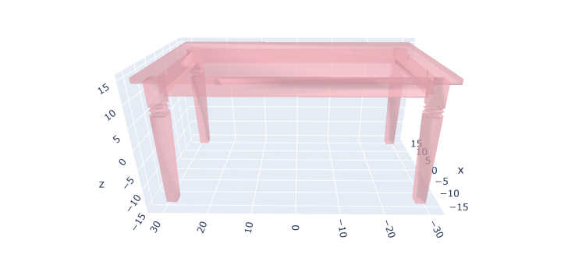
PREPROCESSING TECHNIQUES FOR POINT CLOUD DATA
Downsampling
Normalization
Noise Removal
Feature Extraction
Meshlab

Slide 6
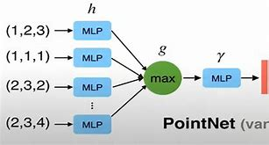
TRAINING SETUP
Training Parameters:
Batch Size: 32
Number of Epochs: 15
Loss Function: Categorical Cross entropy
Optimizer: Adam

Slide 7
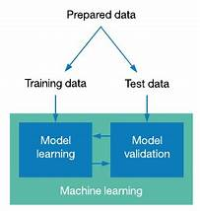
TESTING & EVALUATION
Testing Approach:
Selecting a batch from the test dataset.
Running inference on test samples.
Comparing predicted labels with ground truth labels

Slide 8
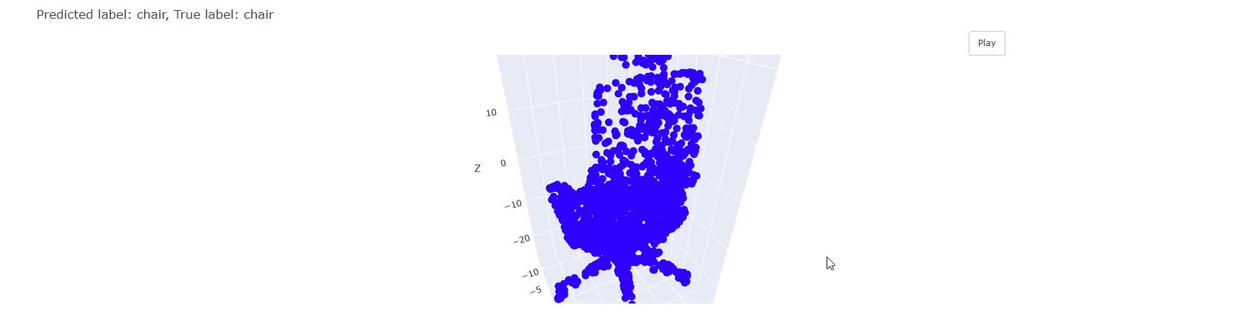
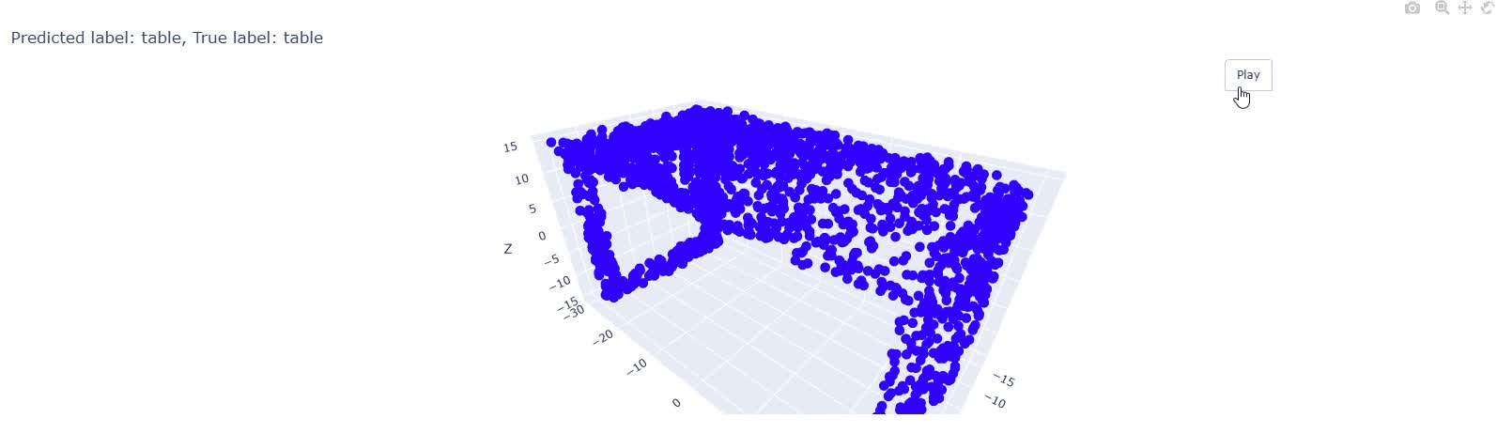
RESULTS & VISUALIZATION

Slide 9
CONCLUSION &
FUTURE WORK
Project Achievements:
Successfully classified 3D point clouds into 10 categories.
Improved performance using normalization and augmentation.
Future Work:
Use larger datasets like ModelNet40.
Experiment with different architectures like PointNet++ or Transformers for 3D data.

Slide 10
THANK YOU!
FOR YOUR ATTENTION

