Slide 1
Computer Science and Engineering with Data Science(CSD)
COURSE PROJECTS (2023-24)
III B.Tech II Semester
Predictive Maintenance for Industrial IoT
Project Guide:
Project Team :
Arigala Likhith Kumar 21E51A6703
Raolapalli Pushkara Kaushik Naidu 21E51A6744
Thatipampula Naveen 21E51A6761
V Ramesh 21E51A6762

Slide 2
Table of Contents
Abstract
Introduction
Data set
Algorithms
Data Collection
Data Processing
Exploratory Data Analysis
Model Selection and Training
Conclusion

Slide 3
Abstract
Industry 4.0 enables technological trends like Big Data Analytics and Machine Learning techniques to converge into and merge with traditional manufacturing processes, resulting in smart manufacturing. Smart manufacturing techniques leverage the use of Industrial Internet of things (IIoT) technology using IoT sensors that are fitted on physical assets to enhance manufacturing processes. IoT Sensors enable smart manufacturing facilities capable of autonomously exchanging information, which can be used to drive business decisions more accurately. Businesses that adopt Smart manufacturing techniques lead to a competitive advantage for these firms as they can bring in higher profit margins, reduced maintenance costs, energy savings, and better-quality products. This Project proposes an architecture for IIoT based predictive maintenance. This project focuses on creating a predictive maintenance model for industrial machines in the automobile industry. By leveraging IoT technology, the model aims to anticipate sudden breakdowns, making production and maintenance processes smarter. The study showcases how implementing such a model can lead to improved efficiency and cost savings in manufacturing operations.

Slide 4
Introduction
Definition of Predictive Maintenance (PdM)
Predictive Maintenance (PdM) is a type of maintenance strategy used to estimate and prevent equipment failures through data analytics. This process aims to reduce unplanned downtime, prolong optimal asset life, and optimise spare parts for repairs
Importance of PdM in Industry
Predictive maintenance (PdM) uses data analysis to identify operational anomalies and potential equipment defects, enabling timely repairs before failures occur. It aims to minimize maintenance frequency, avoiding unplanned outages and unnecessary preventive maintenance costs

Slide 5
Challenges with Traditional Maintenance Approaches
Reactive Maintenance (Run-to-Failure):
Unplanned Downtime: Equipment failures lead to unexpected production halts, causing significant downtime.
High Repair Costs: Emergency repairs and expedited parts replacement often result in higher costs.
Safety Risks: Sudden equipment failures can pose safety hazards to workers.
Preventive Maintenance (Scheduled Maintenance):
Over-Maintenance: Performing maintenance on a fixed schedule can lead to unnecessary servicing, increasing labor and parts costs.
Under-Maintenance: Fixed intervals might not account for actual equipment usage or condition, potentially missing signs of wear and tear.
Inefficiency: Scheduling maintenance based on time rather than condition can lead to suboptimal use of resources.

Slide 6
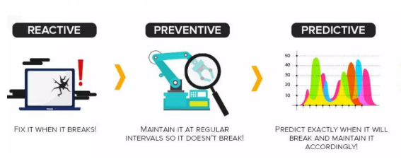
Benefits of Predictive Maintenance
Reduced Downtime
Cost Savings
Increased Equipment Lifespan

Slide 7
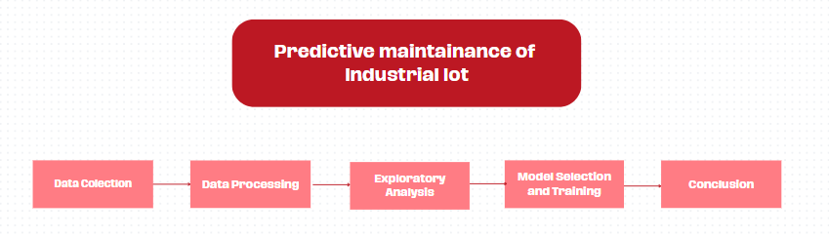
How Predictive Maintenance Works

Slide 8
Data Collection
Here we use the AI4I Predictive Maintenance Dataset from the UCI Repository to carry out an analysis that aims to respond to the needs just reported. The data provided by the UCI repository is a synthetic dataset that reflects real predictive maintenance encountered in industry to the best of their knowledge. The dataset consists of 10,000 data points stored as rows with 14 features in columns:
UID
Product ID
Air temperature [K]
Process temperature [K]
Rotational speed [rpm]
Torque [Nm]
Tool wear [min]
Tool wear failure (TWF)
Heat dissipation failure (HDF)
Power failure (PWF)
Overstrain failure (OSF)
Random failures (RNF)

Slide 9
Data Processing
Data Aggregation
Combining data from multiple sources to create a comprehensive dataset.
Facilitate more accurate analysis by integrating diverse data points.
Enhance the quality and completeness of data for better model training.
Outlier Detection
Identifying data points that deviate significantly from the majority of the data.
Detect anomalies that could indicate potential equipment failures.
Improve the quality of the dataset by removing erroneous data points.
Resampling Using SMOTE
Synthetic Minority Over-sampling Technique (SMOTE) is used to address imbalanced datasets by creating synthetic samples of the minority class.
Balance the dataset to improve model training and performance.
Avoid biases that can occur with imbalanced classes.

Slide 10
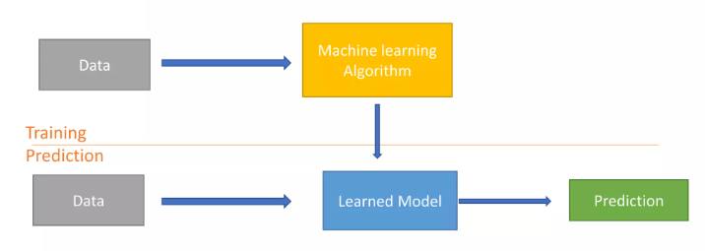
Machine Learning for Predictive Maintenance
Predictive maintenance with machine learning emerges as a viable solution to mitigate the impact of unexpected machine failures . AI-driven anomaly detection and fault prediction in predictive maintenance can yield substantial benefits, including:
Increasing runtime between 10 to 20%.
Reducing maintenance costs by up to 10%.
Minimizing the time needed for maintenance scheduling by up to 50%.

Slide 11
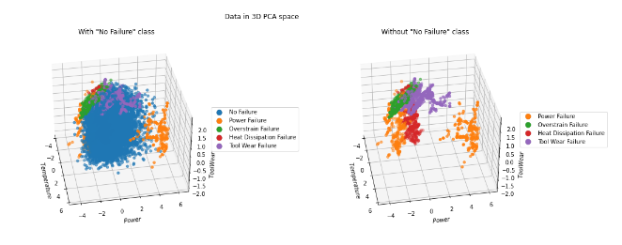
Exploratory Data Analysis
Data Visualization:
Principal Component Analysis (PCA):
A dimensionality reduction technique that transforms high-dimensional data into a lower-dimensional form while preserving as much variance as possible.
To simplify the complexity of high-dimensional data, making it easier to visualize and understand.

Slide 12
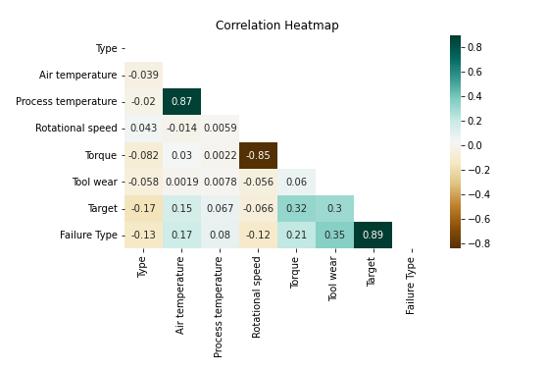
Correlation Heat Map
A visual representation of the correlation matrix showing the strength and direction of relationships between pairs of variables using colors.
To easily identify patterns, relationships, and insights from the data.

Slide 13
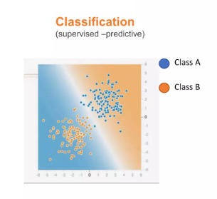
Model Selection and Training
Classification algorithms are part of data mining and use supervised machine learning methods to make predictions about data. The aim of this project is to find the best model for binary classification of the dataset to predict whether or not there will be Machine Failure.
The classification techniques we choose to implement are the following:
Logistic Regression
K-nearest neighbors (K-NN)
Support Vector Machine
Random Forest
XGBoost

Slide 14
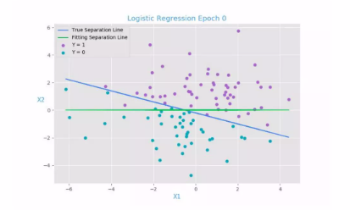
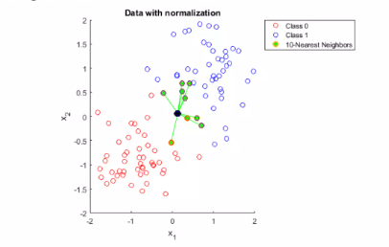
Logistic Regression
Used to predict the probability of a binary outcome, such as whether a machine will fail or not within a certain time frame.
KNN - K Nearest Neighbour
The algorithm classifies a data point based on how its neighbors are classified. The "k" in KNN represents the number of nearest neighbors to consider.

Slide 15
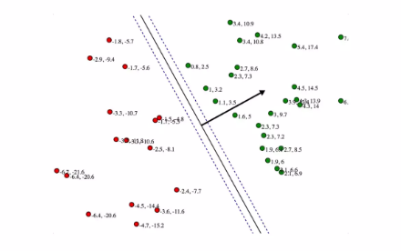
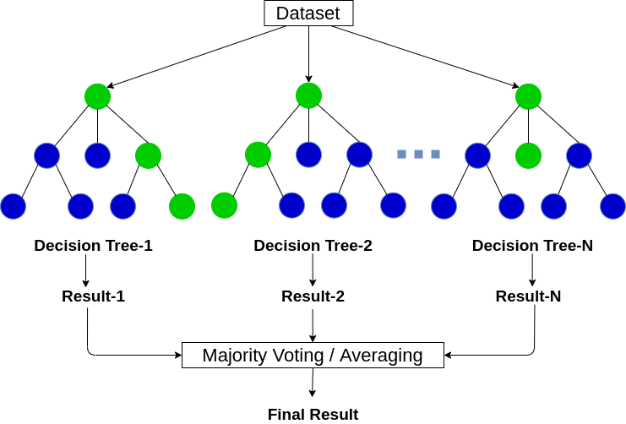
Support Vector Machine (SVM)
It works by finding the hyperplane that best separates different classes in the feature space.
SVM aims to maximize the margin between different classes, making it effective for high-dimensional and non-linear data
Random Forest
Random Forest is an ensemble learning method that constructs multiple decision trees during training and outputs the mode of the classes (classification) or mean prediction (regression) of the individual trees.

Slide 16
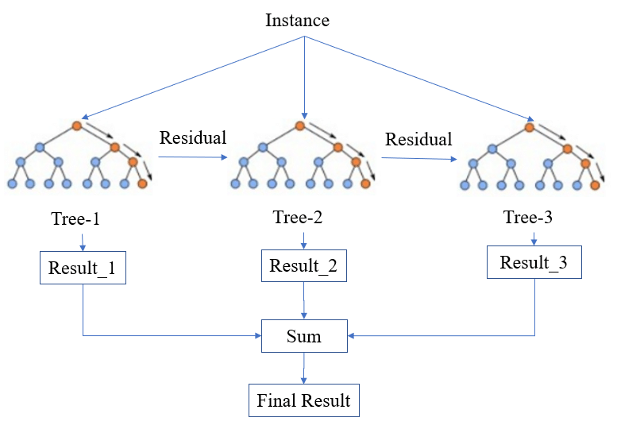
XGBoost
XGBoost (eXtreme Gradient Boosting) is an optimized implementation of the gradient boosting algorithm designed for speed and performance. It builds an ensemble of decision trees sequentially, where each new tree corrects errors made by the previous trees.
To improve predictive accuracy and handle large-scale datasets efficiently.

Slide 17
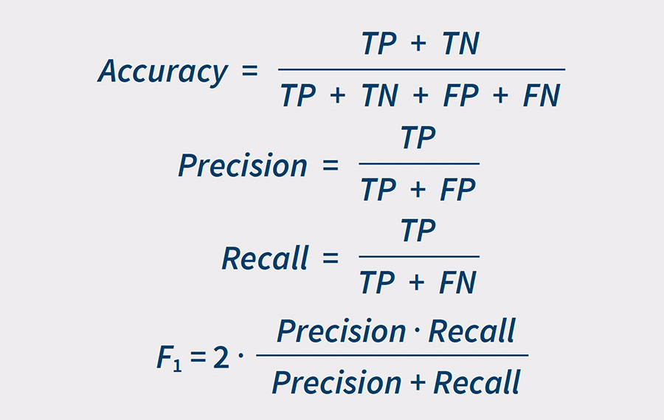
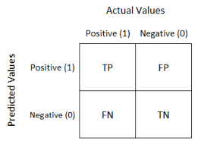
Metrics for Evaluating
Metrics are essential for evaluating the performance of predictive maintenance models. They help in assessing how well the model predicts equipment failures and identifies anomalies, guiding further improvements.
To ensure that the model provides reliable and actionable insights for maintenance decisions.
Confusion Matrix: A table used to describe the performance of a classification model by displaying the true positives, false positives, true negatives, and false negatives.Provides a comprehensive view of model performance, especially useful for understanding the types of errors the model is making.Often visualized as a 2x2 matrix for binary classification.

Slide 18
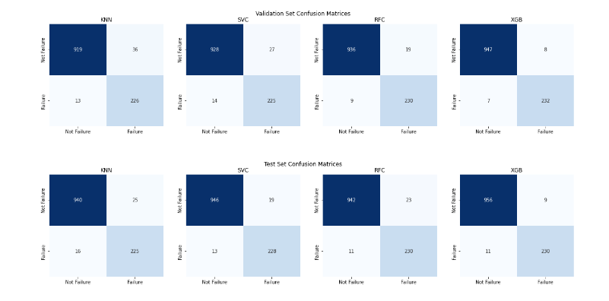
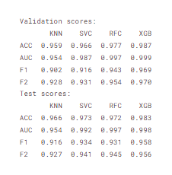

Slide 19
Conclusion
According to our analyses and results, we successfully tackled two tasks: predicting whether a machine will fail and identifying the type of failure. After thorough data preprocessing, including cleaning, encoding, scaling, and PCA, we identified key features: combinations of temperatures, Machine Power, and Tool Wear. Contrary to initial assumptions, machine type was not a significant factor in failure prediction. Among the models tested, XGBoost provided the highest accuracy, though it required longer response times, especially for multi-class classification. KNN, while less accurate, offered instant response times. Therefore, the choice of model depends on the company's priorities: XGBoost for accuracy and KNN for speed

Slide 20
THANK YOU

