Slide 1

GIG MANAGEMENT SYSTEM
Gig Management System is a mini social network that makes easy for music lover to track the gigs of their favourite artists and the artist can aware users about their upcoming gigs.
Created by:-
Nishchay
Prachi Ramesh
Pratyusha Michelle
Are you a music lover?
Join us to follow your favourite artist to track their GIGS!!! ☺

Slide 2
MENU IN GIG MANAGEMENT SYSTEM
GIG Management System offers below menus:-
User Login Page
GIG (Add/Edit/Remove/List) by Artist
GIG (View/Search/Add to Calendar) by User

Slide 3
OVERVIEW
Login Portal
USER
GMS

Slide 4


LOGIN PORTAL
New to GMS?
Want to be a part of our Gig Management System?
Already a User?

Slide 5

FUNCTIONAL DETAILS
USER
Create Gig
My Upcoming Gigs
Edit Gig
Cancel Gig
View Gigs
Search Gigs
Follow Favourite artist
Add Gig to Calendar

Slide 6
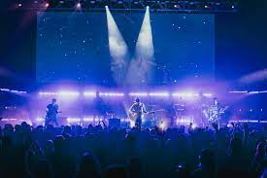
Gigs
Artist
Genre
Location
Date
Time

Slide 7
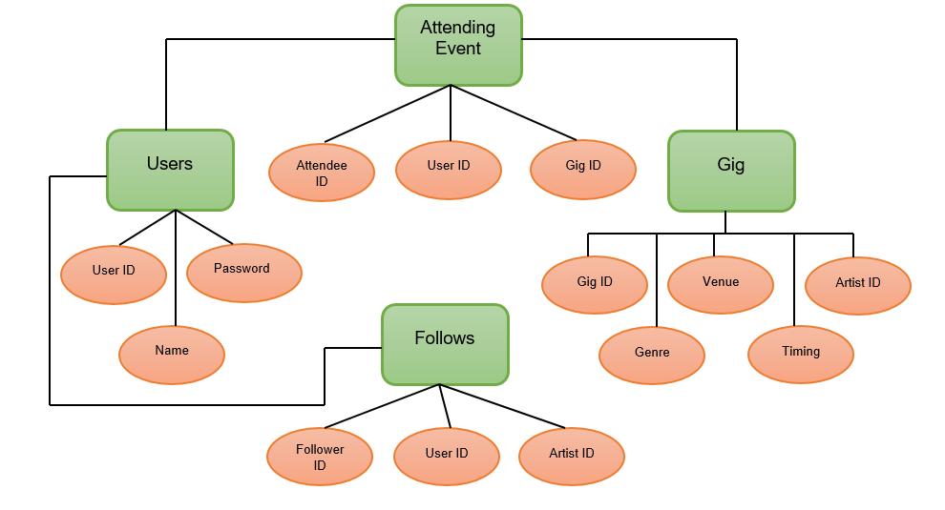
ER DIAGRAM

Slide 8


Software Used
Visual Studio
SQL Server

Slide 9
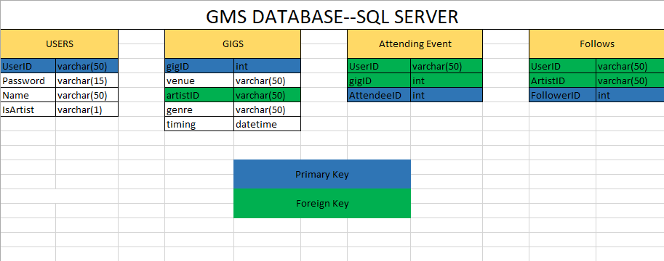
GMS DATABASE--SQL SERVER

Slide 10
THANK YOU!!!

