Slide 1
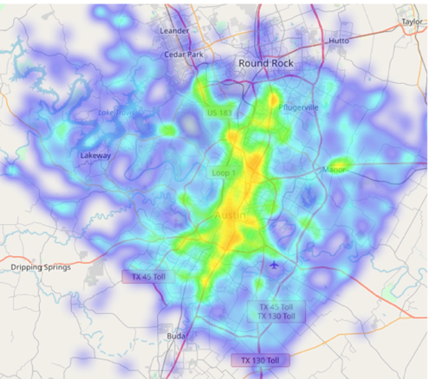
Predicting Road Accidents in the City of Austin
Ramesh Adhikari
12/27/2019
Road Accident density in Austin:
Time period (Sep 26, 2017 to Sep 9, 2019)

Slide 2
Data Story
Road accidents, a big problem
68420 accidents in Austin, Texas in two years (September 2017 to September 2019)
Machine learning can help to save by predicting the potential road accidents (time and location)
We predict the number of daily and hourly accidents at different locations in the city of Austin
Data:
Accidents count of accidents were collected every 5 second traffic incidence report from https://data.austintexas.gov/Transportation-and-Mobility/Real-Time-Traffic-Incident-Reports/dx9v-zd7x
Hourly weather report was extracted from https://api.darksky.net.
Datasets related to schools, traffic signals, historical landmarks are collected from https://data.austin.gov,

Slide 3
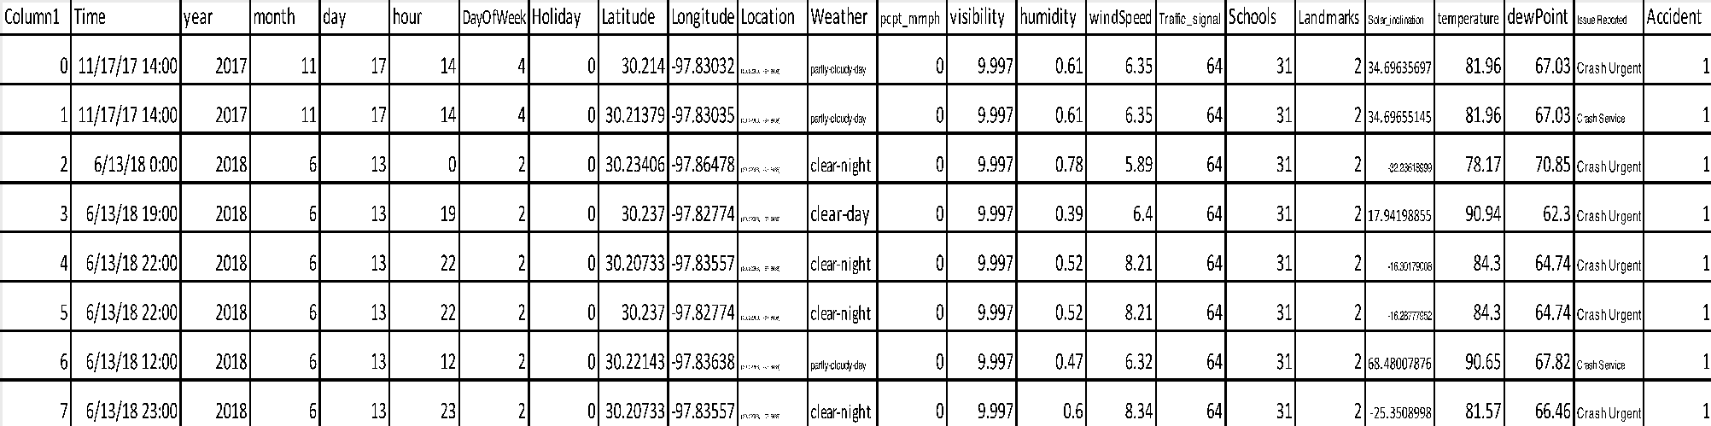
Data Features:

Slide 4
Exploratory Data Analysis:
High Peaks in the Accident Curve
High Precipitation
Low Temperature

Slide 5
Exploratory Data Analysis:
Accidents at various locations
Independent of time features month, day, holidays
Depends on the hour of the day
Strongly depends on locations. Sharply dependent on geographical longitude
We also found weak dependence of nearby traffic signals, school zones and historical landmarks
Distribution of accidents along longitude

Slide 6
Forecasting Road Accidents in Austin:
Time Series Analysis
Baseline Model
Mean absolute errors:
Baseline: 21%
ARIMA: 17%
ARIMA with exogenous variables: 15%
Test Set of Data
ARIMA with Exogenous variables
ARIMA
Test Set of Data
Training Set
Test Set

Slide 7
Performance of Two Decision Based Predictive Models:
Daily Road Accidents in the City of Austin
Random Forest (MAPE : 9 %)
Random Forest Model
Longitude is the most Important
eXtreme Gradient Boosting (MAPE: 8 %)
eXtreme Gradient Boosting

Slide 8
Performance of Two Decision Based Predictive Models:
Road Accidents at Locations (Latitude, Longitude):
Random Forest (MAPE : 11 %)
eXtreme Gradient Boosting (MAPE: 6 %)

Slide 9
eXtreme Gradient Boosting Model:
Prediction of Hourly Average Road Accidents
eXtreme Gradient Boosting (MAPE: 10 %)

Slide 10
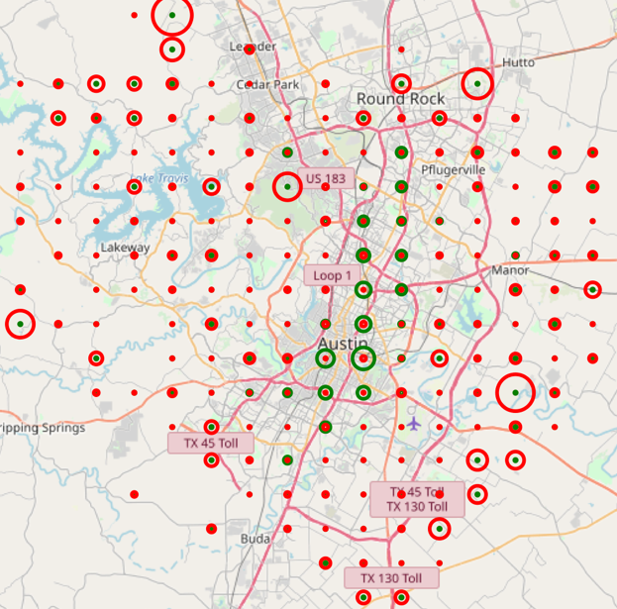
Locations and Prediction Errors:
Actual accident data
Absolute error

Slide 11
Summary:
We predicted the road accidents in the city of Austin at various locations and time
Extreme gradient boosting model outperforms the other models that were used in this project.
Random forest model performs far better than the autoregressive time series model ARIMA, although ARIMA itself performed better than the baseline model for time series analysis.
Location wise accidents have been predicted with performance better than the daily accident counts.

