Slide 1
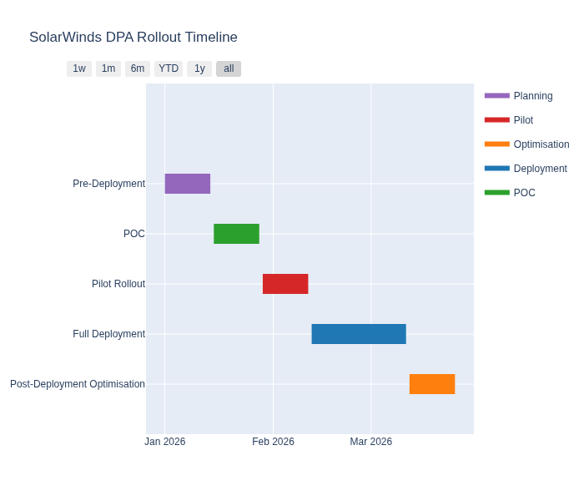
SolarWinds DPA Rollout Timeline

