Slide 1
Introduction to Apache Kafka
Ramesh Poludasu

Slide 2
Agenda
What is Apache Kafka?
Terminology
Cluster & Replication Factor
Producers & Consumers
Zookeeper
Hands-on

Slide 3
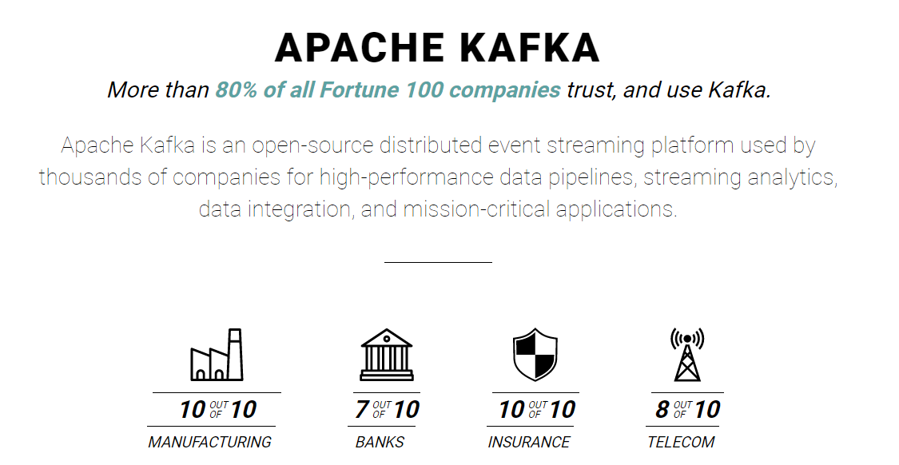
What is Apache Kafka?
Created By LinkedIn, now opensource maintained by Confluent
Distributed, resilient, fault tolerant event streaming platform
Horizontal scalable
100s of brokers
Can scale to millions of msgs/sec
High Performance (latency < 10ms) – NRT
Used by 2000+ firms
Airbnb, LinkedIn, Netflix, Walmart, Uber etc.
Kafka used mainly as Transportation Mechanism
Source: https://kafka.apache.org/

Slide 4

Why Apache Kafka?
Source
Source
Source
Source
Use Cases
Messaging System
Activity Tracking
Gathering Metrics
Application logs
Stream processing
Decoupling system dependencies
Bigdata Integrations (spark, Hadoop etc.)
DATA
DATA
DATA
Source
Source
Source
Source
Target
Target
Target
Target
Complex Architecture
Target
Target
Target
Target
Decoupled Architecture with Kafka

Slide 5
Terminology
Message: A message in Kafka is a key-value pair with some metadata.
Topic : A particular stream of data (like table). Has a name.
Partitions : Topics are split into partitions. Numbered.
Each partition is ordered.
Each message within partition gets an incremental Id called as offset.
Data kept only for limited time (default 7 days).
Immutable data.
Data assigned to partition using hash of key, else it’s random/round robin.
Replica: copy of data
Broker: a server, has an id. certain topic partitions.
If connected to one broker(bootstrap contains broker), will be connected to entire cluster.
Cluster can have any number of brokers.
Cluster: Collection of brokers(servers)
P0
0
1
2
3
4
5
6
P1
0
1
2
3
4
5
P2
0
1
2
3
4
Kafka Topic

Slide 6
Topic Replication Factor
Topics should have replication factor>1 to avoid issues.
Consider TOPIC A with 3 partitions and replication Factor of 2
At any time only one broker can be leader for a partition of a topic to receive and serve the data. Others are replicas. Who decides leaders, replicas? Zookeeper!
Broker1
Broker2
Broker3
Leader
Leader
Leader
Partition-0
Topic A
Partition-1
Topic A
Partition-2
Topic A
Partition-2
Topic A
Partition-0
Topic A
Partition-1
Topic A
Replica
Replica
Replica
Cluster

Slide 7
Producers & Consumers
Producers: write data to topic(collection of partitions).It takes care of to which broker and to which partition to write to. Modes of send are:
Acks=0: No wait for acknowledgment.
Acks=1: wait for leader acknowledgement.
Acks=all: Leader + replicas acknowledgement.
Consumers: Read data from topic. It takes care of which broker to read from. Data read in order within partition.
Kafka stores consumer offsets for each consumer after consuming a message.
Consumer Group:
Each group gets a copy of message.
Each consumer read data from exclusive partition. If consumers>partitions, some remain inactive.
Consumers use group co-Ordinator and a consumer co-Ordinator to assign a consumer to a partition.
Consumer in each group commits the offsets after processing each message.
Consumer1
Broker1
Producer1
Partition-0
Consumer2
Broker2
Producer2
Partition-1
Consumer Group1
Broker3
Partition-2
3 Delivery semantics:
At most once: commit as soon as msg received.
At least once(pref): commit after message is processed.
Exactly once(only for kafka to kafka): kafka => kafka workflows using kafka streams api.
Consumer1
Producer3
Topic-A
Consumer Group2

Slide 8
Zookeeper
Membership of the cluster - maintains a list of all the Kafka brokers
Access control lists - for all the topics ACLs maintained within Zookeeper.
Configuration of each Topic - list of existing topics, the number of partitions for each topic, the location of all the replicas, list of configuration overrides for all topics and which node is the preferred leader, etc.
Controller election - responsibility to maintain the leader-follower relationship across all the partitions. Ensures a controller is available all the time.
Ensemble: Group of Zookeeper servers.
One Leader handles writes, and rest(followers) reads.
Consumer offsets are managed by Kafka.
Zookeeper server 1
Zookeeper server 1
Zookeeper server 1
Kafka
Server 1
Kafka
Server 2
Kafka
Server 3
Kafka
Server 4
Kafka
Server 5

Slide 9
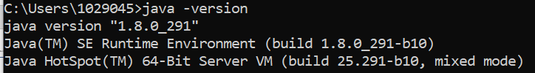
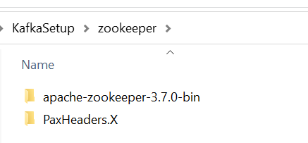
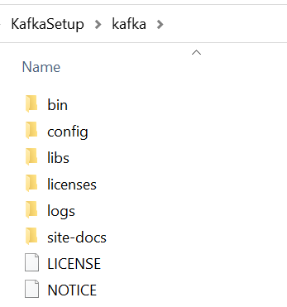
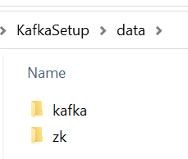
Hands On – Server settings
1
Prerequisites & configurations:
Java 8 Download and install.
Open cmd and type ‘java -version’ to check for java installation. See image1
Apache Zookeeper Download and extract to a folder. See image2.
Apache Kafka Download and extract to a folder. See image3
Create a folder ‘data’. Inside data folder create kafka and zk subfolders. (see image4)
Navigate inside zookeeper folder > conf > zoo_sample.cfg (rename it to zoo.cfg)
Open zoo.cfg. Update
dataDir= C:/Software/KafkaSetup/data/zk
Ensure forward slash (/) or (\\) in the path(windows).
6. Navigate inside kafka folder > conf > server.properties
log.dirs= C:/Software/KafkaSetup/data/kafka
2
3
4

Slide 10
Hands On – Start Servers
Start zookeeper:
C:\KafkaSetup\zookeeper\apache-zookeeper-3.7.0-bin\bin\zkServer.cmd
Start Kafka:
C:\KafkaSetup\kafka\bin\windows\kafka-server-start.bat C:\KafkaSetup\kafka\config\server.properties
Note:
If you see long path issues > Try moving kafka setup to C drive. Keep the path shortest in windows.
Change the path in the above example as per your setup.
Use sh file instead of cmd/bat file on your Linux machine.

Slide 11
Kafka tools & commands
#Create a topic
./bin/windows/kafka-topics.bat --create --zookeeper localhost:2181 --replication-factor 1 --partitions 2 --topic topic-1
#List existing topics
./bin/windows/kafka-topics.bat --list --zookeeper localhost:2181
#delete a topic
./bin/windows/kafka-topics.sh --zookeeper localhost:2181 --delete --topic topic-1
#Produce a message
./bin/windows/kafka-console-producer.bat --broker-list localhost:9092 --topic topic-1
#Consume a message
./bin/windows/kafka-console-consumer.bat --bootstrap-server localhost:9092 --topic topic-1 --from-beginning
#Consumers with a group
./bin/windows/kafka-console-consumer.bat --bootstrap-server localhost:9092 --topic topic-1 --group topics-group1
#Producer with a key
./bin/windows/kafka-console-producer.bat --broker-list localhost:9092 --topic topic-1 --property parse.key=true --property key.separator=":"
#consumer group with print key and consumer per partition
./bin/windows/kafka-console-consumer.bat --bootstrap-server localhost:9092 -topic topic-1 --group topics-group1 --property print.key=true --property key.separator=":"

Slide 12
Practice
Produce a message into a topic and consume it from multiple consumers.
Observe each consumer gets a copy of message.
Messages without keys are evenly distributes across partitions.
List the topics that are available.
Produce a message with key & value and consume it with multiple consumers from a single consumer group.
Observe each consumer group gets a copy of message.
A message with similar key will always goes to same partition.
If consumers > partitions in a consumer group, they remain inactive.
Delete the topic.
Finding difficult? Check about Apache Kafka on www.learnmodeon.com

Slide 13
Thank You

