Slide 1

Name : Rameshbabu Lakshamanan
CellStar AI researcher
Github: https://github.com/rameshbabulakshmanan84/

Slide 2
About Myself
14+ years of overall experience predominantly in BFSI domain with 6+ years in project Management
Implementation of projects in Waterfall and Agile methodologies with various pricing models such as Time Material, Fixed Price and Managed Services.
Product Management, Scope Management, Financial Management and Continuous improvements are my current KRA’s
Fun Fact : Marathon Runner

Slide 3
Problem Statement
Recommendation Approach
Character and word embeddings
Product recommendation

Slide 4
Problem Statement
What is the most similar product that can be recommended to the users?
What products can be recommended to similar set of users?
Solution:
Fasttext method to create the embeddings for the purchase history
Use Doc2Vector method to find similar users
Recommend the products
Reference:
Datasets - onlineretaildataset
Notes:
Merge Sort?

Slide 5
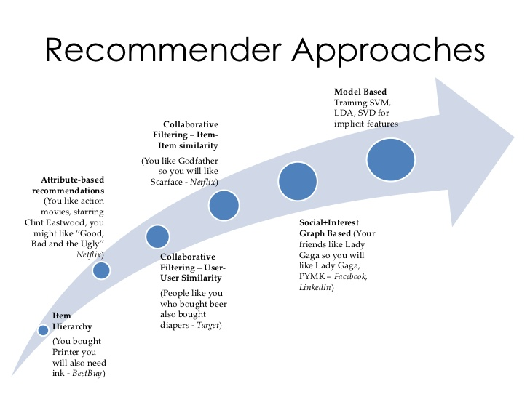
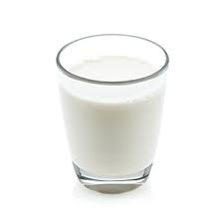
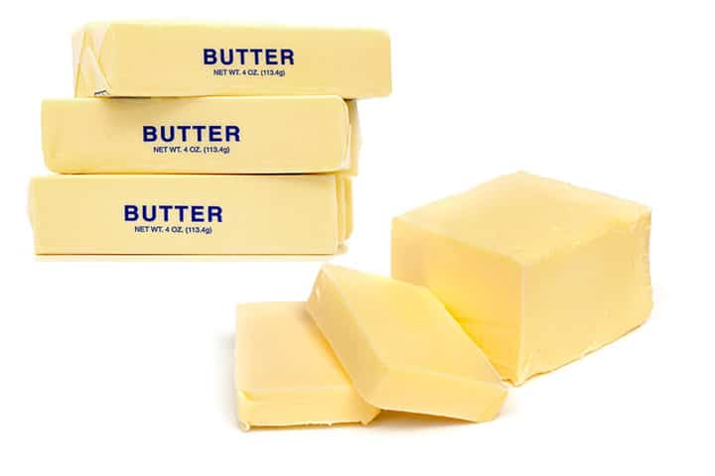

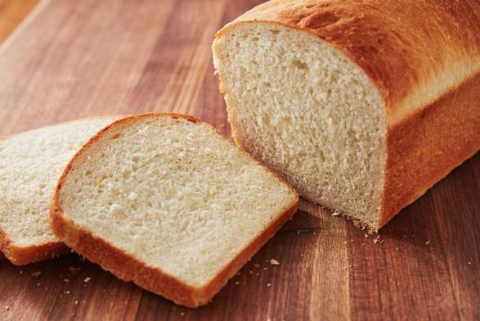
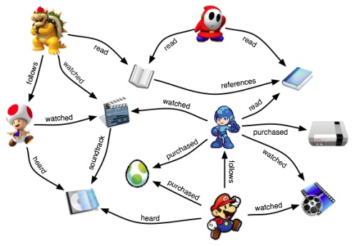
Recommendation Approaches
Fig 1 Items in my cart
Fig 2 Connected Network
Notes:
Merge Sort?

Slide 6
Why Word Embeddings
Traditional word representation - One hot vectors
Eg: “ I ate the orange for the breakfast” -
Words | Integer encoding | One hot encoding
I | 1 | 100000
Ate | 2 | 010000
Orange | 3 | 001000
For | 4 | 000100
The | 5 | 000010
breakfast | 6 | 000001
Disadvantages :
For n vocabulary, require n- dimensions for representation
Computationally expensive
No relation between the individual word vectors
WordEmbeddings are nothing but the vectors learnt by the model to represent the words in the continuous dense space
Techniques : Count vectorizer, TF-IDF vectorizer, Hashing Vectorizer,Word2Vec(Google),Glove(Stanford), Fasttext(Facebook)
Notes:
Merge Sort?

Slide 7
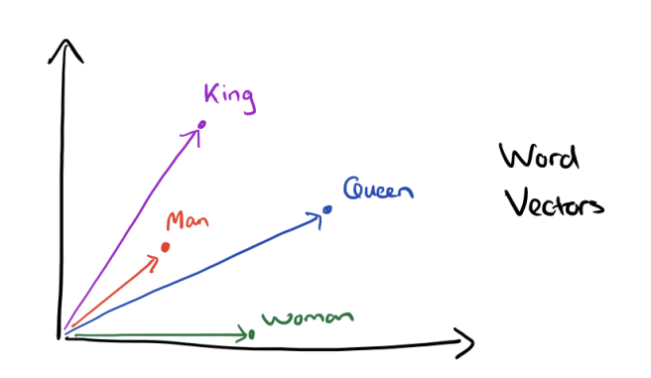
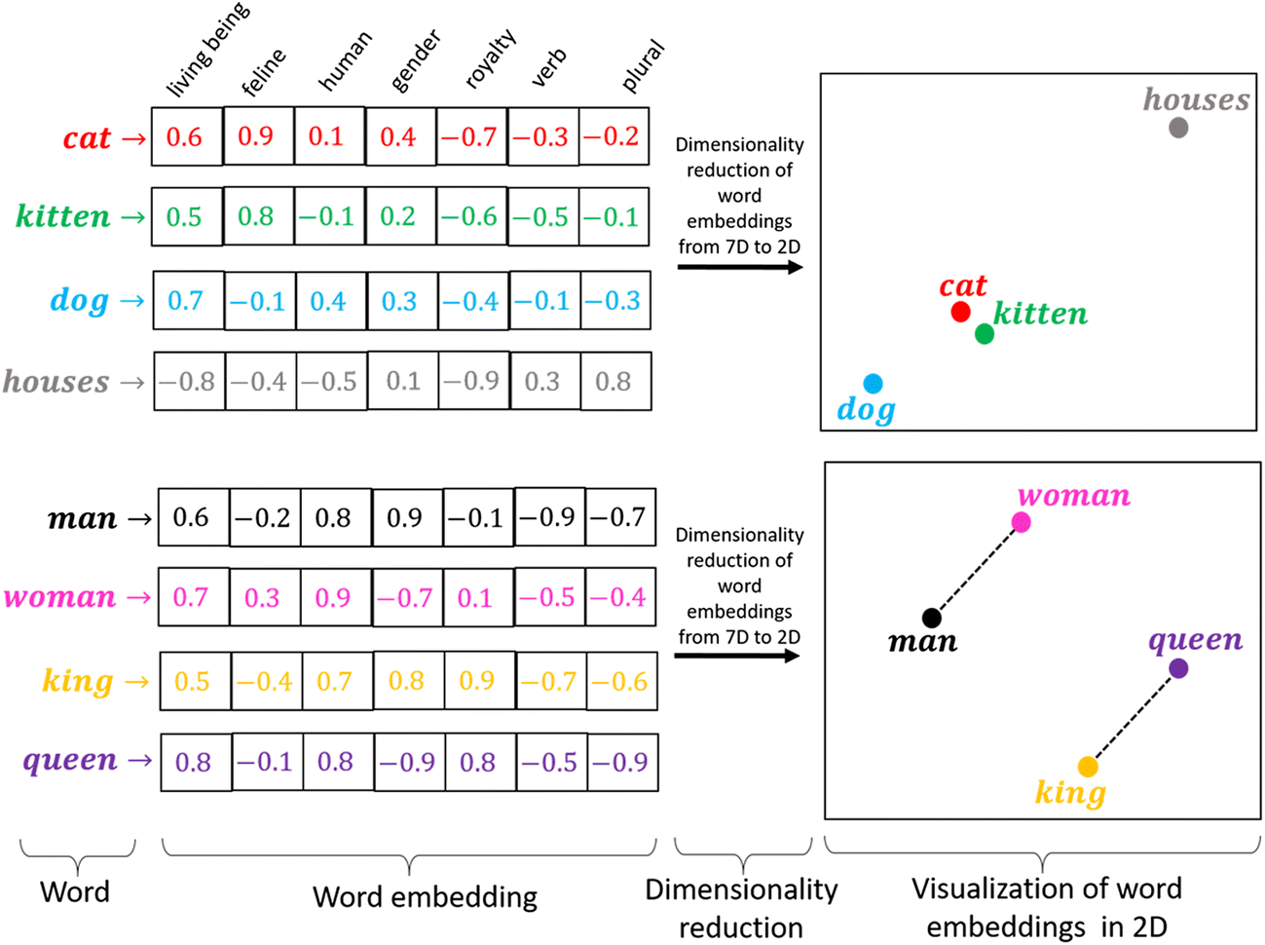
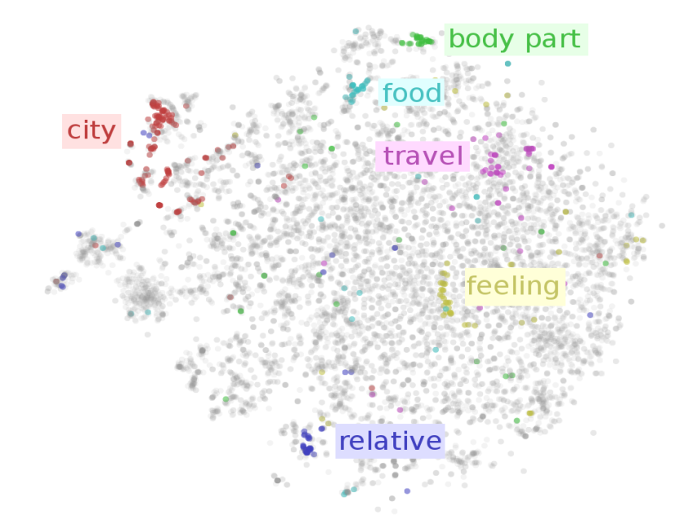
WordEmbedding Visualization
Fig 4 Word Embedding representation
Fig 5 T-SNE 2d representation
Fig 3 Word to vector embedding
Notes:
Merge Sort?

Slide 8
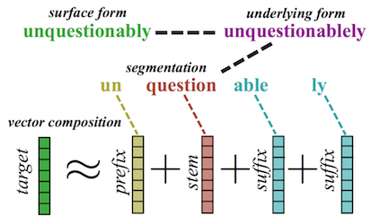
Fasttext
Each sentence is a mixture of words and each word is mixture of character n-grams
Fasttext represents each word as an n-gram of characters. Helps capture meaning of shorter words / embeddings
For eg :
Where : n = 3 -> [<Wh,whe,her,ere,re>] : Number of n-grams words : 5
n_min = 3 , n_max = 4 -> [ <wh,whe,her,ere,re>,<whe,wher,here,ere>] : Number of n-grams words: 9
Two Methods of training – Continuous Bag Of Words(CBOW) vs Skip gram(SG) model.
CBOW – Input : Context words, Output : Target word
SG : Input : Target words, Output : Context word
So out-of-vocab words are represented as the sum of character ngram vectors
model_ft1.wv['223']
model_ft : The complete model : Vocab size : 3166
model_ft1.wv.vectors_ngrams : Returns the vectors of the sub words -→ model_ft1.wv.vectors_ngrams.shape : (20378, 100)
model_ft1.wv.vectors: Return the complete vectors of the complete words : sum of all vector components of the n-grams and word itself :model_ft1.wv.vectors.shape (3166, 100)
model_ft1.wv.vocab : Return the complete Vocabs of the full words. : len(model_ft1.wv.vocab) : 3166
Fig 6 Char n grams

Slide 9
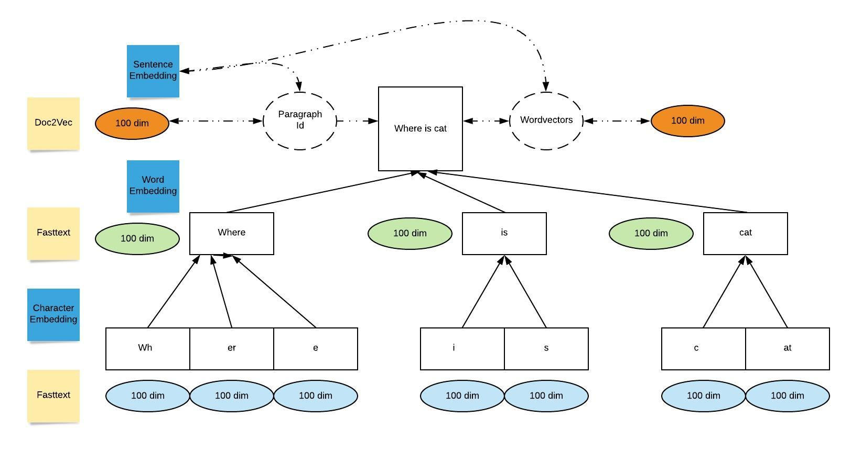
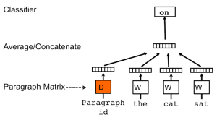
Sentence Embedding – Doc2Vec
Similar to words, sentence can also be embedded or represented
Techniques : TF-IDF ,Doc2Vec,Infersent,Sentence Bert
Paragraph vector or Document vector is of two types
PV - DM : Distributed Memory similar to word2vec CBOW
PV - DBOW : similar to Skipgram
Doc2Vec learns representations for words and labels simultaneously.
docmodel_1 : The complete model : Vocab size : 3469
docmodel_1.wv.vectors: Returns the vectors of the sub words model_ft1.wv.vectors_ngrams.shape : (3469,100)
docmodel_1.docvecs[Tag] : Return the complete vectors of the paragraph/doc
docmodel_1. most_similar : Return the similar vector of the given vector
docmodel_1. infer_vector: Constructs the vector for the given doc corpus
Fig 7 Sentence embedding
Fig 8 PV – DM approach

Slide 10
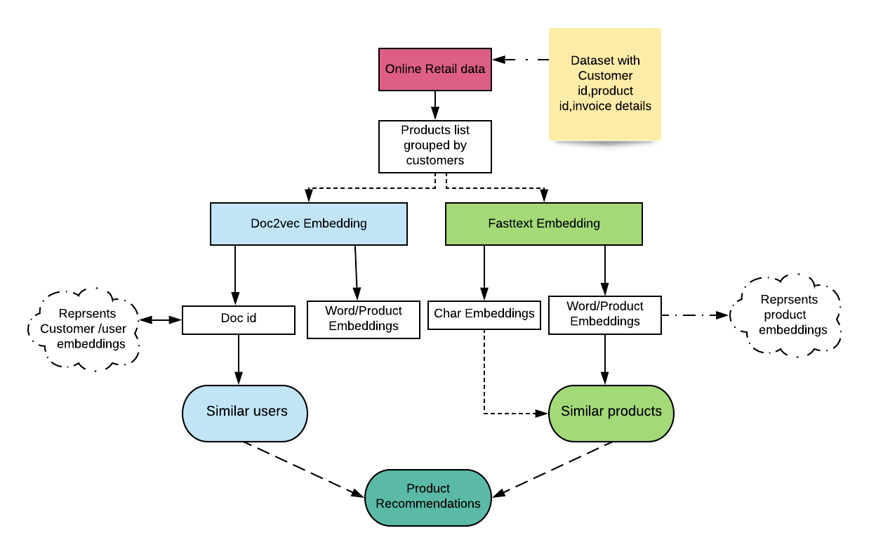
Complete Recommendation System
The online retail data set is preprocessed to group the customers with relevant products
The Products are passed to Fasttext library from gensim – the character and product embeddings are obtained via training.
The Product embeddings are used to predict the relevant /similar products via model.similar_by_vector function.
Import Doc2vec model from gensim
The retail data set is tagged with unique doc ids for each of the products list – TaggedDocument function
The output of the function is product & paragraph embeddings that can be accessed via model.wv.vectors and model.docvecs[Tag] function
The users similarity can be arrived at by using model.docvecs.most_similar(positive=[sample1],topn=5) for top 5 similar users
Fig 9 Function block diagram

Slide 11
Thank you
Name : Rameshbabu Lakshamanan
Github: https://github.com/rameshbabulakshmanan84/NLP-series/blob/master/ProductRecommendation_Fasttext_Doc2Vec.ipynb
Linkedin: https://www.linkedin.com/in/rameshbabu-lakshmanan-060b40a/
Notes:
Merge Sort?

