Slide 1
ConversAI-tion
7 Jul 2023

Slide 2


Slide 3
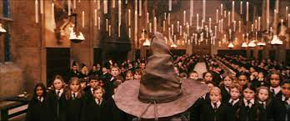

Slide 4
Will AI Kill Us All?
Notes:
AI as a Threat to Humanity: AI could surpass human intelligence, become uncontrollable, and pose a threat to humanity's existence.
AI as a Tool for Human Advancement: AI is a tool created by humans and will always be under human control, offering great potential for solving complex problems and enhancing human progress.
AI as a Catalyst for New Challenges and Adaptation: AI presents challenges and risks, but humans can adapt by acquiring new skills and strategies to ensure a harmonious coexistence with AI systems.

Slide 5
Will AI Ruin Our Society?
Notes:
Negative Impact on Society: AI advancements may disrupt social structures, job markets, and human relationships, leading to negative consequences for society.
Positive Impact on Society: AI has the potential to greatly enhance society by improving efficiency, advancing technology, and addressing complex societal issues.

Slide 6
Will AI Take All Our Jobs?
Notes:
Job Displacement Concerns: AI automation may lead to widespread job loss and unemployment as machines replace human labor in various industries.
Job Creation and Increased Productivity: While some jobs may be replaced, AI can also create new job opportunities and enhance productivity, leading to economic growth and improved work conditions.

Slide 7
Will AI Lead To Crippling Inequality?
Notes:
Exacerbation of Inequality: AI could widen social and economic disparities, as those with access to AI technology and resources may benefit disproportionately.
Bridging the Gap: AI can be leveraged to bridge the gap by providing equal opportunities, reducing bias, and addressing societal inequalities.

Slide 8
Will AI Lead To Bad People Doing Bad Things?
Notes:
Misuse and Risks: AI can be misused by individuals or groups for malicious purposes, such as cyberattacks, deception, or the creation of autonomous weapons.
Responsible AI Development and Regulation: Emphasis on responsible AI development, robust regulations, and ethical guidelines to mitigate risks and ensure AI is used for the benefit of society.

Slide 9
Is AI-driven autonomous drones used for surveillance and law enforcement good for society?
Notes:
Enhanced Security and Crime Prevention: AI-driven drones can provide increased security, improved surveillance capabilities, and more effective law enforcement.
Privacy Infringement and Abuse of Power: Concerns about privacy infringement, civil liberties, potential misuse of power, and the ethical implications of AI-driven surveillance and law enforcement.
Black Mirror:
Hated in the Nation" (Season 3, Episode 6)

Slide 10
Will people choose AI to be life partners? (Will people fall in Love with AI agents)
Notes:
Emotional Support and Companionship: AI companions can provide emotional support, companionship, and personalized experiences to individuals.
Ethical Implications and Importance of Human Relationships: Ethical concerns about dehumanization, the need for genuine human connections, and the impact on social norms and values.
Black Mirror
"Striking Vipers" (Season 5, Episode 1):

Slide 11
How would a society driven by AI-powered social rating systems work? Would it be good to build a society with good behavior and relationships?
Notes:
Accountability and Trust: AI-powered social rating systems can promote accountability, trust, and positive behavior within society.
Concerns about Privacy and Manipulation: Concerns regarding privacy invasion, individual freedom, potential manipulation, and the impact on personal relationships.
https://a16z.com/2023/06/06/ai-will-save-the-world/
Black Mirror
"Nosedive" (Season 3, Episode 1):

Slide 12
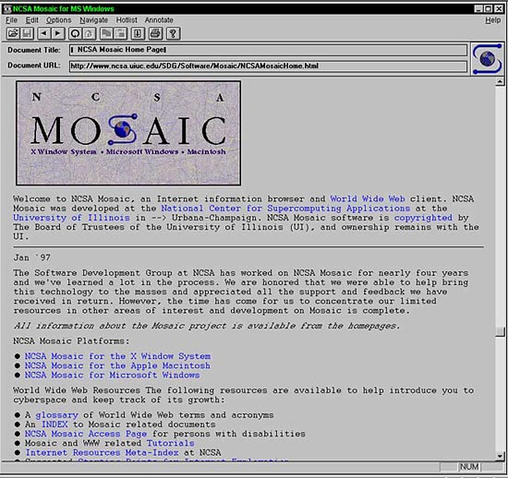
Notes:
April 22, 1993: Mosaic Browser Lights Up Web With Color, Creativity
From there to where we are in 2013 - less than 20 years,

Slide 13
We are in that Mosaic moment in Generative AI?
Notes:
Much as Mosaic, the world’s first free web browser, ushered in the internet era and upended the way we work and live, generative AI has the potential to disrupt nearly every industry—promising both competitive advantage and creative destruction.

Slide 14
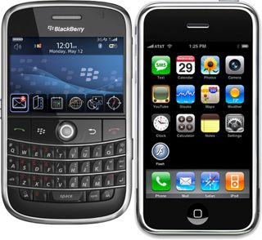

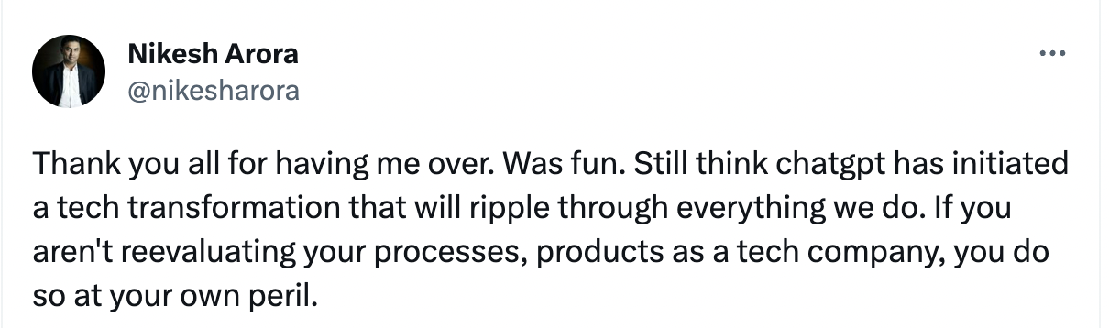
Should business worry about it?
Leading Investor - Reported in WSJ
Says he has rekindled his appetite for investing in technology by talking with ChatGPT in the wee hours about ideas for inventions that the bot validated as wonderful -

Slide 15
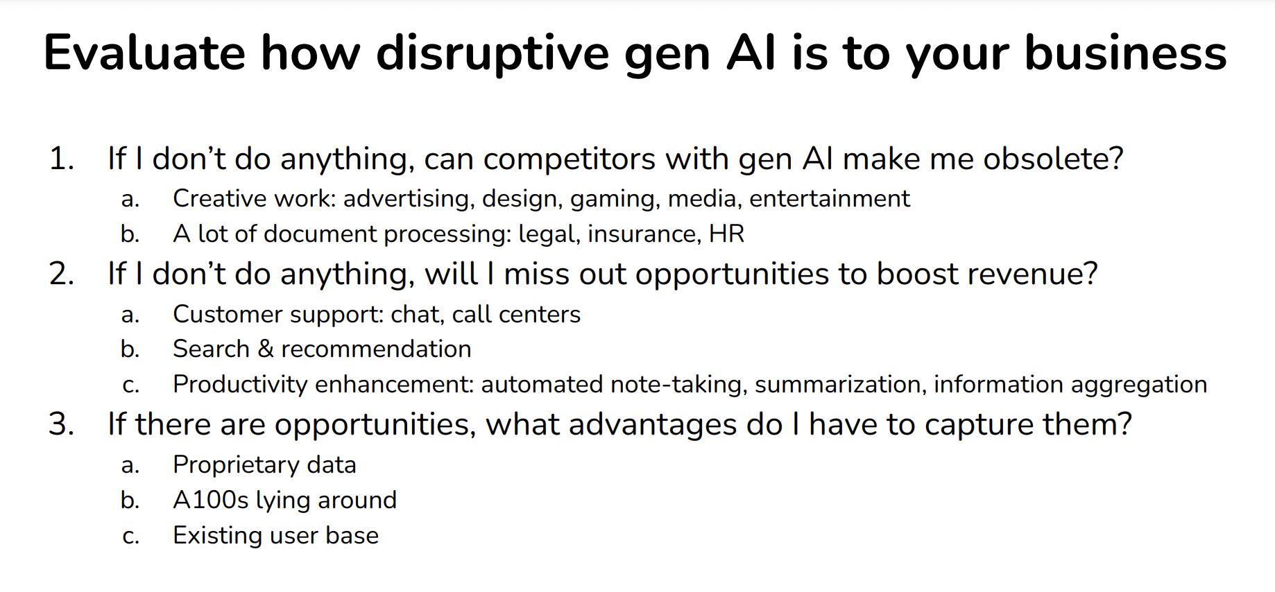
How should businesses evaluate?
https://huyenchip.com/2023/06/07/generative-ai-strategy.html

Slide 16
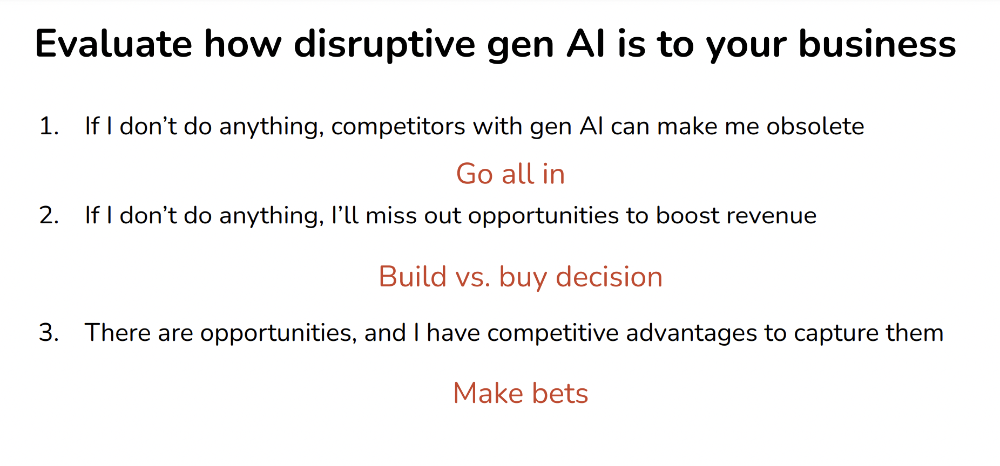
How should businesses evaluate?
https://huyenchip.com/2023/06/07/generative-ai-strategy.html
Notes:
https://huyenchip.com/2023/06/07/generative-ai-strategy.html

Slide 17

How should we think about this?
Identify use cases that will differentiate us, key is to identify the company’s “golden” use cases
Adapt organization structure, how people work.
Setup ethical guardrails and legal protections
Notes:
https://www.bcg.com/publications/2023/ceo-guide-to-ai-revolution

Slide 18
Use Cases

Slide 19
What Use Cases are Enterprises Exploring
Text Classification
Content Creation
Information Extraction
Structured Generation
Q&A
/ Search
Without labelled data
customer review (e.g. positive or negative)
Recommendations
Categorize customer support tickets (e.g. billing, product features, etc.)
Source intensive task requiring hours of sustained creative thinking
Private Brand Images
Generating Descriptions for Products in a Catalog
Images:
Midjourney,
StabilityAI models in HuggingFace, Dreambooth
Read Information from documents and summarize
Creating a Resume Skills Table for Hiring Managers
Unstructured to structured text(JSON) that can be used by another system for downstream tasks
Function Calling in ChatGPT
Margin of xx Detergent bar in Y WH
What is the price of Sugar in mills today?
Large set of internal documents that you would like to use as a source of information when answering questions.
Lang Chain + Vector databases (Pinecone)
Notes:
https://openai.com/blog/function-calling-and-other-api-updates

Slide 20
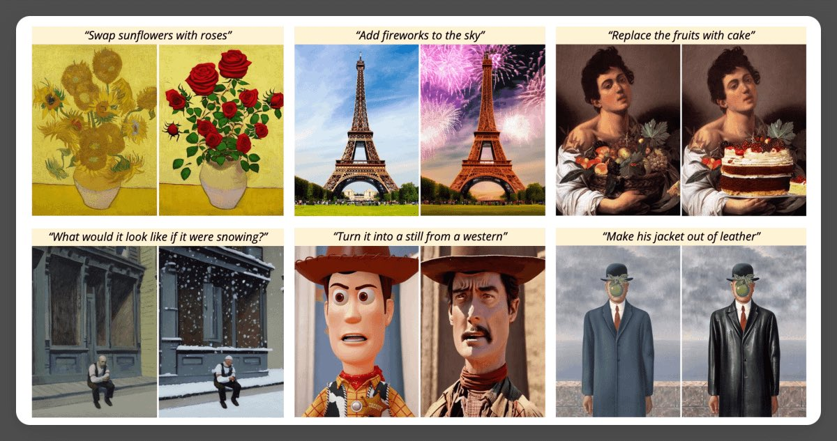
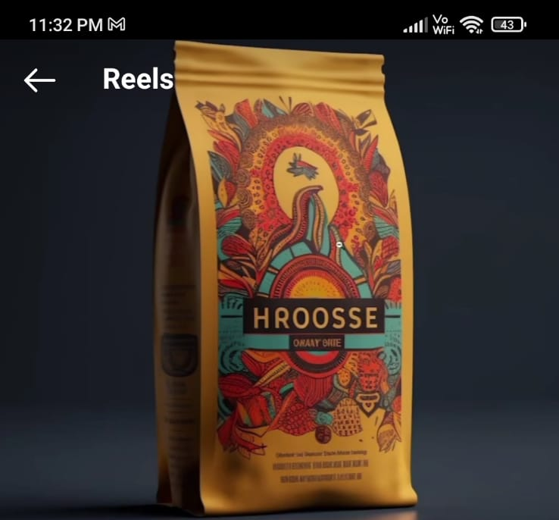
Image of Product Package from Midjourney
Product shots of coffee packets, with minimalistic black logo

Slide 21
Appendix

Slide 22
