Slide 1

Jdbc vs spring jdbc vs hibernate vs spring data jpa
Uniq technologies

Slide 2
JDBC (Java Database Connectivity):
JDBC is a Java API that allows Java programs to interact with databases. It provides a standard interface to connect to relational databases and execute SQL queries.
Low-level API: JDBC is a low-level API, which means that developers need to write more code to handle database operations.
Manual SQL: Developers need to write SQL queries manually for database operations.
Connection Management: Developers need to manage database connections, handle exceptions, and close resources explicitly.

Slide 3
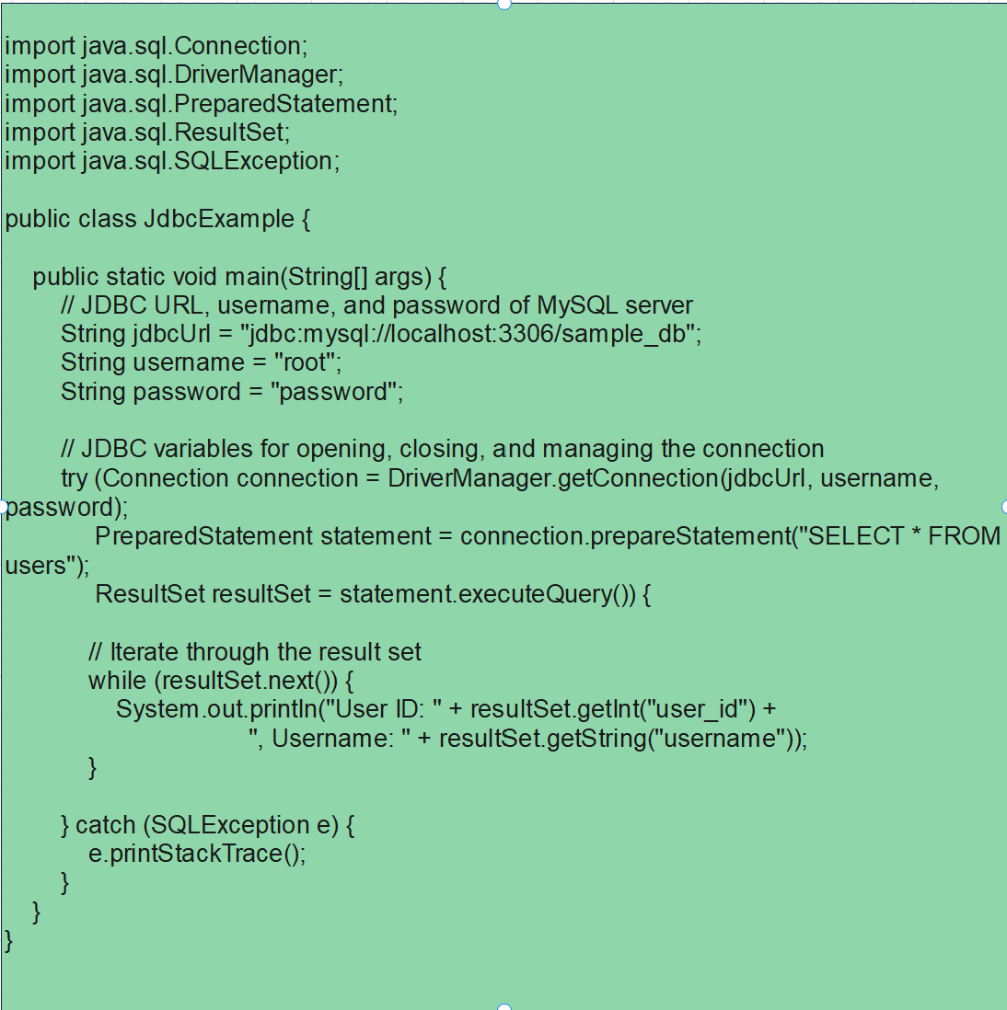
JDBC: Sample code

Slide 4
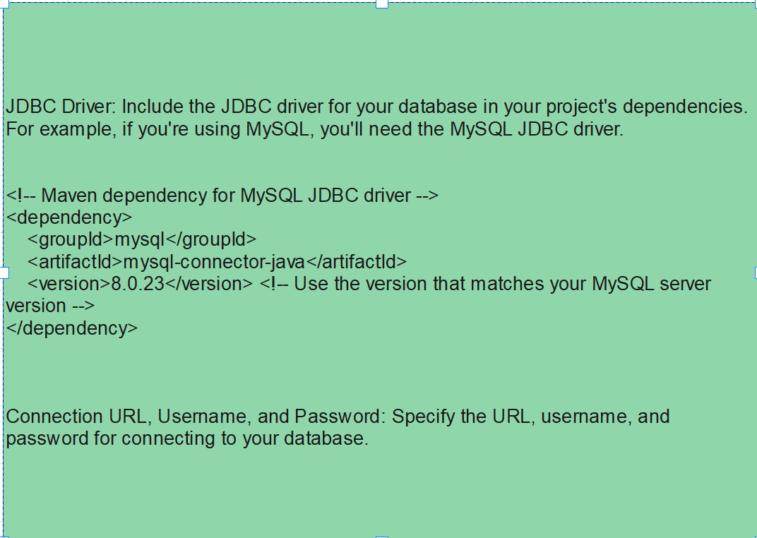
JDBC: Configuration

Slide 5
Spring JDBC:
Spring JDBC is a part of the Spring Framework that simplifies database access using JDBC. It provides higher-level abstractions and utilities to reduce boilerplate code.
Simplified API: Spring JDBC simplifies database access by providing a higher-level API and handling many low-level details behind the scenes.
Exception Translation: It translates JDBC SQLExceptions into Spring's DataAccessException hierarchy for easier error handling.
NamedParameterJdbcTemplate: Spring JDBC introduces the NamedParameterJdbcTemplate, which allows parameterized queries using named parameters.

Slide 6
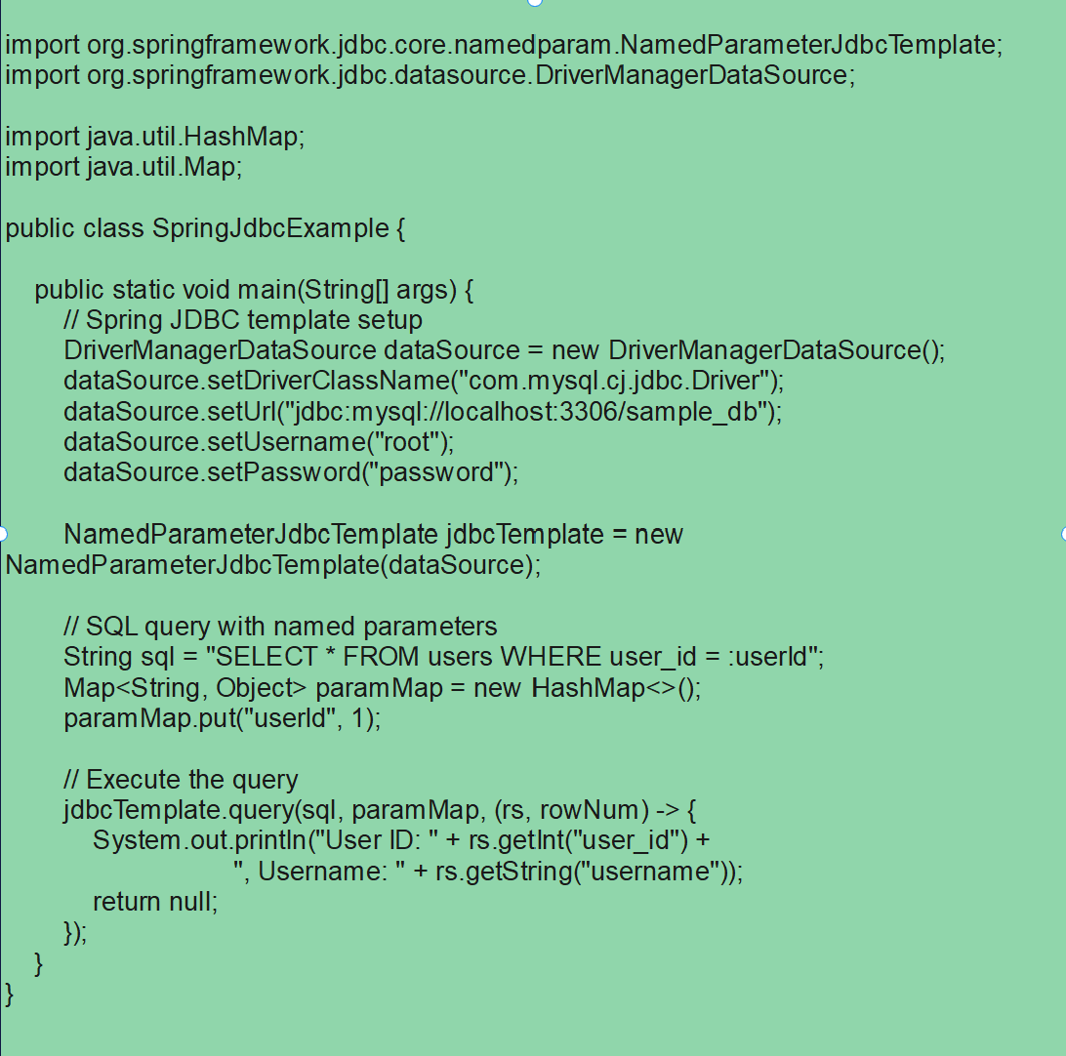
Spring JDBC: Sample code

Slide 7
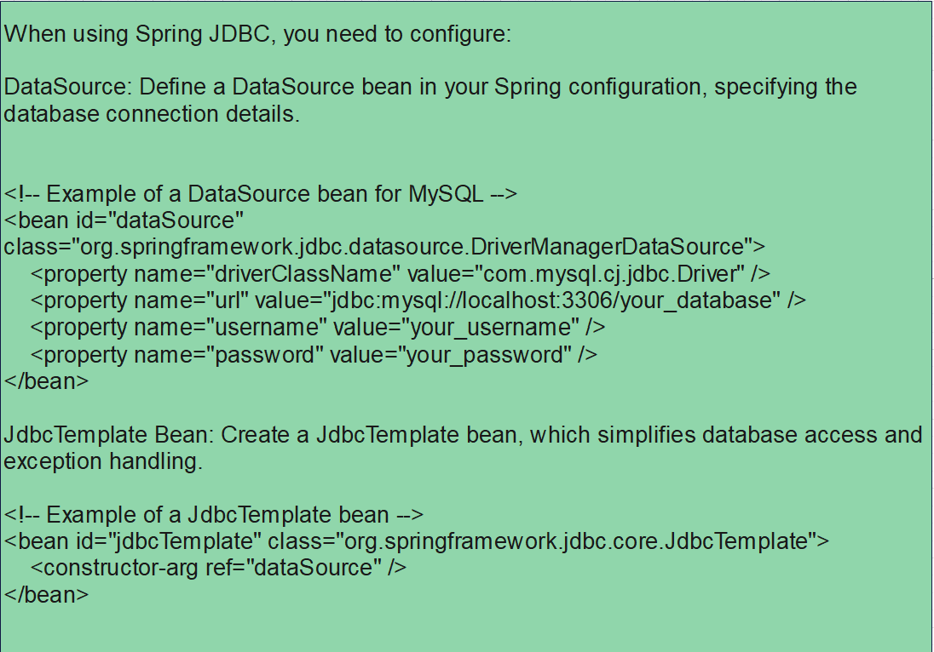
Spring JDBC: Configuration

Slide 8
Hibernate:
Hibernate is an Object-Relational Mapping (ORM) framework for Java. It provides a way to map Java objects to database tables and vice versa, eliminating the need for manual SQL.
ORM Framework: Hibernate is a full-fledged ORM framework, allowing developers to work with Java objects instead of dealing with SQL directly.
Automatic Table Generation: Hibernate can generate database tables based on the Java entities, simplifying the database schema creation process.
HQL (Hibernate Query Language): Developers can use HQL, an object-oriented query language, instead of native SQL queries.

Slide 9
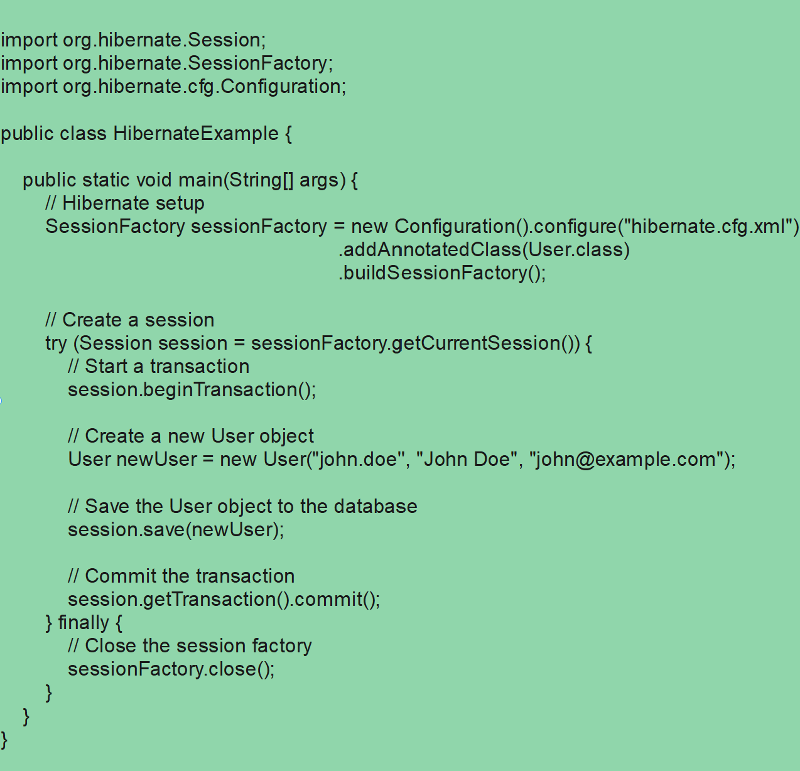
hibernate: Sample code

Slide 10
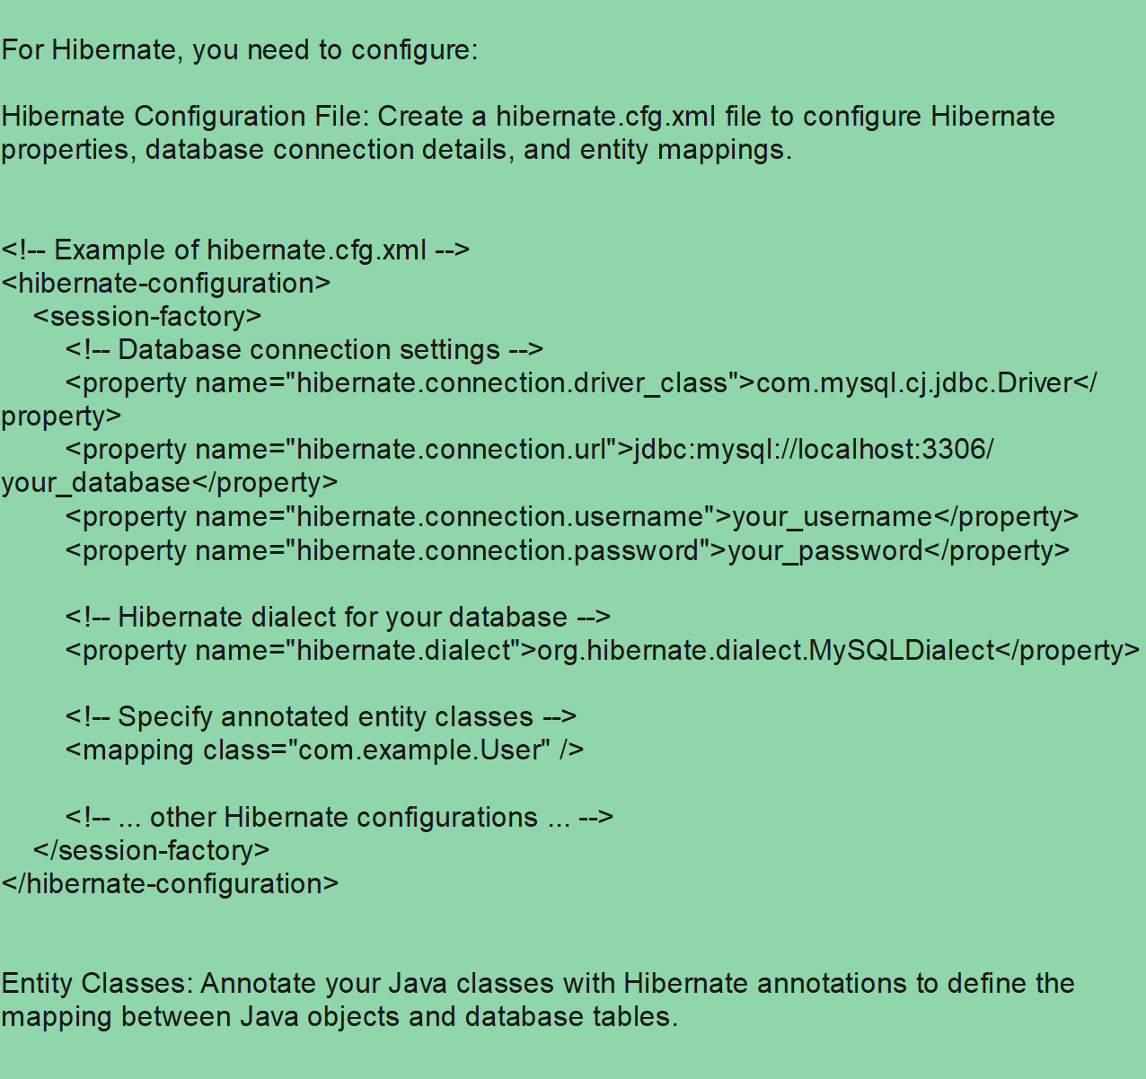
hibernate: Configuration

Slide 11
Spring Data JPA:
Spring Data JPA is a part of the Spring Data project, providing a higher-level abstraction over JPA (Java Persistence API). It simplifies the development of data access layers using JPA.
JPA Abstraction: Spring Data JPA builds on top of JPA, offering additional features and simplifying common tasks.
Repository Interface: Developers can define repositories using interfaces, and Spring Data JPA automatically generates the necessary implementation.
Query Methods: Spring Data JPA allows developers to create queries based on method names, reducing the need for manually written JPQL queries.

Slide 12
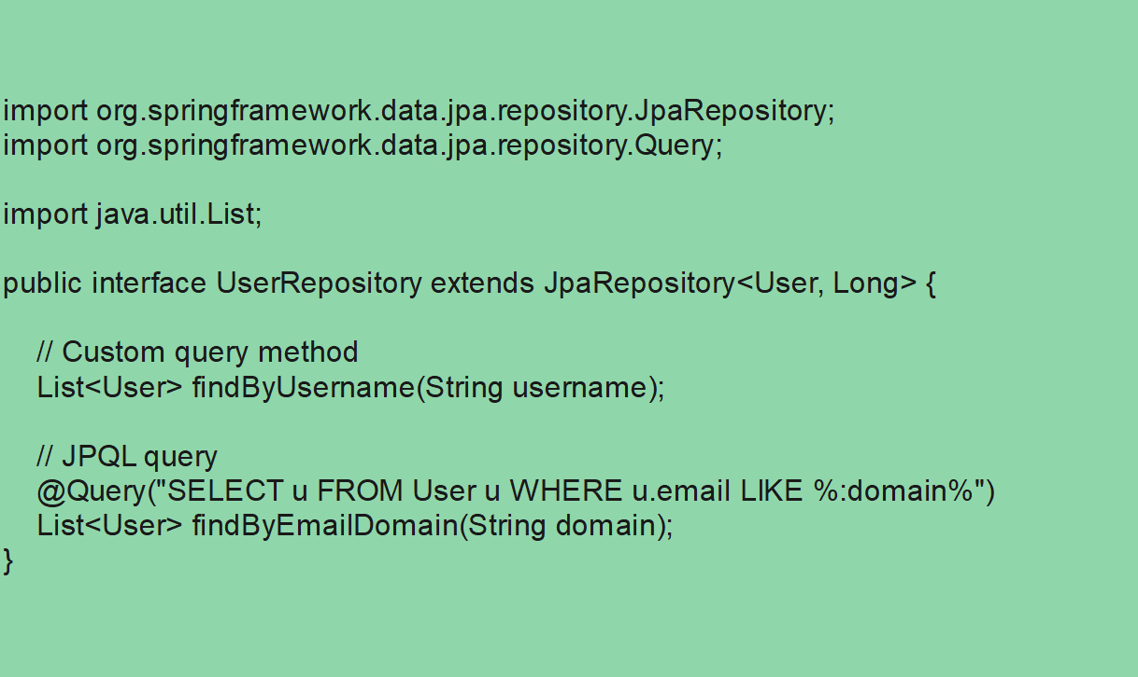
Data jpa: Sample code

Slide 13
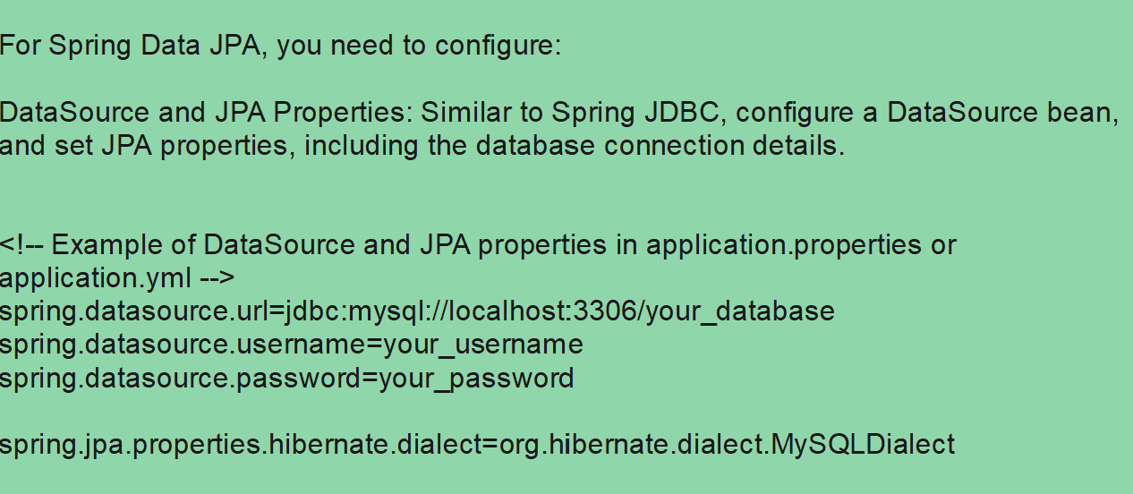
Data jpa: Configuration

Slide 14
Comparison Summary

Slide 15
Abstraction Level:
JDBC: Low-level API, requires more manual coding.
Spring JDBC: Provides a higher-level abstraction over JDBC.
Hibernate: Full-fledged ORM framework, eliminates the need for SQL in many cases.
Spring Data JPA: Builds on JPA, provides repositories and query methods for simplified data access.

Slide 16
Development Style:
JDBC: Manual SQL queries, more control over database operations.
Spring JDBC: Simplifies JDBC, reduces boilerplate code.
Hibernate: Object-oriented approach, works with Java objects instead of SQL.
Spring Data JPA: Repository interfaces and query methods for data access.

Slide 17
Database Schema Handling:
JDBC: Developers manage database schema explicitly.
Spring JDBC: Similar to JDBC but with higher-level abstractions.
Hibernate: Can generate database tables automatically.
Spring Data JPA: Generates queries based on method names, reducing the need for explicit SQL.

Slide 18
Query Language:
JDBC: SQL queries written manually.
Spring JDBC: SQL queries with some level of abstraction.
Hibernate: HQL (Hibernate Query Language) or native SQL.
Spring Data JPA: Query methods and annotations.

Slide 19
Hibernate and Spring Data JPA are related technologies, but they serve different purposes in the context of Java persistence.

Slide 20
Hibernate:
Object-Relational Mapping (ORM):
Purpose: Hibernate is a full-fledged ORM (Object-Relational Mapping) framework that provides a way to map Java objects to database tables and vice versa.
Usage: Developers use Hibernate to work with Java objects in the application code, and Hibernate takes care of the underlying database operations.

Slide 21
Hibernate cont…
SQL Generation:
Query Language: Hibernate supports HQL (Hibernate Query Language), an object-oriented query language, as well as the ability to use native SQL queries.
Automatic SQL Generation: Hibernate can generate SQL queries based on the entity mappings and criteria queries.

Slide 22
Hibernate cont…
Configuration:
Configuration File: Hibernate requires a configuration file (e.g., hibernate.cfg.xml) to specify database connection details, entity mappings, and other configurations.
Session Management:
Session Factory: Hibernate manages sessions and provides a SessionFactory for creating and managing database sessions.

Slide 23
Spring Data JPA:
JPA (Java Persistence API):
Purpose: Spring Data JPA is not a separate persistence technology but a part of the Spring Data project. It simplifies data access using the JPA standard.
Usage: It provides a higher-level abstraction over JPA and simplifies the development of data access layers by using repository interfaces.

Slide 24
Spring Data JPA cont…
Repository Pattern:
Repository Interfaces: Developers define repository interfaces that extend JpaRepository or a similar interface. Spring Data JPA automatically generates the implementation based on the method names.
Query Methods: Developers can create query methods in the repository interface, and Spring Data JPA derives the SQL queries from the method names.

Slide 25
Spring Data JPA cont…
Configuration:
Minimal Configuration: Spring Data JPA requires minimal configuration. The data source and JPA properties can be configured in the application properties or XML configuration.
Integration with Spring Ecosystem:
Spring Ecosystem: Spring Data JPA seamlessly integrates with the broader Spring ecosystem, allowing easy integration with other Spring technologies like Spring Boot, Spring MVC, etc.

Slide 26
Thank you
Uniq technologies

