Slide 1
Angular

Slide 2
What is Angular
Angular is a JavaScript framework which allows you to create reactive Single-Page-Applications(SPAs).

Slide 3
A single page application is an application like this.
https://angular.io/docs
You can navigate around there, and in the URL you can see that we seem to visit different pages, but in the end, our page never changes.

Slide 4
It's only one HTML file and a bunch of JavaScript code we got from the server.
And everything which you see here every change is rendered in the browser.
Now why is it awesome?
Because it gives the user a very reactive user experience.
JavaScript is much faster than having to reach out to a server for every page change and for every new piece of data you want to display.

Slide 5
And therefore, this approach allows you to create web applications which look and feel almost like mobile applications, very fast, everything happens instantly.
And if you do need some data from a server you simply load it in the background, so that the user never leaves this experience of having a reactive web application to use.
So every click I do here simply changes this one single page we're using,this one HTML page.

Slide 6
And how is it done?
Well, JavaScript changes, the DOM, changes whatever is displayed here, changes the HTML code during runtime, so to say.
That is why you never see that refresh icon on the top left spin, because we're only changing the currently loaded page.

Slide 7
And you can even see that if you inspect the source code of a page like this, that is the HTML file.
And as you can see, it doesn't seem to contain the content you are seeing on this page.
We only have one single HTML element, which doesn't seem to be a built in one, a native one, but that's Angular doing its job, and throughout the course you're going to learn what exactly happens here and how Angular does this job.

Slide 8
Angular Versioning
Now one thing that can be confusing when you're getting started with Angular and when you're learning Angular is the versioning of Angular.

Slide 9
It all started with Angular JS or Angular 1 as it's also called which was released.
This was the first version and it was a totally different version of Angular that worked totally differently.
Now the Angular team found out that AngularJS, Angular1 basically wasn't future proof because of some fundamental flaws in the way it was written.
And therefore they completely rewrote it and the result of that was Angular 2 which was released in 2016.
Now Angular 2 is a totally different framework than Angular 1 and nowadays unless you have a really good reason you shouldn't use Angular 1 anymore.
But you actually also won't be using Angular 2 because there have been a couple of other versions of Angular as well.
Angular version 3 was skipped for some internal reasons but then we had Angular 4 and a couple of other versions and then we arrived at Angular 10, 11, 12, 13, 14, 15, and so on so we have a bunch of Angular versions.

Slide 10
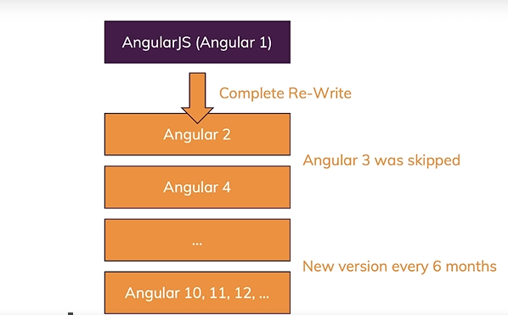
Understanding Angular Versioning

Slide 11
TypeScript
TypeScript really is just a super set to JavaScript. It offers more features than vanilla JavaScript like classes, interfaces, and very important which gives it the name, types, strong typing.
so you define in TypeScript if a certain variable is a number, a string or something else. You don't do this in vanilla JavaScript, there you have dynamic typing.
You can have a string variable and then you assign a number and that's totally fine.
That won't work in TypeScript, it will give you an error and therefore it allows you to write much more robust code which gets checked at the time you write it and not just at the time you run it, a great enhancement.

Slide 12
However, TypeScript doesn't run in the browser, so it is compiled to JavaScript in the end and this compilation is handled by the CLI.
One of the reasons why we need the CLI why we need a project management tool like the CLI.
Now this compilation is really fast and therefore in the end, in the browser, JavaScript is going to run.
We're not writing the Angular app in JavaScript though because whilst technically possible, that won't be much fun.
A lot of the features really only exist in TypeScript and Angular is meant to be used together with TypeScript.
Generally though, TypeScript is an addition to JavaScript not a complete replacement, so a lot of the commands will look really familiar.

Slide 13
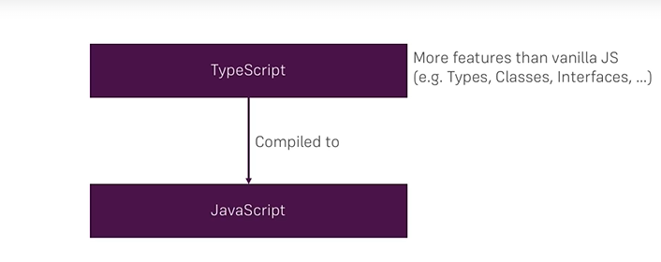

Slide 14
Variables and Data Types
Variables are used to store and retrieve data in any application. Instead of remembering the memory locations of where this data is stored.
we use variables that act as a container of this data.
And when we define a variable in Typescript, we can define it to carry different types of data starting with the number, string, boolean, any and enum.
To define a variable of a certain type,we use the var or let keywords which you will learn later on, then the variable name, colon, the type of data that variable can carry.

Slide 15
And then you assign it value. number can carry, a variable of type number can carry both integer values as well as decimal point values.
String is used to store a sequence of characters which we wrap in double quotes, single quotes, etc.
Boolean represents a true or false.
any on the other hand can be used to carry any type of data.
Once you define a variable of type any, it can hold any type of data at any point in your application.

Slide 16
Enum is a sequence of constant values. You are going to explore all these in the next few lectures.
But one important thing to remember, unlike JavaScript where variables are untyped, in TypeScript, the part of TypeScript is that the variables are typed and it is very strict when it comes to typing.
Here, once you define this x as a number, if you try to assign a string or a Boolean or any other type other than number to x, you will immediately see a completion problem.
And when it comes to naming of your variables, you follow the naming conventions you use in JavaScript and also you should not use any keywords that you will learn later on as your variable names. Otherwise you will see a compilation issue.
Along with these inbuilt data types we can also create our own object types which you'll learn later on using classes, interfaces and many more.

Slide 17
Data Types
number var a:number = 10
string var b:string = “uniq”
Boolean var c:booelan = true
Any var d:any = “uniq”
Enum var e:enum ={Male,Female}
Object Types
Classes
interfaces

Slide 18
Operators
An operator is a special symbol that operates on operands by defining a function that is called upon whenever the operator is invoked. Each operator has a unique symbol used to invoke that operator. Since TypeScript is a strongly typed superset of JavaScript, TypeScript supports all the standard operators supported by JavaScript.

Slide 19
Flow Control Statements
The flow control statements determine the order in which our code is executed at runtime.
There are three different types of flow control statements namely the selection statements, the iterative statements and the transfer statements.
The selection statements which are if-else, switch determine or execute our code conditionally.

Slide 20
The iterative statements help us execute the same code multiple times, using while loop, for loop, do-while loop, etc.
And the transfer statements, as the name itself says, they transfer the execution of our code from one part of the script to another. Statements like break, continue, return
help us do that.

Slide 21
Objects and Arrays
TypeScript is an object oriented programming language and so is this planet.
If you look around you, everything you find, a room, laptop, AC or fan, a chair, everything is an object.
And if you go to real time software applications like Amazon, internally Amazon will represent all the products using a product object.
A shopping cart of a customer can be an object as well and the orders of a customer are objects as well.

Slide 22
So these object representation helps us to map the real world problems to a software solution easily, we
can represent everything as an object and come up with a solution for a real world problem.
Just like JavaScript, we can use the object literal syntax where we define a variable and assign it all the key and value pairs.
This is the object literal syntax, where in we have keys and values within flower brackets that represent an object. The key has a unique name.
These are names and the values can be anything. The values can also be methods or functions. They need not be, these are data properties that you see here.

Slide 23
Similarly you can also define functional properties.
This is object literal syntax. In JavaScript if you want to create a class like syntax or if you want to define a class like construct, before ES6 standard, you will have to do it using functions.
But ES6 has support for classes and more. TypeScript has inbuilt support for interfaces and classes using
which you can define what can go into an object. You can define a blueprint for your objects using interfaces and classes as you will learn in sections later on.

Slide 24
But what you see here is a literal syntax where you define a variable and give all the keys and values what that object can carry.
So always remember, an object simply represents a real world problem space and I have given you an example of Amazon, product, shopping cart and order.
If you take Facebook, you can think of user profile, the pictures, the videos, everything internally is represented as an object.

Slide 25
Functions
Units of code once we put some lines of code inside a function we can call that function and it will perform a certain operation for us and we need not repeat the same code anywhere else in our application.
This usage of the functions can be simply to implement some business logic or to handle a UI event and render a page the functionality itself could be anything.
The syntax for defining a function starts with the function keyword just like java script followed by the
function name and brackets within these brackets.

Slide 26
We can pass parameters as you will learn later on which are inputs for that function and the body of the function starts with the curly brace within which you will put all the lines of code that you want to be executed and it ends with a closing flower bracket in typescript.
When it comes to functions it is very strict when it comes to the parameter types as well as a return type just like other programming languages like Java or C C++ Python.
You can specify what type of data a function can receive and what type of data it can return.
Unlike javascript where you do not specify the type here you can specify the type of the parameter here.

Slide 27
Arrow Functions
Arrow functions are a shortcut to use anonymous functions.
The arrow function which will be There is no function keyword. There are no curly braces and there is no return statement as well, but it works and does what a regular function does.
You are assigning this arrow function to a variable and you can invoke this arrow function using that variable.
So arrow function starts with brackets. If you have any parameters they will go within those brackets.

Slide 28
If there are no parameters, the brackets will be empty followed by an arrow symbol, that is the equal sign and a greater than operator or greater than sign. The name is derived from this arrow.
That is why they are called arrow functions, followed by the body of the function.
If you want to explicitly use a return statement, you can do that but then you will have to use the curly brackets.
But otherwise the return is implicit. It will automatically return this result here.
But if you have multiple lines of code and if you want to return explicitly then all that code can go into flower brackets just like a regular function and then you can add a explicit return statement as well.

Slide 29
Variable Prefixes
Var
Let
Const
Declare

Slide 30
You're already familiar with the var prefix that you have used both in TypeScript as well as in JavaScript world when you declare or define your variables.
Three more prefixes namely let, const and declare that will change the scope of your variables and the way they can be used.
The first one is let. let is a block scope variable. Once you use a variable with the let prefix, it will be available only within that block of code and not outside of it.
Whereas when you define a variable with var it will be available for the entire function or the entire scope within which that var variable is defined. let is supported only starting JavaScript ES6.
The ES6 standard, not all the browsers support let. So TypeScript uses a work around.

Slide 31
Interfaces
When you have worked with objects earlier on you have created a student object using the object literal syntax with a first name, last name and score.
When we create objects like this directly we cannot make sure that the objects are created consistently across our huge applications that we develop.
One developer might not even use these two fields here and one developer might just use the score and so on accidentally.

Slide 32
So to prevent that from happening, to have a standard set of rules for this student object, we can use an interface. So an interface in TypeScript defines all the rules that an object, a function, an array or even classes should follow.
You define an interface using interface keyword, followed by the interface name and within the body you specify all the properties that any object that subscribes or complies with this interface should have.
Here we only define the property name and its type. firstName, lastName, score is of by number and then you can also define functions or methods as well.

Slide 33
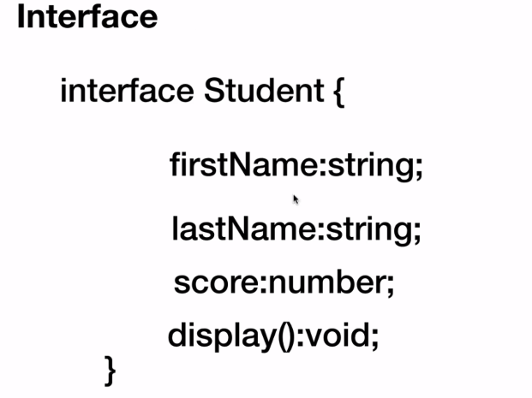

Slide 34
So any object that subscribes to this interface or complies with this interface should have all these properties.
So an interface acts like a contract.
Don't think about inheritance here. In programming languages like Java, you use inheritance or you use interfaces to implement inheritance as well, but that is not the case here.
In TypeScript, it is strictly to define a contract that our objects can follow and it is only compiled time.

Slide 35
So once the code is compiled, once the JavaScript is generated there is no concept of interface at all.
The interfaces will be erased.
You can also define interfaces for functions as well as arrays.
And when you work with classes later on, you can define interfaces for your classes as well.

Slide 36
Classes
Classes are blueprints for objects. Using classes we can define rules and much more.
The same thing when we dealt with interfaces. But classes are not like interfaces.
Along with the set of rules we'll also provide the implementation for the methods, we can define constructors, accessor methods and much more.
And classes are not just a compile time thing like interfaces. Interfaces in TypeScript exist only during the compilation time and they will be erased by the compiler.

Slide 37
But classes exist even at runtime and they are a blueprint or a template to create our objects.
Here, we have a Flight class with two fields on it, flightNo and airlines.
And it also has the implementation for the display method. When we create an object using this class,
we can create any number of objects of this class.
And when you do that they will get these two properties and also this implementation.
And if you define constructors, accessor methods, all those objects will get those constructors and the accessor methods as well.

Slide 38
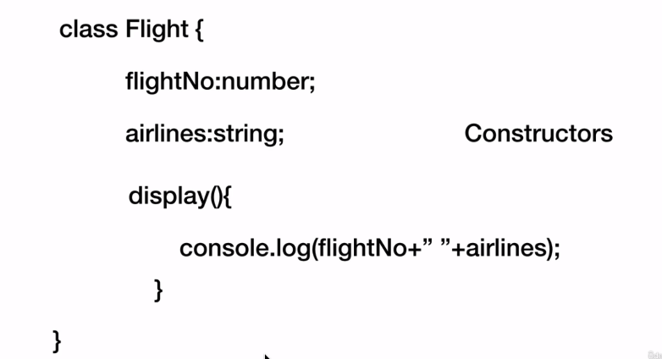

Slide 39
Inheritance
Inheritance is the process of defining a new object with the help of an existing object.
In TypeScript we use the keyword extends to inherit.
Let's take a look at two important things in inheritance with the popular Iphone example. The current version of Iphone out there is Iphone X.
And if Apple will release a next version soon.

Slide 40
So the new version of Iphone that will be coming need not create everything from scratch.
They can use some features and functionality that is available in Iphone X.
The two important things in this process of inheritance are accessing the existing functionality and defining their own functionality.
So a child class can access the existing functionality from a parent class. And if it wants it can update the functionality as well. For example, the new Iphone can access the existing functionality like taking pictures, sending out emails and all that.

Slide 41
And if it wants to update an existing functionality, it could be a better camera in the newer version, improved performance of the entire Iphone itself, etc, that can be done.
Two other terms we hear when we talk about inheritance are reliability and is-a relationship.

Slide 42
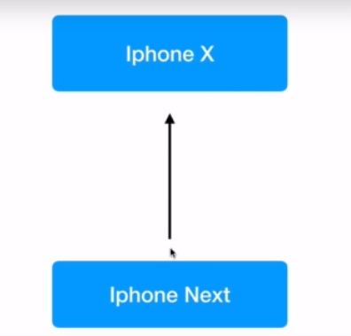

Slide 43
Access Modifiers (public & readonly) , Encapsulation & static

Slide 44
Public readonly
The usage of public and readonly will affect the variables or properties on an object.
So far everything we have done, you are aware of it. That is, by default all the properties of a class are public. Everything in TypeScript by default is public.
You can explicitly state that something is public using the public keyword.
Once you do that they can be accessed anywhere in the code.

Slide 45
So this property can be accessed by simply creating a object of this class.
But now the second type of access specifier as I call them is public readonly. Once you do that you cannot change that property.
So in your application if you want a certain property not to be changed anywhere else except for when it is initialized, use readonly on that property.
This is supported only in TypeScript starting TypeScript 2.0.

Slide 46
Encapsulation
Encapsulation is the process of binding the data and the code together or binding the data properties and the function or method properties on a object together.
That way only that code will have access to that data and the other users of our classes and objects will not be directly able to access the data.
We will achieve this by using a access specifier in TypeScript called private.
So within our class using which we can create objects, if we define a property as private it cannot be accessed directly using the object of that class.

Slide 47
To access this private property they will have to go through the setter and getter accessor methods we define or any other method or function within this class can access this property.
So the users of this particular class called Student, if they want to access this private property they will have to go through one of the methods that is available on this class that uses that property or that gives access to this property.
So this property here is now protected. If they are trying to set a value on this property they will have to do it using the set accessor method. Within that method, we can do any type of validations before we assign the value to the name.
That is the power of encapsulation. We are protecting our data and making sure that it is being used correctly through the get and setter accessors.

Slide 48
Static
how to define class or static properties & static methods :
Common Properties & behavior

Slide 49
Polymorphism
The concept of polymorphism Polly means multi morphic means shapes are forms in the world of object oriented programming.

Slide 50
Typecasting
String to numeric
Using the toString method
Object Casting

Slide 51
Modules
In JavaScript ES5 standard, up to the ES5 standard there is no concept of modules.
That is, if you want to use one JavaScript file within another one, that is all the functionality or the properties available in one JavaScript within another JavaScript, we'll have to use the script tag and include that script and then use the functionality or properties which is painful.
That is why the JavaScript community has worked around using a library called CommonJS.

Slide 52
And there are several other libraries like this which are module loading systems. Using these we can export out modules and import those modules in other scripts.
TypeScript has inbuilt support for a module based system.
TypeScript internally using this CommonJS library by default and we can switch to other libraries as well if required.
Starting the JavaScript version ES6, it will have the support for modules as well.

Slide 53
Using Function Modules
Import Aliasing and Alternate Export Syntax
Default Exports
Class Modules
Aliasing class modules

Slide 54
More Types
various other types that we can use in TypeScript, starting with a map and set up the map and set data structures are supported starting Es6 in JavaScript and TypeScript also supports them.
MAP is a key value pair data structure. You can add any number of entries to a map which are key value pairs.
The key can be of any type and the value can be of any type as well to create a map.
We use the map class and we create an object of type map. We can initialize it right when we create it, or we can add elements to a map using the set method where we pass the key.
And the value has several useful methods like delete to delete an entry, bypassing the key.

Slide 55
The hassle will check if the map has a particular entry with the given key and then we can iterate using the keys by invoking the Keys.
Method will get all the keys. By invoking the values method.
We get all the values and by invoking the entry method, we get all the entries in them happy.
And then set is a data structure which can be used to dynamically add any type of data and said does not allow duplicates.
We will learn how to use set and some of the methods on set as well.

